Slide 1


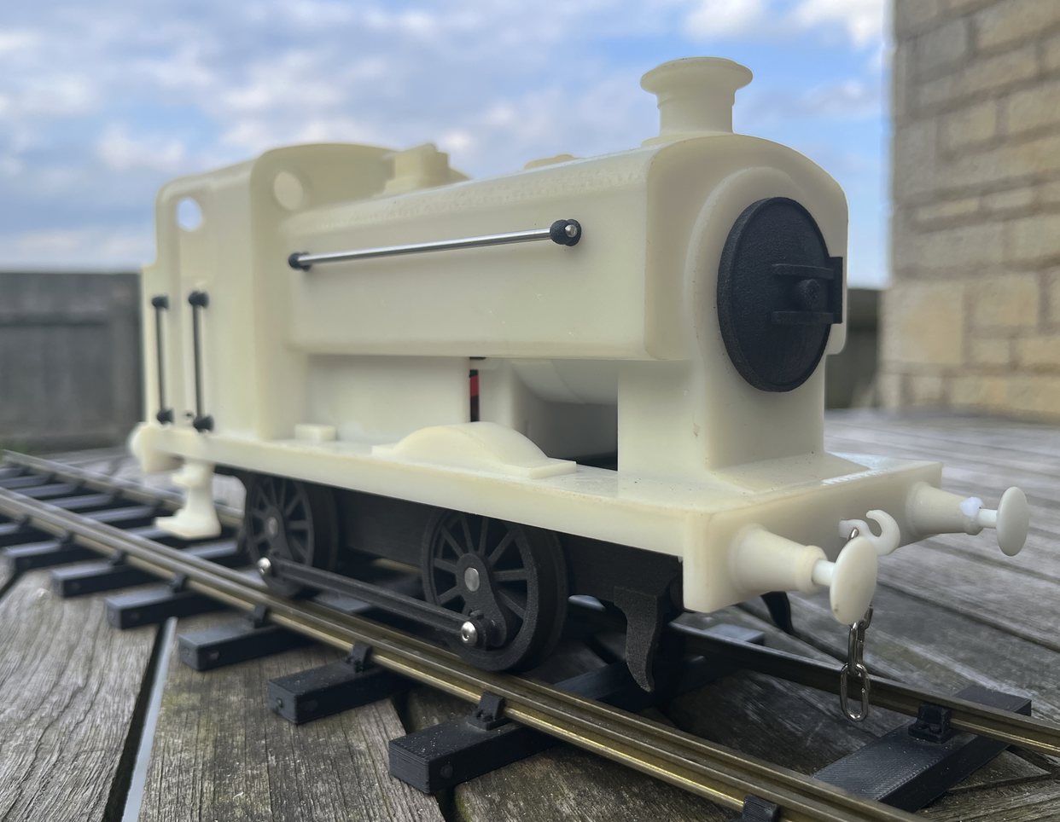
The G1MRA Greenly
Starter Engine
The G1MRA Greenly
Starter Engine
£245 RTR
£245 RTR
£195 kit
£195 kit
David Viewing’s Greenly starter engine is designed as a low-cost entry to Gauge 1 running. It has full radio control with 'cruise control', a powerful 5-pole motor, a flickering firebox light and a smoke generator that puffs.
The engine is a fine runner and can pull a heavy train for hours; it makes a great backup for live steam runners with recalcitrant engines – the batteries will hold charge for months.
The loco is robust enough to handled and operated by young children and will easily cope with 55cm radius curves for that classic round-the-Christmas-tree track.
David Viewing’s Greenly starter engine is designed as a low-cost entry to Gauge 1 running. It has full radio control with 'cruise control', a powerful 5-pole motor, a flickering firebox light and a smoke generator that puffs.
The engine is a fine runner and can pull a heavy train for hours; it makes a great backup for live steam runners with recalcitrant engines – the batteries will hold charge for months.
The loco is robust enough to handled and operated by young children and will easily cope with 55cm radius curves for that classic round-the-Christmas-tree track.
Order now from https://g1mra.com
Order now from https://g1mra.com
RTR models are charged and ready to go but unpainted.
Kits come with pre-wired electronics, but require some mechanical assembly skills – see the detailed instructions available from the website.
RTR models are charged and ready to go but unpainted.
Kits come with pre-wired electronics, but require some mechanical assembly skills – see the detailed instructions available from the website.

