Slide 1
MIB2C
Nov. 1st 2011

Slide 2
Overview
A Perl script name “mib2c”.
Takes the MIB file and converts it into C code.
The generated C codes can be used as "template" files for UCD SNMP implement MIBs.
It will not generate working C file, it only shortens development time.

Slide 3
Requirements
NET-SNMP
“mib2c” requires the SNMP.pm Perl module.
  http://www.cpan.org/modules/by-module/SNMP/
  Or http://www.cpan.org/
“mib2c” also needs the MIB definition files that it can read it and generate template code.

Slide 4
Usage
”mib2c” takes one argument: an OID.
  mib2c 1.3.6.1.2.1.1
  mib2c system
  env MIBS="+BRIDGE-MIB" mib2c dot1dBridge
  env MIBS=ALL mib2c dot1dBridge
The configuration file for VTSS
  mib2c vtss_mib2c_ucd_snmp.conf system
Uses the xxx_init() function to initialize this MIB module.
More information:
  http://www.net-snmp.org/tutorial/tutorial-4/agent/index.html

Slide 5
Usage example
Under Ubuntu, the default directory for mib files loading is /usr/share/snmp/mibs
Step1: Install mib2c
  sudo apt-get install libsnmp-dev
Step2: Add MIB search path
  vi /etc/snmp/snmp.conf
  +/usr/share/mibs/iana:/usr/share/mibs/ietf:/usr/share/mibs/netsnmp:/usr/share/mibs/ieee:/usr/share/mibs/iana
  mibs +ALL
Step3: Run mib2c
  cd /home/pchen/mib2c
  mib2c -c vtss_mib2c_ucdsnmp.conf switchMgmt

Slide 6
Mib2c output
There are four files will be created after run mib2c.
a. xxx.c/h
Revise the "FIXME" parts to make it as a completed code.
b. ucd_snmp_xxx.c/h
  It is based on UCD-SNMP APIs, we should not do any change unless
  the implement is different with standard MIB definition. For example:
  The specific OID is not supported.
  The 'read-write' operation doesn't supported.
  The specific variable range is different from standard definition.

Slide 7
What to do after the code generated ? (1)
1. Copy ouput files to working directory
  Copy xxx.c/h to “vtss_appl/snmp/platform”
  Copy ucd_snmp_xxx.c/h to “vtss_appl/snmp/base/ucd_snmp”
2. Initialize API
  Add include file “xxx.h” in vtss_snmp.c
  Add initial function in vtss_snmp_mibs_init()
3. Compile
  Modify the make file in <TOP>/build/make/module_snmp.in
  After this step, we should compiler the new MIBs files without no error.

Slide 8
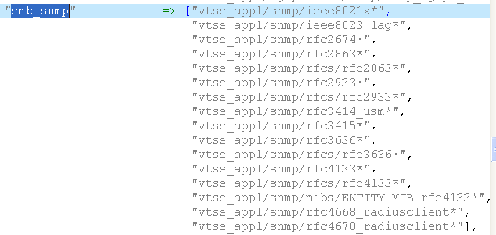
What to do after the code generated ? (2)
4. Revise the "FIXME" parts to make it as a completed code.
5. Don’t forget to modify the filter file for release purpose
  webstax2\build\release\modules_files_hash_table.pl

Slide 9
Appendix - CPAN
1. login using "root"
2. perl -MCPAN -e shell
3. cpan> get <module_name>
4. cpan> install <module_name>
5. q
ps1) cpan>h (help)
ps2) o conf 'urllist' => ftp://ftp2.tnc.edu.tw/pub/unix/perl/CPAN
ps3) <module_name> can be
  String::CRC::Cksum
  Compress::Zlib
  SNMP

Slide 10
Good luck with your project !

