Slide 1


SUDHEE 2026 CBIT HACKATHON
Smart Chemical Inventory
Management System
Smart Lab Inventory
[Team Name]
[Lead Name]
CBIT
Web Application
[ID]

Slide 2

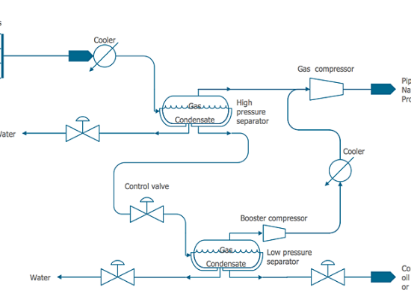
ABSTRACT
The Smart Chemical Inventory Management System is a secure digital ecosystem designed to modernize laboratory safety at CBIT. It replaces fragmented manual tracking with a real-time command center.
Motivation: To safeguard students and faculty from chemical hazards while reducing departmental waste through intelligent expiry tracking and stock optimization.

Slide 3




SYSTEM PROCESS FLOW
User Auth
Dashboard
Operations
Data Persistence
Alert Engine
Secure login for staff & researchers
Real-time stock & expiry overview
Update stock / Use chemical
SQLite transaction logging
Automatic expiry/low stock alerts
The system ensures end-to-end traceability of hazardous materials within the CBIT lab premises.

Slide 4





CORE SOLUTION CONCEPT
Inventory Tracking
Expiry Guard
Safety Digital SDS
Digital logging of chemical entry/exit using QR technology to maintain accurate quantity levels.
Algorithm-based monitoring that flags chemicals 30 days prior to their disposal deadline.
Centralized database of Safety Data Sheets accessible via any mobile device in the lab.

Slide 5







TECHNOLOGY STACK
Python Flask
HTML, CSS, JS
SQLite DB
Micro-web framework for robust backend API handling and business logic.
Frontend stack for a responsive, interactive administrative dashboard.
Lightweight, file-based relational database for local lab data storage.

Slide 6
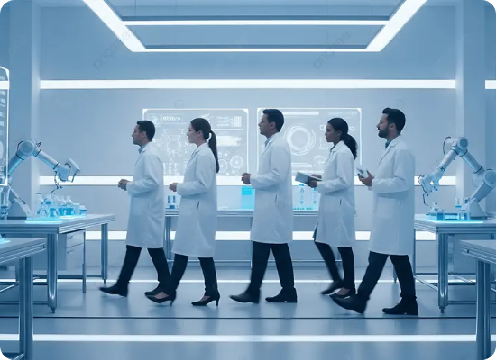
PRIMARY USE CASES
Lab Procurement: Automate purchase orders based on depletion thresholds.
Regulatory Audit: Export CSV/PDF reports of all hazardous materials for safety inspectors.
Researcher Safety: Search for chemical compatibility and storage hazards before usage.

Slide 7

THE SHOWSTOPPER
Intelligent Risk Matrix
Our solution goes beyond tracking. It includes a Storage Compatibility Matrix that alerts staff if incompatible chemicals (e.g., Acids and Bases) are logged into the same storage cabinet, preventing accidental reactions.

Slide 8
TEAM DETAILS
Position | Name | Phone Number | College
Team Lead | [Name] | [Number] | CBIT
Member 1 | [Name] | [Number] | CBIT
Member 2 | [Name] | [Number] | CBIT
Member 3 | [Name] | [Number] | CBIT

Slide 9

THANK YOU
Towards Safer and Smarter Laboratories
SUDHEE 2026 | Smart Chemical Inventory Project

Slide 10



IMAGE SOURCES
https://www.conceptdraw.com/How-To-Guide/picture/how-to-create-chemical-process-flow-diagram-4.png
Source: www.conceptdraw.com
https://files.realpython.com/media/Python-driven-Web-Applications_Watermarked.c5692cb81de8.jpg
Source: realpython.com
https://png.pngtree.com/thumb_back/fw800/background/20251217/pngtree-diverse-international-team-of-professional-scientists-and-engineers-walking-through-a-image_20859546.webp
Source: pngtree.com

