Slide 1


SUDHEE 2026 CBIT HACKATHON
Smart Chemical Inventory
Management System
Smart Lab Inventory
[Enter Team Name]
[Enter Lead Name]
CBIT
Web Application
[Problem ID]

Slide 2


ABSTRACT
The Smart Chemical Inventory Management System addresses the critical need for modernized safety and stock tracking in CBIT laboratories. Our project replaces manual, error-prone logs with a centralized web ecosystem.
Core Concept: To create a real-time, high-security dashboard that streamlines the procurement, usage, and disposal of hazardous chemicals.
Key Objectives: Minimize chemical waste, prevent expiry-related hazards, and ensure 100% regulatory safety compliance.

Slide 3




THE PROBLEM STATEMENT
Manual Tracking
Hazardous Waste
Compliance Gaps
Current systems rely on paper logs, leading to data fragmentation and high error rates in stock levels.
Unknown expiry dates lead to the accumulation of dangerous, unstable chemicals on lab shelves.
Difficult to generate instant safety reports or audit logs for regulatory inspections.

Slide 4
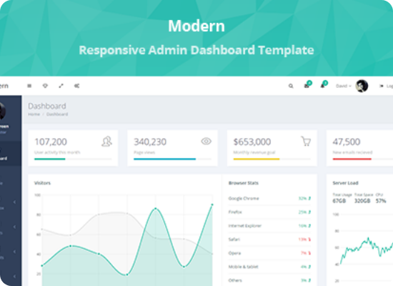
OUR SOLUTION: SMART LAB HUB
Integrated Web Ecosystem
A secure digital inventory system designed specifically for the rigorous environment of CBIT labs. Our platform offers:
Unified Dashboard: Centralized view of all chemicals across multiple laboratory wings.
Role-Based Access: Separate portals for Lab Assistants, Professors, and Admin.
Dynamic Search: Find chemicals by name, CAS number, or shelf location instantly.

Slide 5
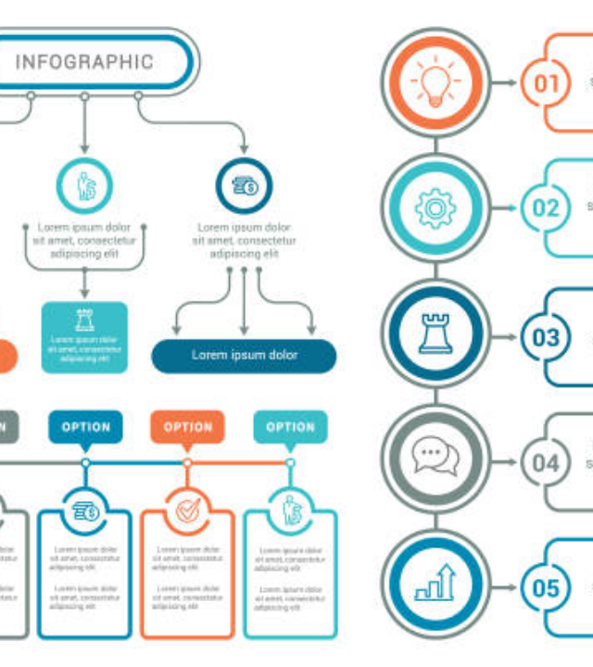
PROCESS FLOW CHART
Our prototype follows a logical, secure workflow to ensure no chemical goes untracked from purchase to disposal.
Ingestion: Scan Barcode/QR to enter new chemical data.
Monitoring: System tracks quantity and environmental conditions.
Trigger: Low stock or expiry alerts sent to the dashboard.
Disposal: Log safe disposal according to SDS guidelines.

Slide 6



SYSTEM PROTOTYPE FEATURES
Automatic Alerts
SDS Digital Vault
Usage Analytics
Real-time notifications for chemicals approaching their expiry date or falling below safety thresholds.
Instant access to Safety Data Sheets (SDS) for every item in the inventory during emergencies.
Visual trends showing which chemicals are most used to optimize future procurement budgets.

Slide 7





TECHNOLOGY STACK
Frontend
Backend
Database
React.js with Tailwind CSS for a fast, responsive, and mobile-friendly user interface.
Node.js and Express providing a secure RESTful API architecture for data handling.
PostgreSQL for robust relational data management with high-integrity audit logging.

Slide 8
USE CASE SCENARIOS
Safety Compliance Audits: Generate a comprehensive inventory report in seconds for external safety inspectors.
Emergency Management: Firefighters or first responders can remotely access chemical maps to identify flammable zones.
Budget Planning: Department heads can identify unused surplus in one lab and transfer it to another, saving costs.
Researcher Training: New students can check digital logs for chemical compatibility before starting experiments.

Slide 9
THE SHOWSTOPPER
100%
Predictive Shelf-Life
Our unique "Safe-Stock" Algorithm doesn't just track expiry; it predicts degradation based on lab temperature logs (via IoT sensors), making our system proactive rather than just reactive.
Compliance Accuracy

Slide 10



DEPENDENCIES & CHALLENGES
Connectivity
Initial Migration
User Training
Requires consistent Wi-Fi access in basement laboratory areas for real-time mobile syncing.
Manual entry of the existing physical inventory into the digital system during the rollout phase.
Brief training for lab staff to ensure standard operating procedures for barcode scanning are followed.

Slide 11
TEAM DETAILS
Position | Full Name | College | Contact Information
Team Lead | [Name] | CBIT | [Phone Number]
Member 1 | [Name] | CBIT | [Phone Number]
Member 2 | [Name] | CBIT | [Phone Number]
Member 3 | [Name] | CBIT | [Phone Number]

Slide 12



THANK YOU!
Questions & Discussion
SUDHEE 2026 CBIT HACKATHON

Slide 13




IMAGE SOURCES
https://image.made-in-china.com/2f0j00tkObmrSEfcoq/Professional-Laboratory-Design-Steel-Structure-Chemical-Lab-Floor-Mounted-Island-Workstation.webp
Source: m.made-in-china.com
https://s3.envato.com/files/217054283/01_modern_theme_preview.__large_preview.__large_preview.png
Source: themeforest.net
https://media.istockphoto.com/id/981756224/vector/infographic-elements.jpg?s=612x612&w=0&k=20&c=Kzhy0Fi5stb3OEZB-uTtNX4p1n_2Lx1rULyKHyMHTGs=
Source: www.istockphoto.com
https://img.freepik.com/premium-photo/group-students-work-together-laboratory-setting-examining-chemicals-beakers_14117-881401.jpg?w=360
Source: www.freepik.com

