Slide 1
AN EXPERIMENTAL COMPARISON ON A REAL-WORLD GRAPH DATASET
PostgreSQL vs Neo4j
When the graph beats the table — and when it doesn't
Giuseppe D'Angelica github.com/g1up3
Data Management 2025/26 — Sapienza Università di Roma Tutor: Roberto Maria Delfino
Nicolas Leone github.com/theunick
Notes:
20 sec. Presentarsi. Una frase: abbiamo messo lo stesso dataset in due paradigmi diversi e li abbiamo messi in gara.

Slide 2
EXECUTIVE SUMMARY
No absolute winner: Neo4j dominates variable-depth traversals (55×), Postgres keeps the fixed-depth join
55×
2.7×
4×
faster shortest path on Neo4j
Postgres on the fixed-depth join (Q09)
shorter code in Cypher
Q10: 792 ms in Postgres, 14 ms in Neo4j — identical semantics, a change of complexity class.
21 SQL lines become 5 Cypher lines on the shortest path; 2× shorter on average across the 12.
With the same precomputation, B-tree joins beat the traversal 2.7× — and the lead widens as data grows.
DM 2025/26 · D'Angelica & Leone · PostgreSQL vs Neo4j
02 / 16
Notes:
40 sec. Il messaggio intero subito: nessun vincitore assoluto. Se il pubblico si distrae dopo questa slide, ha già capito tutto.

Slide 3
THE RESEARCH QUESTION
When does a graph database actually beat a relational one?
Same data, same questions, two paradigms — measured, not argued.
Relational strengths
Graph strengths
· Mature planner, decades of optimisation
· Native traversal of relationships — no joins
· B-tree indexes, OLAP-style aggregations
· Built for paths, neighbourhoods, communities
· Joins as a first-class, well-tuned citizen
· Schema-on-read flexibility
DM 2025/26 · D'Angelica & Leone · PostgreSQL vs Neo4j
03 / 16
Notes:
45 sec. La domanda di ricerca: non 'quale è meglio' ma 'quando'. Due paradigmi con punti di forza dichiarati ex-ante.

Slide 4
THE DATASET — EUROPEAN SOCCER DATABASE (KAGGLE, H. MATHIEN)
A real, non-trivial dataset: 25,979 matches and 917,815 events parsed from raw XML
25,979
11,060
917,815
542,281
matches
players
events
lineup rows
11 leagues · 8 seasons
with FIFA-rating snapshots
parsed from raw XML
11+11 per match
SOURCE
A single 300-MB monolithic SQLite file
CHALLENGE
The Match table: 115 columns, XML-encoded events
DM 2025/26 · D'Angelica & Leone · PostgreSQL vs Neo4j
04 / 16
Notes:
45 sec. Dataset reale, non sintetico. Sottolineare i 917k eventi parsati da XML grezzo: il lavoro di ETL è parte del contributo.

Slide 5
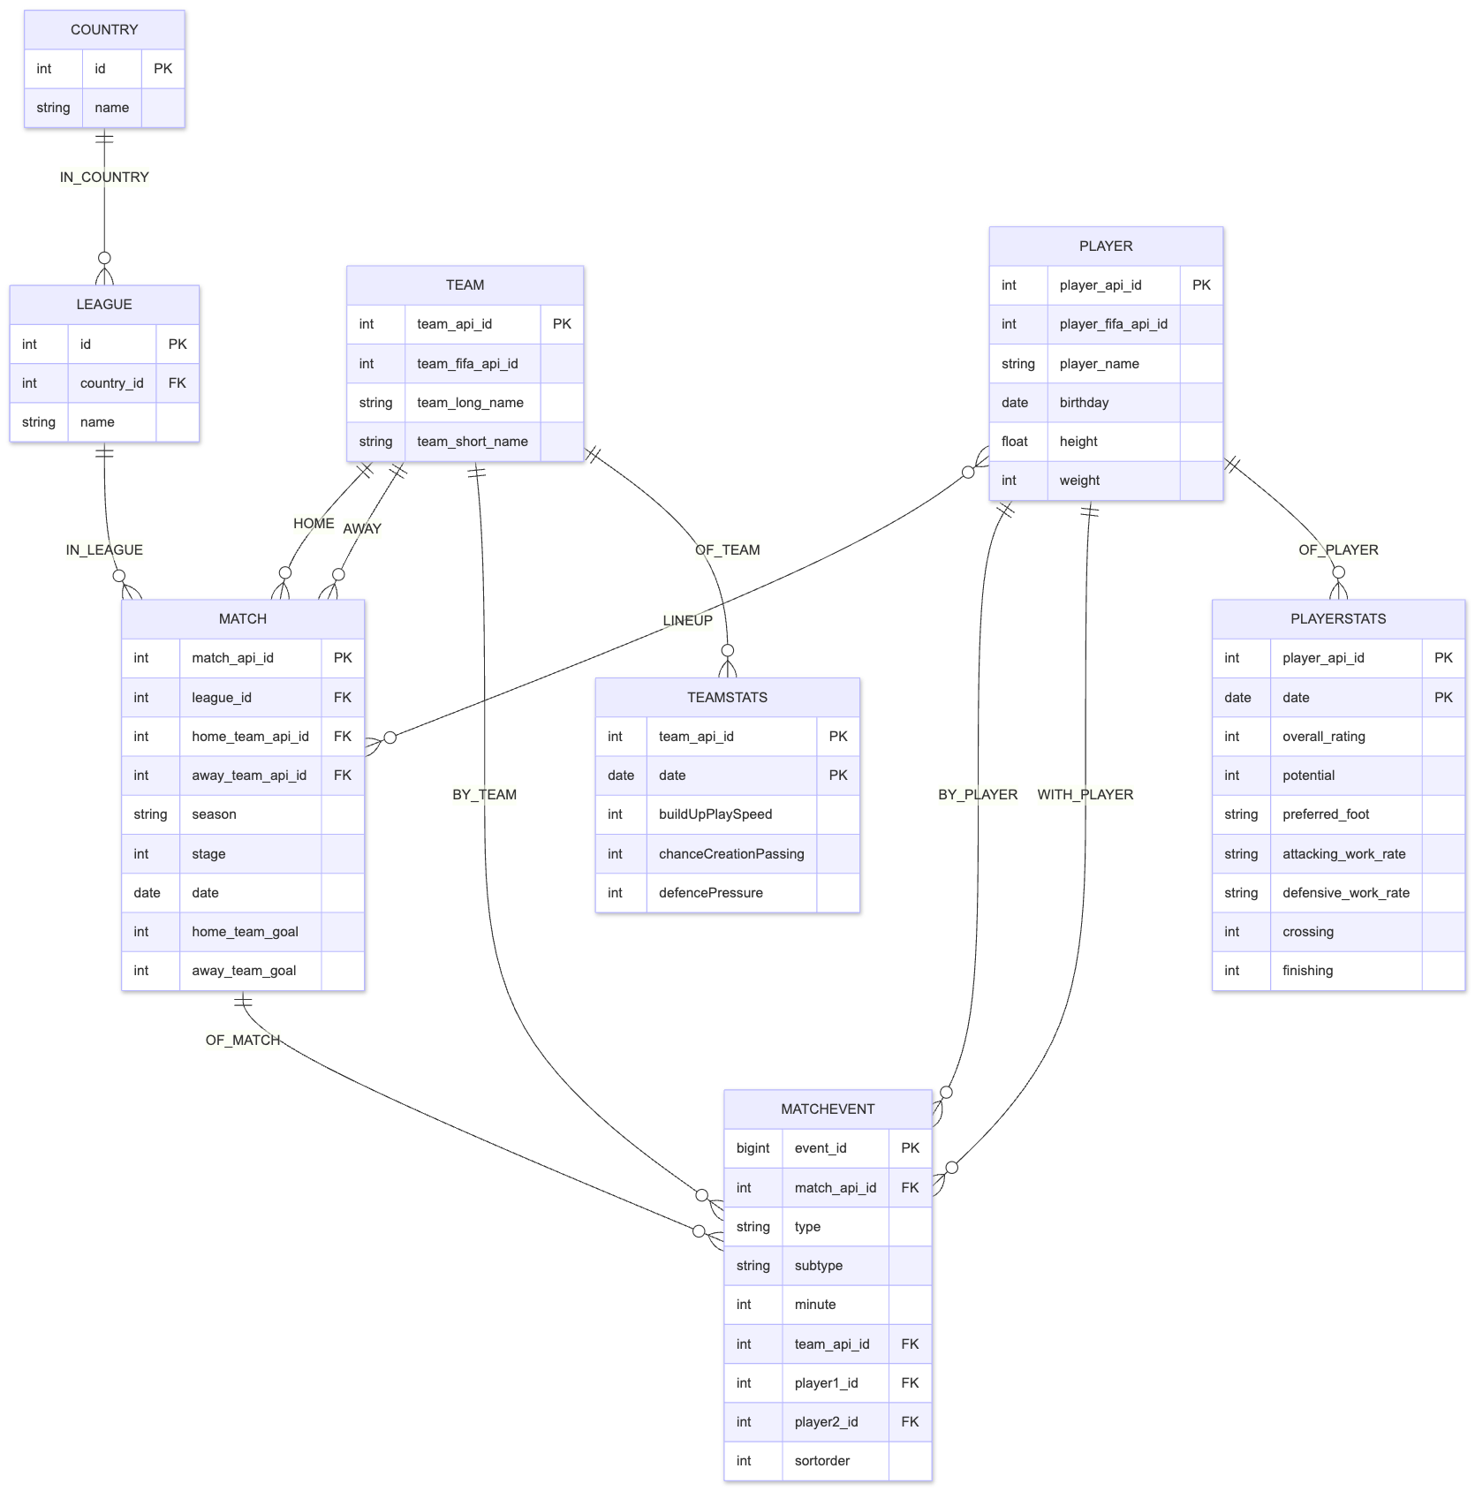
POSTGRESQL DESIGN
From 115 columns to 4 tables: the normalisation that makes the comparison fair
BEFORE — SOURCE
AFTER — NORMALISED
115 columns
match
25,979 rows
→
match_lineup
542,281 rows
22 player ids + 44 pitch coordinates · 8 raw XML fields · 30 betting odds · 11 base fields — all in one Match table
match_event
917,815 rows
match_odds
out of scope
Conceptual ER — shared by both designs
1 · Readable SQL
2 · Events become indexable rows
3 · Symmetry with the graph model
DM 2025/26 · D'Angelica & Leone · PostgreSQL vs Neo4j
05 / 16
Notes:
50 sec. La decisione chiave: esplodere la tabella Match. Tre motivi: leggibilità, semantica normalizzata, simmetria col grafo — la simmetria è ciò che rende il confronto equo.

Slide 6
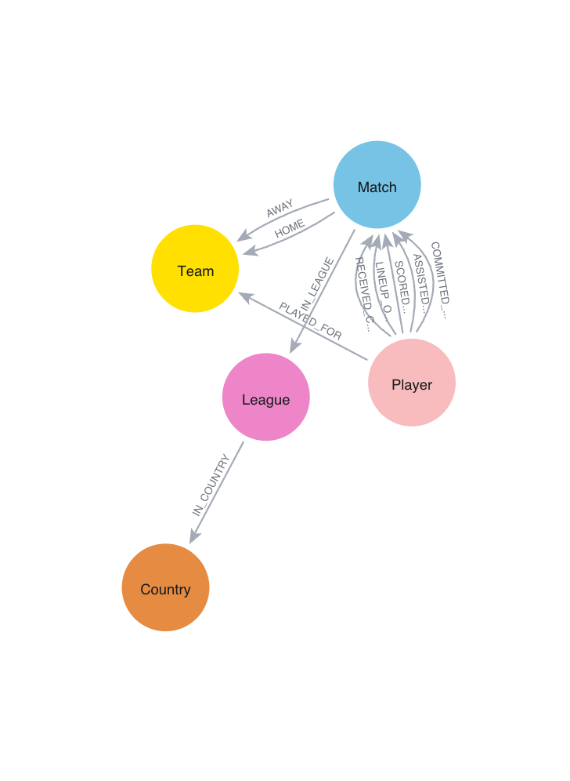
NEO4J DESIGN
In the graph, events become relationships: zero joins to navigate them
(Player)-[:SCORED_IN]->(Match)
Every parsed event is a typed, directed relationship
(Player)-[:PLAYED_FOR]->(Team)
Derived at load time — the edge that powers teammates & shortest-path queries
(Match)-[:HOME|AWAY]->(Team)
Structure (league, country, sides) mirrors the relational FKs 1:1
Actual Neo4j schema visualisation — CALL db.schema.visualization()
DM 2025/26 · D'Angelica & Leone · PostgreSQL vs Neo4j
06 / 16
Notes:
50 sec. Stesse entità concettuali, ma gli eventi diventano relazioni tipizzate: SCORED_IN, LINEUP_OF, PLAYED_FOR. Navigarle non richiede join.

Slide 7
ETL PIPELINE
A reproducible pipeline: SQLite to both databases in ~7 minutes, zero orphan FKs
›
›
›
›
01
02
03
04
05
Extract
Transform
Clean CSVs
Load Postgres
Load Neo4j
Read all tables from database.sqlite
Parse XML events, explode lineup, fix orphan FKs
9 files in clean/ — one source of truth for both DBs
DDL + COPY bulk insert
LOAD CSV + derive PLAYED_FOR
100%
917,815
~7 min
FK integrity — zero orphans across 542k+ refs
typed rows from XML (14,196 matches)
full pipeline re-run, end-to-end
DM 2025/26 · D'Angelica & Leone · PostgreSQL vs Neo4j
07 / 16
Notes:
40 sec. Non leggere gli step: dire solo che è tutto automatizzato e riproducibile in 7 minuti, con integrità referenziale totale. I tre bug risolti sono in backup.

Slide 8
EXPERIMENTAL SETUP & METHODOLOGY
Rigorous by design: 15 runs, bootstrap CIs, significance tests — and results verified equivalent
ENVIRONMENT
STATISTICS
MacBook Air M2 · 8 GB RAM · SSD — single-user, in-memory dataset. PostgreSQL 18.6 (default config) · Neo4j 2026.04.0 Enterprise
1 warm-up
→
15 runs
→
median + 95% CI
→
Mann-Whitney U
RESULT EQUIVALENCE
FAIRNESS CHOICE
Both result-sets normalised (rounding, dates, decimals) and compared as multisets. All 10 read queries: identical answers.
Postgres precomputes mv_played_for to mirror Neo4j's PLAYED_FOR edge — neither system gets a structural advantage on Q09–Q10.
DM 2025/26 · D'Angelica & Leone · PostgreSQL vs Neo4j
08 / 16
Notes:
60 sec. Slide di credibilità: mediana + bootstrap CI + Mann-Whitney, ed equivalenza dei risultati verificata come insiemi. Sottolineare la materialized view: nessun vantaggio strutturale a nessuno dei due.

Slide 9
BENCHMARK DESIGN
12 queries of increasing graph-friendliness — with hypotheses declared before measuring
A
Q01–Q04
Aggregations & 2–3 way joins — top scorers, standings, win %
Hypothesis: Postgres wins or ties
B
Q05–Q07
Multi-hop joins, self-joins, presence-in-all-of (8 seasons)
Hypothesis: slight Neo4j edge
C
Q08–Q10
Network traversal — teammates, 2-hop, shortest path
Hypothesis: Neo4j wins clearly
D
Q11–Q12
Writes — bulk UPDATE, schema evolution (new attribute)
Comparing paradigms, not speed
Every query written twice — same logic in SQL and Cypher, parameterised · queries/sql/Q01..Q12.sql · queries/cypher/Q01..Q12.cypher
DM 2025/26 · D'Angelica & Leone · PostgreSQL vs Neo4j
09 / 16
Notes:
50 sec. Punto di credibilità scientifica: le ipotesi sono dichiarate PRIMA di misurare. Graph-friendliness crescente da A a C, più i workload di scrittura D.

Slide 10
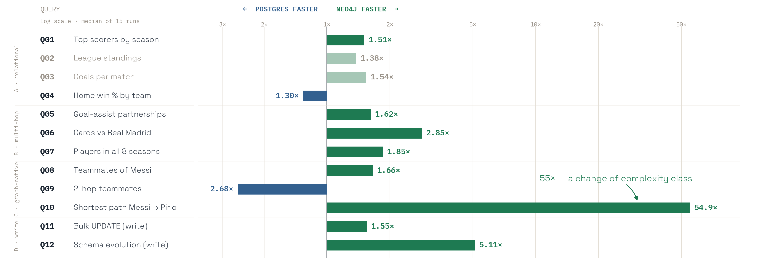
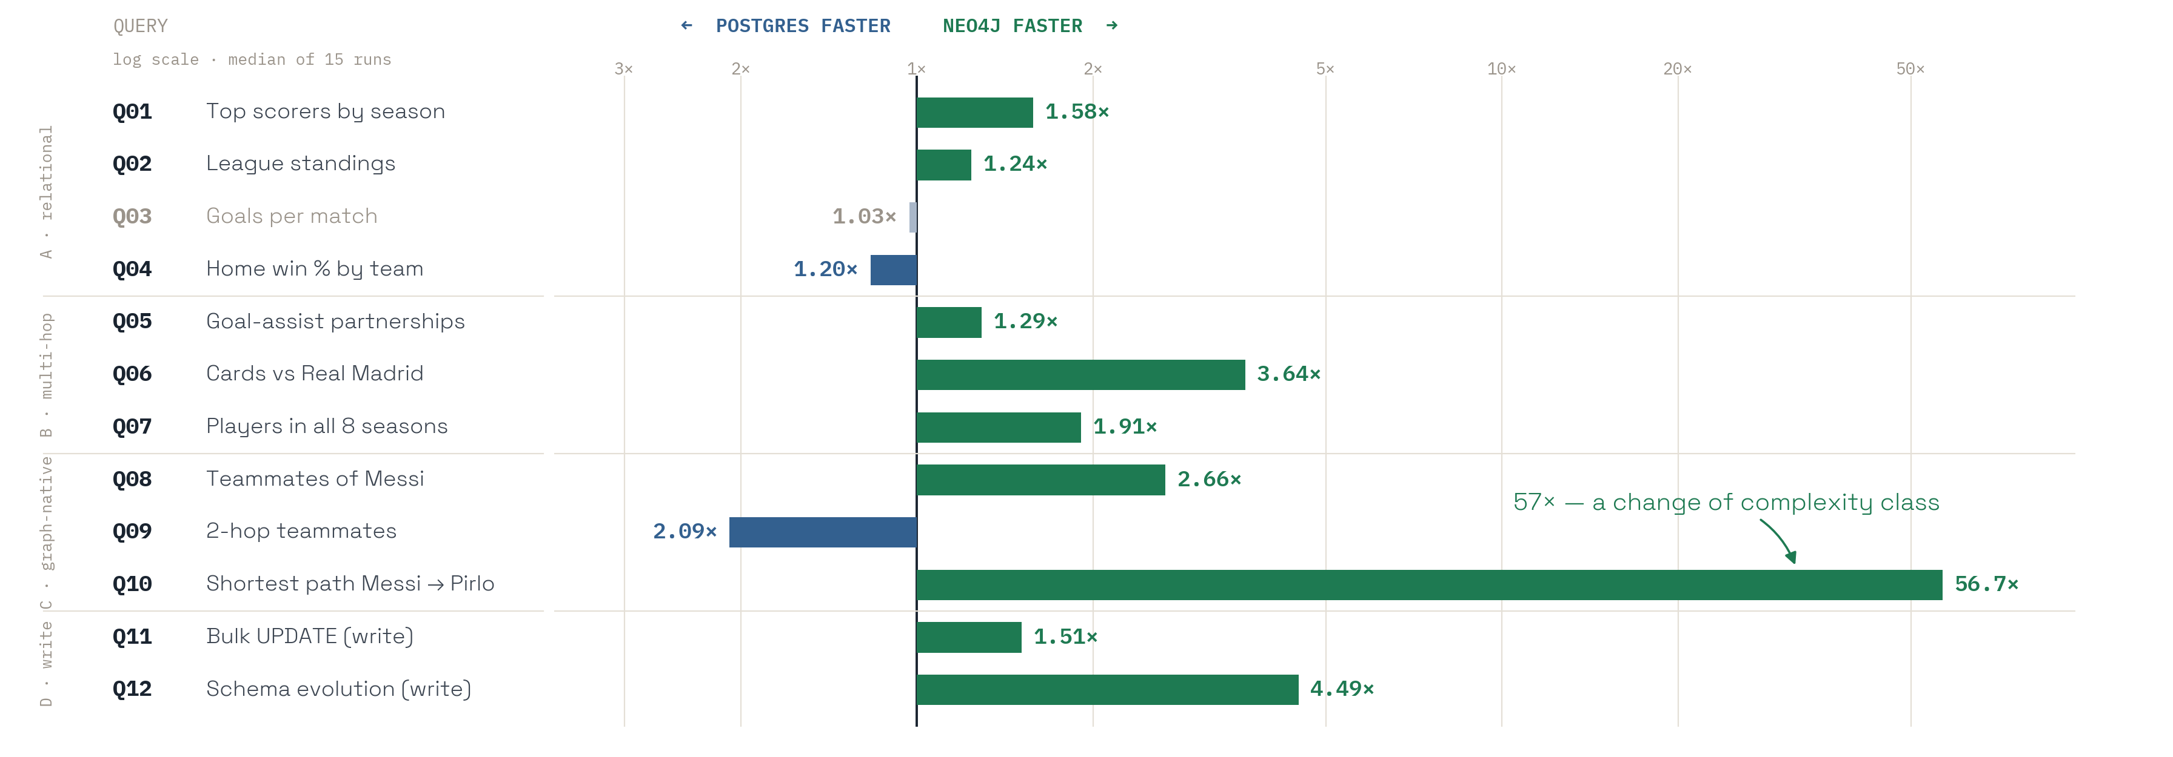
RESULTS — 12 QUERIES, LOG SCALE
Category A is a dead heat across runs; Postgres wins the fixed-depth join, Neo4j every variable-depth traversal and every write
Postgres wins (2)
Neo4j wins (8) · not significant (2)
saturated bars = significant after Holm correction (10/12) · Mann-Whitney U, p < 0.05 · all results equivalent (multiset)
DM 2025/26 · D'Angelica & Leone · PostgreSQL vs Neo4j
10 / 16
Notes:
90 sec — la slide centrale, rallentare. Leggere il pattern, non i numeri: tutte le A a Postgres, poi il campo si ribalta. Q09 è l'eccezione interessante: il 2-hop con dedup è un'aggregazione mascherata. 11 su 12 differenze significative.

Slide 11
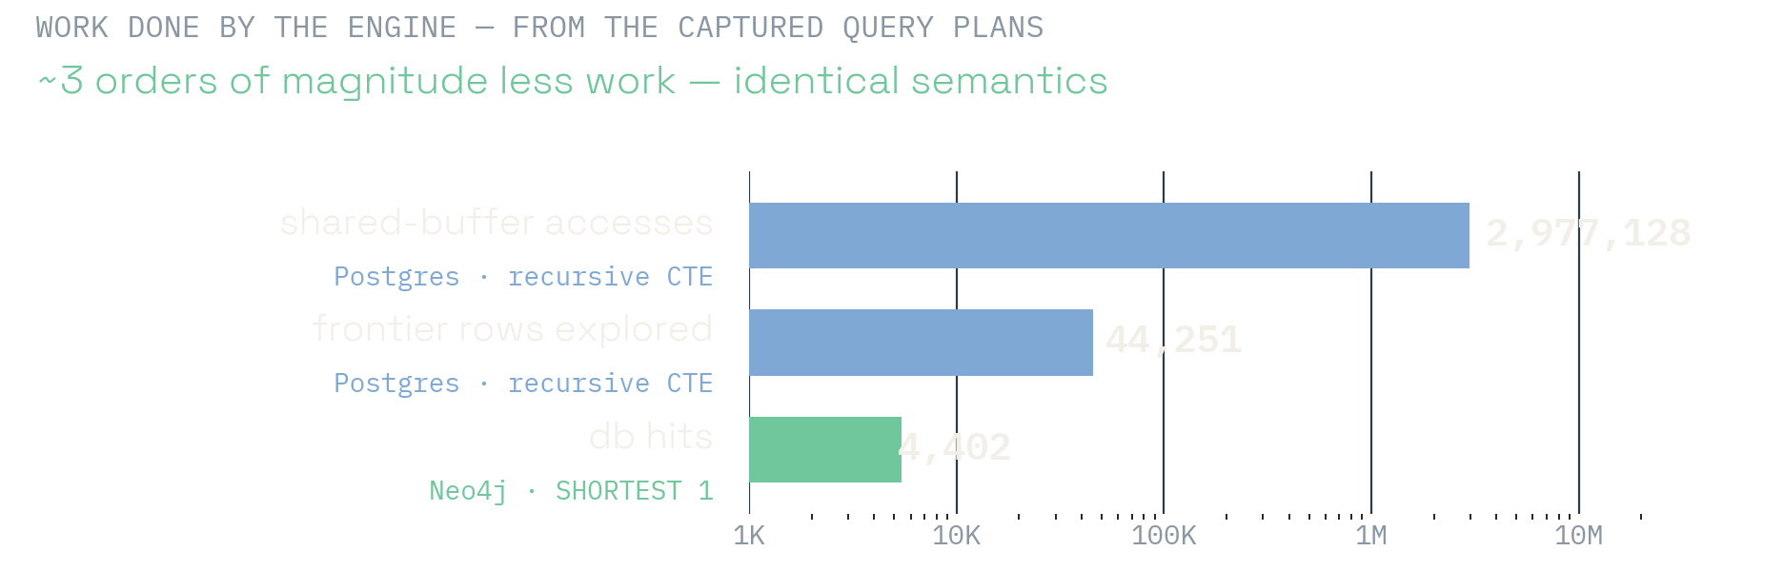
Q10 — SHORTEST PATH, MESSI → PIRLO
55×
faster on Neo4j — a change of complexity class, not an optimisation
POSTGRES
NEO4J
792 ms
14 ms
recursive CTE (BFS)
SHORTEST 1 path pattern
DM 2025/26 · D'Angelica & Leone · PostgreSQL vs Neo4j
11 / 16
Notes:
45 sec. Pausa a effetto. Non è tuning: il recursive CTE esplora tutto il fan-out, SHORTEST 1 si ferma appena tocca. Complessità diversa, non costante diversa.

Slide 12
Q10 — SAME QUESTION, TWO LANGUAGES
21 lines of SQL vs 5 of Cypher — same answer, same semantics
POSTGRESQL — RECURSIVE CTE (BFS)
NEO4J — SHORTEST 1 PATH PATTERN (GQL)
WITH RECURSIVE bfs (player_api_id, distance) AS (
SELECT src, 0 FROM endpoints
UNION
SELECT pf2.player_api_id, b.distance + 1
FROM bfs b
JOIN soccer.mv_played_for pf1
ON pf1.player_api_id = b.player_api_id
JOIN soccer.mv_played_for pf2
ON pf2.team_api_id = pf1.team_api_id
AND pf2.season = pf1.season
AND pf2.player_api_id <> b.player_api_id
WHERE b.distance < 6
)
SELECT MIN(distance) FROM bfs
WHERE player_api_id = dst;
21 → 5
lines of code
26 → 5
MATCH (a:Player {name: $player_a}),
(b:Player {name: $player_b})
MATCH path = SHORTEST 1 (a)
((x:Player)-[r1:PLAYED_FOR]->(:Team)
<-[r2:PLAYED_FOR]-(y:Player)
WHERE r1.season = r2.season){1,6}
(b)
RETURN length(path) / 2;
logical operators
792 → 14
milliseconds
Semantics verified, not assumed: the legacy shortestPath() diverges from the SQL BFS on 1 of 8 player pairs (Ibrahimović → Neuer: 2 hops instead of 3) because it ignores the season between consecutive edges — replaced by the quantified path pattern (report §10.2).
DM 2025/26 · D'Angelica & Leone · PostgreSQL vs Neo4j
12 / 16
Notes:
60 sec. La sproporzione visiva È il messaggio: stessa domanda, 21 righe contro 5. Non leggere il codice: indicare solo la CTE ricorsiva a sinistra e SHORTEST 1 a destra. If asked how we know the semantics match: we ran both formulations on 8 player pairs; the legacy shortestPath() answered 2 hops on Ibrahimovic-Neuer where the season-aware BFS says 3, so we replaced it. That is how we know the 55x is real and not an artefact of a laxer query.

Slide 13
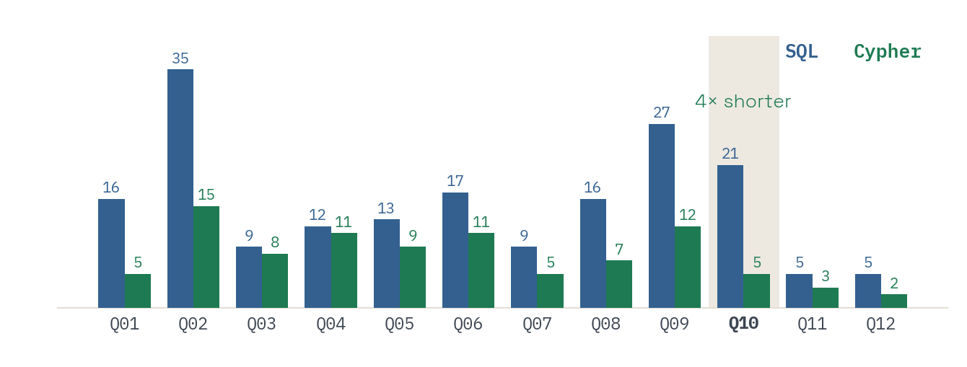
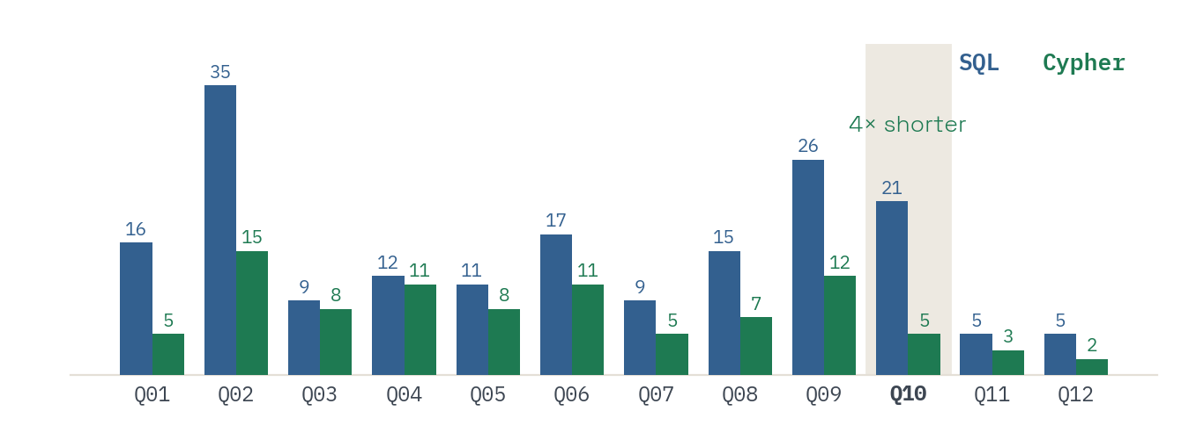
BEYOND MILLISECONDS
Cypher is not just faster: it's 4× shorter — and a schema change is one SET, not a migration
CODE EXPRESSIVENESS — Q10
SCHEMA EVOLUTION — Q12: ADD totalGoals TO EVERY MATCH
4×
fewer lines of code
21 SQL → 5 Cypher
5×
fewer operators
26 SQL → 5 Cypher
POSTGRES — 2 STEPS + LOCK
NEO4J — 1 STEP, NO DDL
ALTER TABLE match
ADD COLUMN total_goals;
UPDATE match
SET total_goals =
home_goal + away_goal;
MATCH (m:Match)
SET m.totalGoals =
m.homeGoals
+ m.awayGoals;
LINES OF CODE PER QUERY — ALL 12, SQL VS CYPHER
436 ms vs 85 ms (5.1×, measured through COMMIT) — same CPU work, radically different change-management: schema-on-write vs schema-on-read.
DM 2025/26 · D'Angelica & Leone · PostgreSQL vs Neo4j
13 / 16
Notes:
60 sec. Due dimensioni non-performance: concisione del codice e agilità dello schema. Q12: ALTER + UPDATE + lock contro un singolo SET — 4.5 volte più veloce, ma il punto vero è il change-management.

Slide 14
CONCLUSIONS
Three takeaways from twelve queries
1
2
3
Where the depth is fixed, the relational join still wins
Neo4j wins where the depth is variable — by a class
Schema flexibility is the forgotten dimension
Two-hop teammates (Q09): same precomputed relation, B-tree joins beat the traversal 2.7× — and the gap widens with data. Light aggregations (< 25 ms): a dead heat across runs.
Q10: 55× with identical semantics — the CTE explores 44,251 states, SHORTEST 1 touches 4,402 db hits. Q06 (2.9×) and Q07 (1.9×) follow; Q07's edge grows with data.
One SET vs ALTER + UPDATE: 5.1× measured through commit. In change-heavy environments this matters more than raw milliseconds.
CAVEATS
Single node, single user, default configs. Four sensitivity analyses in the report: work_mem, Q10 semantics, MVCC bloat (VACUUM protocol), scaling on 2/4/8 seasons.
DM 2025/26 · D'Angelica & Leone · PostgreSQL vs Neo4j
14 / 16
Notes:
60 sec. Tre takeaway, uno per paradigma più la dimensione dimenticata dello schema. Chiudere con il caveat in una riga: singolo nodo, configurazioni default — dettagli in backup.

Slide 15
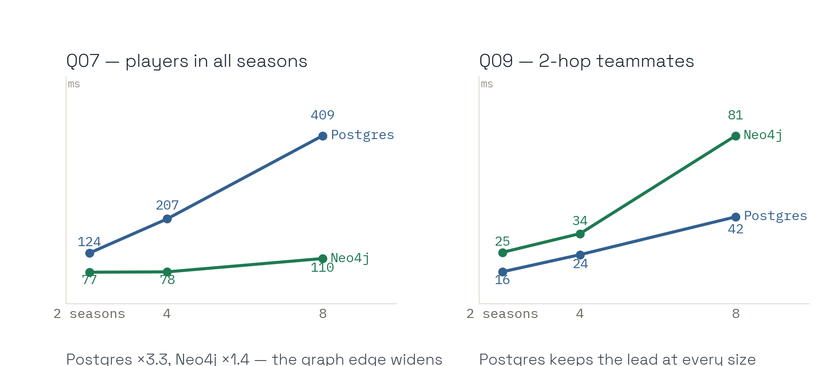
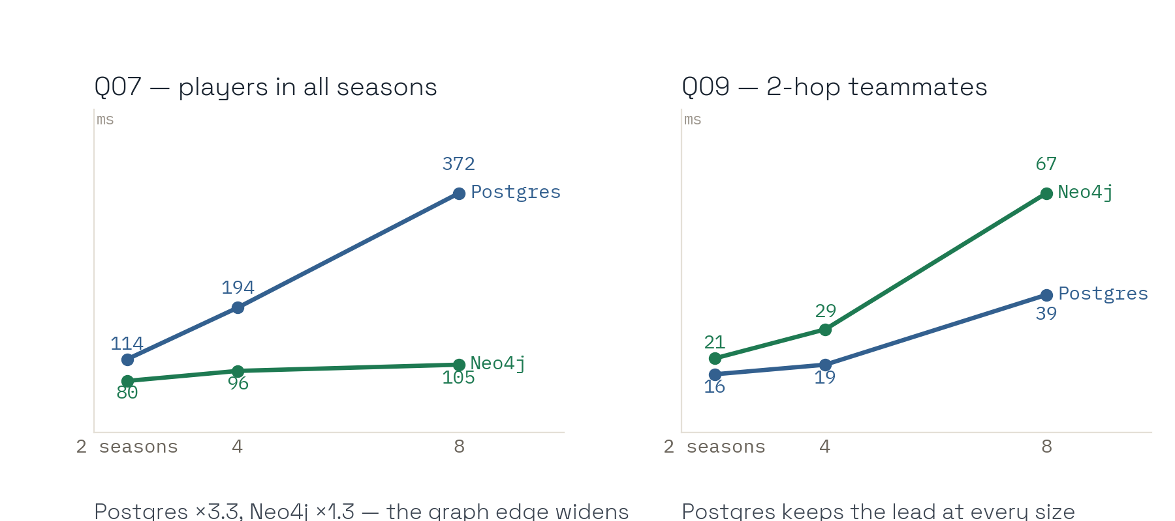
EASE-OF-USE & SCALABILITY
Two more dimensions: ease of use and scalability
5,653
3.3× vs 1.4×
Schema-first found our bugs
How Q07 grows with 4× the data — Postgres vs Neo4j: the graph edge widens
· Postgres' FK check rejected 5,653 orphan player references — Neo4j would have loaded them silently.
· Running both systems side by side caught three more silent bugs: NULL semantics (Q05), path semantics (Q10), name-based grouping (Q07, Q09).
· Cypher is 2× shorter on average, 4× on the shortest path; SQL's explicit schema is the documentation.
CAVEATS
Index-free adjacency does not partition for free: single-node result. 10 runs per cell, medians; on Q09 Postgres keeps its lead at every size.
DM 2025/26 · D'Angelica & Leone · PostgreSQL vs Neo4j
15 / 16
Notes:
Two dimensions the benchmark numbers hide. Ease of use: schema-first is a feature, not friction — the FK check caught 5,653 orphan references that Neo4j would have loaded silently; and keeping the two systems side by side caught three more silent bugs. Scalability, measured: on Q07 Postgres grows 3.3x with 4x the data while Neo4j grows 1.4x — the graph edge widens; on Q09 the fixed-depth join keeps its lead at every size. Caveat: all of this is single node — index-free adjacency does not partition for free.

Slide 16

VERDICT
Not "which is better" — which problem do you have?
Choose PostgreSQL
Choose Neo4j
INTEGRITY
ACID transactions and strict constraints matter
Data is naturally a network of entities and events
WORKLOAD
Reporting and OLAP-style aggregations dominate
Queries traverse paths, neighbourhoods, communities
SCHEMA
Stable and well understood
Evolves frequently and unpredictably
Thank you — live demo time →
github.com/g1up3/DM-Project-2026 · reports/benchmark_report.md
scan — report, harness, plans, sensitivity analyses
DM 2025/26 · D'Angelica & Leone · PostgreSQL vs Neo4j
16 / 16
Notes:
45 sec. Chiusura: non 'quale è meglio' ma 'quale problema hai'. Quattro criteri, due risposte. Poi grazie e passaggio alla demo.

Slide 17
BACKUP — ENGINEERING CHALLENGES
Three bugs only the full load reveals — all fixed upstream
5,653 orphan player refs
INTEGER NULL → "673.0"
card_type CHAR(1) too narrow
Problem — XML events referenced player IDs absent from Player
Problem — pandas float-serialised nullable integers; COPY rejected
Problem — the schema didn't anticipate "y2", the second-yellow code
Fix — nullified in transform.py
Fix — auto-detect and cast to Int64 before CSV write
Fix — widened to VARCHAR(2)
Result — 100% FK integrity, only 0.5% of attributions lost
Result — the kind of bug only the full load reveals
Result — clean load + player_stats.csv shrunk 38 → 25 MB
Each fix is small in isolation; together they make the pipeline reproducible end-to-end.
DM 2025/26 · D'Angelica & Leone · PostgreSQL vs Neo4j
BACKUP
Notes:
Backup per Q&A: i tre bug reali risolti nella pipeline.

Slide 18
BACKUP — INDEX ABLATION
Without indexes both degrade: 3.5× on Postgres, 1.9× on Neo4j
7 index-query pairs (4 PG + 3 Neo4j) — each dropped, measured over 10 runs, restored. Shown: Q08.
PostgreSQL — Q08 ix_lineup_player
Neo4j — Q08 player_name_idx
WITH INDEX — 3.2 ms
WITH INDEX — 3.9 ms
WITHOUT — 11.2 ms
WITHOUT — 7.4 ms
3.48× slowdown
1.91× slowdown
DM 2025/26 · D'Angelica & Leone · PostgreSQL vs Neo4j
BACKUP
Notes:
Backup per Q&A sul rigore sperimentale: ablation study su 7 coppie indice-query, drop-measure-restore.

Slide 19
BACKUP — LIMITATIONS, FUTURE WORK & REFERENCES
What this benchmark does not measure
Single-node, single-user
No tuning
Concurrency, lock contention and MVCC under load are out of scope.
Default configs. work_mem tested on Q07: no effect. A shared_buffers / pagecache grid could shift close category-A races.
Medium scale
Future work
Measured on 2/4/8 seasons: Neo4j's aggregation edge widens with data, Postgres' fixed-depth join edge too. LDBC-SNB scale is future work.
OLTP write-heavy workload · Citus vs Neo4j Fabric · hybrid polyglot architectures.
Angles & Gutierrez (2008), ACM Comp. Surveys · Vicknair et al. (2010), ACM SE · Holzschuher & Peinl (2013), EDBT/ICDT · Erling et al. (2015), LDBC-SNB, SIGMOD · Robinson et al. (2015), Graph Databases 2nd ed.
DM 2025/26 · D'Angelica & Leone · PostgreSQL vs Neo4j
BACKUP
Notes:
Backup: limiti dichiarati e riferimenti bibliografici.

Slide 20
BACKUP — THE 12 QUERIES IN PLAIN WORDS
What each query asks — and what it tests
Q01
Top scorers by season — top-N goal scorers of one season. 3-table join + GROUP BY.
Q07
Players in all 8 seasons — players who appeared in every season of the dataset. COUNT DISTINCT = 8.
cat. A
cat. B
Q02
League standings — full table of one league-season: points, goal difference. UNION ALL + aggregation.
Q08
Teammates of Messi 2015/16 — players who shared a lineup with X in season Y, by shared matches.
cat. A
cat. C
Q03
Goals per match by league — average goals per match in every league, one season. GROUP BY.
Q09
2-hop teammates — teammates-of-teammates of X, ranked by shared team-seasons. Fixed depth, mv_played_for.
cat. A
cat. C
Q04
Home win % by team — teams with the best home-win rate, min. N home matches. Conditional aggregation.
Q10
Shortest path Messi → Pirlo — degrees of separation on the teammate graph, max 6 hops. Recursive CTE vs SHORTEST 1.
cat. A
cat. C
Q05
Goal-assist partnerships — scorer–assister pairs that combined at least N times. Self-join on one event.
Q11
Bulk UPDATE — lowercase the subtype of the 21,442 goal events with a known scorer. Measured to COMMIT.
cat. B
cat. D
Q06
Cards vs Real Madrid — players booked most often when playing against a given team. 4-table join.
Q12
Schema evolution — add totalGoals = home + away to all 25,979 matches. ALTER + UPDATE vs one SET.
cat. B
cat. D
All 12 are parameterised, written twice (queries/sql · queries/cypher) and result-checked as multisets on every run.
DM 2025/26 · D'Angelica & Leone · PostgreSQL vs Neo4j
BACKUP
Notes:
Backup for the Q&A: one line per query, with the category. Use it if the professor asks what a specific query does before asking us to write it live.

Slide 21
BACKUP — FULL RESULTS TABLE
All twelve queries — medians of 15 runs, run_20260921_162704
QUERY
POSTGRES
NEO4J
SPEEDUP
WINNER
p
r
HOLM
Q01
Top scorers by season
10.3 ms
6.9 ms
1.51×
Neo4j
< 0.001
0.75
yes
Q02
League standings
3.7 ms
5.1 ms
1.38×
—
0.229
0.26
no
Q03
Goals per match by league
8.3 ms
5.4 ms
1.54×
Neo4j
0.028
0.47
no
Q04
Home win % by team
15.9 ms
20.7 ms
1.30×
Postgres
0.004
0.61
yes
Q05
Goal-assist partnerships
61.5 ms
38.1 ms
1.62×
Neo4j
< 0.001
0.86
yes
Q06
Cards vs Real Madrid
21.8 ms
7.6 ms
2.85×
Neo4j
< 0.001
1.0
yes
Q07
Players in all 8 seasons
400.2 ms
216.1 ms
1.85×
Neo4j
< 0.001
1.0
yes
Q08
Teammates of Messi 2015/16
7.0 ms
4.2 ms
1.66×
Neo4j
< 0.001
0.93
yes
Q09
2-hop teammates of Messi
28.9 ms
77.6 ms
2.68×
Postgres
< 0.001
1.0
yes
Q10
Shortest path Messi → Pirlo
792.1 ms
14.4 ms
54.89×
Neo4j
< 0.001
1.0
yes
Q11
Bulk UPDATE (write)
303.1 ms
195.6 ms
1.55×
Neo4j
< 0.001
0.95
yes
Q12
Schema evolution (write)
435.9 ms
85.4 ms
5.11×
Neo4j
< 0.001
1.0
yes
Mann-Whitney U two-sided · r = rank-biserial effect size · Holm = significant after Holm-Bonferroni over the 12 tests (10/12) · all 10 read queries return identical multisets
DM 2025/26 · D'Angelica & Leone · PostgreSQL vs Neo4j
BACKUP
Notes:
Backup: the complete table behind the chart on slide 10. Use it when asked for a specific number, a p-value or the effect size; the CSVs are in the repository.

Slide 22
BACKUP — FAIR COMPARISON
Fair comparison: the same precomputation on both sides
POSTGRES — MATERIALIZED VIEW, BUILT ONCE AT LOAD
NEO4J — DERIVED RELATIONSHIP, BUILT ONCE AT LOAD
CREATE MATERIALIZED VIEW mv_played_for AS
SELECT DISTINCT l.player_api_id,
CASE WHEN l.side = 'home' THEN m.home_team_api_id
ELSE m.away_team_api_id END AS team_api_id,
m.season
FROM match_lineup l
JOIN match m ON m.match_api_id = l.match_api_id;
CREATE INDEX ... ON mv_played_for(player_api_id);
CREATE INDEX ... ON mv_played_for(team_api_id, season);
MATCH (p:Player)-[:LINEUP_OF]->(m:Match)
-[:HOME|AWAY]->(t:Team)
WITH p, t, m.season AS season, count(*) AS apps
MERGE (p)-[r:PLAYED_FOR {season: season}]->(t)
SET r.appearances = apps
35,002
Q09 · Q10
why
rows in the view = 35,002 PLAYED_FOR relationships — the two populations coincide
the only queries that use it, on both sides; Q08 walks the raw lineups on both sides
without it Postgres would rebuild played_for with a CTE on every run while Neo4j walks a precomputed edge — asymmetric by design
DM 2025/26 · D'Angelica & Leone · PostgreSQL vs Neo4j
BACKUP
Notes:
Backup for the fairness question. The view is the relational twin of the derived edge: same tuples, same cardinality, both built once at load time and indexed. Q09 and Q10 read it; Q08 does not, on either side.

