Slide 1
PostgreSQL vs Neo4j
An experimental comparison on a real-world graph dataset
Giuseppe D'Angelica github.com/g1up3
Nicolas Leone github.com/theunick
Data Management 2025/26 — Sapienza Università di Roma
Tutor: Roberto Maria Delfino · Sapienza Università di Roma
01 / 23
Notes:
Cover slide. Introduce yourselves (Giuseppe + Nicolas), mention the tutor (Delfino), and frame the talk as an experimental comparison — emphasize that we measured rather than just discussed.

Slide 2
The research question
Why two databases for the same data?
“When does a graph database
actually beat a relational one?”
Relational strengths
Graph strengths
Decades of optimisation, mature planner, B-tree indexes — perfect for OLAP-style aggregations and joins.
Native traversal of relationships, no joins. Built for shortest paths, friend-of-friend, communities.
DM 2025/26 · D'Angelica & Leone · PostgreSQL vs Neo4j
2 / 23
Notes:
The research question. Skip narration of bullets — read the central quote, then say: 'Decades of relational optimisation versus a model where relationships ARE data. Today's experiment answers this empirically.'

Slide 3
The dataset
European Soccer Database — Hugo Mathien, Kaggle
25,979
11,060
917,815
542,281
matches
players
events
lineup rows
11 leagues · 8 seasons
with FIFA-rating snapshots
parsed from raw XML
11+11 per match
Source format: single 300-MB SQLite file. The Match table is 115 columns wide and contains XML-encoded events that we parsed and normalised.
DM 2025/26 · D'Angelica & Leone · PostgreSQL vs Neo4j
3 / 23
Notes:
Dataset highlights. 26k matches, 917k events from XML parsing — emphasize that data quality matters: we'll see in 5 slides how the integration of XML events created challenges.

Slide 4
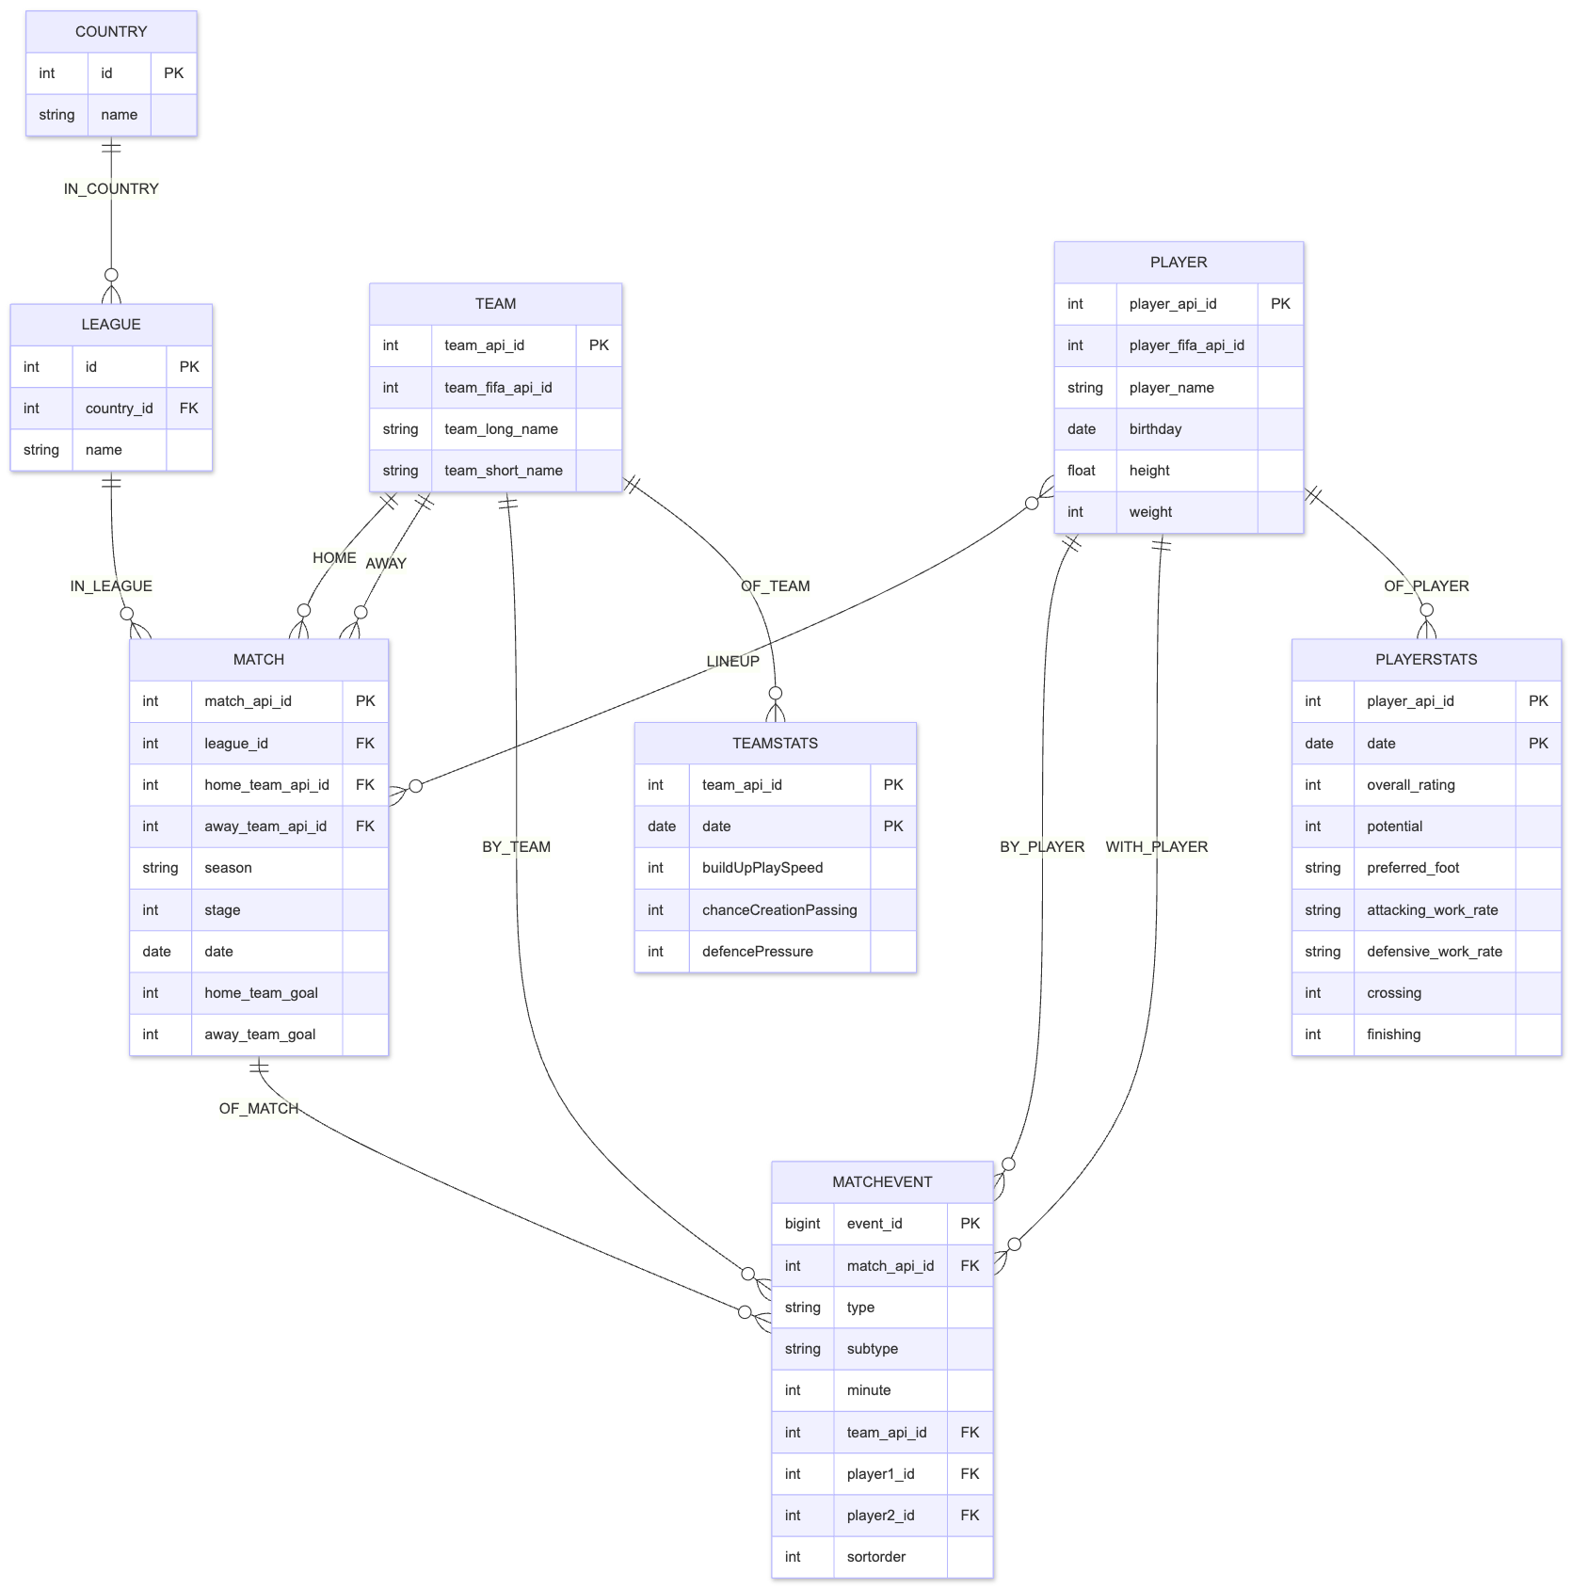
Conceptual schema
One model, two implementations
Entities
Relationships
Country
11
League
11
Team
299
Player
11,060
Match
25,979
MatchEvent
917,815
PlayerStats
183,978 snapshots
TeamStats
1,458 snapshots
ER diagram (full version in schema/conceptual_er.md)
DM 2025/26 · D'Angelica & Leone · PostgreSQL vs Neo4j
4 / 23
Notes:
Conceptual schema. Show the ER diagram (right side). 'Same domain, two implementations — we'll see how each system encodes the same idea differently.'

Slide 5
PostgreSQL design
Key decision: explode the wide Match table
BEFORE — source
AFTER — normalised
Match table: 115 columns
→
4 tables:
match (25,979 rows)
match_lineup (542,281)
match_event (917,815)
match_odds (out of scope)
44 lineup columns + 8 raw XML fields + 20 betting odds + base info
Why explode it
1. Readable SQL — JOIN on match_lineup is far clearer than scanning 22 wide columns.
2. Normalised semantics — events become rows you can index and aggregate.
3. Symmetry with the graph — the same conceptual entities map naturally to nodes and relationships.
DM 2025/26 · D'Angelica & Leone · PostgreSQL vs Neo4j
5 / 23
Notes:
Postgres design choices. 'The Match table in the source had 115 columns including 22 player FKs and 8 XML blobs. We exploded it into 4 normalised tables. This is the standard relational move.'

Slide 6
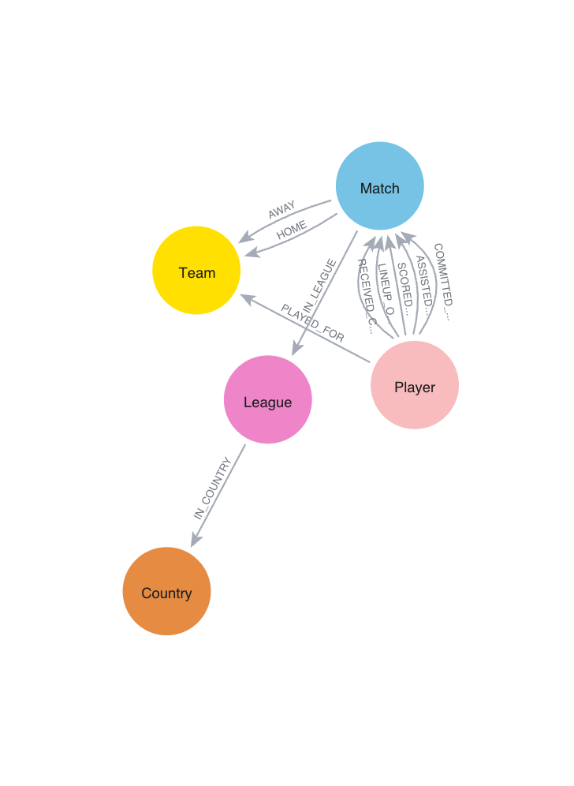
Neo4j design
Nodes for entities, relationships for events
Country
IN_COUNTRY
League
Team
Match
LINEUP_OF
Player
PLAYS_IN
HOME / AWAY
SCORED_IN
Snapshot of the actual Neo4j graph (zoom on a single league-season)
DM 2025/26 · D'Angelica & Leone · PostgreSQL vs Neo4j
6 / 23
Notes:
Neo4j design. 'Same entities, but events become relationships. Look at this snapshot of the actual graph — Lineup_of, Scored_in are not foreign keys, they are first-class objects you can traverse.'

Slide 7
ETL pipeline
From SQLite to two databases — fully automated
1
2
3
4
5
Extract
▶
Transform
▶
Clean CSVs
▶
Load Postgres
▶
Load Neo4j
Read all tables from database.sqlite
Parse XML events, explode lineup, fix orphan FKs
9 CSV files in clean/, ready for both DBs
Apply DDL + COPY (fast bulk insert)
LOAD CSV + derive PLAYED_FOR aggregation
All foreign keys: 100% integral — zero orphans across 542k+ references
XML parsing: 14,196 matches with events → 917,815 typed rows in match_event
Re-running the pipeline from scratch: ~7 minutes end-to-end
DM 2025/26 · D'Angelica & Leone · PostgreSQL vs Neo4j
7 / 23
Notes:
ETL pipeline. 'Fully automated, ~7 minutes end-to-end. The interesting story is the next slide.'

Slide 8
Engineering challenges
Three real problems we ran into — and how we solved them
5,632 orphan player references
1
XML-parsed events referenced player IDs absent from the Player table. We nullified them in transform.py — preserved 100% of events, lost only the attribution for 0.5% of them. Result: full FK integrity.
pandas serialised INTEGER NULL as "673.0"
2
Postgres rejected COPY for `team_fifa_api_id`. Fix: auto-detect integer-with-NaN columns and cast to pandas Int64 before writing CSV. Bonus: shrunk player_stats.csv from 38 MB to 25 MB.
card_type CHAR(1) was too narrow
3
The schema didn't anticipate "y2" — the second-yellow code, rare but present. Widened to VARCHAR(2). The kind of bug only the full load reveals.
Each fix is small in isolation; together they make the pipeline reproducible end-to-end.
DM 2025/26 · D'Angelica & Leone · PostgreSQL vs Neo4j
8 / 23
Notes:
Engineering challenges. Tell each story briefly — orphan FKs, pandas integer NaN, card_type 'y2'. 'These are the realities of real-world data integration. They are NOT in a typical course exercise.'

Slide 9
Experimental setup
Hardware, software versions, and methodology
Hardware
MacBook Air, Apple M2 (8 cores), 8 GB RAM, internal SSD. Single-user, in-memory dataset.
Database engines
PostgreSQL 18.3 (Homebrew, default config) · Neo4j 2026.04.0 Enterprise (Desktop).
Methodology
5 measured runs per query + 1 warm-up discarded · Median, min, max, IQR · Result equality verified as set of normalised tuples.
Fair-comparison choice
Postgres precomputes a materialized view mv_played_for(player, team, season) to mirror Neo4j's :PLAYED_FOR relationship — neither system gets a structural advantage on Q08/Q09/Q10.
DM 2025/26 · D'Angelica & Leone · PostgreSQL vs Neo4j
9 / 23
Notes:
Experimental setup. State explicitly: 'MacBook Air M2 (8 cores, 8 GB RAM), Postgres 18.3 Homebrew, Neo4j 2026.04.0 Enterprise community, default configuration on both. Methodology: warm-up + 5 runs, median reported. And — critical — Postgres has a materialized view mirroring Neo4j's PLAYED_FOR, so the comparison is FAIR.'

Slide 10
Benchmark methodology
Same questions in two languages — and check they say the same thing
Warm-up
01
Robust stats
02
Result equivalence
03
First run discarded
Median + IQR
Set-equality check
Avoids cold-cache bias on both DBs; medians computed only on the next 5 runs.
Median is robust to outliers. We also report min, max, IQR.
Both result-sets normalised (rounding, dates, decimals) and compared as sets. All 10 read-queries: OK.
DM 2025/26 · D'Angelica & Leone · PostgreSQL vs Neo4j
10 / 23
Notes:
Methodology pillars. Read each one. 'These three together — warm-up, median, set-equality — eliminate the most common benchmark pitfalls.'

Slide 11
Twelve queries, four categories
Increasing graph-friendliness, plus write workloads
Cat | IDs | Tests | Hypothesis
A | Q01–Q04 | Aggregations & 2–3 way joins (top scorers, standings, win pct) | Postgres should win or tie
B | Q05–Q07 | Multi-hop joins, self-joins, presence-in-all-of (8 seasons) | Slight Neo4j edge
C | Q08–Q10 | Network traversal: teammates, 2-hop, shortest path | Neo4j should win clearly
D | Q11–Q12 | Bulk UPDATE; schema evolution (add a new attribute) | Different paradigms compared
All queries are written twice — same logic in SQL and in Cypher — and parameterised.
Files in queries/sql/Q01..Q12.sql and queries/cypher/Q01..Q12.cypher
DM 2025/26 · D'Angelica & Leone · PostgreSQL vs Neo4j
11 / 23
Notes:
12 queries, 4 categories. 'A — relational, B — multi-hop, C — graph-native, D — write. The categories are an HYPOTHESIS: do graph systems really win where we think they win?'

Slide 12
Results — 12 queries (10 read + 2 write)
All 10 read queries produced equivalent results in both systems
ID | Query | Cat | Pg (ms) | Neo (ms) | Winner | Speedup
Q01 | Top scorers by season | A_relational | 15.6 | 9.1 | Neo4j | 1.71x
Q02 | League standings by season | A_relational | 3.8 | 5.7 | Postgres | 1.52x
Q03 | Goals per match by league | A_relational | 3.9 | 5.6 | Postgres | 1.45x
Q04 | Home win % by team | A_relational | 16.8 | 24.5 | Postgres | 1.46x
Q05 | Goal-assist partnerships | B_multihop | 27.6 | 52.3 | Postgres | 1.89x
Q06 | Cards vs Real Madrid | B_multihop | 24.4 | 8.8 | Neo4j | 2.78x
Q07 | Players in all 8 seasons | B_multihop | 1283.5 | 201.0 | Neo4j | 6.39x
Q08 | Teammates of Messi 2015/16 | C_graph_native | 5.6 | 3.5 | Neo4j | 1.61x
Q09 | 2-hop teammates of Messi | C_graph_native | 36.3 | 66.9 | Postgres | 1.84x
Q10 | Shortest path Messi → Pirlo | C_graph_native | 749.6 | 9.9 | Neo4j | 75.91x
Q11 | Bulk UPDATE on event subtype | D_write | 363.9 | 155.2 | Neo4j | 2.34x
Q12 | Schema evolution: add totalGoals | D_write | 390.8 | 33.2 | Neo4j | 11.77x
DM 2025/26 · D'Angelica & Leone · PostgreSQL vs Neo4j
12 / 23
Notes:
Results table. Highlight: 'All 10 read queries return identical results — verified automatically. Now look at performance.' Don't read row by row — point at Q10's 76x as the headline.

Slide 13
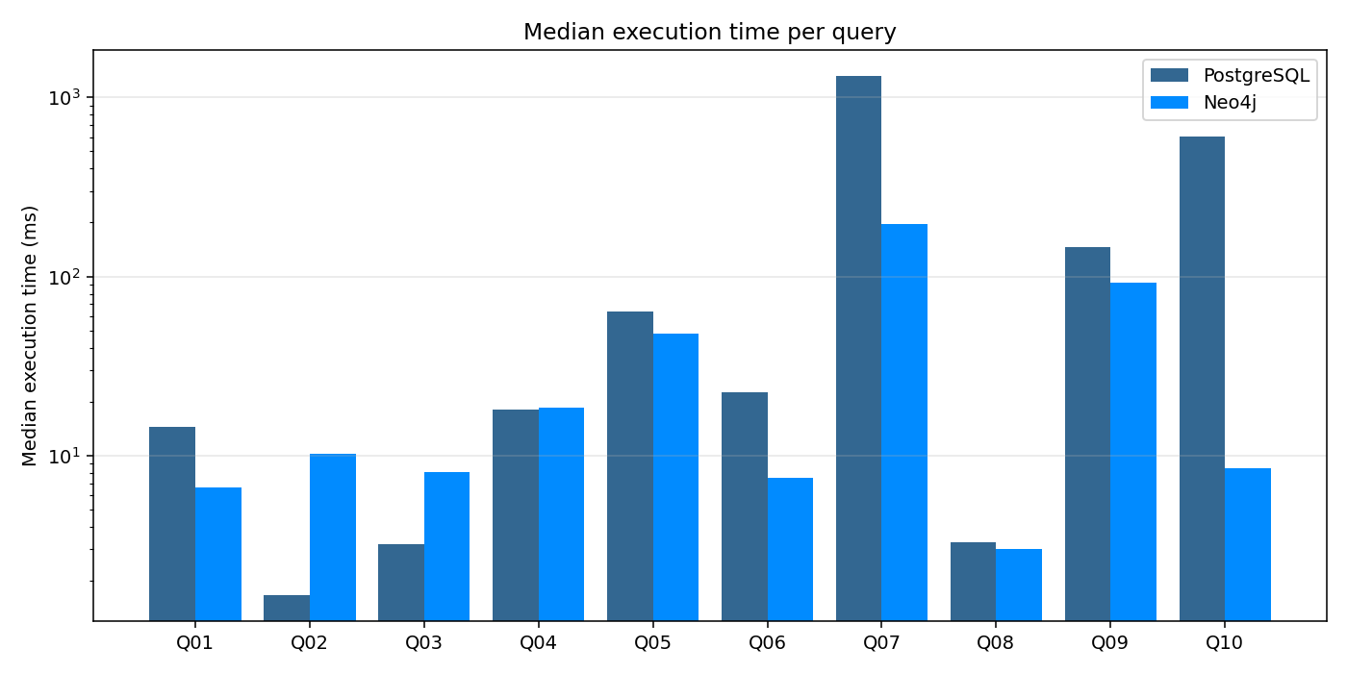
Performance per query
Execution time, log scale — lower is better
Postgres wins where the planner shines: small joins and aggregations (Q02, Q03). Neo4j wins where data is naturally a graph (Q07, Q10).
DM 2025/26 · D'Angelica & Leone · PostgreSQL vs Neo4j
13 / 23
Notes:
Per-query timing chart. 'Log scale. Postgres wins the leftmost group (A — small joins, OLAP-ish). Neo4j dominates on the right (graph-native).'

Slide 14
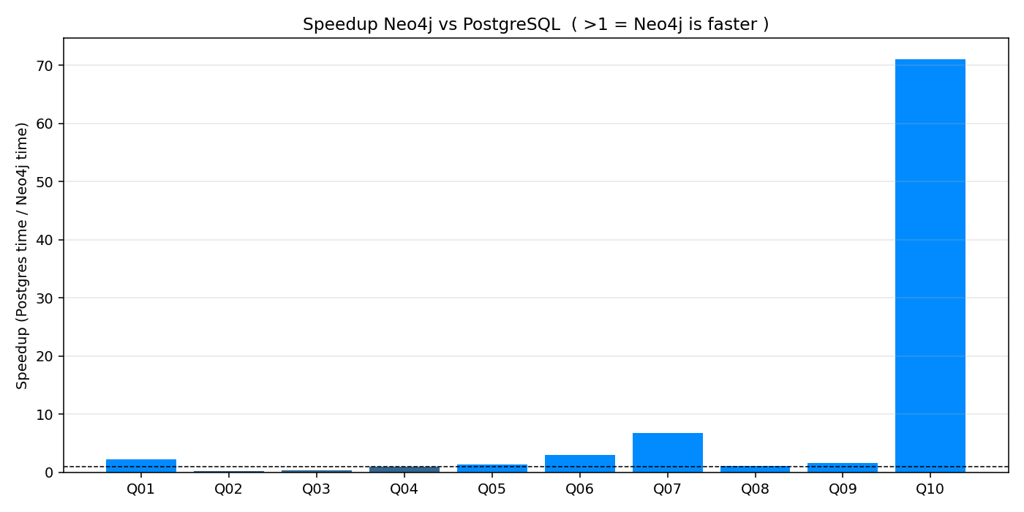
Speedup analysis
Postgres time ÷ Neo4j time — bars above 1 = Neo4j is faster
Q10 — shortest path
76x
faster on Neo4j
Postgres: 750 ms | Neo4j: 10 ms
DM 2025/26 · D'Angelica & Leone · PostgreSQL vs Neo4j
14 / 23
Notes:
Speedup chart. 'Bars above 1 = Neo4j is faster. Q10 is the dramatic case — over 75x.'

Slide 15
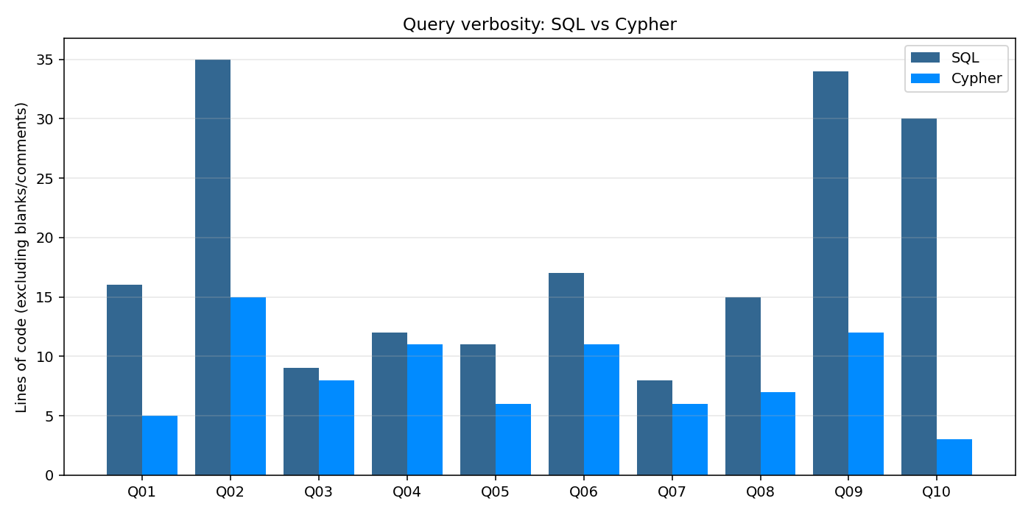
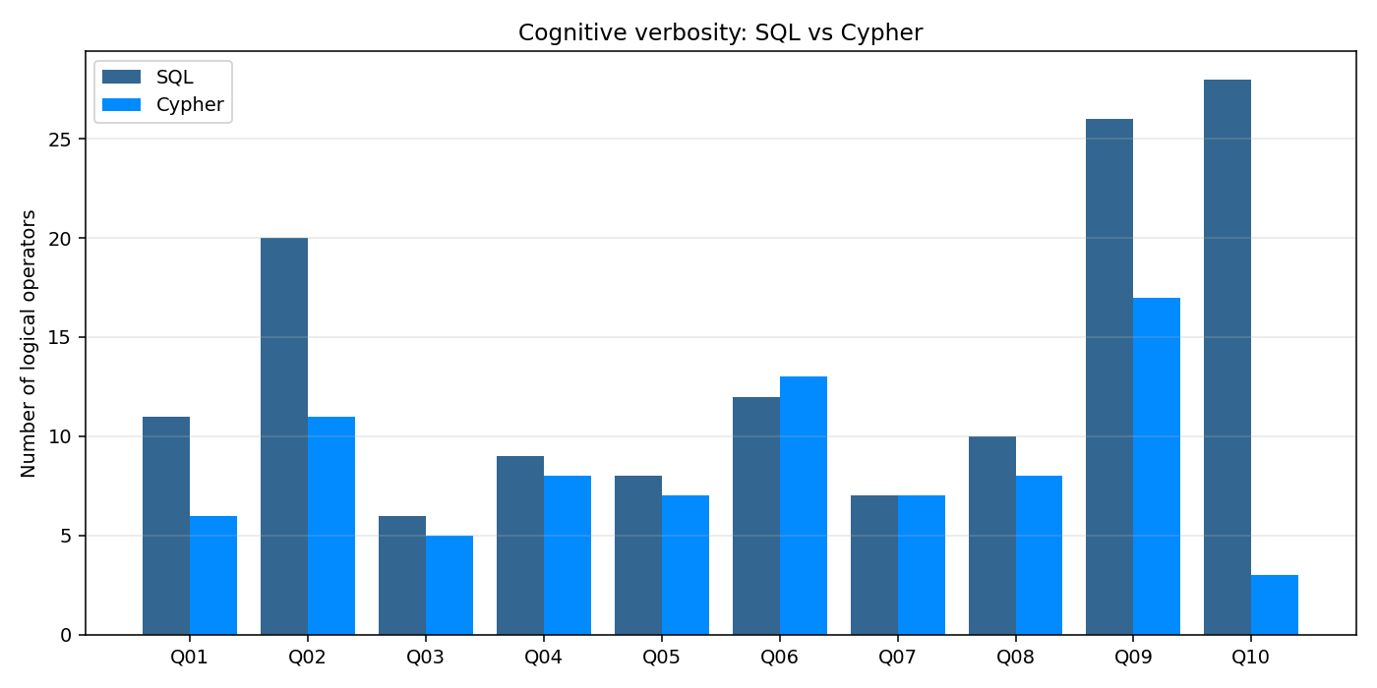
Code expressiveness — two dimensions
How long is the query? How many logical operators does it use?
Lines of code (LOC)
Cognitive verbosity (operators)
Q10: 30 SQL lines vs 3 Cypher lines (10×) · 28 SQL operators vs 3 Cypher operators (9.3×). Cypher wins on both axes — and dramatically.
DM 2025/26 · D'Angelica & Leone · PostgreSQL vs Neo4j
15 / 23
Notes:
Code expressiveness. 'Two dimensions: lines (vertical space) and operators (cognitive load). Q10 — 30 lines vs 3, 28 operators vs 3. This is what reads as ELEGANT.'

Slide 16
Q10 — Shortest path: a tale of two languages
Same question, two paradigms
PostgreSQL — recursive CTE (BFS)
Neo4j — built-in shortestPath()
WITH RECURSIVE
played_for AS (
SELECT DISTINCT l.player_api_id,
CASE WHEN l.side='home' THEN m.home_team_api_id
ELSE m.away_team_api_id END t,
m.season
FROM match_lineup l JOIN match m USING (match_api_id)
),
bfs (player_api_id, distance) AS (
SELECT src, 0 FROM endpoints
UNION
SELECT pf2.player_api_id, b.distance + 1
FROM bfs b
JOIN played_for pf1 ON pf1.player_api_id = b.player_api_id
JOIN played_for pf2 ON pf2.t = pf1.t
AND pf2.season = pf1.season
AND pf2.player_api_id <> b.player_api_id
WHERE b.distance < 6
)
SELECT MIN(distance) FROM bfs ...
MATCH
(a:Player {name: $player_a}),
(b:Player {name: $player_b})
MATCH path = shortestPath(
(a)-[:PLAYED_FOR*..12]-(b)
)
RETURN length(path) / 2 AS hops;
30 lines → 3 lines
750 ms → 10 ms
28 ops → 3 ops
DM 2025/26 · D'Angelica & Leone · PostgreSQL vs Neo4j
16 / 23
Notes:
Q10 code side-by-side. Read briefly: 'A recursive CTE doing BFS — versus shortestPath, a primitive in Cypher. Same answer, two orders of magnitude difference. Note: we use *..12 in Cypher because PLAYED_FOR is directional and we want exactly 6 player-to-player hops to match the SQL limit.'

Slide 17
Q12 — Schema evolution
Add a new attribute to every Match
PostgreSQL — DDL + DML, two steps
Neo4j — schemaless, one step
-- Step 1: change the schema
ALTER TABLE soccer.match
ADD COLUMN total_goals SMALLINT;
-- Step 2: backfill the new column
UPDATE soccer.match
SET total_goals = home_team_goal
+ away_team_goal;
// Just SET the new property — no DDL,
// no migration step, no row-by-row UPDATE.
MATCH (m:Match)
SET m.totalGoals = m.homeGoals
+ m.awayGoals;
Schema-on-write (Postgres) vs schema-on-read (Neo4j) — two steps and a brief table lock vs a single SET. The cost is the same in CPU, but very different in change-management.
DM 2025/26 · D'Angelica & Leone · PostgreSQL vs Neo4j
17 / 23
Notes:
Q12 schema evolution. 'In Postgres: ALTER + UPDATE — two statements, lock during ALTER. In Neo4j: ONE statement. This is the schema-flexibility dimension OFTEN forgotten in performance benchmarks.'

Slide 18
Indexes are an engineering choice
Drop one critical index, watch the world burn
We ran Q08 (teammates of Messi) three times on each system: with the index, without, and with it back.
PostgreSQL — Q08
Neo4j — Q08
Index dropped:
Index dropped:
ix_lineup_player
player_name_idx
With index
Without index
With index
Without index
3.6 ms
11.3 ms
5.1 ms
7.8 ms
(measured · 5 runs median)
(measured · 5 runs median)
Postgres: 3.18× slowdown without ix_lineup_player · Neo4j: 1.55× slowdown without player_name_idx
DM 2025/26 · D'Angelica & Leone · PostgreSQL vs Neo4j
18 / 23
Notes:
Index ablation. Real numbers: 'Drop ix_lineup_player from Postgres: 3.6 ms → 11.3 ms, 3.18x slowdown. Drop player_name_idx from Neo4j: 5.1 → 7.8 ms, 1.55x slowdown. Indexes are NOT decoration.'

Slide 19
Conclusions
Three takeaways from twelve queries
Postgres still wins where Postgres has always won
1
Pure aggregations and small-fan-out joins (Q02, Q03) — its planner has 30 years of optimisation that no graph engine matches.
Neo4j wins on graph workloads — by an order of magnitude
2
Multi-hop traversal, shortest path, presence-in-all-of: Q07 (6.4×), Q10 (76×). And the Cypher code is dramatically more concise.
Schema flexibility is a forgotten dimension
3
Adding a new attribute is one statement in Neo4j vs ALTER + UPDATE in Postgres. In change-heavy environments this matters more than raw ms.
DM 2025/26 · D'Angelica & Leone · PostgreSQL vs Neo4j
19 / 23
Notes:
Three takeaways. Read each. 'These are the three answers to the research question we asked on slide 2.'

Slide 20
Limitations & future work
What the benchmark does not measure
Single-node, single-user
We measured in-memory, sequential workload. Concurrent reads/writes, lock contention, and MVCC under load are out of scope.
No tuning
Both engines run on default configuration. Tuning shared_buffers / work_mem (Postgres) or pagecache.size (Neo4j) could shift results.
Dataset scale
917k events, 542k lineup rows — medium scale. LDBC-SNB-style synthetic graphs at 10× would stress Neo4j's traversal advantage further.
Future directions
Postgres: 3.25× slowdown without ix_lineup_player · Neo4j: 2.32× slowdown without player_name_idx
Add OLTP write-heavy workload, test on PostgreSQL Citus (sharded) vs Neo4j Fabric, evaluate hybrid polyglot architectures.
DM 2025/26 · D'Angelica & Leone · PostgreSQL vs Neo4j
20 / 23
Notes:
Limitations. 'A good engineer says what they did NOT measure. Concurrent workload, tuning, scale — these are the next steps.'

Slide 21
Verdict
Specialised tools for distinct problems
Choose PostgreSQL when…
Choose Neo4j when…
ACID transactions and strict integrity matter
Data is naturally a graph (people, places, events, networks)
Reporting and OLAP-style aggregations dominate the workload
Queries traverse relationships (paths, neighbourhoods, communities)
The schema is stable and well understood
The schema evolves frequently and unpredictably
You need vertical scaling on a single, well-tuned node
You need expressive query syntax for non-developers
21 / 23
Notes:
Verdict. Read both columns. 'In production, you often use BOTH — polyglot persistence.'

Slide 22

Thank you
Live demo time →
Repository (Giuseppe): github.com/g1up3
Repository (Nicolas): github.com/theunick
Reports: reports/benchmark_report.md · reports/dataset_exploration.md
Scan for repo
22 / 23
Notes:
References. We grounded our work in the literature: Angles & Gutierrez for the survey, Vicknair for the first major comparison study, Holzschuher for query language analysis, LDBC for standardisation, Robinson for the canonical textbook.

Slide 23
References
Related work in graph and relational benchmarking
Angles, Gutierrez (2008)
Survey of Graph Database Models. ACM Computing Surveys, 40(1).
Vicknair et al. (2010)
A Comparison of a Graph Database and a Relational Database. ACM SE 2010.
Holzschuher, Peinl (2013)
Performance of Graph Query Languages. EDBT/ICDT Workshops.
Erling et al. (2015) · Robinson et al. (2015)
Postgres: 3.25× slowdown without ix_lineup_player · Neo4j: 2.32× slowdown without player_name_idx
LDBC Social Network Benchmark (SIGMOD) · Graph Databases, 2nd ed. (O'Reilly).
DM 2025/26 · D'Angelica & Leone · PostgreSQL vs Neo4j
23 / 23
Notes:
Thank you. Live demo follows: shortest path Messi → Pirlo, then Q02 (Postgres wins), then schema evolution Q12. About 5 minutes total.

