Slide 1

Stanford University
STATS--PHD

Slide 2

01
Program Overview
Introduction
Rank: #1 in Statistics
Locations: Stanford, California
Website: https://bulletin.stanford.edu/programs/STATS-PHD
Application deadline for PhD Autumn Quarter 2025 is Wednesday, December 4, 2024 (11:59PM PST).
The department looks for students who wish to prepare for either applied or theoretical research careers in statistics or probability.
Entry advice: Advanced undergraduate or master’s level work in mathematics and statistics provides a good background for the doctoral program. Quantitatively oriented students with degrees in other scientific fields are also encouraged to apply for admission.

Slide 3

02
Financial Aid & Support
Please note that requesting financial aid on the application form will not affect your chances of being admitted to the Statistics PhD program. Prospective students should review the estimated expenses associated with graduate study at Stanford.
Students accepted to the PhD program are offered financial support. All tuition expenses are paid, and a fixed monthly stipend is determined to be sufficient to pay living expenses. For students in good standing, financial support can be continued for five years, department resources permitting. The resources for student financial support derive from funds made available for student teaching and research assistantships. Students receive both a teaching and research assignment each quarter, which do not exceed 20 hours together.
Students are encouraged to apply for outside scholarships, fellowships, and other financial support.

Slide 4
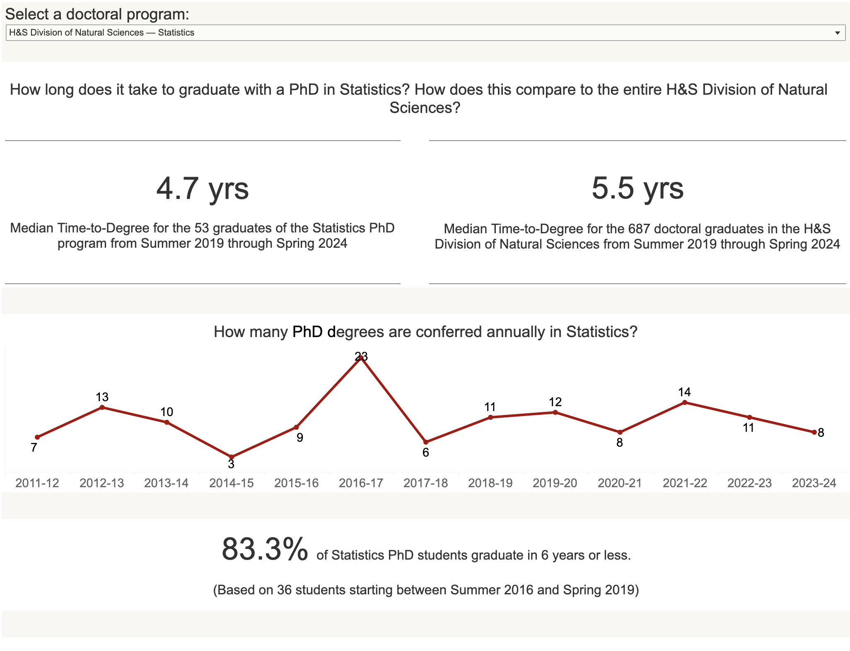
03
Graduation Situation
83.3% of Statistics PhD students can graduate in 6 years or less!
The Meidan Time-to-Degree for the 53 graduates of the Statistics PhD program from 2019 through Spring 2024 is 4.7 years.

Slide 5
04
Procedure--What do we need to submit?
1. Academic Background:
Advanced undergraduate or master's-level coursework in mathematics and statistics is recommended.
Applicants from other quantitative fields (e.g., computational biology, mathematical finance, information science) are encouraged if they have a strong quantitative background​
2. GRE Scores:
The GRE General Test is required, with no specific minimum score. However, successful applicants often have high scores, averaging in the 92nd percentile for Verbal, 94th for Quantitative, and 83rd for Analytical Writing​.
The GRE Math Subject Test is optional starting May 2024, but submitted scores will be considered.
3. TOEFL Scores (for non-native English speakers):
A minimum TOEFL iBT score of 100 is required. Students with scores below 109 may need additional English placement testing.
The average TOEFL score of admitted applicants is around 112​
4. Transcripts and GPA:
A GPA of at least 3.5 is strongly recommended, although there is no strict minimum.
5. Statement of Purpose:
Applicants must provide a clear statement of research interests and motivations for pursuing a PhD in Statistics.
6. Letters of Recommendation:
Typically, three strong recommendation letters are required.
7. Additional Application Materials:
A resume or CV, along with any other supporting materials, may be requested.

Slide 6
05
Program Requirements
Students are required to:
1. Master the material in the prerequisite courses
2. Pass the first-year core program
3. Attempt all three parts of the qualifying examinations and show acceptable performance in at least two of them (end of 1st year)
4. Confirm a principal dissertation research advisor and file for candidacy (early spring quarter of 2nd year)
5. Satisfy the depth and breadth requirements (2nd/3rd/4th year)
6. Successfully complete the thesis proposal meeting and submit the Dissertation Reading Committee form (winter quarter of the 3rd year)
7. Present a draft of their dissertation and pass the university oral examination (4th/5th year)
The PhD requires a minimum of 135 units. Students are required to take a minimum of nine units of advanced topics courses (for depth) offered by the department (not including literature, research, consulting or Year 1 coursework), and a minimum of nine units outside of the Statistics Department (for breadth). Courses for the depth and breadth requirements must equal a combined minimum of 24 units. In addition, students must enroll in STATS 390 Statistical Consulting, taking it at least twice.

Slide 7

HARVARD UNIVERSITY
Harvard University is a private Ivy League research university in Cambridge, Massachusetts, United States. Founded October 28, 1636, and it is the oldest institution of higher learning in the United States. Its influence, wealth, and rankings have made it one of the most prestigious universities in the world.
The department of Statistics ranked 3rd in the U.S. Founded in 1957, the deep interplay between application, computation, and theory is the cornerstone of our community, as well as the backbone of data science.

Slide 8

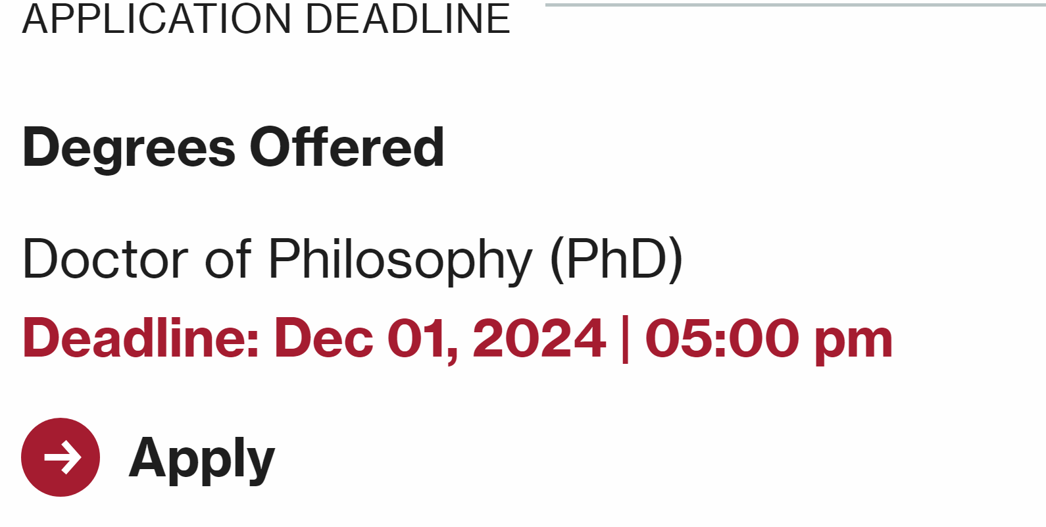

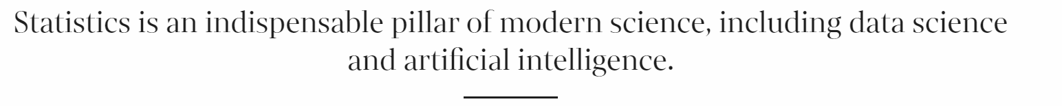
Department of Statistics
PHD in Statistics
MA in Statistics (not accept outer applications since 2017)
Admission decision will be made by Committee.

Slide 9
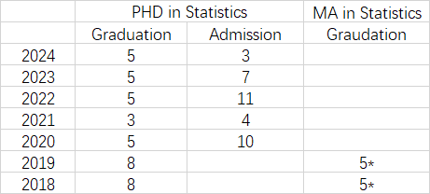

Admission Requirements Financial Aid
Graduation Data
Tuition Fee
First 2 years: Full Time, $55,656/ year
Financial Aid will cover all the tuitions and other expenses ($4500/month).
English Proficiency
Waive;
IELTS ≥ 6.5 / TOEFL(iBT) ≥ 80
Resume (Required)
Personal Statement: ≤ 500 words, Required.
Statement of Purpose: ≤ 1000 words, Required.
Standardized Tests:
GRE General (Optional)
GRE Subject: (Optional)
Academic Background:
Requirements: Linear Algebra, Advanced Calculus.
Measure Theory and Analysis will be helpful to the application.
Have the experience of statistical computational and simulation.
Recommend Letter:
3 Letters
Submit before Deadline.

Slide 10
PHD Program Timeline
Course Requirement:
PHD Qualification Test:
Theory Test: STAT210~213 Course, waive if all get A- or above. (G2 Spring Examination)
Applications: STAT305 course & presentation, or 30 min presentation before G3 spring.
Oral Presentation: 30 minutes G2 year
Quitted this program if any one of tests are not passed.
Post-Qualifying Talks (Research Presentation): Introducing the previous research and progress.
Dissertation: G3 year, submit the topic of essay to supervisor. & Abstract (1 page).
Dissertation Defence:
4 weeks ago: submit draft version. Start from G3
In G6 or higher, at least report the progress to supervisor yearly.
Application to PHD Degree: November, February, May
Source: https://gsas.harvard.edu/policy/statistics

Slide 11
Future Development
Faculty Position:
Stanford
Upenn
Berkeley
JHU
Carnegie Mellon University
Columbia University
GIT
…
Career Development:
Google
Apple
Etsy
Citedal
Boston Red Sox
…

Slide 12


Slide 13
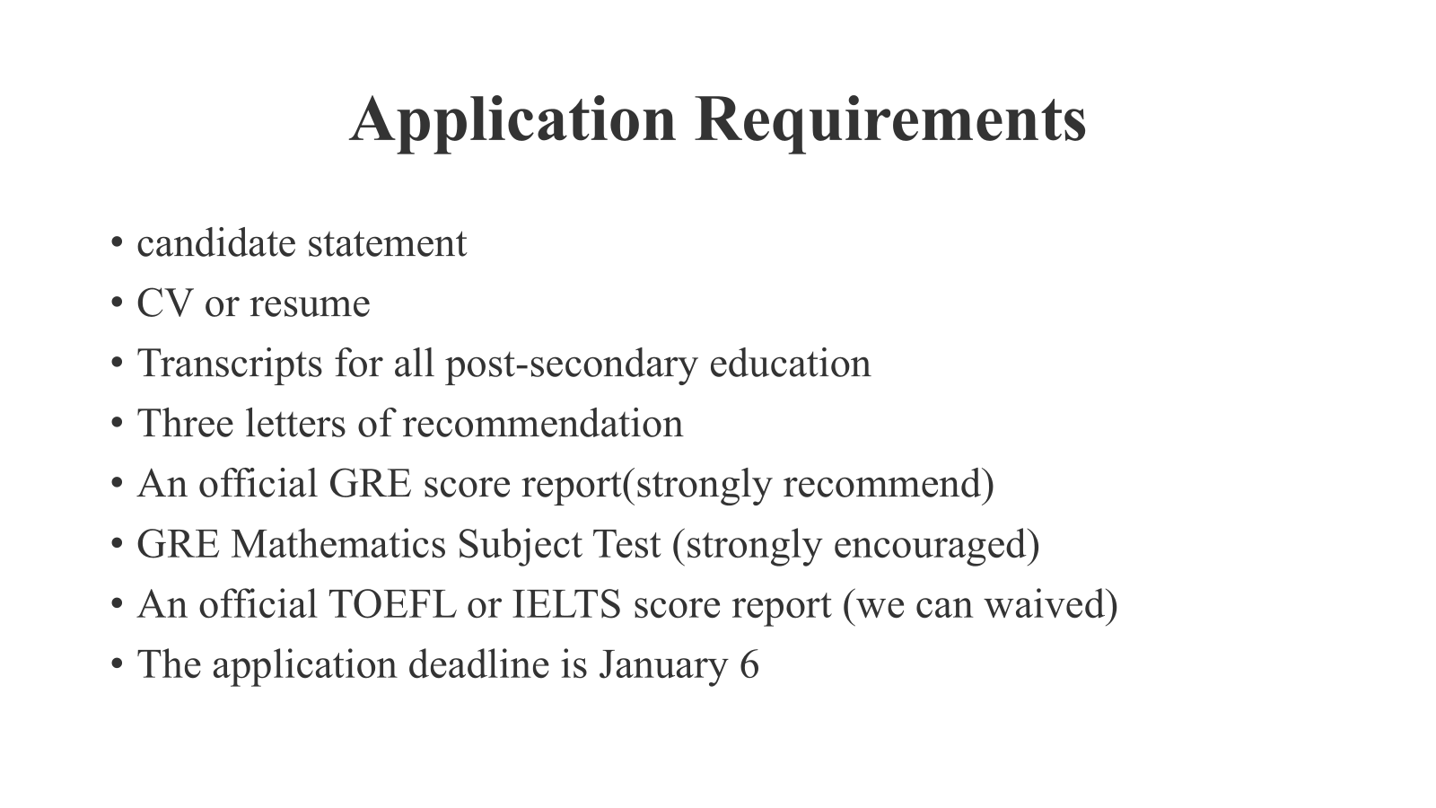

Slide 14
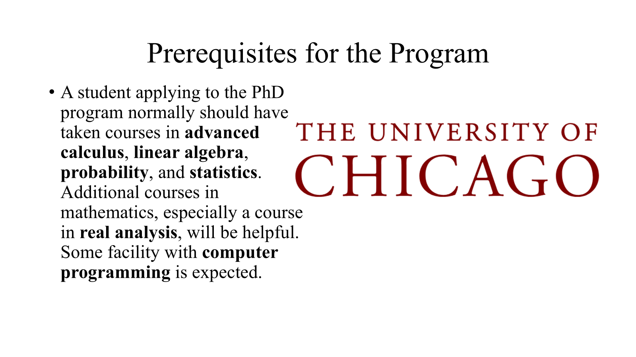

Slide 15
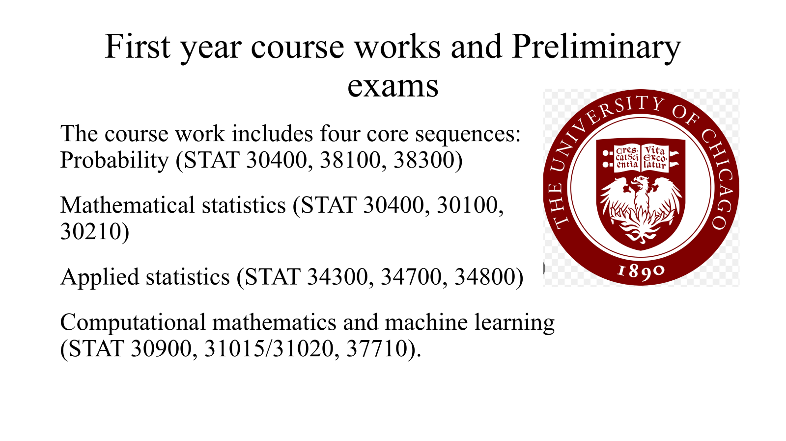

Slide 16
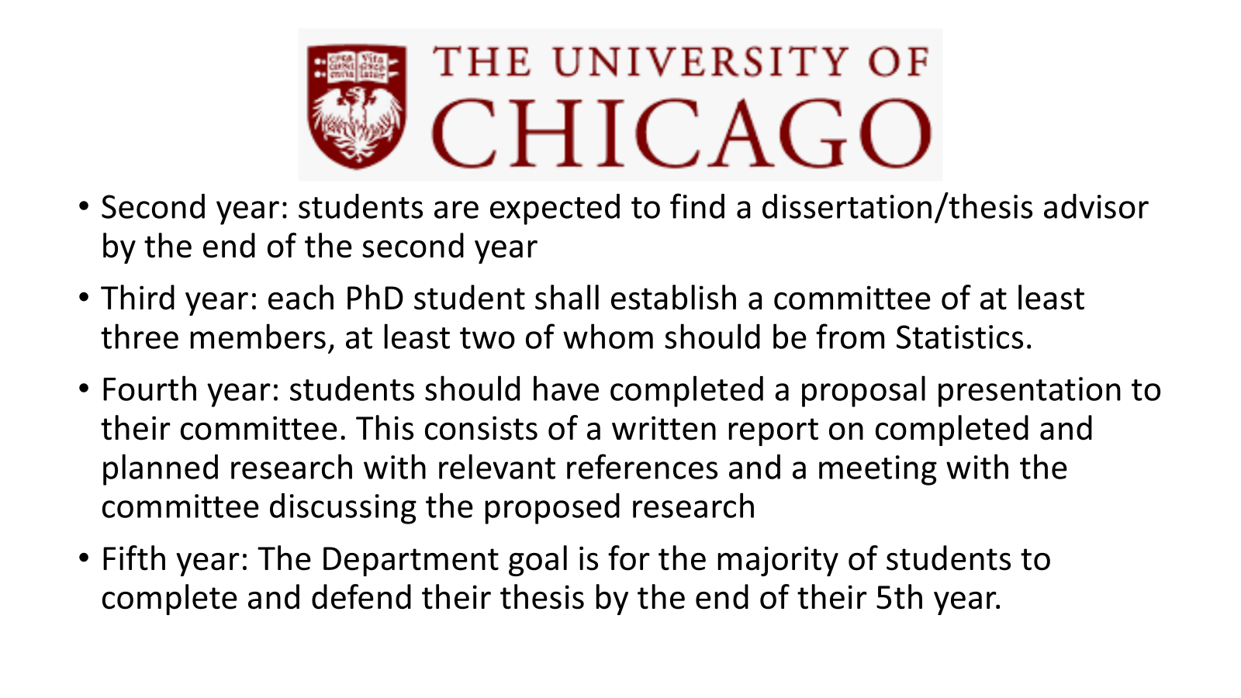

Slide 17

Columbia University
https://stat.columbia.edu/

Slide 18
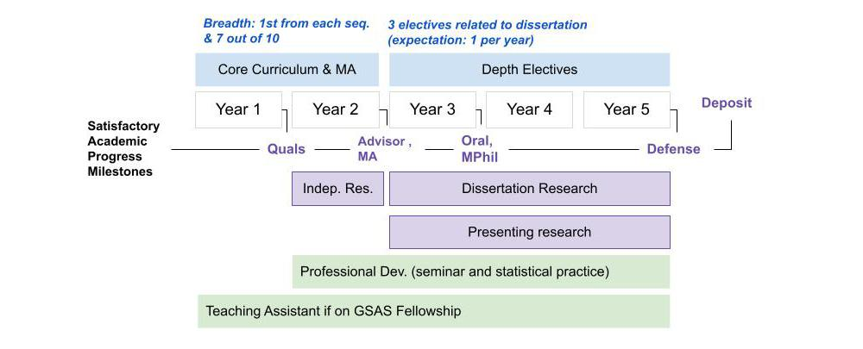
PhD Program Overview
The PhD program prepares students for research careers in probability and statistics in academia and industry. Students admitted to the PhD program earn the MA and MPhil along the way. The first year of the program is spent on foundational courses in theoretical statistics, applied statistics, and probability. In the following years, students take advanced topics courses. Research toward the dissertation typically begins in the second year. Students also have opportunities to take part in a wide variety of projects involving applied probability or applications of statistics.
By the end of year 1: passing the qualifying exams
By the end of year 2: fulfilling all course requirements for the MA degree and finding a dissertation advisor
By the end of year 3: passing the oral exam (dissertation prospectus) and fulfilling all requirements for the MPhil degree
By the end of year 5: distributing and defending the dissertation

Slide 19
Requirment
Suggested Prerequisites: A student admitted to the PhD program normally has a background in linear algebra and real analysis, and has taken a few courses in statistics, probability, and programming. Students who are quantitatively trained or have substantial background/experience in other scientific disciplines are also encouraged to apply for admission.
GRE requirement: Waived for Fall 2024.
Language requirement: The English Proficiency Test requirement (TOEFL) is a Provost's requirement that cannot be waived. 100 (IBT), 600 (PBT) TOEFL, or 7.5 IELTS.
Deadline: Jan 8, 2024
Application process: Please apply by completing the Application for Admission to the Columbia University Graduate School of Arts & Sciences.
Timeline: P.hD students begin the program in September only. Admissions decisions are made in mid-March of each year for the Fall semester.

Slide 20

Generally a specific degree requirement is not stated, so I had to make a subjective selection based on how relevant the master may be to statistics studies
Phd Statistics
Four joint programs: ML, Public policy, Neuroscience, Engineering and Policy. ML and Engineering: indicate after admission to stats phd. The others: indicate when applying for stats phd.
Funding: full tuition + stipend for RA/TA.
December 8 deadline.
Transcripts, statement of purpose, 3 recommendation letters, GRE (optional for stats phd, required for joint), TOEFL/IELTS/DET not required for Columbia students
PhD Operations Research
Deadline 15 December.
A minimum of 3 max 5 recommendation letters (along with evaluation form); at least 1 from academic source, at least 1 from work source if more than 1 year of work experience. GMAT or GRE required. TOEFL, DET, IELTS required.
Funding: if you get it (typically you do) guaranteed for 5 years stipend. No tuition fee as long as in good academic standing
PhD Machine Learning
Early deadline 20 nov; Final deadline 11 dec
GRE optional; TOEFL/IELTS/DET required; statement of purpose 1-2 pages; 3 letters;CV
Funding: tuition waived, stipend from graduate assistantships, which may constrain specific research opportunities.
Other programs in Tepper school of business, less relevant, include:
Business technologies
Economics
Financial Economics

