Slide 1

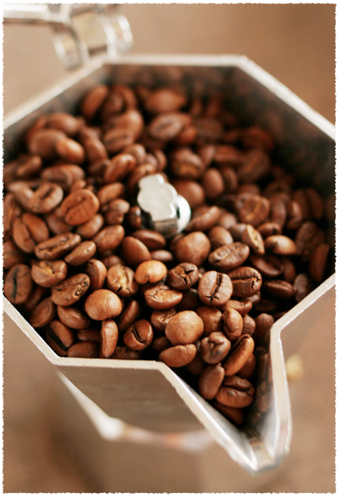

JavaScript
Instructor: 黃國峰

Slide 2








Development
Browser: Chrome, Firefox
編輯器: Sublime
編輯器: Visual Studio Code
網頁動畫: Adobe Edge Animate
遊戲引擎: Unity 3d/MonoDevelop
資料庫: MongoDB
WebServer: Node.js

Slide 3


Web Application
MySql (SQL)
PHP
Asp.NET(C#, VB)
Sql Server (SQL)
Node.js
MongoDB (NoSQL)
Server
JavaScript
JavaScript

Slide 4


程式語言核心概念
變數和資料型態 Variables and Data Types
條件判斷式 Conditionals
迴圈 Loops
陣列 Arrays
函式 Functions
自訂物件 Custom Objects
JSON (JavaScript Object Notation)

Slide 5
Data Types
C/C++
JavaScript
char
string
int (short, long)
float
double
bool
String
Number
Boolean
Array
Object

Slide 6
Variables
C/C++
JavaScript
char Ch=’A’;
unsigned int anInteger;
float fNumber;
double dNumber;
bool YesNot;
var Ch= "A";
var num=1.1;
var num : float=1.1; //unity 3D
var YesNot=true;
var ary=[1, 2, 3];
var obj=new Object();
obj.name="John";
obj.age=20;
var obj = {name: "John", age:20, body:[“happy”, 180]}

Slide 7

Conditional: if
a==1?
true
false
"a等於1"
"a不等於1"

Slide 8
Conditionals
C/C++
if(a==1){
  cout << "a 等於 1";
}
JS
var a=prompt("a=?");
if(a==1){
  console.log("a 等於 1");
}
C/C++
if(a==1 && b=="good"){
  cout << "a, b Good";
}else{
  cout << "a, b Bad";
}
JS
if(a==1 && b=="good"){
  console.log("a, b Good");
}

Slide 9
Comparison Operators
Javascript 多了兩個邏輯比較運算
=== 值與型態都相同傳回true
  var x=5;
  x === "5"
  x === 5
!== 值或型態不同傳回true

Slide 10
Conditional: switch
switch(a)
1
2
default
"a等於1"
"a等於2"
"a不等於1"
...

Slide 11
Conditional: switch
C/C++ (限整數)
switch(a){
  case 1: cout << "a 等於 1";
  break;
  case 2: cout << "a 等於 2";
  break;
  default: cout << "a 不等於 1,2";
}
JS (不限整數)
switch(a){
case "1": msg= "a 等於 1";
break;
case "2": msg= "a 等於 2";
break;
default: msg= "a 不等於 1,2";
}
console.log(msg);
Try it: http://www.w3schools.com/js/tryit.asp?filename=tryjs_switch

Slide 12
Loops
JS
var sum= 0;
for(var i = 0; i<10; i++){
  sum += i;
}
var j = 10;
while(j > 0){
  sum -= j;
  j--;
}
Q: sum=?
JS
var sum=55;
var j = 10;
do{
  sum -= j;
  j--;
} while(j > 0)
Q: sum=?

Slide 13
Arrays
JavaScript
var uArray = new Array(); //Empty Array
var myArray = [1, 2, 3];
//push
myArray.push("str");
//pop
myArray.pop(); //put "str" out
//index
myArray[0]; //output 1
1 | 2 | 3
1 | 2 | 3 | "str"
1 | 2 | 3

Slide 14
Arrays
shift(), unshift()
unshift()
push()
1 | 2 | ... | n
shift()
pop()

Slide 15
Arrays
splice(start, count,...), slice() //串接或切割陣列
concat() //將陣列串在一起
sort() //排序
  compaire function: 決定排序的先後依據
reverse() //反向
forEach(value, index) //尋訪每一個陣列元素

Slide 16
Functions
C/C++
void showNothing(){
  int i=0;
}
string showMsg(){
  return "Hello!";
}
int addTen(int intput){
  return input+10;
}
JS
function showNothing(){
  int i=0;
}
function showMsg(name){
  return "Hello"+name+ "!";
}
function addTen(intput){
  return input+10;
}
Notes:
<!DOCTYPE html>
<html>
<head>
<title>Introduce to HTML</title>
</head>
<body>
<h1>JavaScript<h1>
<script>alert("JS is running!");</script>
</body>
</html>

Slide 17
Custom Objects
var ball= new Object();
ball.weight = 5;
ball.color = "red";
ball.price = 500;
ball.changeWeight = changeWeight;
var ball={weight:5, color:”red”, price:500, changeWeight=changWeight}
function changeWeight(w){
this.weight=w;
}
Q: ball.changeWeight(20); ball.weitht = ?

Slide 18
Date Objects
  var today = new Date()
  var d1 = new Date("October 13, 1975 11:13:00")
  var d2 = new Date(10000000)//milliseconds since 1970/01/01 0:0:0
  var d3 = new Date(2014,0,24,11,33,0,200)//2014年1月24日11點33分0秒200毫秒
  if(d1 > d2) console.log("d1>d2");
getFullYear()
getTime()//milliseconds
getDay(), getHours(), getMinutes(), getSeconds()

Slide 19
Math Object
Properties
  E, LN2, LN10, LOG2E, LOG10E, PI, SQRT2
Methods
  abs(), acos(), asin(), atan(), ceil(), cos(), exp(), floor(), log(), max(), min(), pow(), random(), round(), sin(), sqrt(), tan()

Slide 20
Custom Class
var Node = function(p, n){
var price=p;
var name=n;
var next;
this.print = function(){
console.log(name);
}
}
var root = new Node(1,"one");
root.print();

Slide 21
Regular Expression: RegExp
http://www.w3schools.com/jsref/jsref_obj_regexp.asp
http://www.w3schools.com/js/js_regexp.asp
宣告
  var patt=new RegExp(pattern,modifiers);
  var patt=/pattern/modifiers;//i: case-insensitive, g: global match, m: multi line
Example:
  var pat1=/^[A-Z]\d{9}/i //第一個字為A-Z(i:不分大小寫)接著9個數字
  var pat2=/o/g; //g: global matching
  var str="Hello world!";
  pat2.test(str); //return true
  pat1.exec(str); //return '' (null)

Slide 22
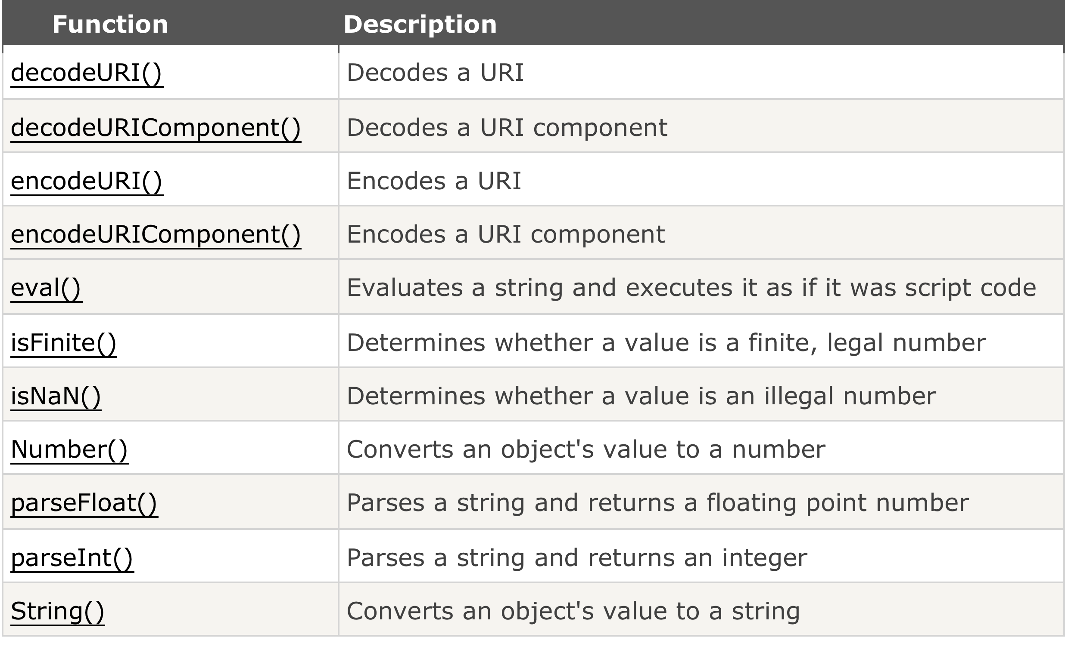
Global Functions

Slide 23


JS Libraries
JQuery
JQueryUI
Browser版本相容性
跨平台
Html5, CSS3

Slide 24
Excercise
請輸入一實數，然後計算出其平方根
輸入0~100之間的一個成績(整數)，若成績在90~100則顯示A，80~89顯示B， 70~79顯示C， 60~69顯示D，60以下顯示E(分別用if else …及switch實作 OR 查表法)
輸入a, b, c的值，然後解出ax² + bx + c = 0中x的值，若根為複數，亦必須印出（如2+3i)
輸入n個數值，分別計算其平均值及標準差
練習RegExp範例，並說明其用途:
  var USER_Pat = /^[a-zA-Z0-9_-]{3,20}$/;
  var PASS_Pat = /^.{3,20}$/;
  var EMAIL_Pat = /^[\S]+@[\S]+\.[\S]+$/;

Slide 25

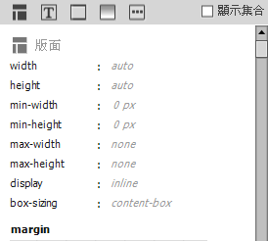
Review HTML/CSS by Dreamweaver CC
版面
文字
邊框
背景
其他

Slide 26
JQuery
jQuery is a JavaScript Library（程式庫）
簡化JS程式碼
易學
語法
  $(selector).action()
  ＄：JQuery
  selector: 選擇html元素，#id, .class, tag
  action() 如：特效fadeOut(), show(), hide(), html(), val(), addClass(), removeClass()

Slide 27
Javascript
JQuery
$(function(){
$("#masthead").mouseover(function(event) {
$("#nav").hide();
});
});
Inline
  <div id="masthead" onmouseover="style.visibility='hidden'">
  Internal
<script>
function hideNav(){
document.getElementById("nav").style.visibility="hidden";
};
</script>
  <div id="masthead" onmouseover="hideNav()">
External
<script src="abc.js"/>

Slide 28
JQuery Install
Download jquery.js
  <head>
  <script src="jquery-1.11.1.min.js"></script>
  </head>
CDN (Content Delivery Network)
  <head>
  <script src="http://ajax.googleapis.com/ajax/libs/jquery/1.11.1/jquery.min.js"></script>
  </head>

Slide 29
JQuery Events
html: <button id="btn" onclick="myFunction"/>
JQuery: use callback function
  $("#btn").click(function(){
  $(this).hide();
  });
http://www.w3schools.com/jquery/jquery_events.asp
Mouse Events | Keyboard Events | Form Events | Document/Window Events
click | keypress | submit | load
dblclick | keydown | change | resize
mouseenter | keyup | focus | scroll
mouseleave |  | blur | unload

Slide 30
JQuery Effects
jQuery Hide/Show: $("p").hide(); $("p").show();
jQuery Fade: $("p").fadeIn(); fadeOut(), fadeToggle(), fadeTo()
jQuery Slide: slideDown(), slideUp(), slideToggle()
jQuery Animate: $(selector).animate({params},speed,callback);
jQuery stop(): $(selector).stop(stopAll,goToEnd);停止特效或動畫
jQuery Chaining: $("p").slideUp(1000).slideDown(2000);

Slide 31
JQuery HTML
取得或改變HTML元素的內容
text()：純文字
html()：含html語法的文字
val()：欄位值，如<input id="input1"/>, $("#input1").val()
在等號右邊為取出值，將新內容放在函式參數內為改變現有的內容
var inStr = $("#input1").val();
$("#input1").val( "abcde");

Slide 32
JQuery 動態增減HTML
Add
  $("body").append("<p>Good!</p>");
  prepend(), after(), before()
Remove
$("p").remove() 本身及子元件均移除
$("body").empty() 僅移除子元件

Slide 33
JQuery 動態增減class
Add
  $("#menu1").addClass("active");
Remove
$("#menu1").removeClass("active");

Slide 34
JQuery 動態改變CSS
單一屬性
$("p").css("propertyname","value");
多屬性（使用JSON)
css({"propertyname":"value","propertyname":"value",...});

Slide 35
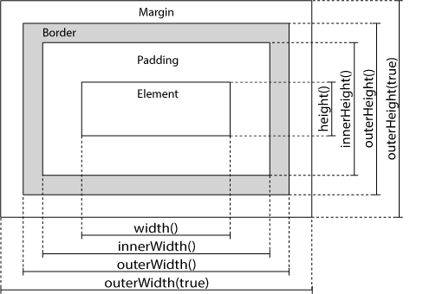
JQuery 取得元素尺寸
source: http://www.w3schools.com/jquery/jquery_dimensions.asp

Slide 36
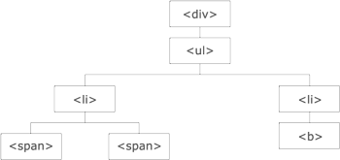
JQuery Traversing
The <div> element is the parent of <ul>, and an ancestor of everything inside of it
The <ul> element is the parent of both <li> elements, and a child of <div>
The left <li> element is the parent of <span>, first child of <ul>
The <span> element is a child of the left <li> and a descendant of <ul> and <div>
The two <li> elements are siblings (they share the same parent)
The <b> element is a child of the right <li> and a descendant of <ul> and <div>

Slide 37
JQuery AJAX
Load: $(selector).load(URL,data,callback); 可載入文字檔取代現有元素內的文字
  Ex: http://www.w3schools.com/jquery/tryit.asp?filename=tryjquery_ajax_load_callback
Get: $.get(URL,callback); 參數含在URL內
Post: $.post(URL,data,callback); data是以JSON編碼的參數
  http://www.w3schools.com/jquery/jquery_ajax_get_post.asp

