Slide 1
Jupyter Widgets

Slide 2









Jupyter Widgets Architecture
Client
Server
Front-end (JavaScript)
Back-end
(Python Kernel)
WebSocket

Slide 3
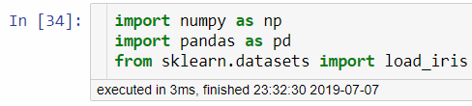
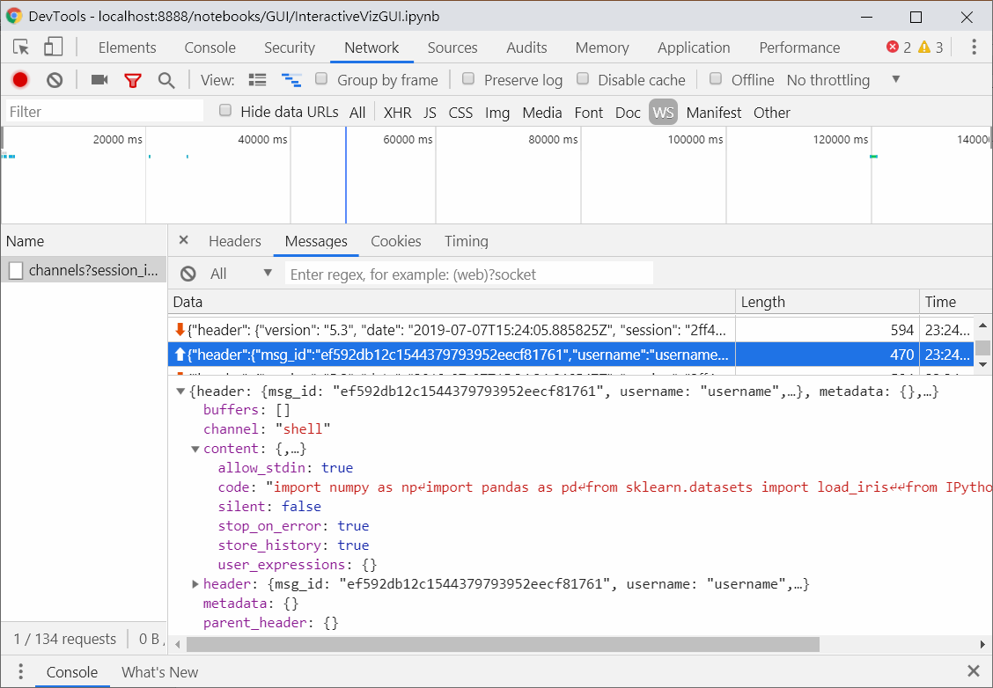
How Jupyter use WebSocket?

Slide 4
Back-end (Python)
from traitlets import Unicode, Bool
from ipywidgets import DOMWidget, register
@register
class Email(DOMWidget):
_view_name = Unicode('EmailView').tag(sync=True)
_view_module = Unicode('email_widget').tag(sync=True)
# Attributes
value = Unicode('Test').tag(sync=True)
disabled = Bool(False).tag(sync=True)

Slide 5
Front-end (JavaScript)
%%javascript
require.undef('email_widget');
define('email_widget', ["@jupyter-widgets/base"], function(widgets) {
var EmailView = widgets.DOMWidgetView.extend({
// Render the view.
render: function() {
this.email_input = document.createElement('input');
this.email_input.value = this.model.get('value');
this.email_input.disabled = this.model.get('disabled');
this.el.appendChild(this.email_input);
// Python -> JavaScript update
this.model.on('change:value', this.value_changed, this);
this.model.on('change:disabled', this.disabled_changed, this);
// JavaScript -> Python update
this.email_input.onchange = this.input_changed.bind(this);
},
value_changed: function() {
this.email_input.value = this.model.get('value');
},
disabled_changed: function() {
this.email_input.disabled = this.model.get('disabled');
},
input_changed: function() {
this.model.set('value', this.email_input.value);
this.model.save_changes();
},
});
return { EmailView: EmailView };
});

