Slide 1

FINANCIAL ANALYTICS & MODELLING
A Data Engineering, Forecasting and Fraud Detection Capstone for Nexus Bank
Gautam Pant (G25AI1019) | Durgesh Pandey (G25AI1018) | Gundlapalli Venkata Suneel Kumar (G25AI1020)
Divya Daiyya (G25AI1017) | Devabhakthuni Vijay Sai Krishna (G25AI1016) — Team 4
Indian Institute of Technology Jodhpur | School of Artificial Intelligence & Data Science
Postgraduate Diploma in Data Engineering • in association with Futurense.uni • July 2026

Slide 2
The Story We're About to Tell
From a six-week brief to a real analytics pipeline, and everything that changed once real data replaced test data
1
2
3
4
The Problem
What We Built
The Twist
The Payoff
Nexus Bank needs price forecasting + fraud detection
An end-to-end pipeline — ingestion to interactive dashboard
Real data changed our fraud model recommendation completely
Honest findings, a working system, and a clear recommendation

Slide 3
The Business Problem
Nexus Bank's analytics division asked us to solve two very different problems
Portfolio Forecasting
Fraud Detection
How is the portfolio behaving day to day?
Which stocks are riskier / more volatile right now?
Can near-term price direction be predicted at all?
Catch fraudulent transactions before real losses occur
Fraud is extremely rare — about 0.17% of transactions
A model with too many false alarms won't be trusted
A continuous, time-dependent forecasting problem
A rare-event classification problem under heavy imbalance

Slide 4
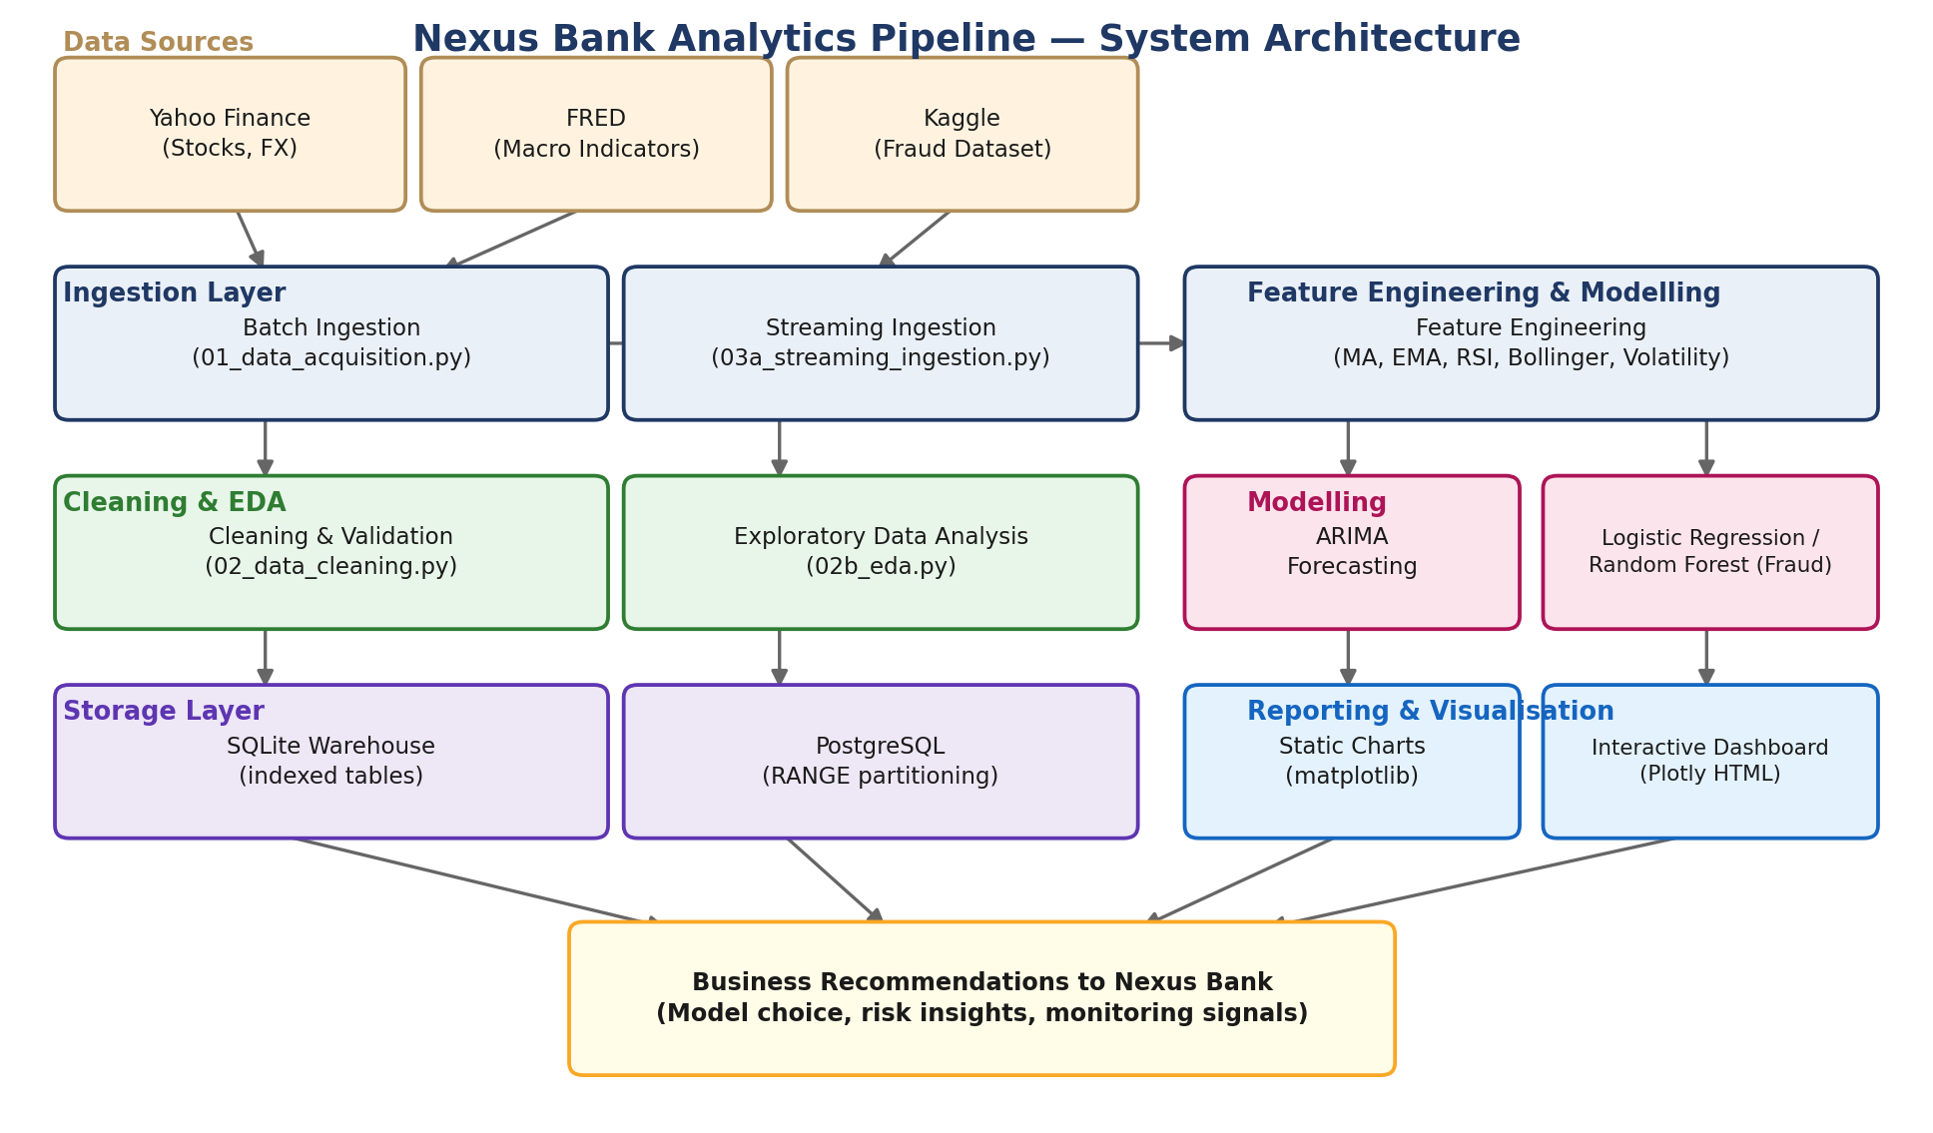
Our Solution: One End-to-End Pipeline
From three raw data sources to business recommendations, all in one automated flow

Slide 5
Real Data, Not Just Realistic Data
Every number in this deck comes from live sources, not synthetic stand-ins
Yahoo Finance
Historical prices — AAPL, MSFT, JPM, XOM, GOOGL (2018–2025)
9,770 rows
Yahoo Finance
FX rates — EUR/USD, GBP/USD, USD/JPY
5,865 rows
FRED
GDP, CPI, Federal Funds Rate
90 monthly rows
Kaggle
Real Credit Card Fraud Detection dataset
283,726 rows, 473 fraud
A real integration snag we hit and fixed: newer yfinance versions return capitalised, sometimes nested column names — normalised immediately after download.

Slide 6
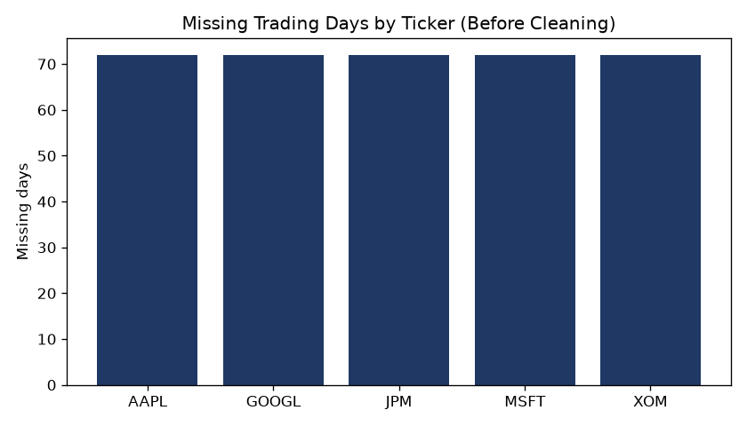
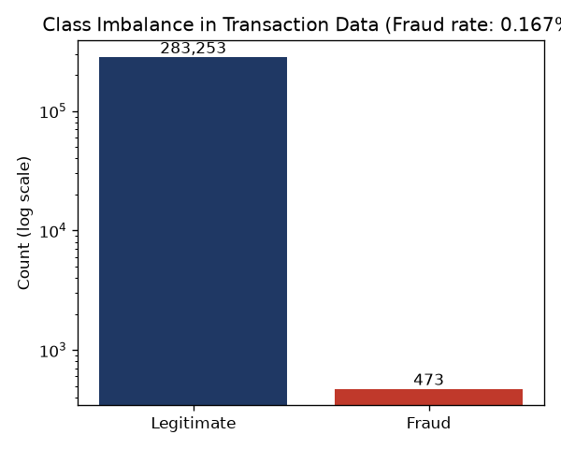
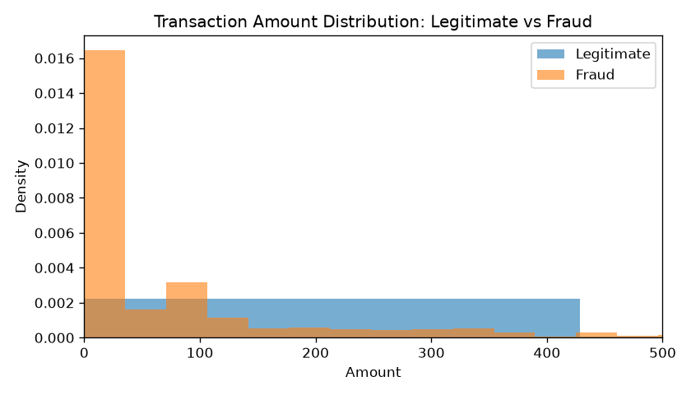
Cleaning & Exploring the Real Data
Looking at the raw shape of the data before touching a single feature
All five tickers were missing exactly 72 of the same trading days — a strong sign this is genuine market structure (shared US holidays), not a data bug.
Our 40%-move outlier rule fired zero times on real data — but correctly caught every planted error in our earlier synthetic test.
1,081 duplicate transactions were found in the real 284,807-row Kaggle file — a genuine data-quality issue our synthetic data never had.

Slide 7
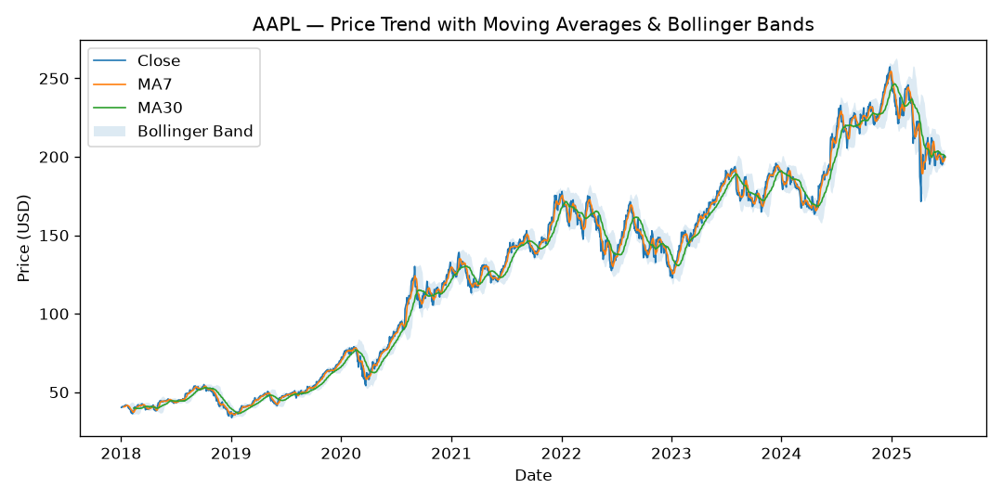
Feature Engineering, Grounded in Theory
Every indicator traces back to a real, citable source — and computed causally, with no look-ahead
Moving Averages (MA7/MA30, EMA)
Smooth day-to-day noise to reveal trend
Bollinger Bands
Bollinger (2001) — bands at ±2σ around a moving average
RSI-14
Wilder (1978) — momentum oscillator, 0–100 scale
Volatility (20-day, annualised)
Standard quant-finance risk measure
Real bug we caught: an early RSI draft used a centred rolling window — a subtle look-ahead bias — found by checking output by hand against Wilder's own textbook example.

Slide 8
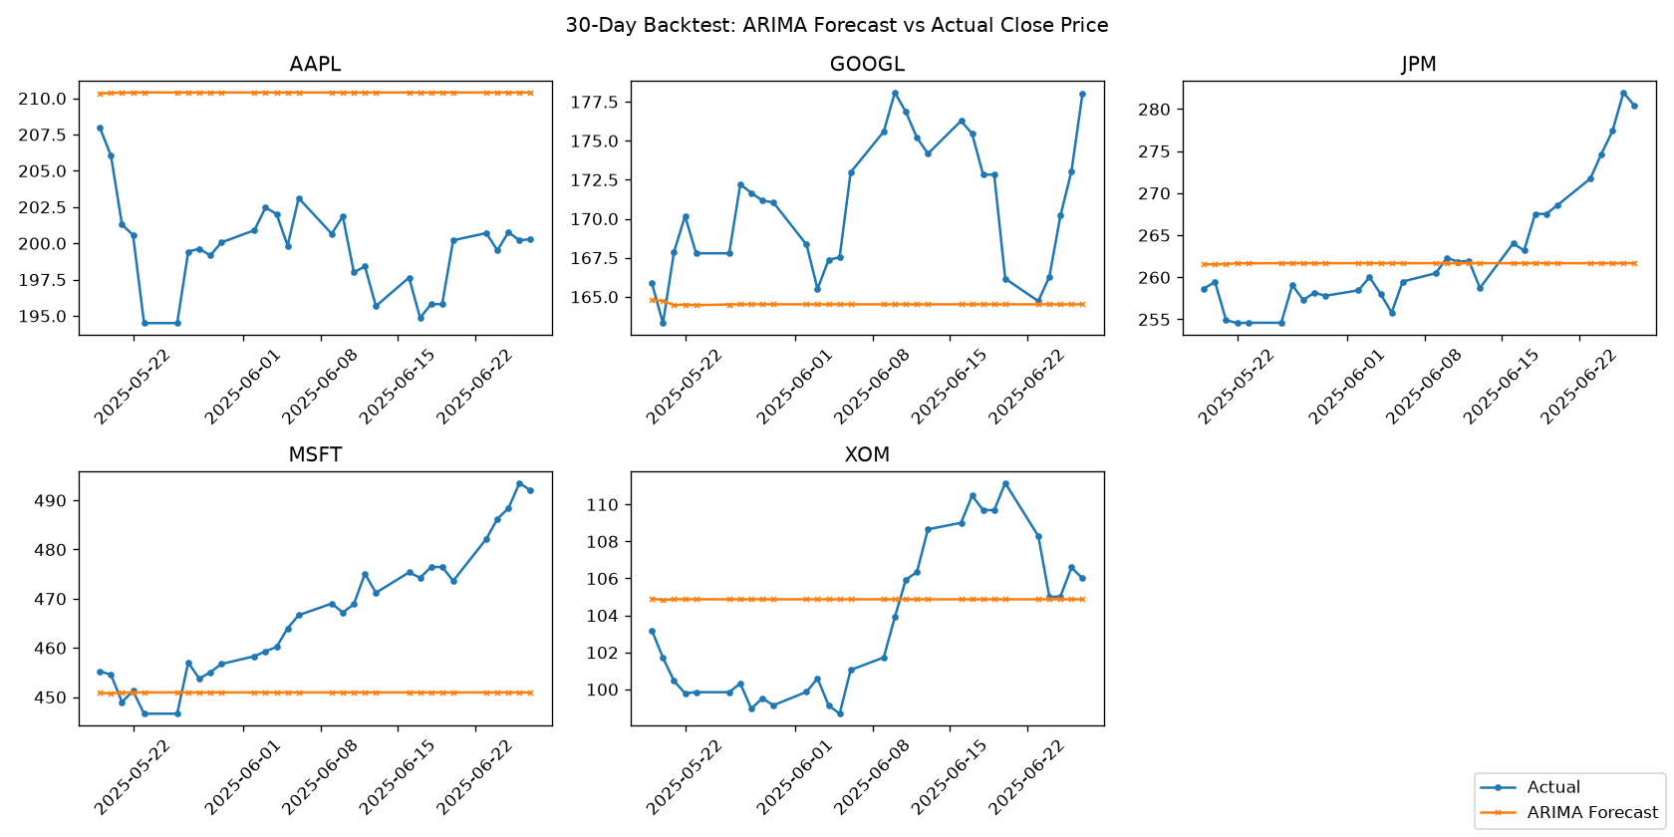
Forecasting: Accurate, But Honestly Flat
ARIMA(5,1,0), walk-forward backtested on 30 real trading days, five tickers
3.67%
Average 30-day MAPE across 5 tickers
The honest finding
Our forecast line comes out nearly flat. Adding a drift term made it worse, not better — on every ticker.
We believe this reflects the Efficient Market Hypothesis (Fama, 1970) — not a bug.

Slide 9
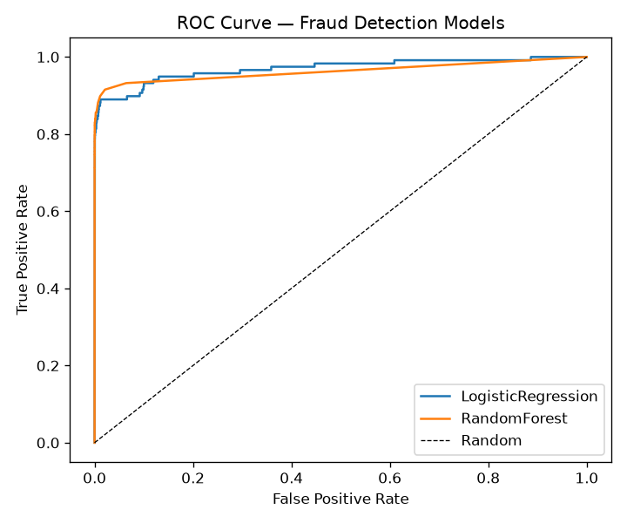
Fraud Detection: The Real-Data Reveal
The single biggest thing that changed once synthetic data was replaced with the real Kaggle dataset
Model
Precision
Recall
ROC-AUC
Logistic Regression
5.5%
89.0%
0.970
Random Forest
92.6%
74.6%
0.963
On synthetic data, both models looked almost perfect (AUC ≈ 1.00).
On real data, Logistic Regression's precision collapsed to 5.5% — 19 of every 20 fraud alerts are false alarms.
Random Forest held up: 92.6% precision, 74.6% recall.
This reversed our recommendation to Nexus Bank.

Slide 10
Business Impact & Our Recommendation
Illustrative estimates built on simple, stated assumptions — not audited financial projections
If Nexus Bank used Logistic Regression
Our Recommendation: Random Forest
A fraud team acting on its alerts would spend the overwhelming majority of their time chasing false alarms — at scale, this is how teams stop trusting alerts altogether.
92.6% precision means the large majority of alerts are genuine fraud — investigation time is spent efficiently, and the model earns the team's trust.
Forecasting model: best used as a monitoring / early-warning signal, not a standalone trading trigger.

Slide 11
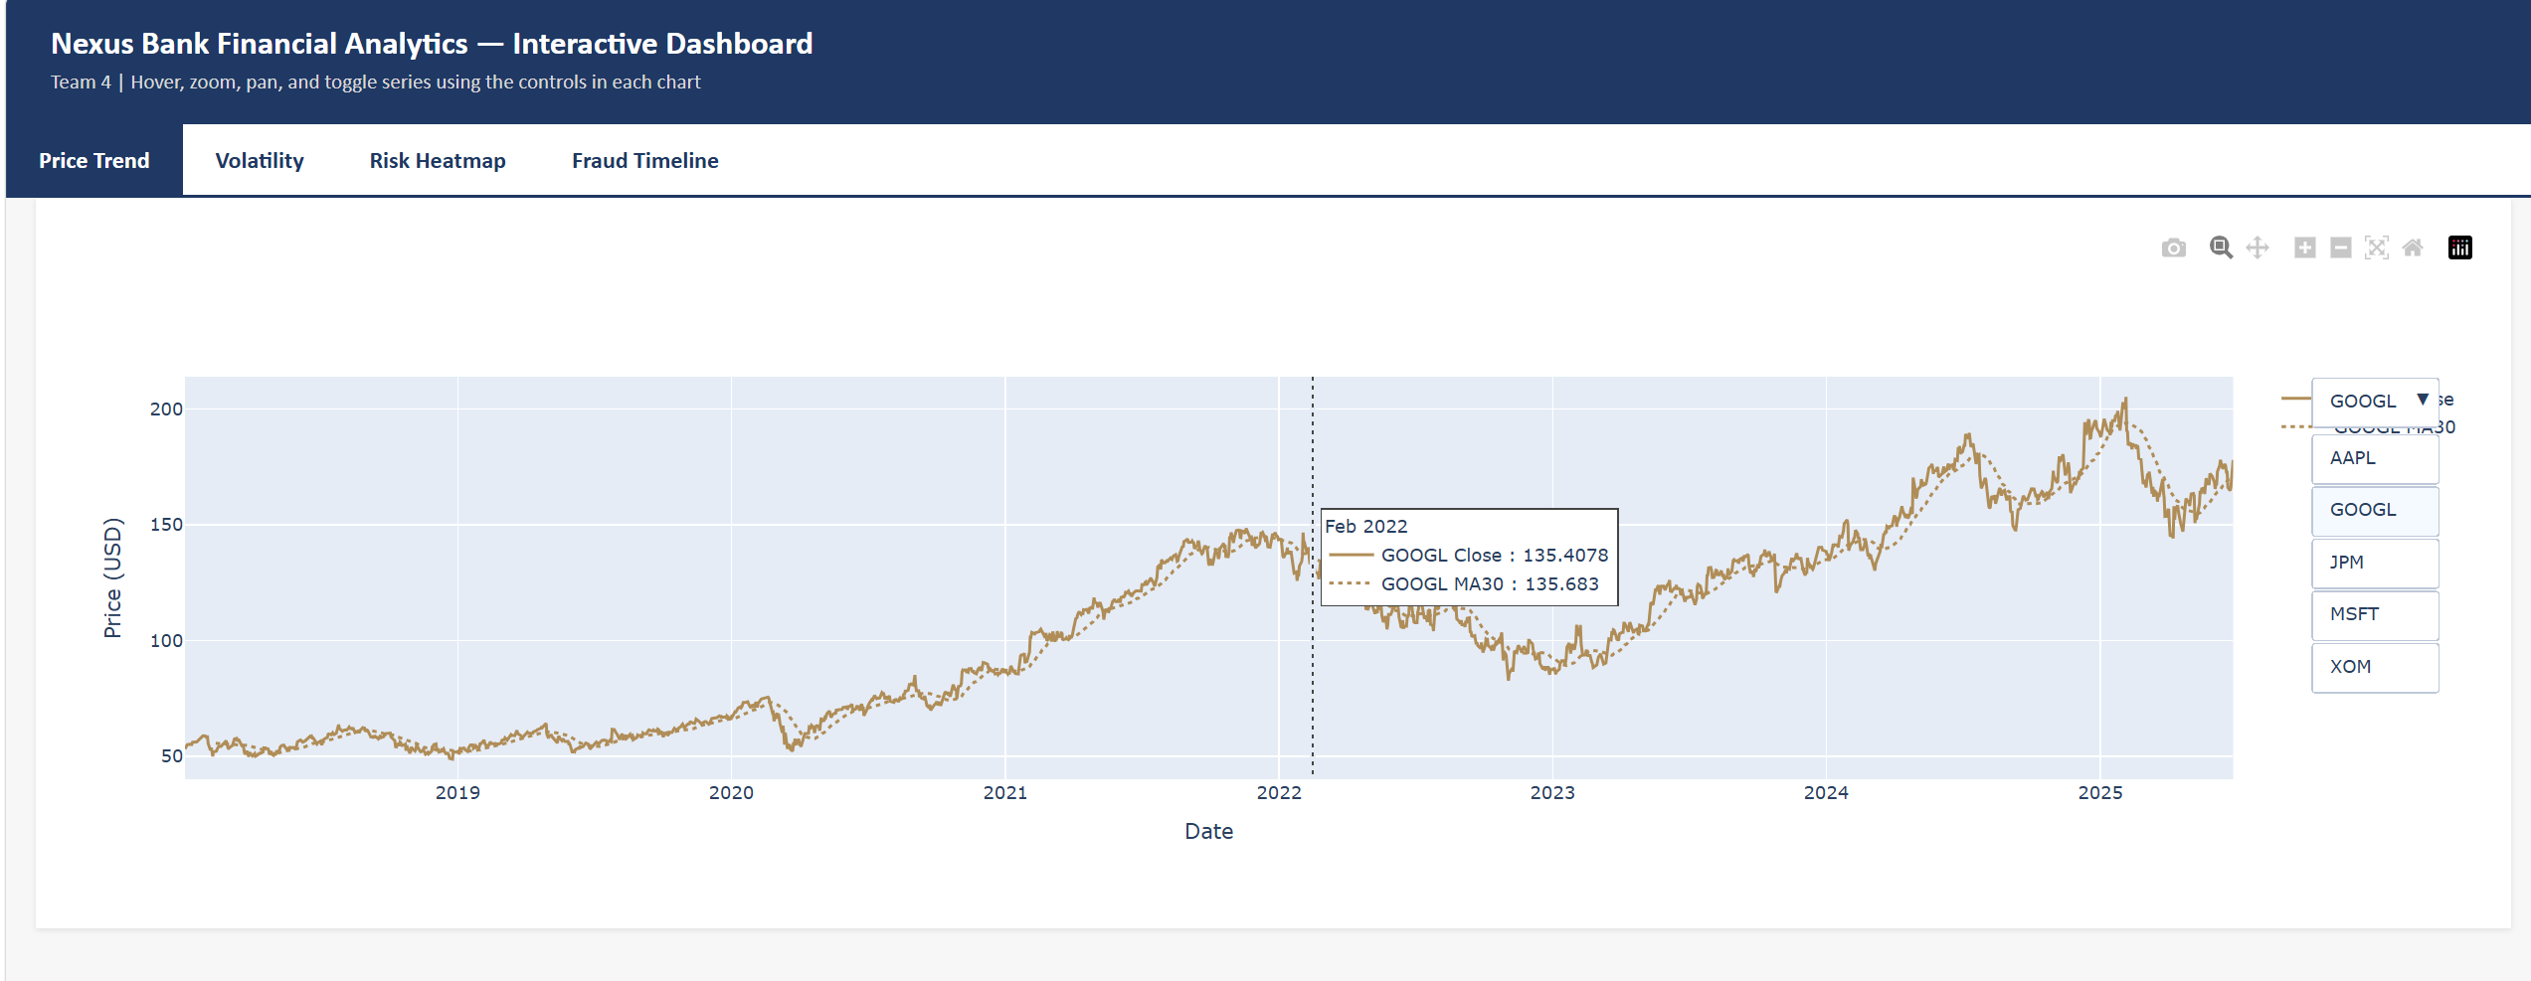
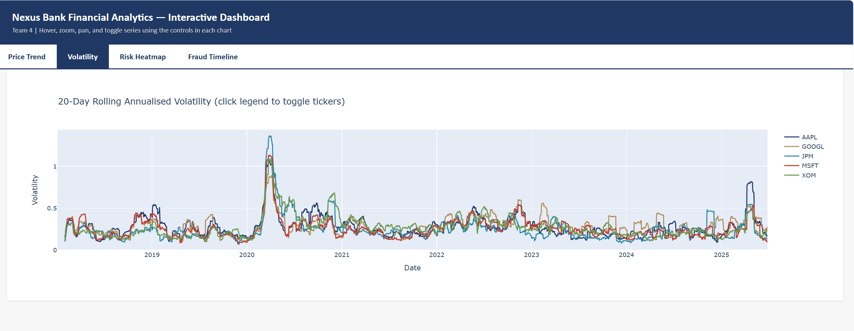
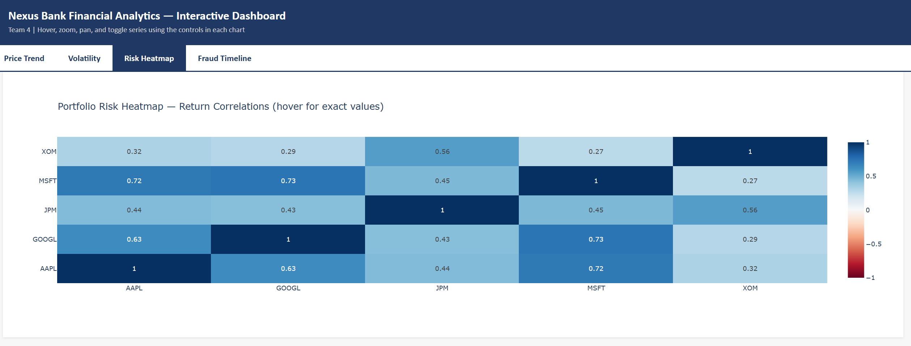
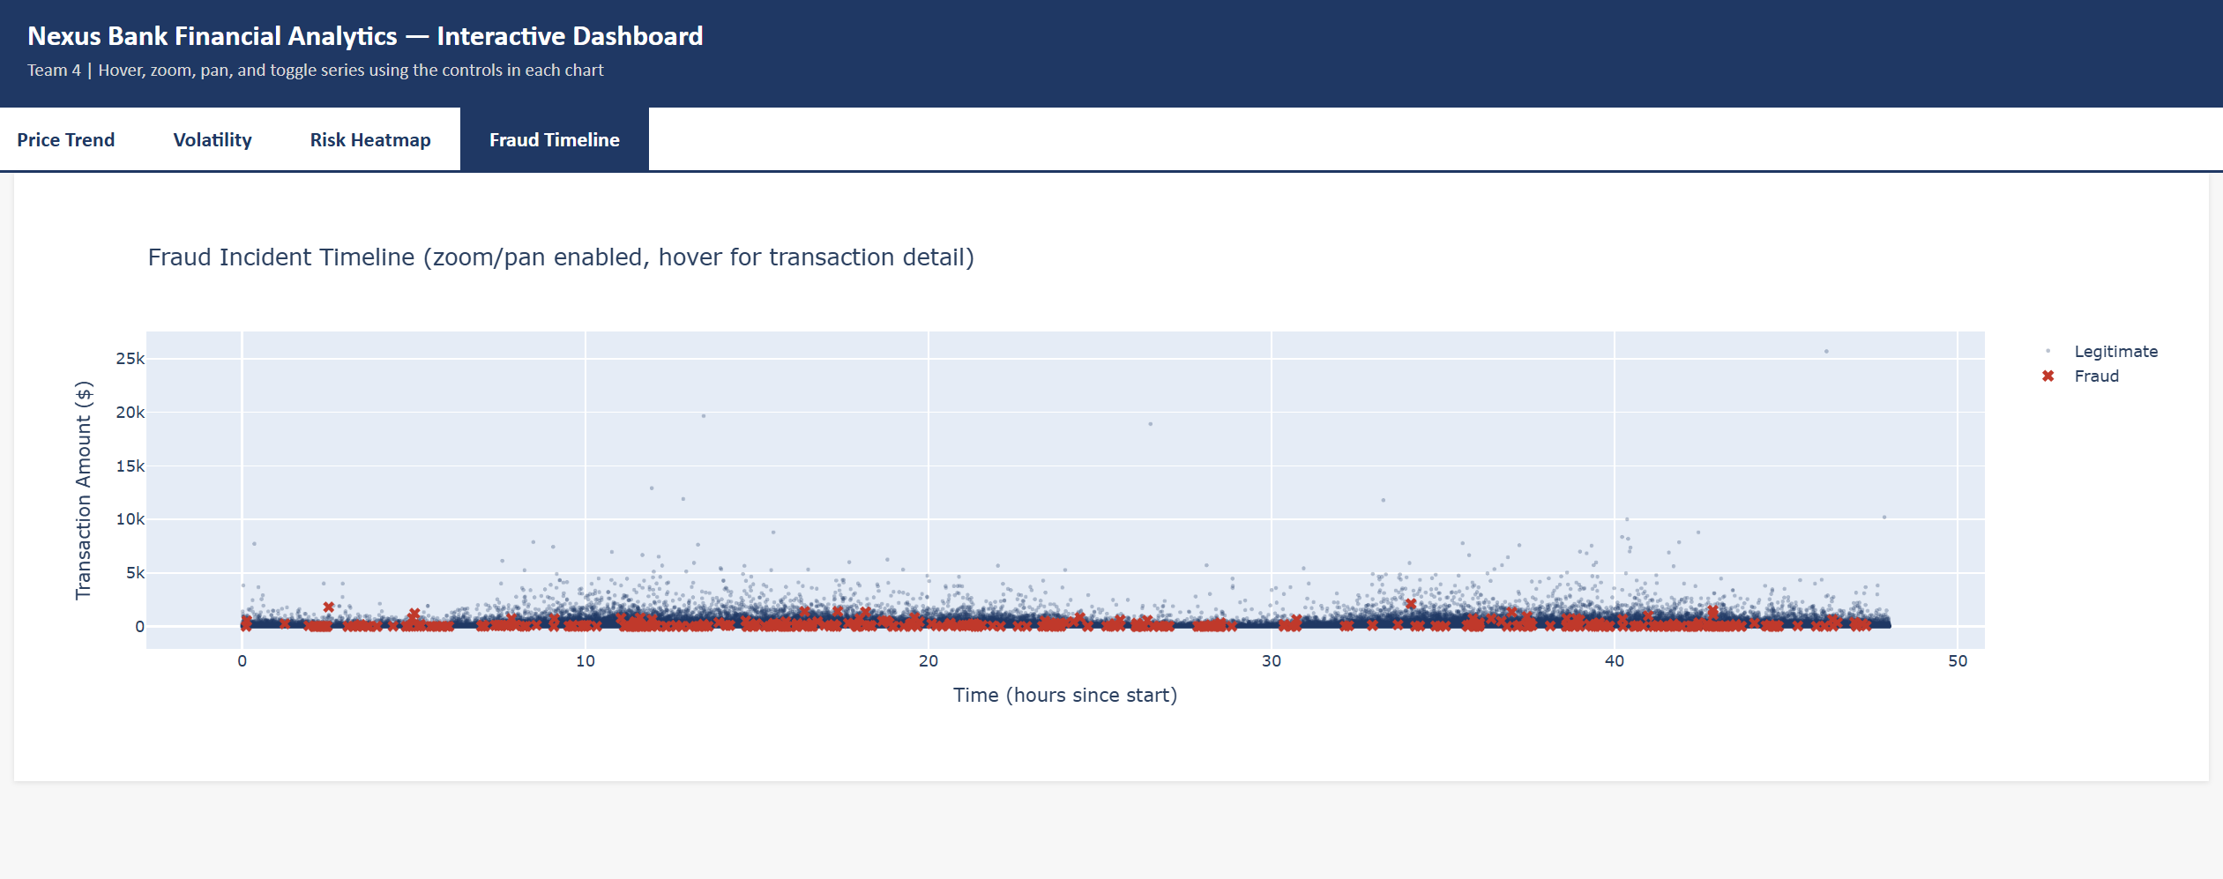
A Genuinely Interactive Dashboard
Built with Plotly — hover, zoom, pan, and a ticker-selector, in one self-contained HTML file
Price Trend
Volatility
Risk Heatmap
Fraud Timeline

Slide 12





Team 4
Five people, five roles, one pipeline
Durgesh Pandey
Venkat Suneel Kumar
Gautam Pant
Divya Daiyya
Vijay Sai Krishna
G25AI1018
G25AI1020
G25AI1019
G25AI1017
G25AI1016
Pipeline Engineer
Pipeline / Feature Engineer
Analytics Lead / Reviewer
Documentation & Data Quality
Business-Technical Liaison
Indian Institute of Technology Jodhpur • Postgraduate Diploma in Data Engineering • in association with Futurense.uni

Slide 13
What Real Data Taught Us
Four honest findings we chose to explain rather than hide
Fraud model reversal
Logistic Regression's precision collapsed on real data (5.5%) — Random Forest became our clear recommendation.
Flat forecasts, real theory
ARIMA's flat forecast reflects the Efficient Market Hypothesis, not a bug — adding drift made it worse.
A real schema gap
The public Kaggle dataset has no account_id field, so our account-level aggregation couldn't run as planned.
Real partitioning, proven
We built genuine PostgreSQL RANGE partitioning and proved it with EXPLAIN ANALYZE query plans.

Slide 14
Conclusion
A working analytics pipeline, built on real data, with recommendations we can defend end to end.
Real data across the board: Yahoo Finance, FRED, and the actual Kaggle fraud dataset.
Two models compared honestly, with a recommendation that changed once real data arrived.
A genuinely interactive dashboard, real database partitioning, and streaming vs. batch ingestion.
GitHub Repository
Video Walkthrough
https://github.com/g25ai1020-lab/Capstone-Project-Group-4.git
https://drive.google.com/drive/folders/1mR8333WS1yrI_43AE5xzd_46PAwNNXOb

Slide 15
References
[1] J. Bollinger, Bollinger on Bollinger Bands. New York: McGraw-Hill, 2001.
[2] J. W. Wilder, New Concepts in Technical Trading Systems. Greensboro, NC: Trend Research, 1978.
[3] G. E. P. Box and G. M. Jenkins, Time Series Analysis: Forecasting and Control. San Francisco: Holden-Day, 1970.
[4] T. Fischer and C. Krauss, "Deep learning with LSTM networks for financial market predictions," European Journal of Operational Research, vol. 270, no. 2, pp. 654-669, 2018.
[5] E. F. Fama, "Efficient capital markets: A review of theory and empirical work," The Journal of Finance, vol. 25, no. 2, pp. 383-417, 1970.
[6] A. Dal Pozzolo et al., "Calibrating probability with undersampling for unbalanced classification," IEEE SSCI, 2015, pp. 159-166.
[7] A. Dal Pozzolo et al., "Credit card fraud detection: A realistic modeling and a novel learning strategy," IEEE TNNLS, vol. 29, no. 8, pp. 3784-3797, 2018.
[8] N. V. Chawla et al., "SMOTE: Synthetic minority over-sampling technique," Journal of Artificial Intelligence Research, vol. 16, pp. 321-357, 2002.
[9] J. Davis and M. Goadrich, "The relationship between Precision-Recall and ROC curves," ICML, 2006, pp. 233-240.
[10] R. Elmasri and S. B. Navathe, Fundamentals of Database Systems, 7th ed. Boston: Pearson, 2016.
Thank you.

