Slide 1
Electrical Powertrain
Battery Box
Gustavo Hurtado and Hunter Orrell
Mechanical
Goals
Reliable tabs, Improving Tolerancing, Improve Manufacturing, and Reduce Imperfections
Design
Modified original design of bracket coupled with tab and gussets
Material: 4130 Steel
Increasing span between gussets to 0.9”
Increase distance between bolts to 1” to reduce M_z but not M_x
Manufacturing: Jigs, reduce warping and imperfections
Notes:
Goals: (Focus on Reliability rather than Performance)
Reliable Tabs:
Move from gussets and tabs to a bar tab
Increases reliability by being able to be welded instead of not
Improving Tolerancing:
Accounting for the max tolerance of .5 mm per module in each direction.
Improving Manufacturing:
Make the manufacturing process smoother and result in fewer issues.
Two jigs (Top and Bottom -> Inner and Outer)
Reduce Imperfections
This part is mainly from the warping issue we had from welding thicker steel to thinner steel sheets
Fix this by second jig and using the aluminum jig as a thermal sink
Talk About Design Process:
Had bar design idea by focusing on structural integrity
Created Analytical Model
Created Matlab Solver
Notch in tab design
Bending the floor to reduce welding we want on the box
Talk about issues we tackled:
For Mechanical:
Tabs
Tolerancing
For Thermal
Experimental Testing
Modeling to match data

Slide 2
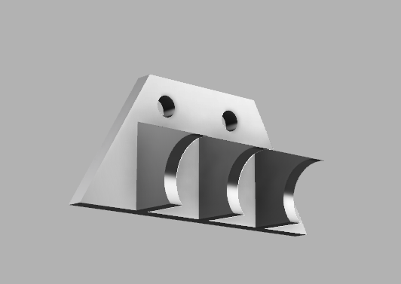
Electrical Powertrain
Battery Box
Gustavo Hurtado and Hunter Orrell
Tab CAD Model:
Figure 1: New tab with increased spacing
Notes:
Not going with welding a “half moon” design because we would be welding a thinner tube to a thichk chassis tube which could warp.

Slide 3
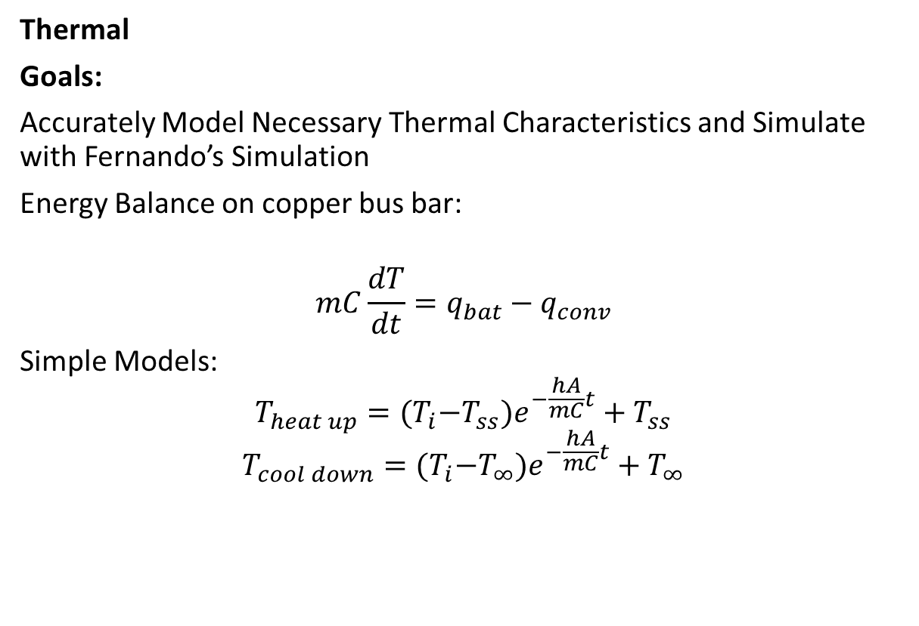
Electrical Powertrain
Battery Box
Gustavo Hurtado and Hunter Orrell
Thermal
Goals:
Accurately Model Necessary Thermal Characteristics and Simulate with Fernando’s Simulation
Energy Balance on copper bus bar:
$$mC\frac{dT}{dt}=q_{bat}−q_{conv}$$
Simple Models:
$$T_{heat up}={(T}_{i}−T_{ss})e^{−\frac{hA}{mC}t}+T_{ss}$$
$$T_{cool down}={(T}_{i}−T_{∞})e^{−\frac{hA}{mC}t}+T_{∞}$$
Notes:
Talk about experimental process:
Struggled over selecting control volume
Ended up selecting copper bus bar in module
Weighed in as 22 g
Used Lumped Capacitance Model and found Bi = 0.2
Used shortest distance from battery cell to terminal for Bi number
E.B. consists of mainly:
m and C or copper, qbat and qconv
The heat up formula changes as qbat was changed to find appropriate qbat

Slide 4
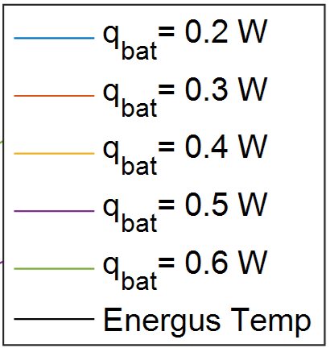

Electrical Powertrain
Battery Box
Gustavo Hurtado and Hunter Orrell
Thermal
Figure 2 and 3: Analytical temperature curves compared to Energus Module temperature data during ~50A discharge
$q_{bat}=0.4 W and h=4\frac{W}{m^{2}∗K}$ are acceptable assumptions
The Final Cooldown Temp is: 39.727. The Initial Temp was: 24.000.
Overall, the temperature rose by 65.531 percent.
Notes:
**Notes:
Keep in mind the module ran for just under 30 minutes: we won’t have the module running for that long.

Slide 5
Electrical Powertrain
Battery Box
Gustavo Hurtado and Hunter Orrell
Thermal
Applying Fern’s track simulator over 30 laps:
Key Assumptions: 45-50A each acceleration, Ti=30C, Tinf = 42C, the simulator is a 2D simulator – not including a tire model and has various assumptions regarding acceleration and cornering

