Slide 1







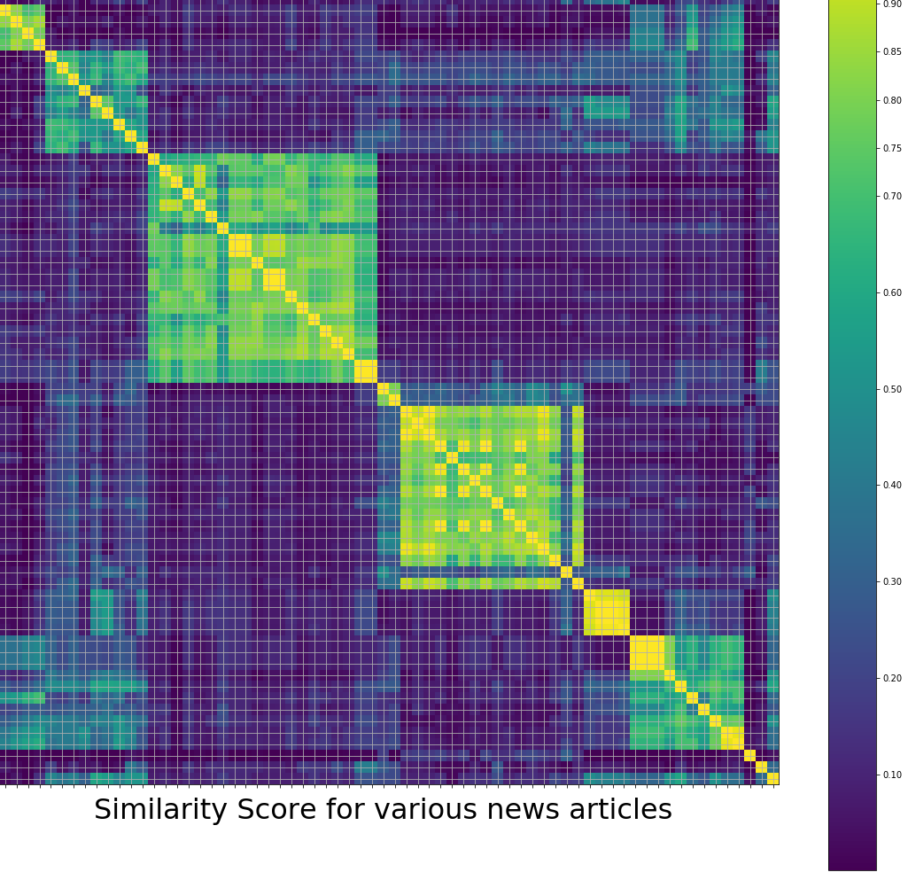
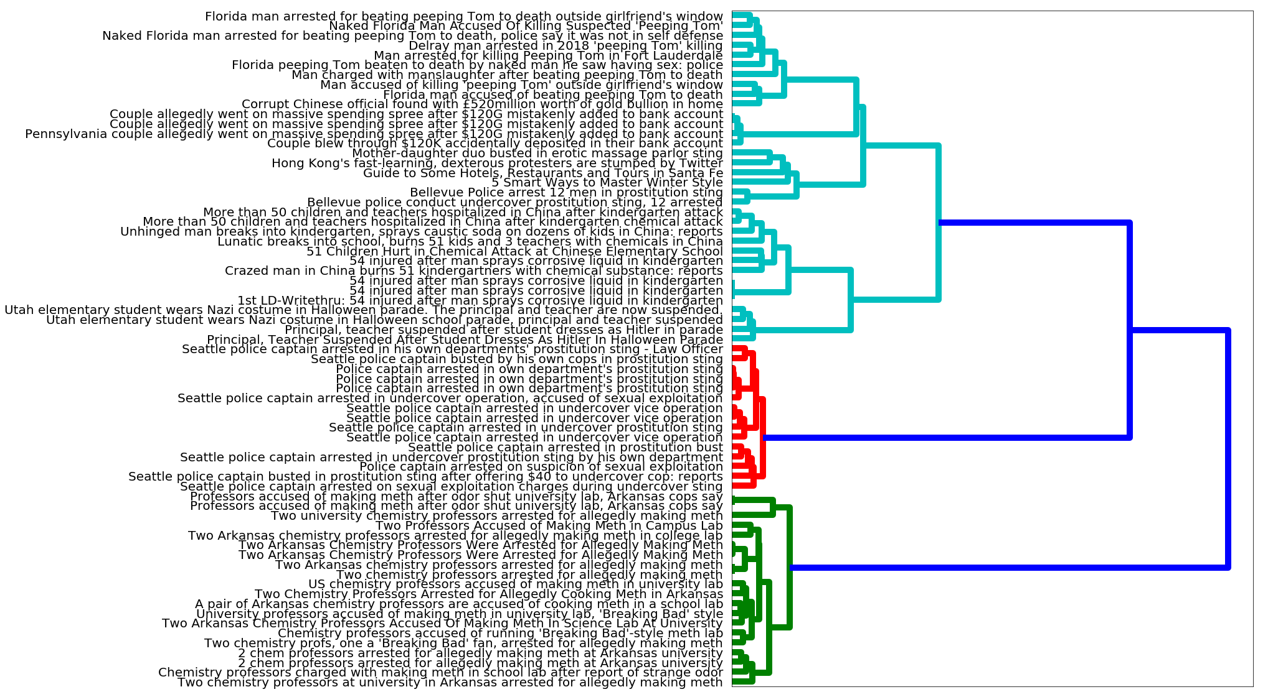




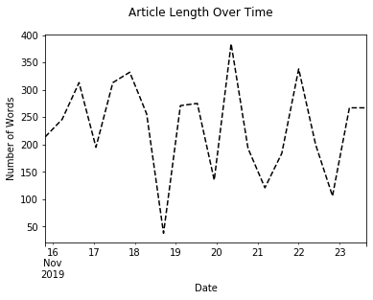
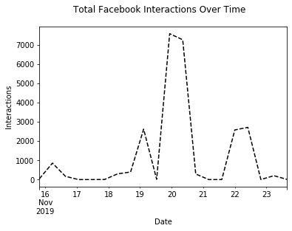
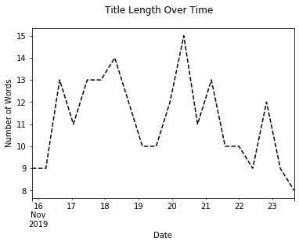
A Systematic Approach to Analyzing Syndication of Viral News Stories
Samuel Teplov, Gaurav Deshpande, Alon Peer
Faculty Advisor: Dr. Nicolas Christin
Methodology
Problem Statement
Misinformation has become a normal occurrence in our interconnected society
Media outlets further exacerbate this problem by blindly syndicating articles
Tracing the propagation path of syndicated articles is a very tedious task
Stage 1 - Data Collection
Identification of Viral News
Gathering Similar Articles
Web Scraping
Objective
To create a system which automatically identifies related articles, clusters them together, and then performs analysis on the associated metadata.
Stage 2 – Applying Big Data Techniques
CSV of articles and meta data
Contributions
Semi automatic search of related articles
Classification of related articles based on similarity score
Identification of propagation path
Analyze of various metadata features
Dataset Aggregation &
Pre-Processing
Clustering
Stage 3 – Data Analysis
Future Work
Create a fully automated process to analyze propagation paths of syndicated articles and identify articles’ origin
Incorporate our work into already existing fake news classification models
Analyzing Propagation of Articles

Slide 3
METHODOLOGY
Identification of viral news
Gathering relevant news stories
Web scraping
Pre-processing
Clustering
Analysis
Phases:
Phase I : Manual Approach
Phase II : Semi-automated Approach
Phase III : Fully-automated Approach
PROJECT

Slide 4
A Systematic Approach to Analyzing Syndication of Viral News Stories
Samuel Teplov Gaurav Deshpande Alon Peer
Problem Statement
Criteria and methodology
Conclusion
This is a good place to briefly, but effectively, describe your product or services.
This is a good place to briefly, but effectively, describe your product or services.
This is a good place to briefly, but effectively, describe your product or services.
Objective
This is a good place to briefly, but effectively, describe your product or services.
Analysis
This is a good place to briefly, but effectively, describe your product or services.
Background
This is a good place to briefly, but effectively, describe your product or services.
Future Work
This is a good place to briefly, but effectively, describe your product or services.
CITATIONS:
1.
2.
3.
4.
5.
6.
7.
8.
9.
10.
11.
12.

