Slide 1
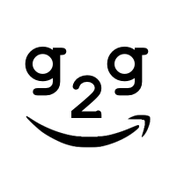



RDF Data
G2G Mapper
Graph DB Specific Format
G2GML
IN
OUT
Property Graph Pattern ⇔ RDF Graph Pattern

