Slide 1
Introduction to
Kyoto Products

Slide 2
Kyoto Cabinet
- lightweight database library -

Slide 3
Features
straightforward implementation of DBM
  process-embedded database
  persistent associative array = key-value storage
  successor of QDBM, and sibling of Tokyo Cabinet
    e.g.) DBM, NDBM, GDBM, TDB, CDB, Berkeley DB
  C++03 (with TR1) and C++0x porable
    supports Linux, FreeBSD, Mac OS X, Solaris, Windows
high performance
  insert 1M records / 0.8 sec = 1,250,000 QPS
  search 1M records / 0.7 sec = 1,428,571 QPS

Slide 4
high concurrency
  multi-thread safe
  read/write locking by records, user-land locking by CAS
high scalability
  hash and B+tree structure = O(1) and O(log N)
  no actual limit size of a database file (up to 8 exa bytes)
transaction
  write ahead logging, shadow paging
  ACID properties
various database types
  storage selection: on-memory, single file, multiple files in a directory
  algorithm selection: hash table, B+ tree
other language bindings
  C, Java, Python, Ruby, Perl, Lua, and so on

Slide 5
Database Types
ProtoHashDB: prototype hash database
  on-memory database implemented with std::unorderd_map
ProtoTreeDB: prototype tree database
  on-memory database implemented with std::map
CacheDB: cache hash database
  on-memory database featuring LRU deletion = typical cache
GrassDB: cache tree database
  on-memory database of B+ tree = cache with order
HashDB: file hash database
  file database of hash table = typical DBM
TreeDB: file tree database
  file database of B+ tree = DBM with order
DirDB: directory hash database
  respective files in a directory of the file system = for large records
ForestDB: directory tree database
  directory database of B+ tree = huge DBM with order

Slide 6
performance characteristics

Slide 7
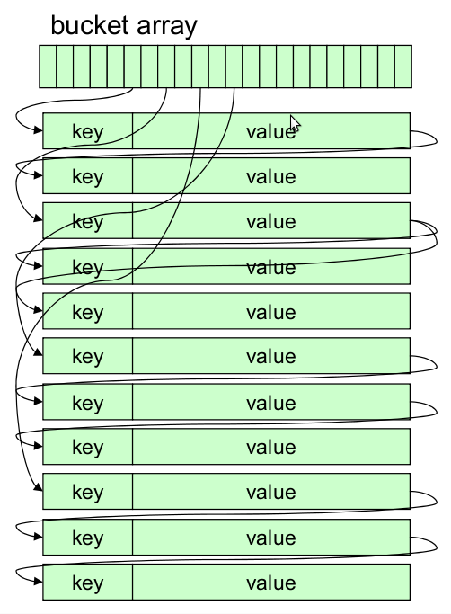
HashDB: File Hash Database
static hashing
  O(1) time complexity
  jilted dynamic hashing for simplicity and performance
separate chaining
  binary search tree
  balances by the second hash
free block pool
  best fit allocation
  dynamic defragmentation
combines mmap and pread/pwrite
  saves calling system calls
tuning parameters
  bucket number, alignment
  compression

Slide 8
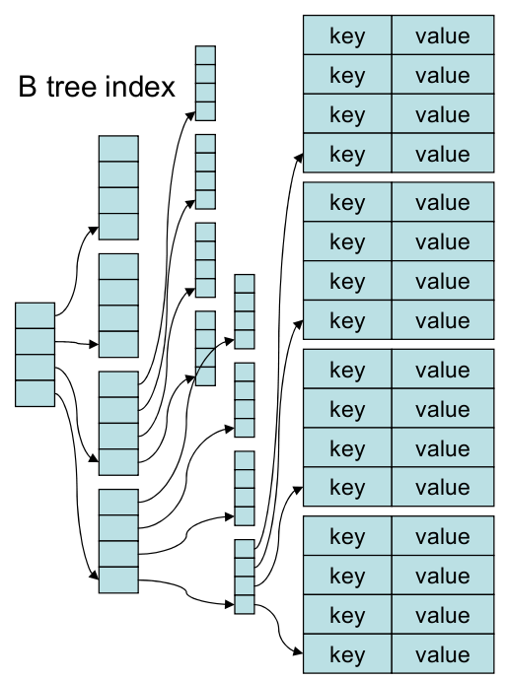
TreeDB: File Tree Database
B+ tree
  O(log N) time complexity
  custom comparison function
page caching
  separate LRU lists
  mid-point insertion
stands on HashDB
  stores pages in HashDB
  succeeds time and space efficiency
cursor
  jump, step, step_back
  prefix/range matching

Slide 9
HashDB vs. TreeDB

Slide 10
Directory Databases
DirDB: directory hash database
  respective files in a directory of the file system
  suitable for large records
  strongly depends on the file system performance
    ReiserFS > EXT3 > EXT4 > EXT2 > XFS > NTFS
ForestDB: directory tree database
  B+ tree stands on DirDB
  reduce the number of files and alleviates the load
  most scalable approach among all database types

Slide 11
On-memory Databases
ProtoDB: prototype database template
  DB wrapper for STL map
  any data structure compatible std::map are available
  ProtoHashDB: alias of ProtoDB<std::unordered_map>
  ProtoTreeDB: alias of ProtoDB<std::map>
CacheDB: cache hash database
  hash table with double linked list
  constant memory usage
  LRU (least recent used) records are removed
  much less memory usage than std::map and std::unordered_map
GrassDB: cache tree database
  B+ tree stands on CacheDB
  much less memory usage than CacheDB

Slide 12
Class Hierarchy
DB = interface of record operations
  BasicDB = interface of storage operations, mix-in of utilities
    ProtoHashDB, ProtoTreeDB, CacheDB, HashDB, TreeDB, ...
    PolyDB
PolyDB: polymorphic database
  dynamic binding to concrete DB types
    "factory method" and "strategy" patterns
  the concrete type is determined when opening
    naming convention
      ProtoHashDB: "-", ProtoTreeDB: "+", CacheDB: "*", GrassDB: "%"
      HashDB: ".kch", TreeDB: ".kct", DirDB: ".kcd", ForestDB: ".kcf"

Slide 13
Components
applications
C++
C
Java
Python
Ruby
Perl
Lua
etc.
PolyDB
ProtoHashDB
ProtoTreeDB
GrassDB
TreeDB
ForestDB
ProtoDB
CacheDB
HashDB
DirDB
C++03 & TR1 libs
IO abst
threading abst
DB abst
Operating Systems (POSIX, Win32)

Slide 14
Abstraction of KVS
what is "key-value storage" ?
  each record consists of one key and one value
  atomicity is assured for only one record
  records are stored in persistent storage
so, what?
  every operation can be abstracted by the "visitor" pattern
  the database accepts one visitor for a record at the same time
    lets it read/write the record arbitrary
    saves the computed value
flexible and useful interface
  provides the "DB::accept" method realizing whatever operations
  "DB::set", "DB::get", "DB::remove", "DB::increment", etc. are built-in as wrappers of the "DB::accept"

Slide 15
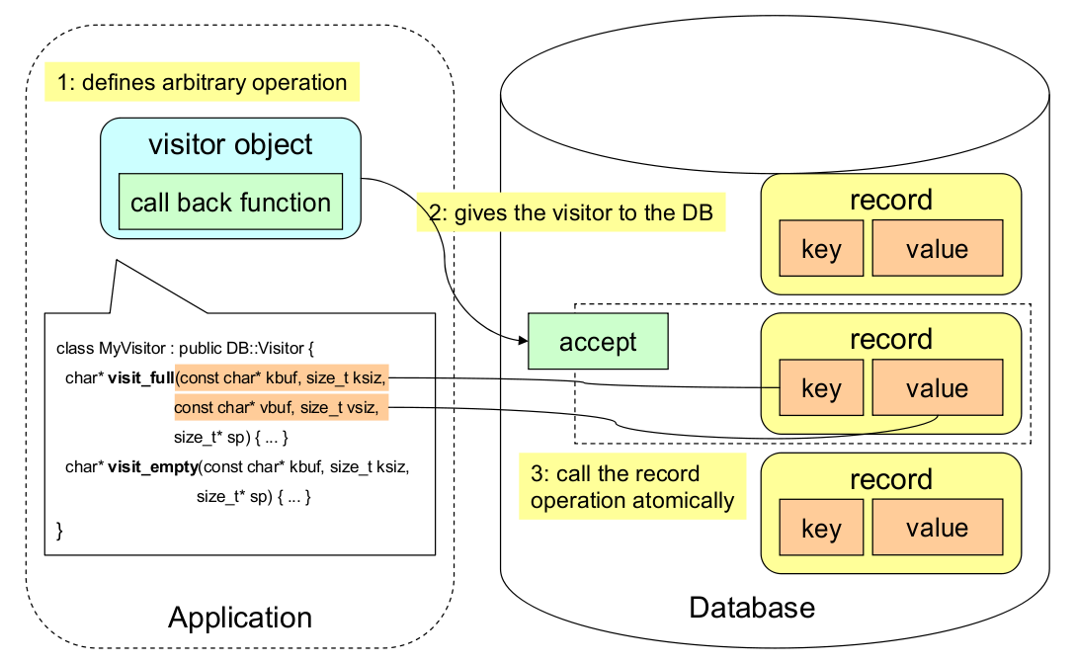
Visitor Interface

Slide 16
Comparison with Tokyo Cabinet
pros
  space efficiency: smaller size of DB file
    footprint/record: TC=22B -> KC=16B
  parallelism: higher performance in multi-thread environment
    uses atomic operations such as CAS
  portability: non-POSIX platform support
    supports Win32
  usability: object-oriented design
    external cursor, generalization by the visitor pattern
    new database types: GrassDB, ForestDB
  robustness: auto transaction and auto recovery
cons
  time efficiency per thread: due to grained lock
  discarded features: fixed-length database, table database
  dependency on modern C++ implementation: jilted old environments

Slide 17
Example Codes
#include <kcpolydb.h>
using namespace std;
using namespace kyotocabinet;
// main routine
int main(int argc, char** argv) {
// create the database object
PolyDB db;
// open the database
if (!db.open("casket.kch", PolyDB::OWRITER | PolyDB::OCREATE)) {
cerr << "open error: " << db.error().name() << endl;
}
// store records
if (!db.set("foo", "hop") ||
!db.set("bar", "step") ||
!db.set("baz", "jump")) {
cerr << "set error: " << db.error().name() << endl;
}
// retrieve a record
string* value = db.get("foo");
if (value) {
cout << *value << endl;
delete value;
} else {
cerr << "get error: " << db.error().name() << endl;
}
// traverse records
DB::Cursor* cur = db.cursor();
cur->jump();
pair<string, string>* rec;
while ((rec = cur->get_pair(true)) != NULL) {
cout << rec->first << ":" << rec->second << endl;
delete rec;
}
delete cur;
// close the database
if (!db.close()) {
cerr << "close error: " << db.error().name() << endl;
}
return 0;
}
#include <kcpolydb.h>
using namespace std;
using namespace kyotocabinet;
// main routine
int main(int argc, char** argv) {
// create the database object
PolyDB db;
// open the database
if (!db.open("casket.kch", PolyDB::OREADER)) {
cerr << "open error: " << db.error().name() << endl;
}
// define the visitor
class VisitorImpl : public DB::Visitor {
// call back function for an existing record
const char* visit_full(const char* kbuf, size_t ksiz,
const char* vbuf, size_t vsiz, size_t *sp) {
cout << string(kbuf, ksiz) << ":" << string(vbuf, vsiz) << endl;
return NOP;
}
// call back function for an empty record space
const char* visit_empty(const char* kbuf, size_t ksiz, size_t *sp) {
cerr << string(kbuf, ksiz) << " is missing" << endl;
return NOP;
}
} visitor;
// retrieve a record with visitor
if (!db.accept("foo", 3, &visitor, false) ||
!db.accept("dummy", 5, &visitor, false)) {
cerr << "accept error: " << db.error().name() << endl;
}
// traverse records with visitor
if (!db.iterate(&visitor, false)) {
cerr << "iterate error: " << db.error().name() << endl;
}
// close the database
if (!db.close()) {
cerr << "close error: " << db.error().name() << endl;
}
return 0;
}

Slide 18
Other Kyoto Products?
now, planning...
Kyoto Tycoon?
  database server using Kyoto Cabinet
  supports expiration and multiple databases
Kyoto Diaspora?
  inverted index using Kyoto Cabinet

Slide 19
maintainability is our paramount concern...
FAL Labs
http://fallabs.com/
mailto:info@fallabs.com

Slide 20


