Slide 1
Internal Management Task System
Yoan Ivanov

Slide 2
What we will be talking about today
Work Breakdown Structure
Time Estimates
Task Dependencies
Development Approach
Assumptions
Questions
Initial Version Estimation

Slide 3
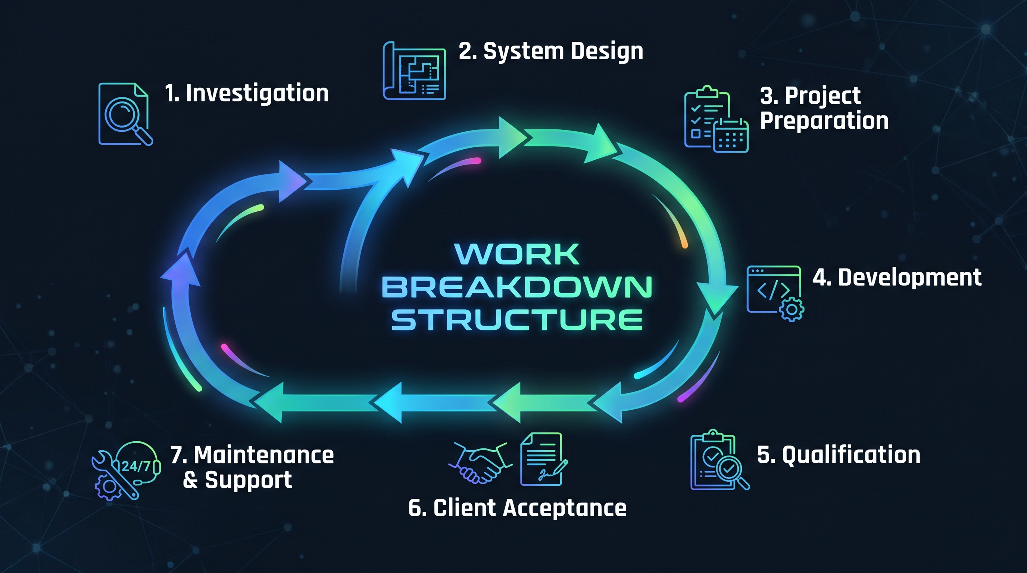

Slide 4
Time Estimations
Total Estimated Hours: 129

Slide 5

Task Dependencies

Slide 6

Development Approach

Slide 7
Assumptions
Team Size
Roles in the System
Task Assignment
Version Control

Slide 8
Product Owner
Consultation
Register in the system
Task Deletion

Slide 9

Estimation for the
Initial Version

Slide 10
Questions?

Slide 11
Thank you for the attention!

