Slide 1
Topic 3.2 Searching and Extracting Data from Files
How to Prepare for the LPI Linux Essentials Certification Exam
C851 Cohort Session for Sunday, August 29, 2021
Dr. John S. Galliano | C851 Linux Foundations Instructor

Slide 2
Agenda
Welcome
About the Exam
The 5 Exam Domains
Topics/Weightings
LPI Retake Policy
Demos/Hands-on
Sample Exam Questions
Wrap-Up

Slide 3

About the Linux Essentials v1.6 [1]
No prerequisites
Closed book, up to 60 minutes
40 multiple-choice (with some multi-select and fill-in-the-blank items) questions
Minimum pass score 500 points (200-800 scale)
Partially correct responses not accepted (for F-I-T-B questions LPI may accept multiple correct versions of an answer [2]
Total exam weight count is 40, thus 40 questions
[1] Linux Professional Institute, “Linux Professional Institute Linux Essentials,” Linux Professional Institute, 21-Oct-2018. [Online]. Available: https://www.lpi.org/our-certifications/linux-essentials-overview. [Accessed: 14-Aug-2021]
[2] Dr. Galliano’s correspondence with LPI, dated August 2021: Example: with/without leading path in a case where the answer is a command
Notes:
Example: If an objective has a weight of 4, there will be 4 questions on the exam related to that objective [2]
Link: 3rd party cert tips video https://bit.ly/3party_cert_tips

Slide 4

5 Exam Domains [3]
The Linux Community and a Career in Open Source
Finding Your Way on a Linux System
The Power of the Command Line
The Linux Operating System
Security and File Permissions
[3] Linux Professional Institute, “Linux Essentials Objectives V1.6 - LPI Wiki,” Linux Professional Institute, 25-Jan-2020. [Online]. Available: https://wiki.lpi.org/wiki/Linux_Essentials_Objectives_V1.6. [Accessed: 14-Aug-2021].

Slide 5

Exam Topics/Weightings
Linux Essentials v1.6 Exam Topics [4] | 1.1 | 2
 | 1.2 | 2
 | 1.3 | 1
 | 1.4 | 2
 | 2.1 | 3
 | 2.2 | 2
 | 2.3 | 2
 | 2.4 | 2
 | 3.1 | 2
 | 3.2 | 3
 | 3.3 | 4
 | 4.1 | 1
 | 4.2 | 2
 | 4.3 | 3
 | 4.4 | 2
 | 5.1 | 2
 | 5.2 | 2
 | 5.3 | 2
 | 5.4 | 1
 |  | 40
[4] Linux Professional Institute, “Linux Essentials Objectives V1.6 - LPI Wiki,” Linux Professional Institute, 25-Jan-2020. [Online]. Available: https://wiki.lpi.org/wiki/Linux_Essentials_Objectives_V1.6. [Accessed: 14-Aug-2021].
Notes:
• A weight of “1” equates to 1 exam question
• Since there is a weight of ‘3’, you will see 3 questions on searching and extracting data from files!

Slide 6

LPI Exam Re-Take Policy [5]
Anyone who takes an LPI exam once must wait one week before re-taking
Anyone who takes an LPI exam a second (and subsequent) time must wait 30 days before re-taking
These are LPI policies, not WGU policies!
[5] Linux Professional Institute, “Privacy Statement and Policies,” Linux Professional Institute, 18-May-2018. [Online]. Available: https://www.lpi.org/policies. [Accessed: 14-Aug-2021].
Notes:
• Anyone who passes an LPI exam may not retake that exam for two years

Slide 7
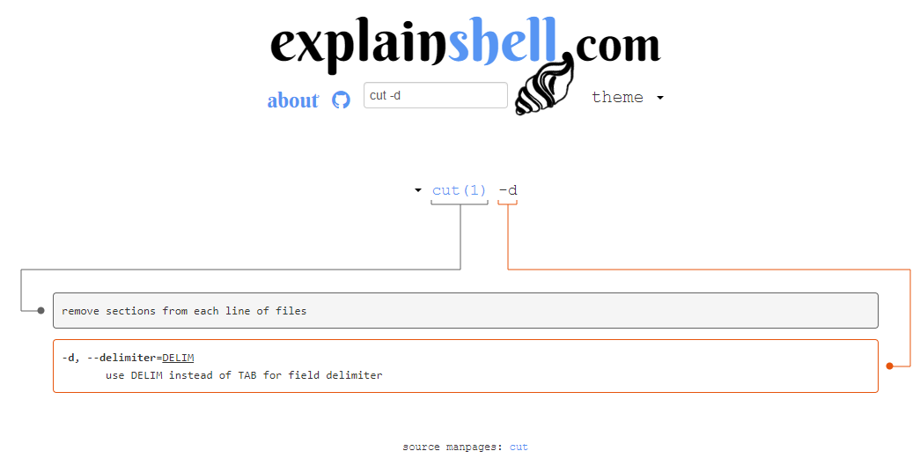
3.2 Searching & Extracting Data from Files [6]
Weight: 3 (3 questions)
Key Knowledge Areas:
Command line pipes
I/O redirection
basic regular expressions using ., [ ], *, and ?
Files used, terms and utilities:
grep
less
cat, head, tail
sort
cut
wc
[6] Linux Professional Institute (LPI), “Exam 010 Objectives,” Linux Professional Institute, 21-Oct-2018. [Online]. Available: https://www.lpi.org/our-certifications/exam-010-objectives. [Accessed: 10-Jul-2021].
Notes:
• commands used in today’s content, ‘#’ denotes a comment
grep
less
cat, head, tail
sort
cut
wc
• redirection components include file descriptors:
0 = STDIN, how we send data to a command via the keyboard
1 = STDOUT, what the command provides as a result of execution (no result is usually a good thing)
2 = STDERR, what the command provides if an error condition occurs
3+ … actual file handles
• we can handle file descriptors using these shortcuts
The ‘>’, ‘>>’, ‘<‘ characters can be used to redirect
To capture the content of stderr, the redirect 2> should be used
Using 1>&2 redirects stdout to stderr
Using 2>&1 redirects stderr to stdout
To discard the output of a command, its content can be redirected to the special file /dev/null, like >log.txt 2>/dev/null
• Commands used
ls | cat -n > out.txt #pipe the output of ls to cat and redirect that to a file
• Link: https://explainshell.com/

Slide 8
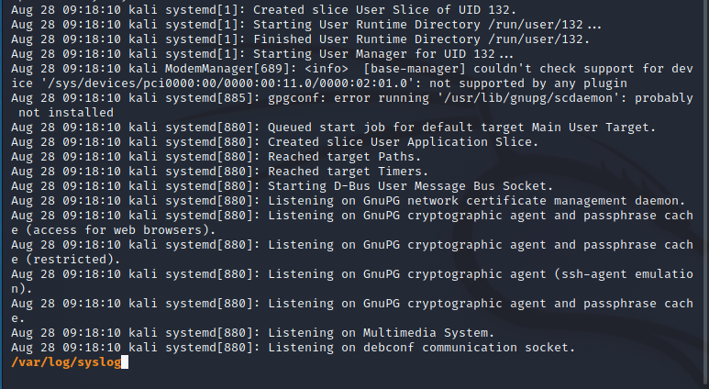
Viewing and Paging Files
cat
less, more
head, tail
Notes:
• cat, head, tail, less and more are commands we use to view files
• less and more allow us to “page” through a file 1 page (or terminal screen) at a time
• “less is more” because less is an improved more – we can page forward and backwards, execute advanced searching, and – wait for it – MORE!
• Commands used:
cat <filename> #views the file
tail <filename> #views the last 10 lines
Head <filename> #views the first 10 lines
more <filename> #views the file 1 page at a time
less <filename> #views the file 1 page at a time
cat > filename> #create a new file, entering text 1 line at a time; press ctrl+d to exit/save
tail –f /varlog/syslog #last 10 lines dynamic updating
head –n25 <filename> #show 25 lines rather than just 10

Slide 9
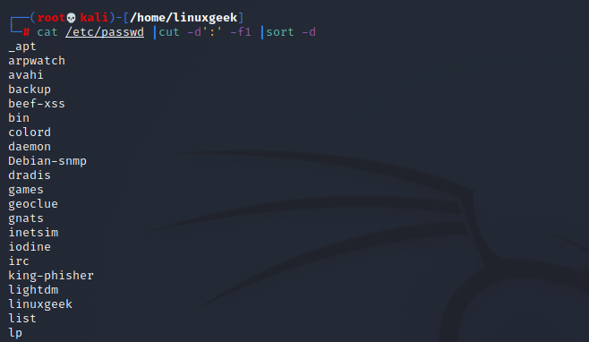
Manipulating Command Output
Piping and redirection
cut, sort, wc
Notes:
• We can create entirely new commands via piping, the act of combining commands together so that the output of the first command becomes the input of the second
Ex: cat a file and use the ‘|’ symbol to send it to grep to perform a keyword search
cat /var/log/syslog |grep ssh #look for ssh matches in the log
• cut, sort, and wc helps us manipulate commands
Ex: process a file by viewing, cutting, and sorting
cat /etc/passwd |cut –d’:’ –f1 |sort –d |wc -l #get the contents of the passwd file, extract the usernames only, sort alphabetically, count the # of accounts

Slide 10
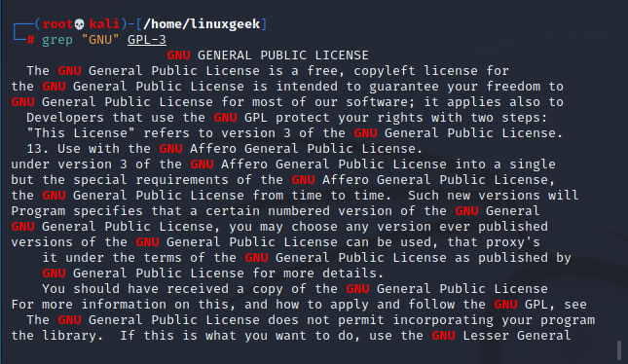
Grepping and REGEX
grep
Basic regex using ., [ ], *, and ?
Notes:
• When it comes to working with text in the Linux CLI, think of grep as the Swiss Army Knife of your toolbox
cp /usr/share/common-licenses/GPL-3 . #Ubuntu/Debian systems
ls –ltr #check for a good copy
grep "GNU" GPL-3 #execute a simple grep search
grep -i "license" GPL-3 #make grep search all cases
ps -efH |grep -v grep |grep sudo #make grep ‘forget’ certain things in the matched output
ps -efH |grep -v grep |grep sudo #make grep show you the line#
• Regex is a standard for finding text
grep "^GNU" GPL-3 #finds ‘GNU’ only at the start of a line
grep "and$" GPL-3 #finds ‘and’ only at the end of a line
grep "..cept" GPL-3 #grep matches words w/2 chars pre ‘cept’
grep "t[wo]o" GPL-3 #matches any 3-chars w/ t and o, that also match a w or o in the middle

Slide 11
What Questions Do you Have for Me?

