Slide 1
Topic 2.1 Command Line Basics
C851 Cohort Live Session for Sunday, January 9, 2022
Dr. John S. Galliano | C851 Linux Foundations Instructor

Slide 2
Agenda
Welcome
About the LPI Linux Essentials Exam
The 5 Exam Domains
Lecture
Demos
Sample Exam Questions
Wrap-Up

Slide 3
About the Exam v1.6 [1]
LPI Exam Re-Take Policy [3]
No prereq’s, closed book, up to 60 minutes
40 questions (3 question types)
~75% (30) single-select multiple choice
~19% (7-8) multiple-select multiple choice
~6% (3-4) fill-in-the-blank
Partially correct responses not accepted [2]
Min score 500 points on 200-800 scale
Scaled scoring across all exam forms to normalize for difficulty level of questions
Number of correct answers to achieve 500 points varies across exam forms
Lifetime certification
Anyone who takes an LPI exam once must wait one week before re-taking
For second/subsequent retakes you must wait 30 days
3rd and subsequent attempts at your own cost ($120)
[1] Linux Professional Institute, “Linux Professional Institute Linux Essentials,” Linux Professional Institute, 21-Oct-2018. [Online]. Available: https://www.lpi.org/our-certifications/linux-essentials-overview. [Accessed: 14-Aug-2021]
[2] Dr. Galliano’s correspondence with LPI, dated August 2021: Example: with/without leading path in a case where the answer is a command
[3] Linux Professional Institute, “Privacy Statement and Policies,” Linux Professional Institute, 18-May-2018. [Online]. Available: https://www.lpi.org/policies. [Accessed: 14-Aug-2021]
Notes:
PRO TIP: Do not underestimate the technical focus of this exam. You will want to be comfortable with the commands and practice in the Linux terminal!
Notes:
• LPI *may* accept multiple correct versions of an answer for F-I-T-B questions [2]
• Anyone who passes an LPI exam may not retake that exam for two years [3]

Slide 4

Understanding the Linux/open-source industry and knowing popular open-source apps
The 5 Exam Domains [4]
1. The Linux Community and Careers in Open Source
4. The Linux Operating System
5. Security and File Permissions
3. The Power of the Command Line
2. Finding Your Way on a Linux System
The 3 Candidate Expectations [4]
Understanding of security and administration (e.g., user/group management, permissions, special files/directories)
Understanding the major parts of the Linux OS and showing technical proficiency on the CLI
[4] Linux Professional Institute, “Linux Professional Institute Linux Essentials,” Linux Professional Institute, 21-Oct-2018. [Online]. Available: https://www.lpi.org/our-certifications/linux-essentials-overview. [Accessed: 14-Aug-2021]
Notes:
Links:
• View the 3rd party cert tips video at https://bit.ly/3party_cert_tips
• https://explainshell.com/ to learn about commands, options, arguments
• https://learning.lpi.org/en/learning-materials/010-160/
• https://overthewire.org to practice command line skills
• Dr. Galliano’s Github repo (study guide, cheatsheets, slidedecks, etc. at https://github.com/g33k247/851
Exam Objectives:
1. The Linux Community and a Career in Open Source
1.1 Linux Evolution and Popular Operating Systems - Distributions (Debian, Ubuntu (LTS), CentOS, openSUSE, Red Hat, SUSE, Linux Mint, Scientific Linux) - Embedded Systems (Raspberry Pi, Raspbian, Android) - Linux in the Cloud
1.2 Major Open Source Applications
- Desktop applications (OpenOffice.org, LibreOffice, Thunderbird, Firefox, GIMP) - Server applications (Nextcloud, ownCloud; Apache HTTPD, NGINX, MariaDB, MySQL, NFS, Samba) - Development languages (C, Java, JavaScript, Perl, shell, Python, PHP) - Package management tools and repositories (dpkg, apt-get, rpm, yum_
1.3 Open Source Software and Licensing - Open source philosophy - Open source licensing - Free Software Foundation (FSF), Open Source Initiative (OSI) - Open source business models
1.4 Information and Communication Technology (ICT) Skills and Working in Linux - Desktop skills - Getting to the command line - Industry uses of Linux, cloud computing and virtualization
2. Finding Your Way on a Linux System
2.1 Command Line Basics - Basic shell - Command line syntax - Variables - Quoting
2.2 Using the Command Line to Get Help - Man pages - Info pages - /usr/share/doc/ - locate
2.3 Using Directories and Listing Files - Files, directories - Hidden files and directories - Home directories - Absolute and relative paths
2.4 Creating, Moving and Deleting Files - Files and directories - Case sensitivity - Simple globbing
3. The Power of the Command Line
3.1 Archiving Files on the Command Line - Files, directories - Archives, compression (tar, gzip, bzip2, xz, zip)
3.2 Searching and Extracting Data from Files - Command line pipes (grep, less, cat, head, tail, sort, cut, wc) - I/O redirection - Basic Regular Expressions using ., [ ], *, and ?
3.3 Turning Commands into a Script - Basic shell scripting - Awareness of common text editors (vi and nano)
4. The Linux Operating System
4.1 Choosing an Operating System - Differences between Windows, OS X and Linux (GUI versus command line, desktop configuration) - Distribution life cycle management (maintenance cycles, beta and stable)
4.2 Understanding Computer Hardware - Motherboards, processors, power supplies, optical drives, peripherals - Hard drives, solid state disks and partitions, /dev/sd* - Drivers
4.3 Where Data is Stored - Programs and configuration (/etc) - Processes (ps, top) - Memory addresses - System messaging (syslog, dmesg) - Logging (/var/log)
4.4 Your Computer on the Network - Internet, network, routers - Querying DNS client configuration - Querying network configuration
5. Security and File Permissions
5.1 Basic Security and Identifying User Types
- Root and standard users - System users
5.2 Creating Users and Groups - User and group commands - User IDs
5.3 Managing File Permissions and Ownership - File and directory permissions and ownership (ls -l, ls -a, chmod, chown)
5.4 Special Directories and Files - Using temporary files and directories (/tmp/, /var/tmp/ and Sticky Bit; ls -d) - Symbolic links (ln -s)

Slide 5
2.1 Command Line Basics [6]
Exam Topics/Weightings [5]
Description:
Basics of using the Linux command line
Key Knowledge Areas:
Basic shell
Command line syntax
Variables
Quoting
Files used, terms and utilities:
Bash
Echo
History
PATH environment variable
Export
type
Linux Essentials v1.6 Exam Sub-Topics [5] | 1.1 | 2
 | 1.2 | 2
 | 1.3 | 1
 | 1.4 | 2
 | 2.1 | 3
 | 2.2 | 2
 | 2.3 | 2
 | 2.4 | 2
 | 3.1 | 2
 | 3.2 | 3
 | 3.3 | 4
 | 4.1 | 1
 | 4.2 | 2
 | 4.3 | 3
 | 4.4 | 2
 | 5.1 | 2
 | 5.2 | 2
 | 5.3 | 2
 | 5.4 | 1
 |  | 40
[5] Linux Professional Institute, “Linux Essentials Objectives V1.6 - LPI Wiki,” Linux Professional Institute, 25-Jan-2020. [Online]. Available: https://wiki.lpi.org/wiki/Linux_Essentials_Objectives_V1.6. [Accessed: 14-Aug-2021]
[6] Linux Professional Institute (LPI), “Exam 010 Objectives,” Linux Professional Institute, 21-Oct-2018. [Online]. Available: https://www.lpi.org/our-certifications/exam-010-objectives. [Accessed: 10-Jul-2021]
Notes:
PRO TIP: An exam objective weight of 3 means you should expect 3 questions on the exam related to that objective.

Slide 6
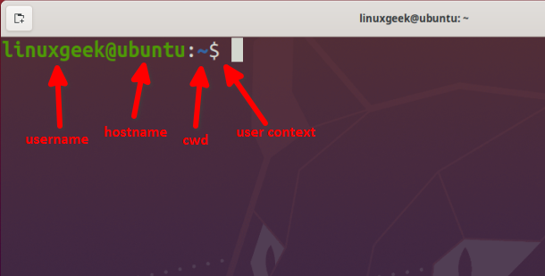
2.1 Command Line Basics
Basic shell
The shell is a text-based interface between you and the OS, a.k.a., the CLI
Multiple shells exist, BASH the de facto standard on modern distros
The shell has a prompt, configurable by the user [7]:
username
hostname
current working directory
user context, where $ is a standard user and # is the superuser
[7] Professor Kristopher Goodell, “C851 Controlling the Prompt” WGU, 14-Nov-2021. [Online]. Available: https://wgu.hosted.panopto.com/ Panopto/Pages/Viewer.aspx?id=ead47465-803d-4d0b-b51f-ade00171c975. [Accessed: 5-Jan-2022]
Notes:
Note: For more on customizing your prompt, please see Professor Goodells video, “C851 Controlling the Prompt” at https://wgu.hosted.panopto.com/Panopto/Pages/Viewer.aspx?id=ead47465-803d-4d0b-b51f-ade00171c975
Commands:
echo ‘Hello World!’
echo $USER #current user
echo $HOME #path to user’s home folder
echo $SHELL #user’s shell
echo $PATH #path environment variable
history
!665
<CTRL><SHIFT><C> #copy text in the terminal
<CTRL><SHIFT><V> #paste text in the terminal

Slide 7
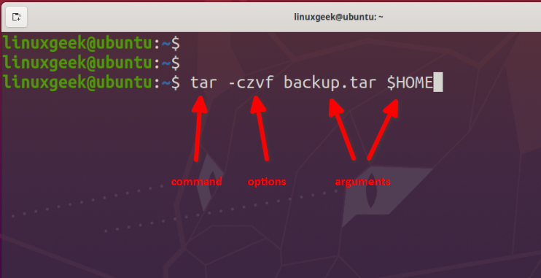
2.1 Command Line Basics
Command line syntax
command [option(s)/parameter(s)...] [argument(s)...]
Only the command is required
Options are switches that modify
Arguments are data passed
2 Types:
Builtin to the shell
External (reside in the filesystem)
Notes:
Notes
• Builtin commands (e.g., cd, set, export)
• External commands (e.g., /usr/bin/find)
Commands
type cd
cd --help
which ls
type ls
file ls
ls --help
man ls
type cat cd ls #type with multiple arguments
# Command short vs. long formats
ls -la
ls --all --format=long
cat animals2.sh
cat -n animals2.sh

Slide 8
2.1 Command Line Basics
Quoting
Char | Meta (or Special) Character Meaning
. | Match any 1 character
* | Match zero or more characters
^ | Match line or string start pattern (e.g., ^start)
$ | Match line or string end pattern (e.g., end$)
\ | Escape next char, remove special meaning
[ ] | Match 1 in list or range (e.g., ["abc", "def"] or [1..9])
+ | Match 1 or more preceding (e.g., grep a+)
? | Match zero or 1 preceding character
Double Quotes
Interpret text as regular characters
Most special characters lose meaning
Single Quotes
Interpret text as regular characters
No characters have special meaning
Escape Characters
Special characters lose their meaning
Notes:
Notes
Exceptions for double quotes: $, \, `
Commands
printf "k\\nk“ #newline character has special meaning
printf 'k\\nk’ #newline character does not have special meaning
datecommand=“date”
datecommand=‘date’
datecommand=`date`
echo I am $USER #shows current user
echo "I am $USER“ #shows that the $ is an exception
echo ‘I am $USER’ #shows the exact string, not the result
touch new file #creates 2 files
touch “new file” #space character loses special meaning
echo $USER #shows the variable expanded
echo \$USER #removes the special meaning to the $
Other character meanings:
$ Variable substitution
` ` Command substitution
( ) Command grouping
{ }String substitution
\ Escapes next character
! History character
* ? [ ] ~ Filename metacharacters

Slide 9
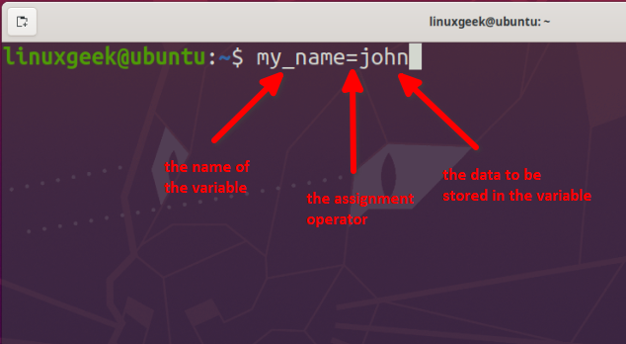
2.1 Command Line Basics
Variables
Store data (e.g., integers, strings)
Data can be accessed later
2 types known as the variable scope
Local
Known to the local shell only
Not inherited by sub-processes
Environment
Available globally
DATE, HOME, PATH, USER
The complete set of environment variables a.k.a. as “the environment”
Not persistent
Notes:
Commands
myname=john
echo "My name is: $myname“
unset myname #remove a variable
echo $myname #validate variable has been removed
echo $myname
bash -c 'echo $myname’
export myname
bash -c 'echo $myname’
unset myname
bash -c 'echo $myname'
env |less #prints environment variables
$ <TAB><TAB>
echo $PATH
echo -e "$USER \n$HOME \n$SHELL“ #print 3 env variables split by newlines
TZ=MST date && TZ=EST date

Slide 10


Join at https://app.sli.do/event/ll0ztpme

Slide 11

Demos
Based on Red Hat Enterprise Linux (RHEL)
Oracle Linux is an open-source clone
Did You Know? Oracle’s Linux distro is a clone of RHEL and used in the Oracle Cloud Infrastructure (OCI).

Slide 12
What Questions Do you Have?

