Slide 1
Topic 2.2 Using the Command Line to Get Help
C851 Cohort Live Session for Wednesday, March 9, 2022
Dr. John S. Galliano | C851 Linux Foundations Instructor

Slide 2
Agenda
Welcome
Lecture
Demos
Sample Exam Questions
Wrap-Up

Slide 3
2.1 Using the Command Line to Get Help [1]
Exam Topics/Weightings [2]
Linux Essentials v1.6 Exam Sub-Topics [5] | 1.1 | 2
 | 1.2 | 2
 | 1.3 | 1
 | 1.4 | 2
 | 2.1 | 3
 | 2.2 | 2
 | 2.3 | 2
 | 2.4 | 2
 | 3.1 | 2
 | 3.2 | 3
 | 3.3 | 4
 | 4.1 | 1
 | 4.2 | 2
 | 4.3 | 3
 | 4.4 | 2
 | 5.1 | 2
 | 5.2 | 2
 | 5.3 | 2
 | 5.4 | 1
 |  | 40
Description:
Running help commands and navigation of the various help systems
Key Knowledge Areas:
--help, man and info pages, /usr/share/doc/
which, whereis
locate, find
[1] Linux Professional Institute (LPI), “Exam 010 Objectives,” Linux Professional Institute, 21-Oct-2018. [Online]. Available: https://www.lpi.org/our-certifications/exam-010-objectives. [Accessed: 10-Jul-2021]
[2] Linux Professional Institute, “Linux Essentials Objectives V1.6 - LPI Wiki,” Linux Professional Institute, 25-Jan-2020. [Online]. Available: https://wiki.lpi.org/wiki/Linux_Essentials_Objectives_V1.6. [Accessed: 14-Aug-2021]

Slide 4
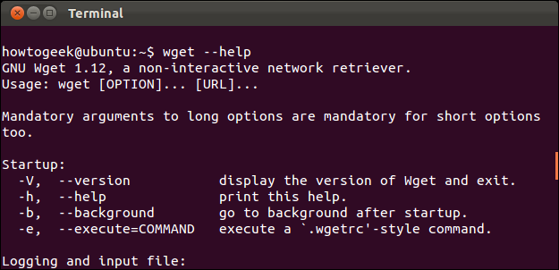
2.2 Using the CLI to Get Help
The 3 Ways to Get Help
command sensitive help
the Linux Programmer’s Reference Manual
the software developer
Notes:
Commands:
locate --help #context sensitive help in the terminal
man locate #the manual page for the command given
ls /usr/share/doc #view documentation provided by the developer on any installed package
ls -R /usr/share/doc
ls -la /usr/share/doc/zip
ls -la /usr/share/doc/ufw/examples

Slide 5
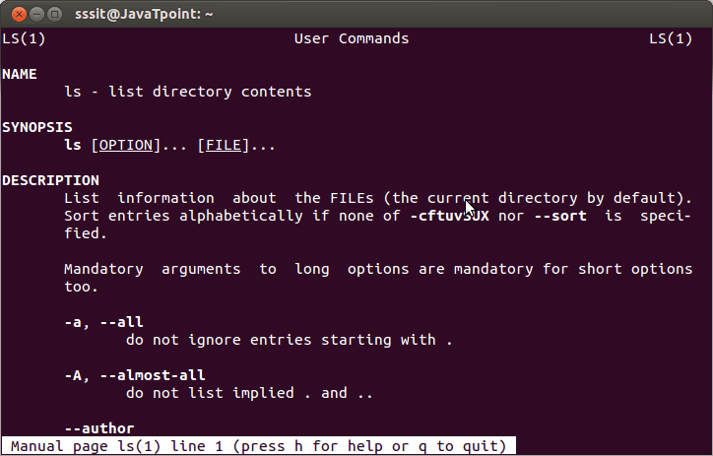
2.2 Using the CLI to Get Help
The man Pages
Title (the page’s name)
Summary of the command’s syntax
Description of the command’s purpose
Listing/description of each of the command’s options
Navigate via cursor, page up/dn keys
Search using the '/' key
Exit using the 'q' key
Category | Description
1 | User command
5 | Configuration files and file formats
8 | System administrator commands
Notes:
Notes: As a programmer, sections 2 and 3 could be of interest as well.
Commands:
man 1 crontab #get use command help
man 5 crontab #get config files/file formats
# show pg up/dn, space bar, q
/crontab #performs a search for the keyword

Slide 6
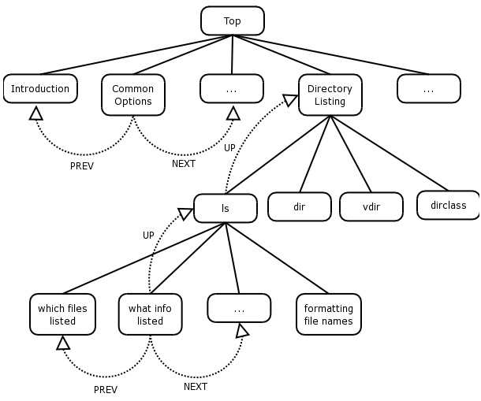
2.2 Using the CLI to Get Help
info Pages, Part 1
GNU Project alternative to man pages
Info pages hyperlinked like web pages
info reads info files, tree structured into individual nodes, each a single topic
Hyperlinks move between nodes
Accessed with the command info
A hyperlink is activated by placing the cursor upon it and pressing ENTER
Notes:
Commands:
info locate

Slide 7
2.2 Using the CLI to Get Help
info Pages, Part 2
+-----------------------+-------------------------------------+
| Command | Action |
+-----------------------+-------------------------------------+
| ? | Display command help |
| PAGE UP or BACKSPACE | Display previous page |
| PAGE DOWN or spacebar | Display next page |
| n | Next—display the next node |
| p | Previous—display the previous node |
| U | Up—show parent node, usually a menu |
| ENTER | Hyperlink at cursor to next NODE |
| Q | Quit |
+-----------------------+-------------------------------------+

Slide 8
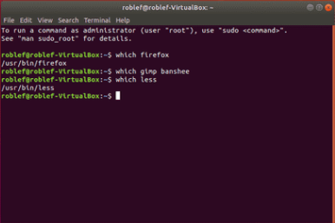
2.2 Using the CLI to Get Help
which, whereis, whatis
which searches for executable programs/scripts located in $PATH
whereis provides the command location and man page location
whatis provides the name and 1-line description of a man page matching a specified keyword
Notes:
Commands:
which locate #finds the command in the $PATH variable
echo $PATH
which -a locate #finds all occurrences
man -k passwd #list where the man pages are located
apropos passwd #find close matches
whereis ps #shows command location and man page
whatis crontab #shows applicable man sections

Slide 9
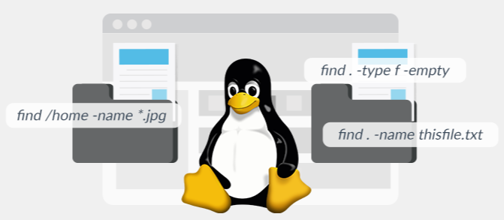
2.2 Using the CLI to Get Help
locate, find
searches a database and outputs every name matching a string
uses inherent globbing (e.g., locate animal is like locate *animal*)
because locate is reading from an index, you may not find recently created files
run the updatedb command to refresh index at /var/lib/mlocate/mlocate.db
find command used to search for file objects on the live filesystem
searches a directory tree recursively, including subdirectories
Notes:
Commands:
locate -S #info about the index
locate animal #searches for all instances of the keyword
locate -l 3 README #finds the first 3 occurrences
touch shopping_list.md
locate shopping_list.md
updatedb
locate shopping_list.md
find /home -name shopping_list.md

Slide 10

Demos
Based on Ubuntu

