Slide 1
Topic 5.1 Basic Security and Identifying User Types
C851 Cohort Live Session for Sunday, October 24, 2021
Dr. John S. Galliano | C851 Linux Foundations Instructor

Slide 2
Agenda
Welcome
Lecture
Demos
About the Exam
The 5 Exam Domains
Topic 5.1 Basic Security and Identifying User Types
Wrap-Up

Slide 3

About the Linux Essentials v1.6 [1]
The 5 Exam Domains [3]
No prerequisites
Closed book, up to 60 minutes
40 multiple-choice (some multi-select and fill-in-the-blank items) questions
Min pass score 500 points (200-800 scale)
Partially correct responses not accepted (for F-I-T-B questions LPI may accept multiple correct versions of an answer [2]
Total exam weight count is 40, thus 40 questions
The Linux Community and a Career in Open Source
Finding Your Way on a Linux System
The Power of the Command Line
The Linux Operating System
Security and File Permissions
[1,3] Linux Professional Institute, “Linux Professional Institute Linux Essentials,” Linux Professional Institute, 21-Oct-2018. [Online]. Available: https://www.lpi.org/our-certifications/linux-essentials-overview. [Accessed: 14-Aug-2021]
[2] Dr. Galliano’s correspondence with LPI, dated August 2021: Example: with/without leading path in a case where the answer is a command
Notes:
Examples:
• If an objective has a weight of 3, there will be 3 questions on the exam related to that objective [2]
Links:
• View the 3rd party cert tips video at https://bit.ly/3party_cert_tips
• https://explainshell.com/ to learn about commands, options, arguments
• Dr. Galliano’s Github repo (study guide, cheatsheets, slidedecks, etc. at https://github.com/g33k247/851, specifically the user management cheatsheet at https://github.com/g33k247/851/blob/main/cheatsheets/cheat_sheet_users_groups.pdf

Slide 4

LPI Exam Re-Take Policy [4]
Anyone who takes an LPI exam once must wait one week before re-taking
Anyone who takes an LPI exam a second (and subsequent) time must wait 30 days before re-taking
3rd and subsequent attempts at your own cost ($120)
[4] Linux Professional Institute, “Privacy Statement and Policies,” Linux Professional Institute, 18-May-2018. [Online]. Available: https://www.lpi.org/policies. [Accessed: 14-Aug-2021].
Notes:
• Anyone who passes an LPI exam may not retake that exam for two years

Slide 5

Exam Topics/Weightings
Linux Essentials v1.6 Exam Topics [5] | 1.1 | 2
 | 1.2 | 2
 | 1.3 | 1
 | 1.4 | 2
 | 2.1 | 3
 | 2.2 | 2
 | 2.3 | 2
 | 2.4 | 2
 | 3.1 | 2
 | 3.2 | 3
 | 3.3 | 4
 | 4.1 | 1
 | 4.2 | 2
 | 4.3 | 3
 | 4.4 | 2
 | 5.1 | 2
 | 5.2 | 2
 | 5.3 | 2
 | 5.4 | 1
 |  | 40
[5] Linux Professional Institute, “Linux Essentials Objectives V1.6 - LPI Wiki,” Linux Professional Institute, 25-Jan-2020. [Online]. Available: https://wiki.lpi.org/wiki/Linux_Essentials_Objectives_V1.6. [Accessed: 14-Aug-2021].
Notes:
• A weight of “1” equates to 1 exam question
• Since there is a weight of ‘2’, you will see 2 questions on this topic!

Slide 6

5.1 Basic Security and Identifying User Types [6]
Weight: 2 (2 questions)
Description:
Various types of users on a Linux system
Key Knowledge Areas:
Root and standard users
System users
Files used, terms and utilities:
/etc/passwd, /etc/shadow, /etc/group
id, last, who, w
sudo, su
[6] Linux Professional Institute (LPI), “Exam 010 Objectives,” Linux Professional Institute, 21-Oct-2018. [Online]. Available: https://www.lpi.org/our-certifications/exam-010-objectives. [Accessed: 10-Jul-2021].

Slide 7

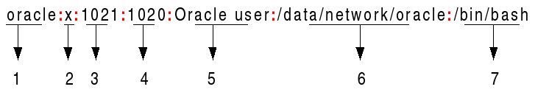
Where are Accounts Stored? [7]
Accounts are maintained in /etc/password
Username: Between 1 and 32 characters in length.
Password: An x character indicates the hashed password is stored in /etc/shadow file
User ID (UID): UID 0 (zero) is reserved for root / normal users start at 1000
Group ID (GID): The primary group ID (stored in /etc/group file)
User ID Info (GECOS): Comment field (used by the finger command)
Home directory: Absolute path to the User’s home directory
Command/shell: Path of the User’s default shell (/bin/bash)
[7] C. Bresnahan and R. Blum, “LPI Linux Essentials Study Guide: Exam 010 v1.6.,” John Wiley & Sons, Incorporated, 2020. Chapter 12 [Online]. Available: https://ebookcentral.proquest.com/lib/westerngovernors-ebooks/reader.action?docID=6002518. [Accessed: 23-Oct-2021].
Notes:
Commands (‘#’ denotes a comment):
# what user/context is on the system?
id #what is the current user’s identity & group membership
whoami #what is my current user context
who #who is currently online
who am i #displays data only about the current user
w #like whoami but more verbose
pinky <username> #modern version of finger
# User Passwords
passwd
passwd –Sa #display the information of all users
passwd -e #expire a user’s password immediately (forces user to change password at next login)
passwd -l #lock a user’s password (adds “!” at start of user’s password & user can’t change password when locked)
passwd -u #unlock user’s password
echo -e "new_password" | passwd <username> #for shell scripting

Slide 8
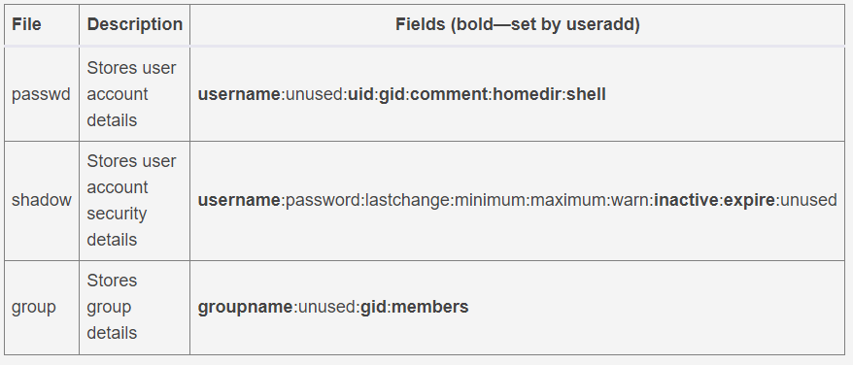
The 3 User Management Files Compared
PRO TIP: getent is a utility for fetching entries using the Name Service Switch (NSS) libraries from a specific system database
Notes:
Commands (‘#’ denotes a comment):
#View Accounts
ls -l /etc/passwd #what perms are on the file (-rwr—r– or 644)
stat /etc/passwd #see details, note user/owner
less /etc/passwd or getent passwd #list all users
getent passwd | wc –l #how many accounts on my system
less /etc/shadow #list all users and password details
less /etc/group #list group memberships
grep -w ‘^linux' /etc/passwd #show only a specific user’s entry
cut -d: -f1 /etc/passwd #display only the username
awk -F: '{ print $1}' /etc/passwd #display only the username
grep -E '^UID_MIN|^UID_MAX' /etc/login.defs #what are the UID bounds on the system
getent passwd {1000..60000} #list only user accounts
groups billy susan #command is used to show all the groups a user belongs to
lslogins –u #shows user accounts
Exam Essentials:
• Know the difference between an account name and UID
• Know how to read the /etc/passwd and /etc/shadow files (colon delimited)
• The root user has its own home directory called /root
• For users to successfully log in, they must have a valid username, password, and other information defined in /etc/passwd and /etc/shadow files

Slide 9

Root, Standard, and System Users [7]
Root user = superuser = UID 0
System Accounts = 1 – 999
Normal users = 1000+
Note: System accounts are used for nologin accounts to support daemons, services, or applications
[7] C. Bresnahan and R. Blum, “LPI Linux Essentials Study Guide: Exam 010 v1.6.,” John Wiley & Sons, Incorporated, 2020. Chapter 12 [Online]. Available: https://ebookcentral.proquest.com/lib/westerngovernors-ebooks/reader.action?docID=6002518. [Accessed: 23-Oct-2021].
Notes:
Commands (‘#’ denotes a comment):
#View Accounts
grep -E '^UID_MIN|^UID_MAX' /etc/login.defs #what are the UID bounds on the system
getent passwd {1000..60000} #list only user accounts
getent passwd billy susan
getent group billy susan
sudo passwd -S billy #get status on a specific user account
for p in $(ls /home); do passwd -S $p; done #bash 1-liner to get status on user accounts
Exam Essentials:
• Know the difference between an account name and UID
• The root user has its own home directory called /root
• For users to successfully log in, they must have a valid username, password, and other information defined in /etc/passwd and /etc/shadow files
NOTE: The -S option to passwd outputs the status of the password for a given account. The status information consists of 7 fields:
• The 1st field is the user's login name
• The 2nd field indicates if the user account has a locked password (LK), has no password (NP), or has a usable password (PS)
• The 3rd field gives the date of the last password change
• The next 4 fields are the minimum age, maximum age, warning period, and inactivity period (in days)

Slide 10
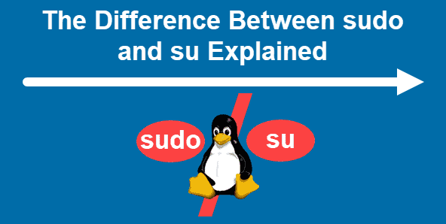
User Context
Substitute User
su (in the current shell)
sudo (execute w/interactive root privilege)
sudo -i (non-interactive root privilege)
sudo su (execute w/root privilege & current user’s password)
Root User
su - (substitute user to root)
root login (login as the root account)
Others
sudo -s (spawns subshell based on $SHELL)
sudo -c (run a single command as root)
PRO TIP: When sudo su is run, “.profile,” “.bashrc” and “/etc/profile” will be started, like running su (or su root)
Notes:
Commands (‘#’ denotes a comment):
sudo -l #see what privileges the current user has under sudo
sudo -l -U billy #see privs for another user
Exam Essentials:
• The ‘#’ character denotes root access

Slide 11

Demos
Based on Red Hat Enterprise Linux (RHEL)
Oracle Linux is an open-source clone
Did You Know? Oracle’s Linux distro is a clone of RHEL and used in the Oracle Cloud Infrastructure (OCI).
Notes:
Commands (‘#’ denotes a comment):

Slide 12

Notes:
Interested?
• Contact the email address or connect via social media links at the bottom of the graphic
• Mention that you were referred by Dr. Galliano.

Slide 13
What Questions Do you Have for Me?

