Slide 1
Topic 4.4 Your Computer on the Network
C851 Cohort Live Session for Sunday, September 12, 2021
Dr. John S. Galliano | C851 Linux Foundations Instructor

Slide 2
Agenda
Welcome
Upgraded C851
About the Exam
The 5 Exam Domains
Topics/Weightings
LPI Retake Policy
Demos/Hands-on
Sample Exam Questions
Wrap-Up
Look for the notes in the window next to the presentation >>

Slide 3
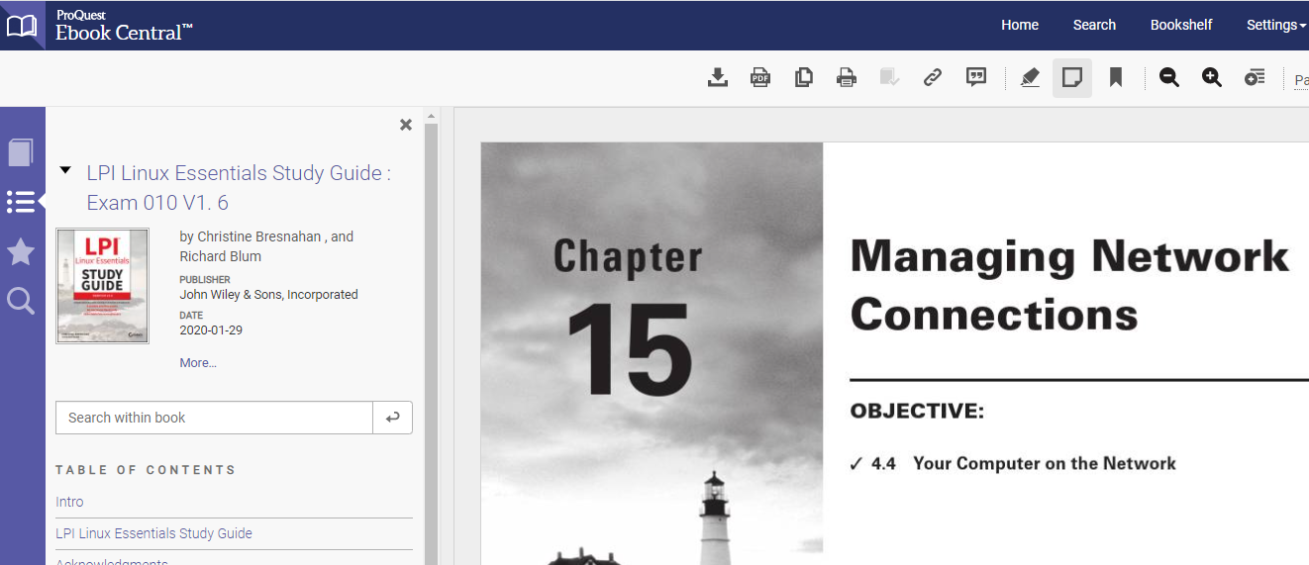
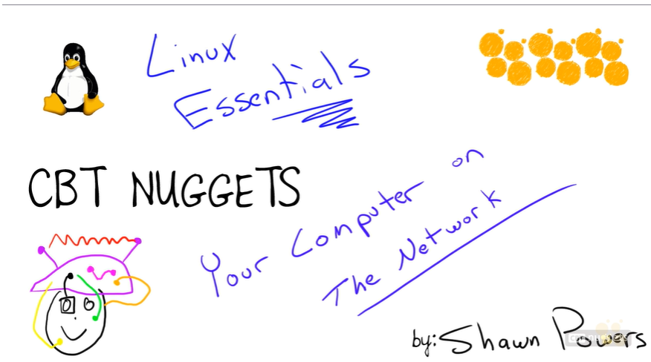
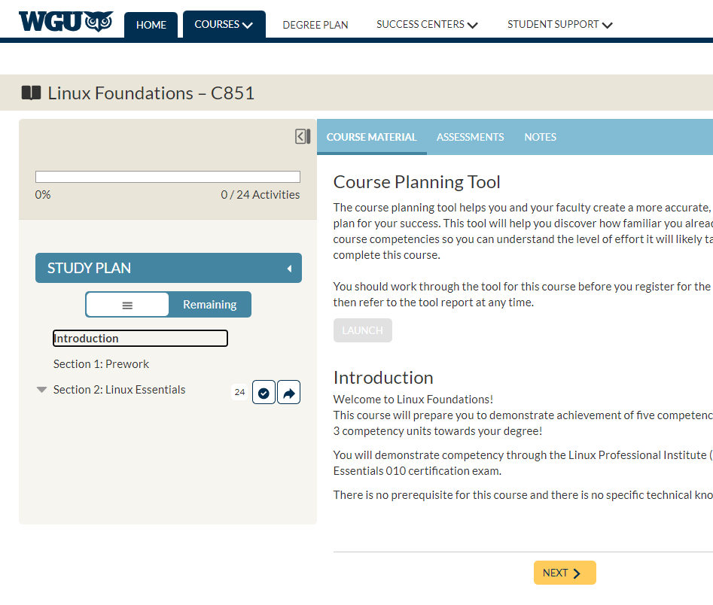
C851 v4 Upgraded Course Experience
C851 gets an UPGRADE!
Refreshed course site launches on 9/23
Content remains the same but new labs built on RHEL
New delivery via CBTnuggets and the Sybex LPI Linux Essentials prep guide
You are encouraged to install your own VM by following along at: https://bit.ly/create_vm
Notes:
Create your own VM Using Kali Linux: https://bit.ly/create_vm

Slide 4

About the Linux Essentials v1.6 [1]
The 5 Exam Domains [3]
No prerequisites
Closed book, up to 60 minutes
40 multiple-choice (some multi-select and fill-in-the-blank items) questions
Min pass score 500 points (200-800 scale)
Partially correct responses not accepted (for F-I-T-B questions LPI may accept multiple correct versions of an answer [2]
Total exam weight count is 40, thus 40 questions
The Linux Community and a Career in Open Source
Finding Your Way on a Linux System
The Power of the Command Line
The Linux Operating System
Security and File Permissions
[1,3] Linux Professional Institute, “Linux Professional Institute Linux Essentials,” Linux Professional Institute, 21-Oct-2018. [Online]. Available: https://www.lpi.org/our-certifications/linux-essentials-overview. [Accessed: 14-Aug-2021]
[2] Dr. Galliano’s correspondence with LPI, dated August 2021: Example: with/without leading path in a case where the answer is a command
Notes:
Example: If an objective has a weight of 4, there will be 4 questions on the exam related to that objective [2]
Link: View the 3rd party cert tips video at https://bit.ly/3party_cert_tips

Slide 5

LPI Exam Re-Take Policy [4]
Anyone who takes an LPI exam once must wait one week before re-taking
Anyone who takes an LPI exam a second (and subsequent) time must wait 30 days before re-taking
3rd and subsequent attempts are at your own cost ($120)
[4] Linux Professional Institute, “Privacy Statement and Policies,” Linux Professional Institute, 18-May-2018. [Online]. Available: https://www.lpi.org/policies. [Accessed: 14-Aug-2021].
Notes:
• Anyone who passes an LPI exam may not retake that exam for two years

Slide 6

Exam Topics/Weightings
Linux Essentials v1.6 Exam Topics [5] | 1.1 | 2
 | 1.2 | 2
 | 1.3 | 1
 | 1.4 | 2
 | 2.1 | 3
 | 2.2 | 2
 | 2.3 | 2
 | 2.4 | 2
 | 3.1 | 2
 | 3.2 | 3
 | 3.3 | 4
 | 4.1 | 1
 | 4.2 | 2
 | 4.3 | 3
 | 4.4 | 2
 | 5.1 | 2
 | 5.2 | 2
 | 5.3 | 2
 | 5.4 | 1
 |  | 40
[5] Linux Professional Institute, “Linux Essentials Objectives V1.6 - LPI Wiki,” Linux Professional Institute, 25-Jan-2020. [Online]. Available: https://wiki.lpi.org/wiki/Linux_Essentials_Objectives_V1.6. [Accessed: 14-Aug-2021].
Notes:
• A weight of “1” equates to 1 exam question
• Since there is a weight of ‘3’, you will see 3 questions on searching and extracting data from files!

Slide 7
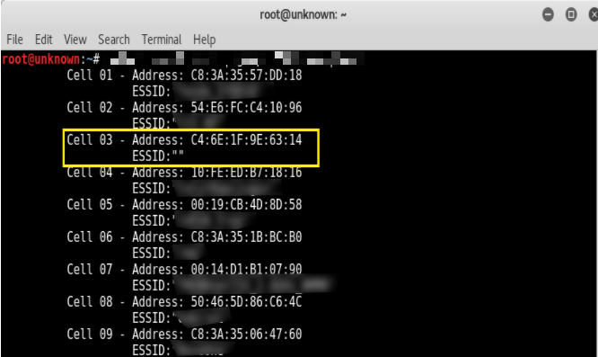
4.4 Your Computer on the Network [6]
Weight: 2 (2 questions)
Key Knowledge Areas:
Internet, network, routers
Querying DNS client configuration
Querying network configuration
Files used, terms and utilities:
route, ip route show
ifconfig, ip addr show
netstat, ss
/etc/resolv.conf, /etc/hosts
IPv4, IPv6
ping
host
[6] Linux Professional Institute (LPI), “Exam 010 Objectives,” Linux Professional Institute, 21-Oct-2018. [Online]. Available: https://www.lpi.org/our-certifications/exam-010-objectives. [Accessed: 10-Jul-2021].
Notes:
• commands used in today’s content, ‘#’ denotes a comment
route –n #shows kernel routing table, gateway, mask, flags, metric, inteface
ip route show #shows default route via the gateway, interface, and src ip
ifconfig #shows data for each interface, incld ip addr, mask, broadcast, mac addr, and stats
ip addr show #shows similar data, often colorized
netstat -ant #shows socket statistics
ss –ant #shows socket statistics
ping –c1 <ip_addr> #sends a single ping packet to establish connectivity
host www.google.com #shows dns info and mx records
ethtool <devname> #shows NIC parameters
• Link: https://explainshell.com/

Slide 8
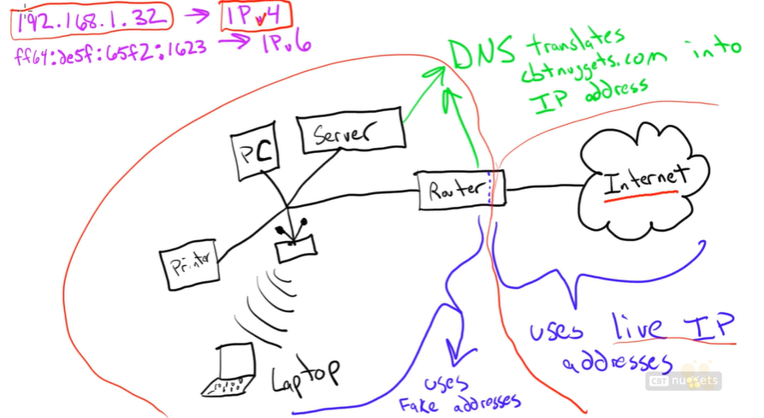
The Internet, Network, & Routers[7]
There are 5 configuration items you need to know for the exam:
Host / localhost addressing
The local subnet
The default route
The Hostname
DNS configuration
[7] P. Shaun, “CBT Nuggets - Linux Essentials: Your Computer on the Network,” CBT Nuggets, 26-Jul-2018. [Online]. Available: https://www.cbtnuggets.com/learn/it-training/playlist/nrn:playlist:certification:5b5b36564c71f3564524dcf4/16? autostart=1. [Accessed: 11-Sep-2021].
Notes:
• Networking commands for addressing
ifconfig
ip a show
• Networking commands for routing
route -n
ip route show
• Networking commands for hostname
hostname
Hostnamectl

Slide 9
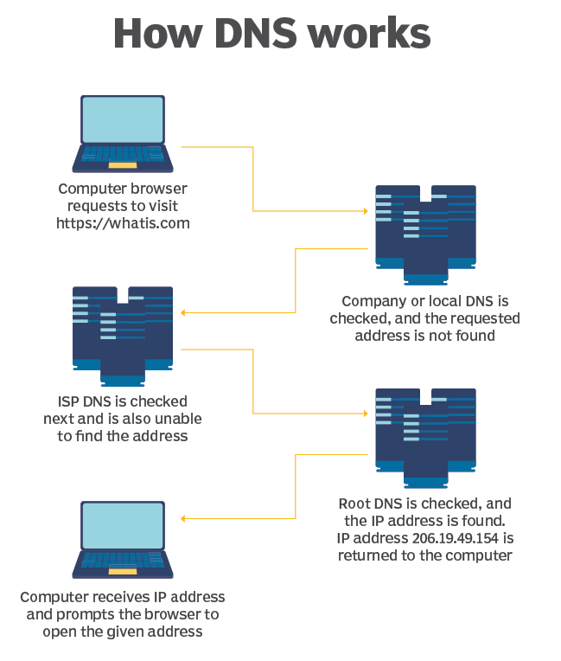
What is DNS?
How is name resolution implemented on your Linux host?
[8] B. Posey, “What Is DNS Over HTTPS (DoH)?,” SearchSecurity, 21-May-2020. [Online]. Available: https://searchsecurity.techtarget.com/definition/DNS-over-HTTPS-DoH. [Accessed: 11-Sep-2021].

Slide 10
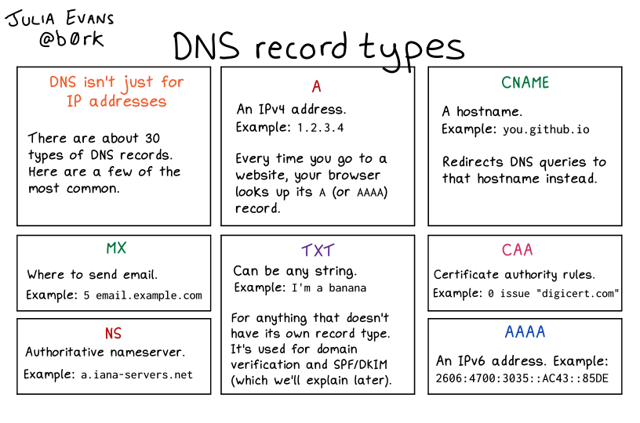
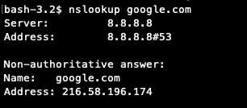
Querying DNS & Configs
DNS configurations
DNS lookups
DNS record types[9]
[9] J. Evans, “DNS Record Types,” Wizard Zines, 2021. [Online]. Available: https://wizardzines.com/comics/dns-record-types/. [Accessed: 11-Sep-2021].
Notes:
• DNS configurations
cat /etc/nsswitch #config file that tells Linux where to look for DNS information (ex: files DNS)
cat /etc/hosts #represents the “files” entry in nsswitch.conf, typically has entries for localhost and hostname
cat /etc/resolv.conf #represents the “files” entry in nsswitch.conf, typically has 1 or more nameserver, including local DNS cache
• DNS lookups
nslookup www.google.com #provides DNS query, typically in both IPv4/IPv6
dig www.google.com #newer utility to perform DNS queries

Slide 11
How do we troubleshoot networking on a Linux host? “Network troubleshooting is a repeatable process, which means that you can break it down into clear steps that anyone can follow.” [10]
The CompTIA 6-Step Methodology
1. Identify the Problem
2. Develop a Theory
3. Test the Theory
4. Plan of Action
5. Implement the Solution
6. Verify System Functionality
7. Document the Issue
[10] CompTIA, “Network Troubleshooting | How To Fix A Network Connection | Computer Network | CompTIA,” Default. [Online]. Available: https://www.comptia.org/content/guides/a-guide-to-network-troubleshooting. [Accessed: 11-Sep-2021].
Notes:
• Checking configurations
ifconfig
ip addr show
route
ip route show
nmtui #graphical terminal utility to configure network interfacesnmcli device #Display network devices
nmcli device show eth0 #Show information about eth0 device
nmcli connection #Show network connections
• Establishing connectivity
ping –c1 <ip_addr> #sends a single ping packet to establish connectivity
ping –c2 127.0.0.1 == ping –c2 192.168.171.128 == ping –c2 localhost #check the local tcp/ip stack
ping –c2 192.168.171.1 #check connectivity to the local router or default gateway
ping –c2 1.1.1.1 #check connectivity to a dns server on the Itnernet
ping6 google.com #ipv6 version of ping
traceroute 8.8.8.8 #check connectivity between 2 hosts
• Monitoring connections
netstat -ant #shows socket statistics
ss –ant #shows socket statistics
netstat --listening -l #List ports in listening mode
netstat --all –a #List all ports
netstat --route -r #Display routing tables
netstat --interfaces -i #Display TX/RX packet statistics for each interface

Slide 12
What Questions Do you Have for Me?

