Slide 1
Topic 2.3 - Using Directories and Listing Files
C851 Cohort Live Session for Sunday, September 26, 2021
Dr. John S. Galliano | C851 Linux Foundations Instructor

Slide 2
Agenda
Welcome
Upgraded C851
Format Comparison
The New Labs
Demos
About the Exam
The 5 Exam Domains
Wrap-Up

Slide 3

About the Linux Essentials v1.6 [1]
The 5 Exam Domains [3]
No prerequisites
Closed book, up to 60 minutes
40 multiple-choice (some multi-select and fill-in-the-blank items) questions
Min pass score 500 points (200-800 scale)
Partially correct responses not accepted (for F-I-T-B questions LPI may accept multiple correct versions of an answer [2]
Total exam weight count is 40, thus 40 questions
The Linux Community and a Career in Open Source
Finding Your Way on a Linux System
The Power of the Command Line
The Linux Operating System
Security and File Permissions
[1,3] Linux Professional Institute, “Linux Professional Institute Linux Essentials,” Linux Professional Institute, 21-Oct-2018. [Online]. Available: https://www.lpi.org/our-certifications/linux-essentials-overview. [Accessed: 14-Aug-2021]
[2] Dr. Galliano’s correspondence with LPI, dated August 2021: Example: with/without leading path in a case where the answer is a command
Notes:
Example: If an objective has a weight of 4, there will be 4 questions on the exam related to that objective [2]
Link: View the 3rd party cert tips video at https://bit.ly/3party_cert_tips

Slide 4

LPI Exam Re-Take Policy [4]
Anyone who takes an LPI exam once must wait one week before re-taking
Anyone who takes an LPI exam a second (and subsequent) time must wait 30 days before re-taking
3rd and subsequent attempts are at your own cost ($120)
[4] Linux Professional Institute, “Privacy Statement and Policies,” Linux Professional Institute, 18-May-2018. [Online]. Available: https://www.lpi.org/policies. [Accessed: 14-Aug-2021].
Notes:
• Anyone who passes an LPI exam may not retake that exam for two years

Slide 5

Exam Topics/Weightings
Linux Essentials v1.6 Exam Topics [5] | 1.1 | 2
 | 1.2 | 2
 | 1.3 | 1
 | 1.4 | 2
 | 2.1 | 3
 | 2.2 | 2
 | 2.3 | 2
 | 2.4 | 2
 | 3.1 | 2
 | 3.2 | 3
 | 3.3 | 4
 | 4.1 | 1
 | 4.2 | 2
 | 4.3 | 3
 | 4.4 | 2
 | 5.1 | 2
 | 5.2 | 2
 | 5.3 | 2
 | 5.4 | 1
 |  | 40
[5] Linux Professional Institute, “Linux Essentials Objectives V1.6 - LPI Wiki,” Linux Professional Institute, 25-Jan-2020. [Online]. Available: https://wiki.lpi.org/wiki/Linux_Essentials_Objectives_V1.6. [Accessed: 14-Aug-2021].
Notes:
• A weight of “1” equates to 1 exam question
• Since there is a weight of ‘3’, you will see 3 questions on searching and extracting data from files!

Slide 6
2.3 Using Directories and Listing Files [6]
Weight: 2 (2 questions)
Key Knowledge Areas:
Files, directories
Hidden files and directories
Home directories
Absolute and relative paths
Files used, terms and utilities:
Common options for ls
Recursive listings
cd
. and ..
home and ~
[6] Linux Professional Institute (LPI), “Exam 010 Objectives,” Linux Professional Institute, 21-Oct-2018. [Online]. Available: https://www.lpi.org/our-certifications/exam-010-objectives. [Accessed: 10-Jul-2021].
Notes:
• commands used in today’s content, ‘#’ denotes a comment
• Link: https://explainshell.com/

Slide 7
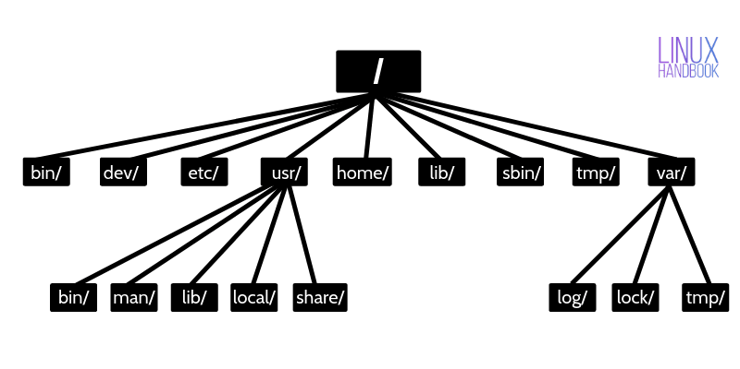
Understanding Where Things Go [7]
FHS
[7] A. Prakesh, “Linux Directory Structure Explained For Beginners,” Linux Handbook, 26-Jun-2019. [Online]. Available: https://linuxhandbook.com/linux-directory-structure/. [Accessed: 26-Sep-2021].
Notes:
Important to know for the exam:
/
/home, ls -la
/etc
/mnt, /media
/tmp
/var, /var/log
/dev, /proc, /sys
Commands used:
man hier #get help on the FHS
tree /home #hierarchical view of the file system

Slide 8
Exploring Files and Directories
Files, directories
Where am I?
Absolute and relative paths
Absolute path (always relative to the / directory):
/home/susan/documents
Relative path (from Susan’s docs):
../downloads
/
home
susan
billy
documents
downloads
[7] P. Shaun, “CBT Nuggets - Linux Essentials: Your Computer on the Network,” CBT Nuggets, 26-Jul-2018. [Online]. Available: https://www.cbtnuggets.com/learn/it-training/playlist/nrn:playlist:certification:5b5b36564c71f3564524dcf4/16? autostart=1. [Accessed: 11-Sep-2021].
Notes:
Commands used:
ls -la #long file listing, showing all files
cd , cd ~, cd ., cd .. #2 ways to change directory to home (relative path), pwd, and parent directories
cd /home/linuxgeek #change directory to home (absolute path)

Slide 9
Manipulating Files
. and ..
Hidden files
Creating new files
Copying/Moving files
Deleting files
[7] P. Shaun, “CBT Nuggets - Linux Essentials: Your Computer on the Network,” CBT Nuggets, 26-Jul-2018. [Online]. Available: https://www.cbtnuggets.com/learn/it-training/playlist/nrn:playlist:certification:5b5b36564c71f3564524dcf4/16? autostart=1. [Accessed: 11-Sep-2021].
Notes:
Important to know for the exam:
. = current working directory
.. = parent directory
Commands used:
ls, ls ., ls ..
ls -a
ls -l
ls -la
ls -d
ls -F
ls –R
ls -F /usr /bin/ls
ls -l t*
for f in $(ls); do file $f; done
touch newfile
cp –v newfile oldfile
mv newfile newfile1
rm newfile
ln -s /etc/resolv.conf dns

Slide 10
Manipulating Directories
Home directories
/tmp
Moving and deleting directories
[7] P. Shaun, “CBT Nuggets - Linux Essentials: Your Computer on the Network,” CBT Nuggets, 26-Jul-2018. [Online]. Available: https://www.cbtnuggets.com/learn/it-training/playlist/nrn:playlist:certification:5b5b36564c71f3564524dcf4/16? autostart=1. [Accessed: 11-Sep-2021].
Notes:
- Commands used
mkdir newdir
mkdir -p dirone newdir/dirtwo
rmdir dirone
rmdir newdir/dirtwo newdir
rmdir -r newdir
/tmp directory

Slide 11

Demos
Based on Red Hat Enterprise Linux (RHEL)
Oracle Linux is an open-source clone
Did You Know? Oracle’s Linux distro is a clone of RHEL and used in the Oracle Cloud Infrastructure (OCI).

Slide 12


Slide 13
What Questions Do you Have for Me?

