Slide 1
Topic 1.3 Open Source Software and Licensing
C851 Cohort Live Session for Sunday, December 12, 2021
Dr. John S. Galliano | C851 Linux Foundations Instructor

Slide 2
Agenda
Welcome
About the LPI Linux Essentials Exam
The 5 Exam Domains
Lecture
Sample Exam Questions
Wrap-Up

Slide 3

About the Linux Essentials v1.6 [1]
LPI Exam Re-Take Policy [3]
No prerequisites
Closed book, up to 60 minutes
40 questions (3 question types)
~75% (30) single-select multiple choice
~19% (8) multiple-select multiple choice
~6% (3) fill-in-the-blank
Partially correct responses not accepted [2]
Min score 500 points on 200-800 scale
Scaled scoring across all exam forms to normalize for difficulty level of questions
Number of correct answers to achieve 500 points varies across exam forms
Lifetime certification
Anyone who takes an LPI exam once must wait one week before re-taking
For second/subsequent retakes you must wait 30 days
3rd and subsequent attempts at your own cost ($120)
[1] Linux Professional Institute, “Linux Professional Institute Linux Essentials,” Linux Professional Institute, 21-Oct-2018. [Online]. Available: https://www.lpi.org/our-certifications/linux-essentials-overview. [Accessed: 14-Aug-2021]
[2] Dr. Galliano’s correspondence with LPI, dated August 2021: Example: with/without leading path in a case where the answer is a command
[3] Linux Professional Institute, “Privacy Statement and Policies,” Linux Professional Institute, 18-May-2018. [Online]. Available: https://www.lpi.org/policies. [Accessed: 14-Aug-2021].
Notes:
Notes:
• LPI *may* accept multiple correct versions of an answer for F-I-T-B questions [2]
• Anyone who passes an LPI exam may not retake that exam for two years [3]

Slide 4
The 5 Exam Domains [4]
The 3 Candidate Expectations [4]
The Linux Community and Careers in Open Source
Finding Your Way on a Linux System
The Power of the Command Line
The Linux Operating System
Security and File Permissions
Understand the Linux/open source industry and know popular open source apps
Understand major parts of the Linux OS and show technical proficiency on the CLI
Basic understanding of security and administration (e.g., user/group management, command line, permissions)
Do not underestimate the technical nature of this exam. You must be familiar with commands and practice in the Linux terminal!
[4] Linux Professional Institute, “Linux Professional Institute Linux Essentials,” Linux Professional Institute, 21-Oct-2018. [Online]. Available: https://www.lpi.org/our-certifications/linux-essentials-overview. [Accessed: 14-Aug-2021]
Notes:
Links:
• View the 3rd party cert tips video at https://bit.ly/3party_cert_tips
• https://explainshell.com/ to learn about commands, options, arguments
• https://learning.lpi.org/en/learning-materials/010-160/
• https://overthewire.org to practice command line skills
• Dr. Galliano’s Github repo (study guide, cheatsheets, slidedecks, etc. at https://github.com/g33k247/851
Exam Objectives:
1. The Linux Community and a Career in Open Source
1.1 Linux Evolution and Popular Operating Systems - Distributions (Debian, Ubuntu (LTS), CentOS, openSUSE, Red Hat, SUSE, Linux Mint, Scientific Linux) - Embedded Systems (Raspberry Pi, Raspbian, Android) - Linux in the Cloud
1.2 Major Open Source Applications
- Desktop applications (OpenOffice.org, LibreOffice, Thunderbird, Firefox, GIMP) - Server applications (Nextcloud, ownCloud; Apache HTTPD, NGINX, MariaDB, MySQL, NFS, Samba) - Development languages (C, Java, JavaScript, Perl, shell, Python, PHP) - Package management tools and repositories (dpkg, apt-get, rpm, yum_
1.3 Open Source Software and Licensing - Open source philosophy - Open source licensing - Free Software Foundation (FSF), Open Source Initiative (OSI) - Open source business models
1.4 Information and Communication Technology (ICT) Skills and Working in Linux - Desktop skills - Getting to the command line - Industry uses of Linux, cloud computing and virtualization
2. Finding Your Way on a Linux System
2.1 Command Line Basics - Basic shell - Command line syntax - Variables - Quoting
2.2 Using the Command Line to Get Help - Man pages - Info pages - /usr/share/doc/ - locate
2.3 Using Directories and Listing Files - Files, directories - Hidden files and directories - Home directories - Absolute and relative paths
2.4 Creating, Moving and Deleting Files - Files and directories - Case sensitivity - Simple globbing
3. The Power of the Command Line
3.1 Archiving Files on the Command Line - Files, directories - Archives, compression (tar, gzip, bzip2, xz, zip)
3.2 Searching and Extracting Data from Files - Command line pipes (grep, less, cat, head, tail, sort, cut, wc) - I/O redirection - Basic Regular Expressions using ., [ ], *, and ?
3.3 Turning Commands into a Script - Basic shell scripting - Awareness of common text editors (vi and nano)
4. The Linux Operating System
4.1 Choosing an Operating System - Differences between Windows, OS X and Linux (GUI versus command line, desktop configuration) - Distribution life cycle management (maintenance cycles, beta and stable)
4.2 Understanding Computer Hardware - Motherboards, processors, power supplies, optical drives, peripherals - Hard drives, solid state disks and partitions, /dev/sd* - Drivers
4.3 Where Data is Stored - Programs and configuration (/etc) - Processes (ps, top) - Memory addresses - System messaging (syslog, dmesg) - Logging (/var/log)
4.4 Your Computer on the Network - Internet, network, routers - Querying DNS client configuration - Querying network configuration
5. Security and File Permissions
5.1 Basic Security and Identifying User Types
- Root and standard users - System users
5.2 Creating Users and Groups - User and group commands - User IDs
5.3 Managing File Permissions and Ownership - File and directory permissions and ownership (ls -l, ls -a, chmod, chown)
5.4 Special Directories and Files - Using temporary files and directories (/tmp/, /var/tmp/ and Sticky Bit; ls -d) - Symbolic links (ln -s)

Slide 5
1.3 Open Source Software and Licensing [6]
Exam Topics/Weightings [5]
Linux Essentials v1.6 Exam Sub-Topics [5] | 1.1 | 2
 | 1.2 | 2
 | 1.3 | 1
 | 1.4 | 2
 | 2.1 | 3
 | 2.2 | 2
 | 2.3 | 2
 | 2.4 | 2
 | 3.1 | 2
 | 3.2 | 3
 | 3.3 | 4
 | 4.1 | 1
 | 4.2 | 2
 | 4.3 | 3
 | 4.4 | 2
 | 5.1 | 2
 | 5.2 | 2
 | 5.3 | 2
 | 5.4 | 1
 |  | 40
Weight: 1 (1 questions)
Description:
Open communities and licensing Open Source Software for business
Key Knowledge Areas:
Open source philosophy and licensing
Free Software Foundation (FSF)
Open Source Initiative (OSI)
Files used, terms and utilities:
Copyleft, Permissive
GPL, BSD, Creative Commons
Free Software, Open Source Software, FOSS, FLOSS
Open source business models
[5] Linux Professional Institute, “Linux Essentials Objectives V1.6 - LPI Wiki,” Linux Professional Institute, 25-Jan-2020. [Online]. Available: https://wiki.lpi.org/wiki/Linux_Essentials_Objectives_V1.6. [Accessed: 14-Aug-2021].
[6] Linux Professional Institute (LPI), “Exam 010 Objectives,” Linux Professional Institute, 21-Oct-2018. [Online]. Available: https://www.lpi.org/our-certifications/exam-010-objectives. [Accessed: 10-Jul-2021].
Notes:
PRO TIP: An exam objective weight of 1 means you should expect 1 questions on the exam related to that objective.

Slide 6
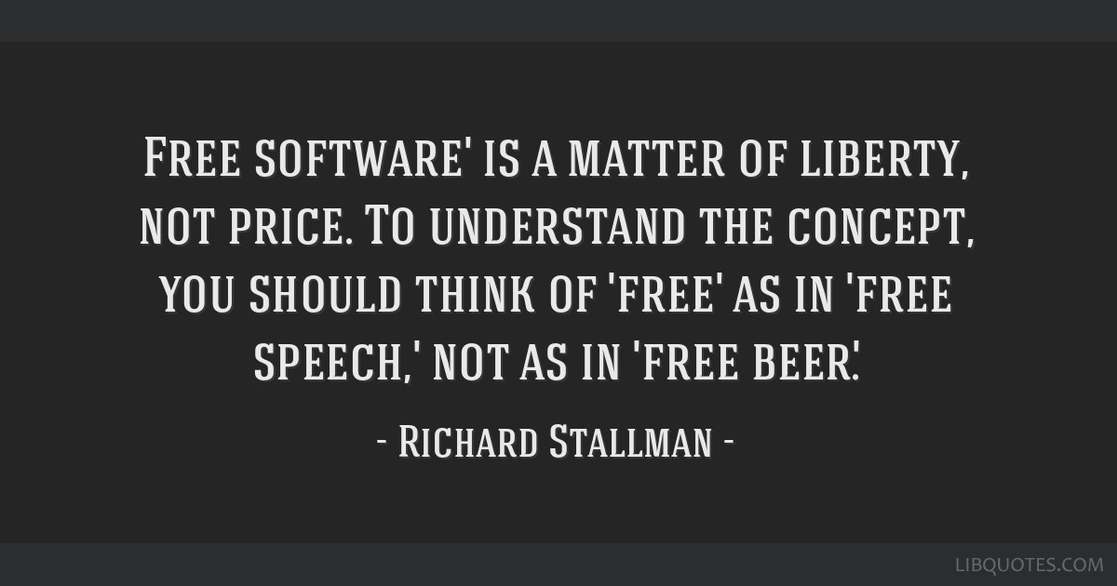
1.3 Open-Source Software and Licensing
Open source philosophy/licensing can be summarized by 4 Essential User Freedoms:
0. Run the program for any purpose
1. Study how the program works, and change it so it does your computing as you wish
2. Redistribute copies to help others
3. Distribute modified versions to others
FOSS: Free and Open Source Software
FLOSS: Free/Libre and Open Source Software
Free Software Foundation (FSF)
founded in 1985 by Richard Stallman, more of a socio-political movement
Open Source Initiative (OSI)
founded in 1998 by Eric S. Raymond and Bruce Perens, mainly concerned with licensing issues

Slide 7

1.3 Open-Source Software and Licensing
How do we license software – A digital product?
Right to use vs. right of ownership via 2 license types:
Copyleft [7] basically retains all rights to the full source code and all rights to modify and distribute the entire code
Permissive allows developers to include their own copyright notices
Copyleft
Permissive
GPL Apache BSD MIT
[7] The GNU Project, “What Is Copyleft?,” Free Software Foundation, 15-Dec-2018. [Online]. Available: https://www.gnu.org/licenses/copyleft.en.html. [Accessed: 14-Aug-2021].

Slide 8
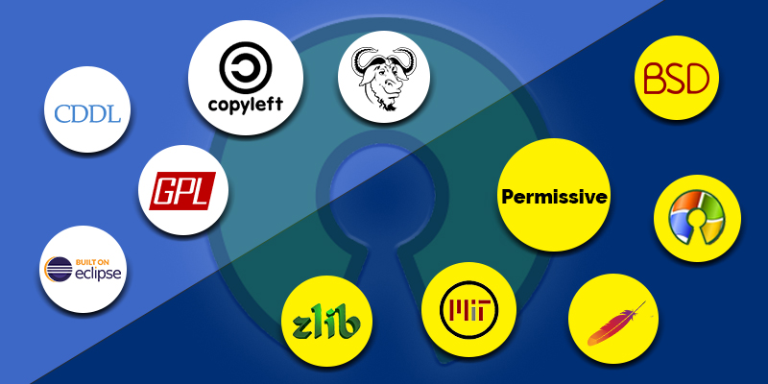
1.3 Open-Source Software and Licensing
GNU General Public License (GPL):
Copyleft (basically all rights remain intact)
Any derivative work is released open-source under the same terms
Does not restrict original freedoms when distributing, even if modified or extended
Examples: Ansible, GNU Emacs, Joomla, the Linux kernel
Notes:
Learn more:
https://tldrlegal.com/
https://opensource.org/licenses
https://choosealicense.com/

Slide 9
1.3 Open-Source Software and Licensing
Apache License 2.0
Permissive
Does not require derivative work to be distributed under the same terms
Retains Apache’s copyright notice and grants patent rights
Examples: Android, httpd, spark
Notes:
Learn more:
https://tldrlegal.com/
https://opensource.org/licenses
https://choosealicense.com/

Slide 10
1.3 Open-Source Software and Licensing
BSD License
Permissive
Does not require derivative work to be distributed under the same terms
Licensees cannot use original Author’s name or trademark for derivative work
Contains an advertising clause and a non-endorsement clause
Examples: Django, Redis, Ruby, Nginx, NetBSD
Notes:
Learn more:
https://tldrlegal.com/
https://opensource.org/licenses
https://choosealicense.com/

Slide 11
1.3 Open-Source Software and Licensing
MIT License
Very permissive
Do whatever you want with source code IF you add a copy of the original MIT license and copyright notice
Suitable for commercial use
node.js, jQuery, angular
Notes:
Learn more:
https://tldrlegal.com/
https://opensource.org/licenses
https://choosealicense.com/

Slide 12
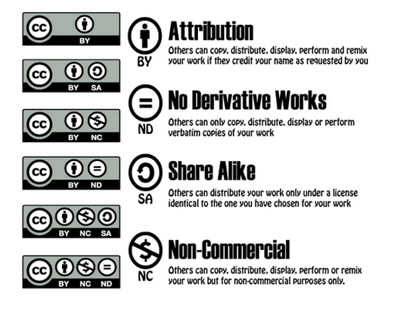
1.3 Open-Source Software and Licensing
Creative Commons
A global nonprofit organization that enables sharing and reuse of creativity and knowledge through the provision of free legal tools
Transfer of the open source principles to other, non-technical areas
Focus of rights assignment goes back from the distributor to the author
Author makes work available by choosing from a set of features -- the more chosen, the more restrictive the license
6 license features (refer to graphic) in 4 categories
Refer to the slide notes for a definition of each of the 6 six possible combinations and licenses offered by CC
Notes:
For a better understanding, here is an overview of the six possible combinations and licenses offered by CC:
• CC BY (“Attribution”)The free license that allows anyone to edit and distribute the work as long as they name the author.
• CC BY-SA (“Attribution-ShareAlike”)As CC BY, except that the modified work may only be distributed under the same license. The principle reminds of the copyleft, because the license is “inherited” here as well.
• CC BY-ND (“Attribution-NoDerivatives”)Like CC BY, except that the work may only be passed on unmodified.
• CC BY-NC (“Attribution-NonCommercial”)The work may be edited and distributed by naming the author, but only under non-commercial conditions.
• CC BY-NC-SA (“Attribution-NonCommercial-ShareAlike”)As BY-NC, except that the work may only be shared under the same conditions (i.e. a copyleft-like license).
• CC BY-NC-ND (“Attribution-NonCommercial-NoDerivatives”)The most restrictive license: the distribution is allowed with attribution of the author, but only unchanged and under non-commercial conditions

Slide 13
1.3 Open-Source Software and Licensing
Business Models in Open Source:
Crowdfunding: Collection of money donations via platforms like Kickstarter or Indiegogo
Dual licensing: free software offered in parallel under a more restrictive/proprietary license
Professional services: professional services such as consulting, maintenance, or helpdesk obtained directly from a service provider
Software as a Service (SaaS): cloud providers run applications on their infrastructure and grant their customers access to the installed application (e.g., CRM, ERM, etc.)
Customer-specific extensions: Think of these as plugins or modules to extend capabilities of existing software
Crowd Funding
Dual Licensing
Professional Services
SaaS
Customer Specific Extensions
Open Source Business Models

Slide 14


Join at https://app.sli.do/event/ceWSnEccDLkLbQrUAqnRCa

Slide 15

Demos
Based on Red Hat Enterprise Linux (RHEL)
Oracle Linux is an open-source clone
Did You Know? Oracle’s Linux distro is a clone of RHEL and used in the Oracle Cloud Infrastructure (OCI).

Slide 16

Notes:
Interested?
• Contact the email address or connect via social media links at the bottom of the graphic
• Mention that you were referred by Dr. Galliano.

Slide 17
What Questions Do you Have?

