Slide 1
Self-Hosting Simple Web Services with Traefik and Docker Compose
Matthew McGraw
SeaGL 2022

Slide 2
Who am I?
Full-Time Dad; Some time blogger and speaker
Advocate for data privacy and decentralization
Expert in doing things the wrong way so you don’t have to!

Slide 3
What gives me the Right?
Long time Linux user
Been self-hosting for almost 10 years
FOSS

Slide 4


What is self-hosting?
Any server you have root access to
Any server you have SSH keys to
Any server you can destroy at will

Slide 5
What is self-hosting?
On Premises
Can be anything
  Raspberry Pi
  Old laptop
  Retired server
In a Datacenter
Someone Elses Metal
  Linode
  Digital Ocean
  Non-profit

Slide 6
Why might I want to self-host?
Data Privacy and Decentralization
  Google, Facebook, etc
Cost Savings
  Pay hosting costs; not subject to a service providers whims
Love to Tinker and Learn
  A hobby or a tool to learn a new skill
It’s FUN!!!
  This is why we “FOSS”, right?

Slide 7
What can I self-host?
Blogs and Websites
  Ghost, Wordpress, MKDocs, etc
Media Servers
  Plex, Jellyfin, Airsonic
Backup/File Share
  Duplicati, FileGator, Nextcloud
Document Editors
  Code-server, Hedgedoc
Check out http://fleet.linuxserver.io

Slide 8
What is Traefik?
Traefik is a cloud-based router and reverse proxy
Traefik is a very complex, powerful software and we are just scratching the surface of its capabilities in this talk.

Slide 9
What is docker-compose?
Docker-compose is an orchestration platform for managing docker containers.
Docker-compose is a very complex, powerful software and we are just scratching the surface of its capabilities in this talk.

Slide 10
What am I assuming about you?
You have a passing familiarity with Docker
You are able to install/run/manage a linux box (server)
You are interested in self-hosting SOMETHING
You would like to make this process as simple as possible

Slide 11
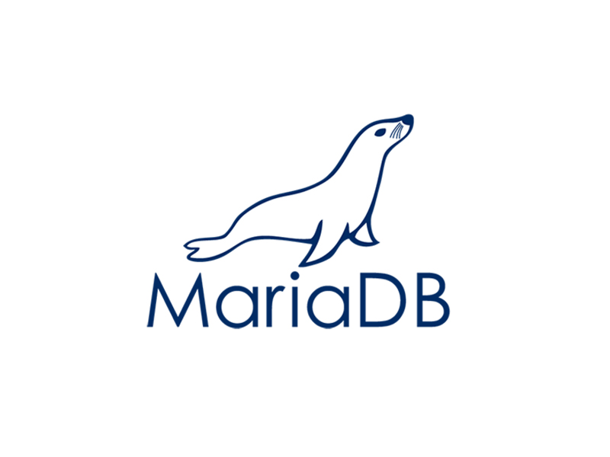


What is our project today?
Traefik
  Cloud router and reverse proxy
MariaDB
  free/open source SQL Database
Hedgedoc
  “The best platform to write and share markdown”
  (hedgedoc.org)

Slide 12
Files We Need
It’s not as hard as the Traefik Docs make it seem.
There are instructions for 1.x and 2.x versions of Traefik available on the web
You only NEED one file:
docker-compose.yml
You can use multiple docker-compose.yml files but we are not doing this today.

Slide 13
A word about multiple docker-compose.yml files
This is a tad more complicated. It requires setting up some docker networking which is outside the scope of this talk.
I run my personal setup with multiple docker-compose files. If you want to know more, please contact me.

Slide 14
The Process
Install Docker
Create volume (directory/filesystem/etc) to hold configs and container data. USE AN ADEQUATE SIZE VOLUME!
Create directories for this project (/data/configs/letsencrypt and /data/configs/hedgedoc) per the docker-compose file
Create docker-compose.yml file in /data/configs/
Run `docker-compose up -d` to start your containers

Slide 15
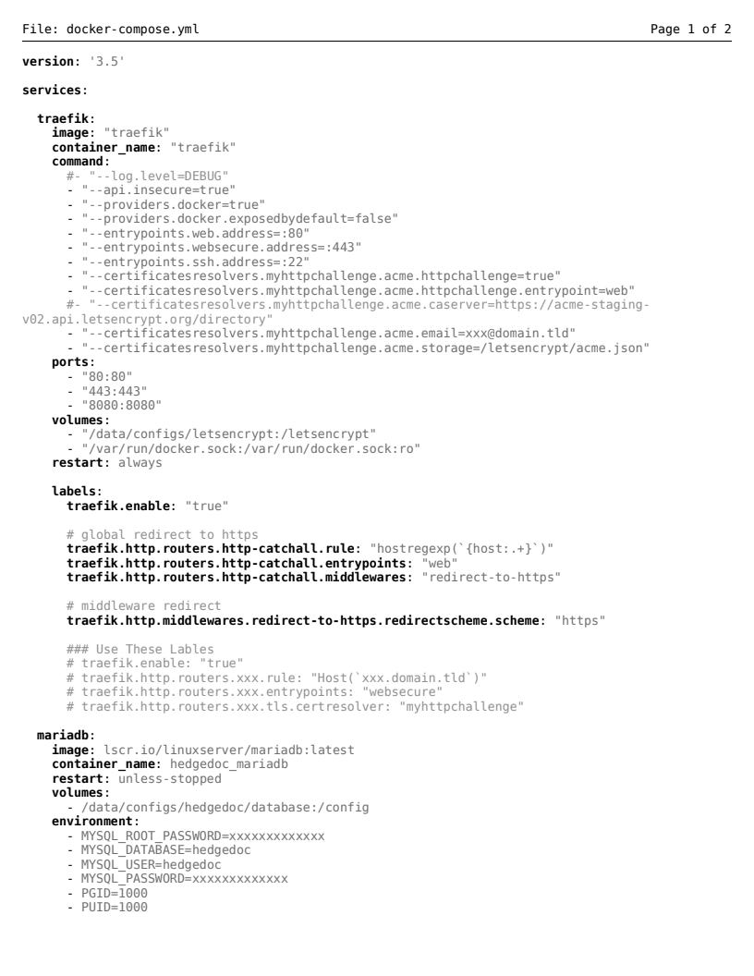
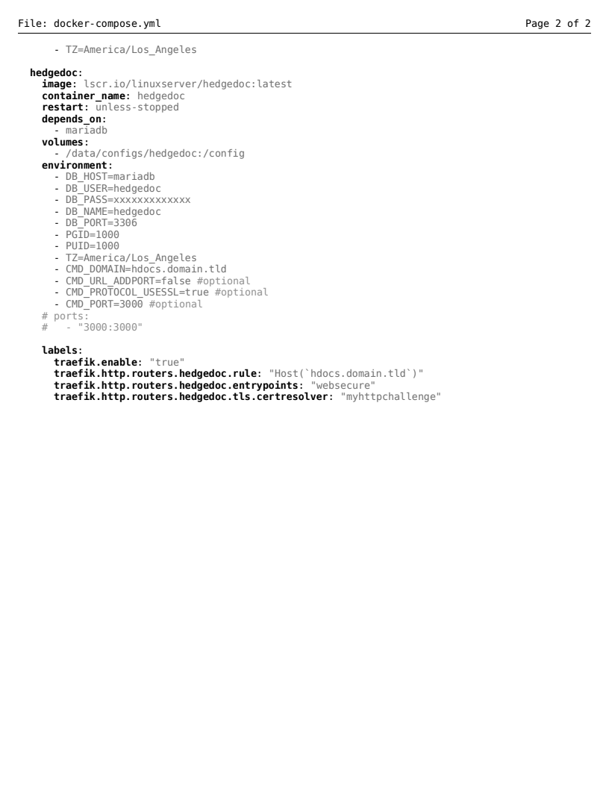

Slide 16
That’s it for this talk
I hope you have found this interesting and informative. This talk is released under a CC license and all the slides, documents, and assets can be found at: https://github.com/g33kdad/SeaGL22-talk

