Slide 1

Group 10 iCalendar
Hongyi Guo, Jiawei Li
Shihao Zhao, Zhonghao Liu, Manke Luo
Chuan-Keng Chou, Chidinma Nwaka

Slide 2
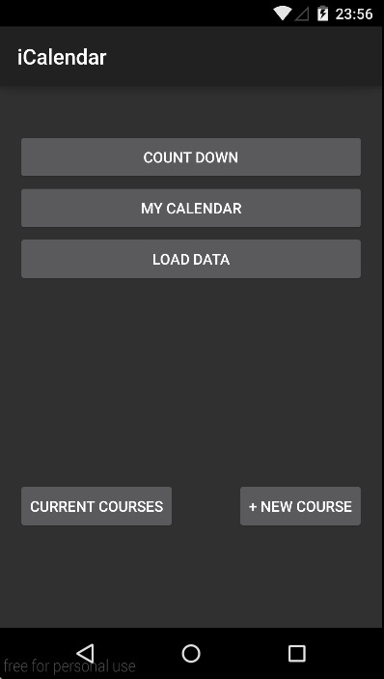
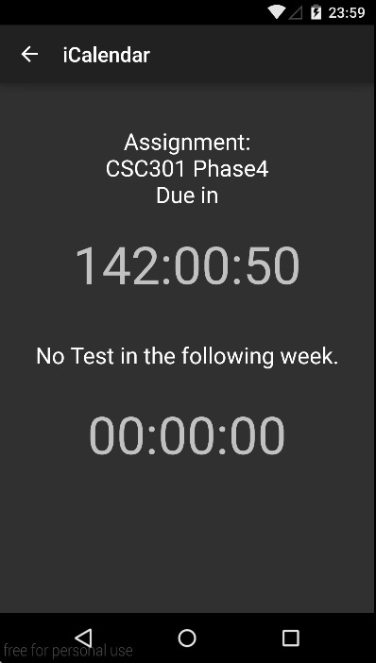
Time management tool for students
You can add/modify Courses, Assignments and Tests.
Tell you how many hours you left
(Assignments/Tests)

Slide 3
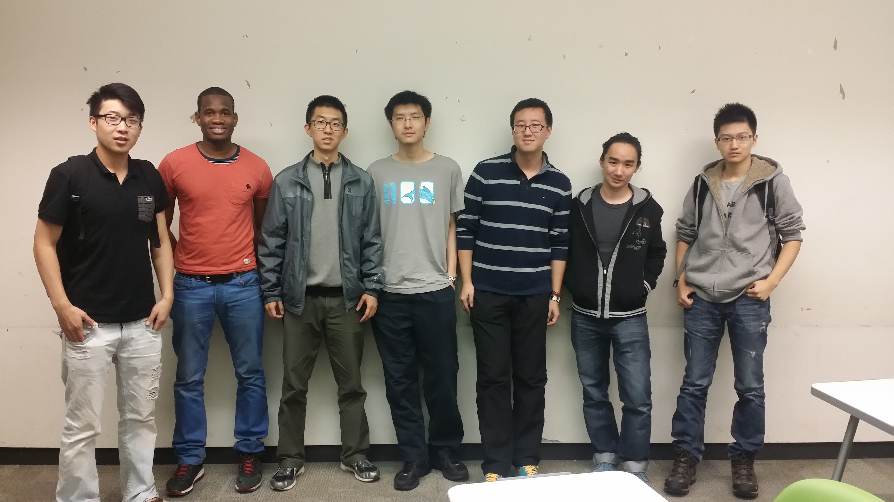
Work Distribution:
Android UI: Jiawei Li, Shihao Zhao, Zhonghao Liu
Android backend class: Manke Luo, Chuan-Keng Chou, Chidinma Nwaka
Server&Database: Hongyi Guo
Presentations&Reports: Chidinma Nwaka,
Zhonghao Liu

Slide 4
Main Components
Backend Classes (Assignment.java, Course.java, Student.java and Test.java)
UI (Android L)
Server&Database (PHP, MySQL)

Slide 5
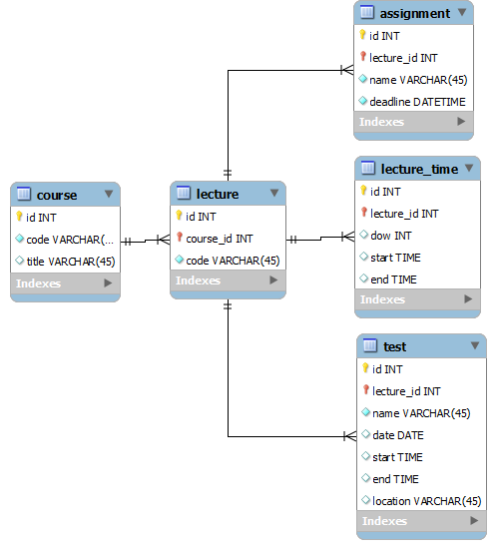
Backend Classes
Student.java
Course.java
Assignment.java
Test.java

Slide 6
Student
Database
Course(s)[CSC108]
Unique
Assignment(s)
[A1, Nov. 27 due 15:00]
[A2, Dec.1 due 15:00]
Test(s)
[Final, Dec 11,
09:00 - 12:00, EX200]

Slide 7
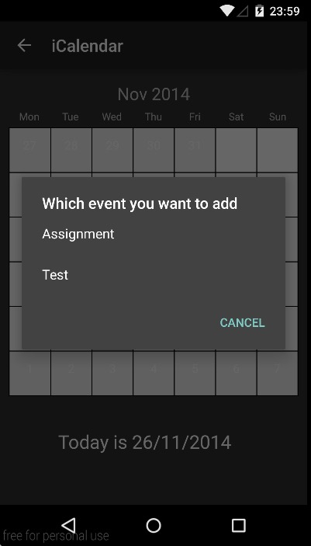
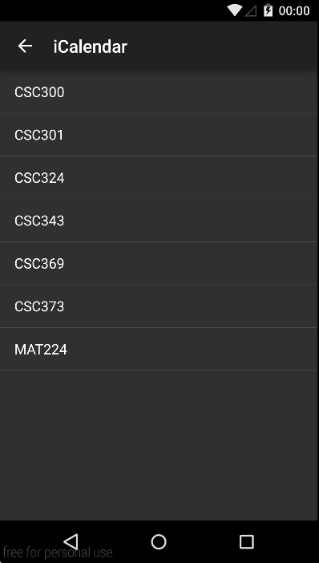

Slide 8
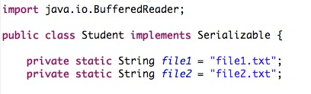
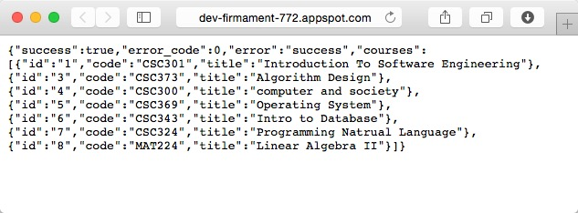
Design Pattern
DAO (Data Access Object)
Two ways to save data
At Phase 2, we use temporary files
/src/com/calendarcardsample/backend/Student.java
But now, our database is ONLINE!

Slide 9



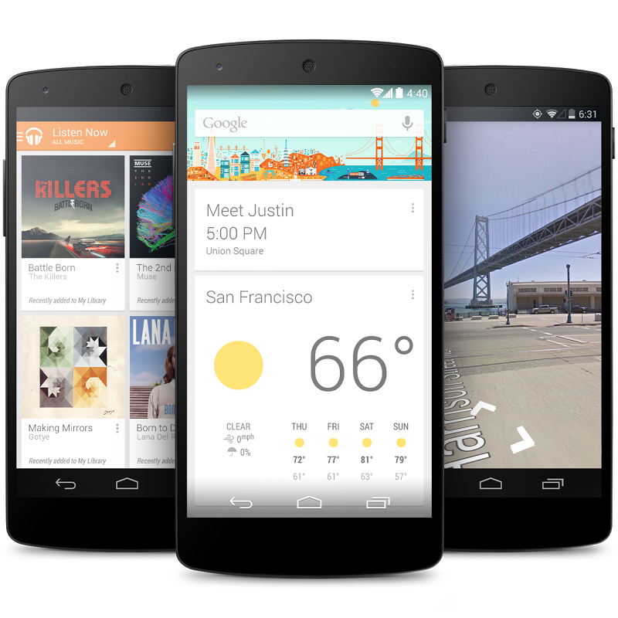

Tools we use
Communication
Java
Storing our server and database
$600/year (Thank you, Hongyi)
Sharing Code and Version Control
Nexus 5
Testing (Thank you, Kevin)

Slide 10
Technical Challenges
Github-Merge (Version Control)
Not every one have Android phone (emulator on CDF is SLOW and is not support Android 5)
Different people have different skills

