Slide 1
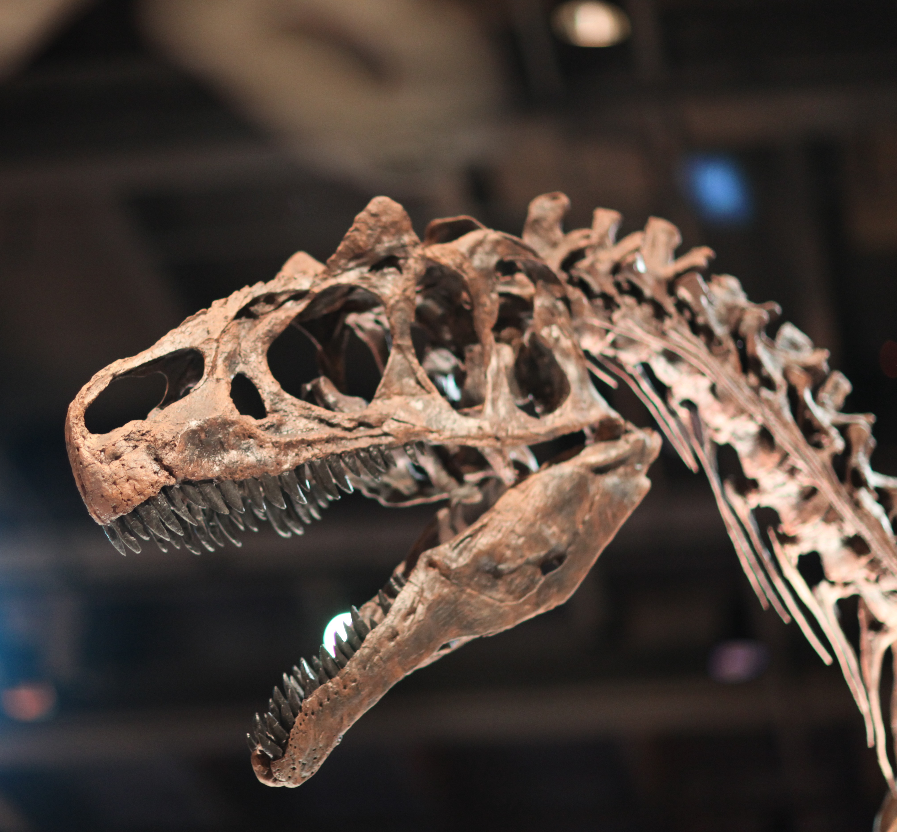
Earl Douglas National Park
www.earldouglasnationalpark.org
Come out today and explore our park if your ready for an adventure. We have plenty of attractions for you and your family to enjoy. We host the largest fossil quarry in North America and a beautiful museum were you and your family can learn and explore the prehistoric time. Don’t want to be stuck indoors? Then come outside and explore the trails, participate in a fossil scavenger hunt, or see the ancient petroglyphs of the first human tribes to occupy this land.

