Slide 1
Working In Teams
Module VI

Slide 2
Introduction
▶ Team( a group of people) is created to carry out a joint assignment. They work together to carry out the task/project.
▶ Understand how to enhance communication between individual developers, within teams/across teams
▶ Project team is sometimes referred to all the people working on a project
▶ Communication genres(types) refer to methods of
communication
2

Slide 3
Communication Plan
Collaborative nature of the project will have an influence on all the stages of Stepwise Planning
▶ Identify project scope and objectives – stakeholders are identified and communication channels are established
▶ Identify project infrastructure – Organizational structure is identified
▶ Analyze project characteristics – Decision son how the project is to
be executed
▶ Estimate effort for each activity – Developer Productivity
▶ Identify activity risks – Continued availability of staff
▶ Allocate resources – H/w and S/w resource allocation
▶ Review or publicize plan – communication plan to publicize is
produced
3

Slide 4
Becoming a Team- how teams are formed?
▶ 5 stages of development of Team
▶ Forming – members get to know each other and frame rules to
work together
▶ Storming – conflicts rise among members of operations when they try to exert leadership
▶ Norming – Conflicts are solved and group identity emerges
▶ Performing – start working on tasks
▶ Adjourning – Group disbands/disperses
▶ In general, specific team building activities can be carried out as
ice breaking
4

Slide 5
▶ Different types of people in a team to balance (Belbin)
▶ The chair – Good at running meetings(organizer), strong, calm
▶ The plant – good at generating ideas
▶ The monitor – good at evaluating ideas and potential solutions
▶ The shaper – one who orients the teams attention
▶ The team worker - providing good working environment
▶ The resource investigator - finding resources/information
▶ The completer / finisher - concerns with completing tasks
▶ The company worker – Good team player who undertakes less attractive task if needed for teams success
▶ In general 30% of the people cannot be classified as above(Belbin)
5

Slide 6
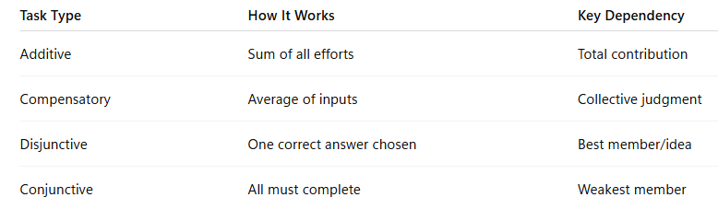
Group Performance
▶ Judgments are needed about which tasks are best carried out
collectively and which are best carried out by individuals.
▶ In certain cases, Groups are more effective than working alone.
Some yield better result; Some slow down
▶ Categorizing group tasks
▶ Additive Tasks – efforts of each member is added
▶ Compensatory Tasks - errors of some is compensated by input of others
▶ Disjunctive tasks - Only one correct answer (all accepting one common answer)
▶ Conjunctive tasks – cooperative attitude is productive. Overall task is completed only when all participants complete
6

Slide 7
Decision Making
▶ Categories of decision making
▶ Structured – simple, routine decisions where rules can be applied straightforward.
▶ Unstructured – complex, often require a degree of creativity
▶ Mental Obstacles to good decision making
▶ Faulty heuristics (rules of thumb may be useful, but may mislead)
▶ When its based only on information
▶ Based on stereotypes (fixed idea)
▶ Escalation of commitment – adopting a failure model
▶ Information overload – too much information
7

Slide 8
Group Decision Making
▶ Decisions made by the team as a whole are more likely to be accepted than those that are imposed.
▶ Brainstorming techniques can help groups, but, research states that people often come up with more ideas individually than in a group.

Slide 9
Obstacles to group decision making
▶ Time consuming
▶ Conflicts within group
▶ Decision unduly influenced by dominant personalities
▶ In general, people modify their personal judgements to conform group norms, where common attitudes developed by a group over time
▶ It is observed that people sometimes make decisions that carry more risk than they make on their risk. This is termed as risky shift.

Slide 10
Measures to reduce the disadvantages of group decision (Delphi technique)
The following procedure is carried out
▶ The cooperation of number of experts is enlisted
▶ The problem is presented to the experts
▶ The experts record the recommendations
▶ These recommendations are collected and reproduced
▶ The collected responses are recirculated
▶ The experts comment on the ideas of others and modify their recommendations if so moved
▶ If the leader detects consensus, then the process is concluded, otherwise the comments are recirculated to experts.
Adv: can be carried out with experts dispersed geographically. But,
process may be time-consuming
11

Slide 11
Organization and Team Structures
Large s/w development companies are usually organized into departments.
It can be based on product lines, staff specialization, customer category, geographical location, etc
Eg. Academic programmes at VIT--- schools--- departments, etc
▶ Department Structure- How is a department organized into teams?
▶ Team Structure – How are project teams structured?
12

Slide 12
Department Structure
Types:
▶ Functional format
▶ Project format
▶ Matrix format
▶ A functional organization is an organization where staff are grouped by areas of specialization and managed by a person with expertise in that area.
▶ In a project based organization, teams are formed to achieve
specific projects and are led by a project manager
▶ While a matrix organization combines aspects of both functional and project structures such that team members report to both a functional manager and one or more project managers.
13

Slide 13
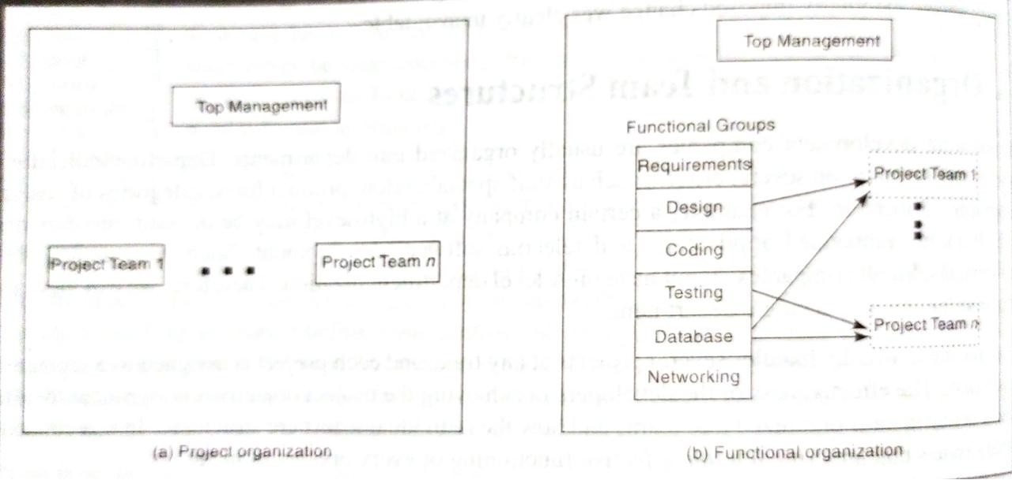
Department Structure
14

Slide 14
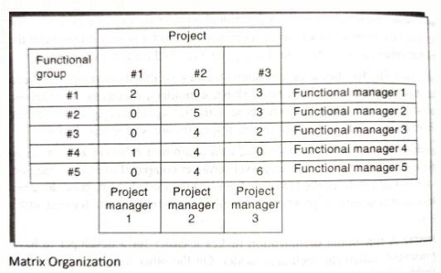
Department Structure
▶ Matrix format: flexible resource allocation, efficient knowledge sharing across projects, and strong project focus, though it can lead to confusion or conflict due to competing priorities from multiple managers.
15

Slide 15
Benefits
▶ Efficient knowledge sharing: Specialists can share expertise across different projects and functional areas, breaking down traditional practices.
▶ Flexibility: Resources can be allocated dynamically based on the needs of different projects.
▶ Skill development: Team members gain valuable experience by working on various projects and interacting with different teams.
▶ Strong project focus: Project managers can focus on project goals while functional managers focus on technical details and long-term department health.
▶ Efficient handling of problems associated with manpower turnover

Slide 16
Drawback
▶ Confusion: Employees may become confused when receiving conflicting instructions from two managers (Conflicts can occur between project managers and functional managers)
▶ Frequent shifting of staff by functional managers is a concern
▶ Power struggles: The balance of power between functional and project managers needs to be clear to avoid conflicts.
▶ Work overload: Team members can be overloaded with demands
from multiple managers, potentially leading to burnout

Slide 17
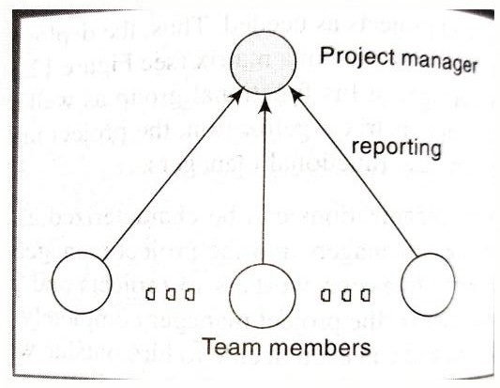
Team Structure
▶ Chief Programmer Team (More efficient for small and simple projects)
▶ Drawback: More responsibilities to Chief programmer
18

Slide 18
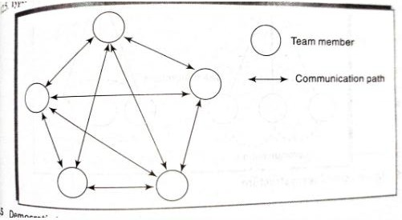
Team Structure
▶ Democratic Team( decisions through discussions among all)
19

Slide 19
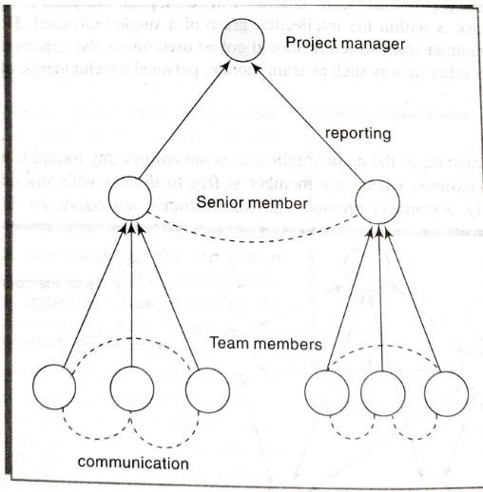
Team Structure
▶ Mixed Control Team
20

Slide 20
Coordination Dependencies
▶ Shared resources – technical support
▶ Producer-customer (right time) relationships
▶ Task-subtask dependencies
▶ Accessibility (right place) dependencies
▶ Usability (right thing) dependencies
▶ Fit requirements
21

Slide 21
Communication Plans
▶ What
▶ Who/Target
▶ Purpose
▶ When/Frequency
▶ Type/Method
▶ Responsibility
22
Task orientation People orientation

Slide 22
Leadership
▶ Coercive power – force(treat) someone to do. Ability to influence someone's behavior through the threat or use of punishment
▶ Connection power – have access with those who have power. They leverage their network to secure partnerships, gain new clients, or find funding.
▶ Legitimate power – Based on persons title or position held
▶ Reward power – the ability of a leader to influence others by offering positive incentives or rewards (holder can give rewards)
▶ Expert power – the ability to influence others based on one's specialized knowledge, skills, or expertise in a particular area (person with specialization)
▶ Information power – the ability to influence others through controlling and sharing valuable information, data, or knowledge (has exclusive access to information)
▶ Referent power – a type of influence that stems from a leader's personal charisma, integrity, and the friendliness that inspires others to follow them out of respect and admiration (inspire others with leadership)
23

Slide 23
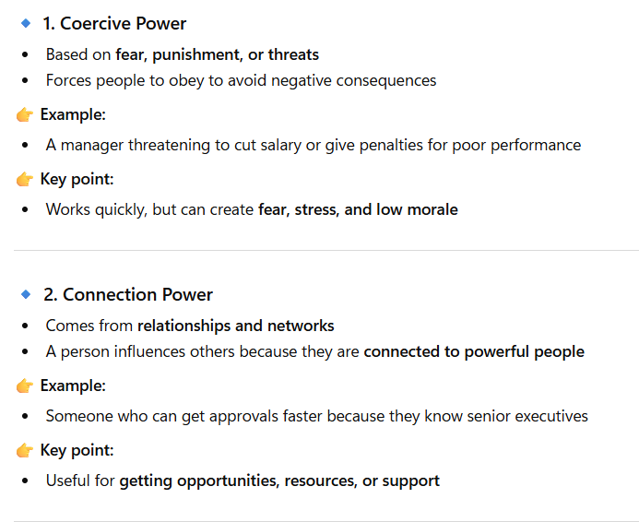

Slide 24
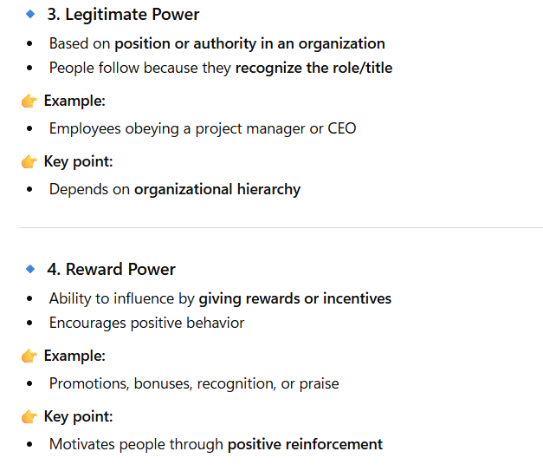
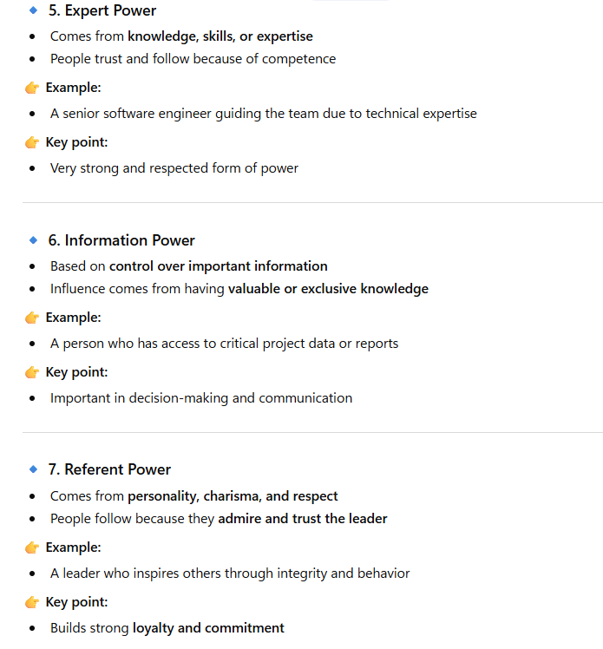

Slide 25
Leadership Styles
▶ Directive autocrat – make decisions alone, close supervision
▶ Permissive autocrat - make decisions alone, subordinates have freedom in implementation
▶ Directive democrat - make decisions participatively, close supervision
▶ Permissive democrat - make decisions participatively, subordinates have freedom in implementation
24

Slide 26
