Slide 1
Informal Design Guidelines
goodness to measure the quality of the design
first is the logical (or conceptual) level
The second is the implementation (physical storage) level
Informal Design Guidelines for Relational Databases
1. Semantics of the Relation Attributes
2. Redundant Information in Tuples and Update
Anomalies
3. Null Values in Tuples
4. Spurious Tuples

Slide 2
1.1 Semantics of the Relation Attributes
GUIDELINE 1: Informally, each tuple in a relation should represent one entity or relationship instance. (Applies to individual relations and their attributes).
Attributes of different entities (EMPLOYEEs, DEPARTMENTs, PROJECTs) should not be mixed in the same relation
Only foreign keys should be used to refer to other entities
Entity and relationship attributes should be kept apart as much as possible.
Bottom Line: Design a schema that can be explained easily relation by relation. The semantics of attributes should be easy to interpret.

Slide 3
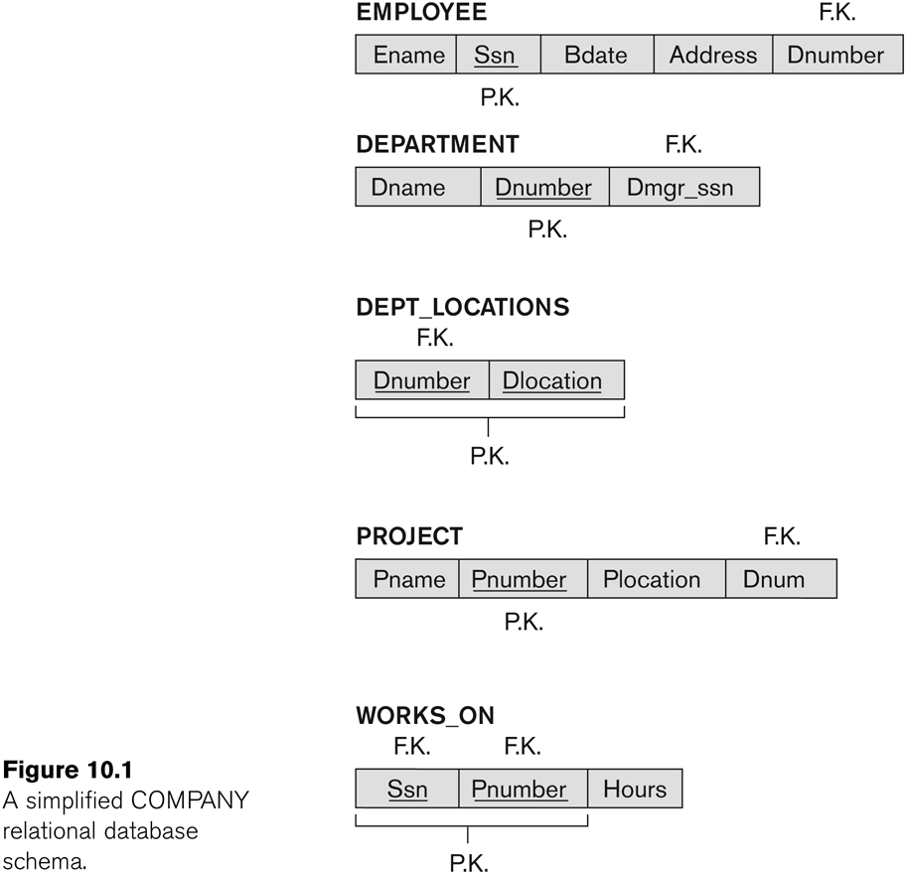
Figure 10.1 A simplified COMPANY relational database schema

Slide 4
1.2 Redundant Information in Tuples and Update Anomalies
Information is stored redundantly
Wastes storage
Causes problems with update anomalies
Insertion anomalies
Deletion anomalies
Modification anomalies

Slide 5
EXAMPLE OF AN UPDATE ANOMALY
Consider the relation:
EMP_PROJ(Emp#, Proj#, Ename, Pname, No_hours)
Update Anomaly:
Changing the name of project number P1 from “Billing” to “Customer-Accounting” may cause this update to be made for all 100 employees working on project P1.

Slide 6
EXAMPLE OF AN INSERT ANOMALY
Consider the relation:
EMP_PROJ(Emp#, Proj#, Ename, Pname, No_hours)
Insert Anomaly:
Cannot insert a project unless an employee is assigned to it.
Conversely
Cannot insert an employee unless an he/she is assigned to a project.

Slide 7
EXAMPLE OF AN DELETE ANOMALY
Consider the relation:
EMP_PROJ(Emp#, Proj#, Ename, Pname, No_hours)
Delete Anomaly:
When a project is deleted, it will result in deleting all the employees who work on that project.
Alternately, if an employee is the sole employee on a project, deleting that employee would result in deleting the corresponding project.

Slide 8
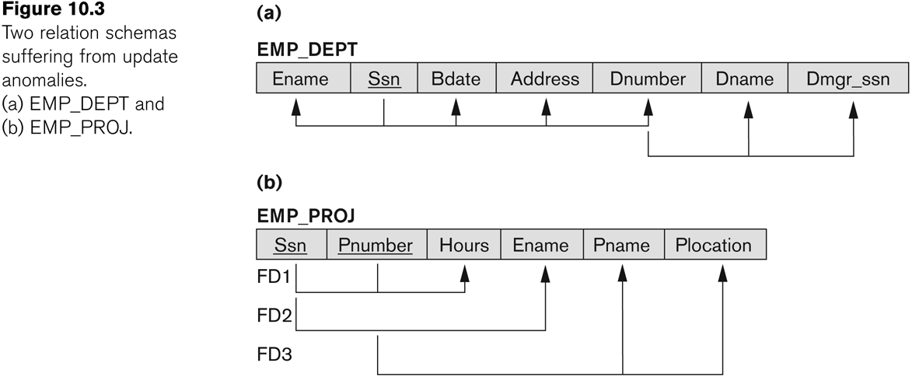
Figure 10.3 Two relation schemas suffering from update anomalies

Slide 9
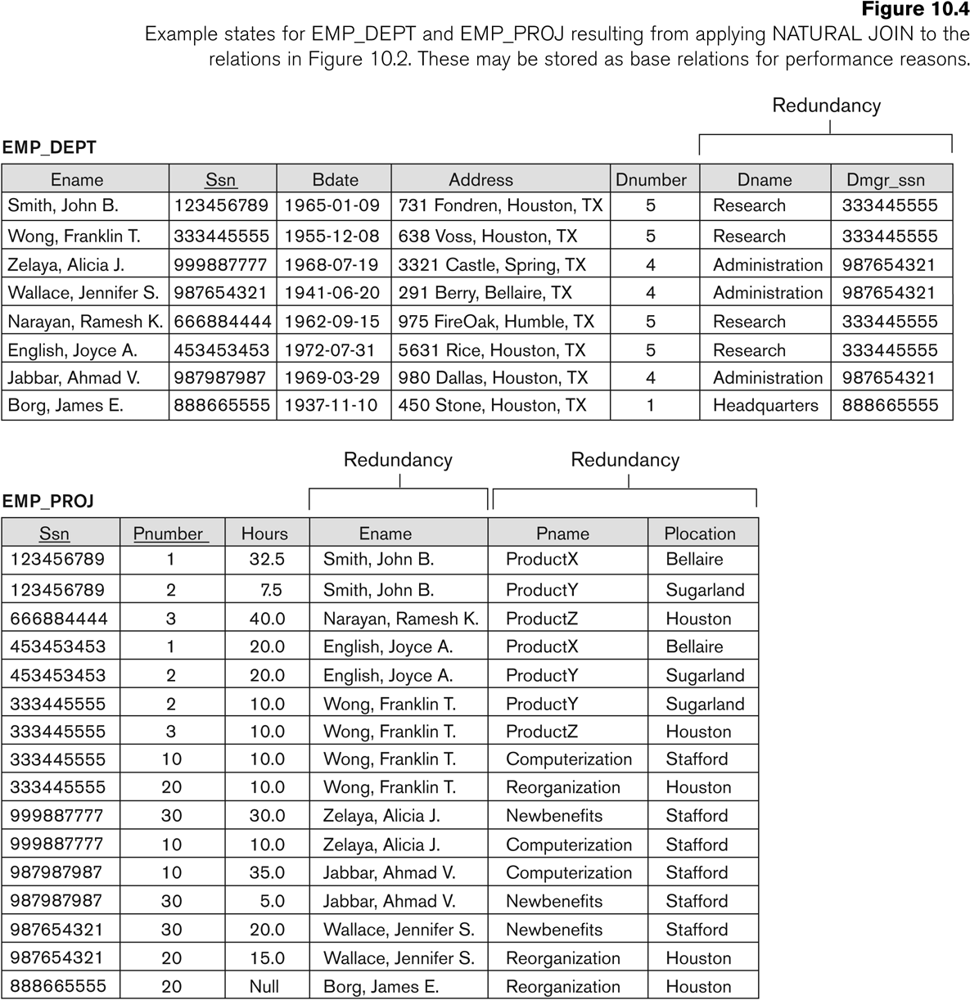
Figure 10.4 Example States for EMP_DEPT and EMP_PROJ

Slide 10
Guideline to Redundant Information in Tuples and Update Anomalies
GUIDELINE 2:
Design a schema that does not suffer from the insertion, deletion and update anomalies.
If there are any anomalies present, then note them so that applications can be made to take them into account.

Slide 11
1.3 Null Values in Tuples
GUIDELINE 3:
Relations should be designed such that their tuples will have as few NULL values as possible
Attributes that are NULL frequently could be placed in separate relations (with the primary key)
Reasons for nulls:
Attribute not applicable or invalid
Attribute value unknown (may exist)
Value known to exist, but unavailable

Slide 12
1.4 Spurious Tuples
Bad designs for a relational database may result in erroneous results for certain JOIN operations
The "lossless join" property is used to guarantee meaningful results for join operations
GUIDELINE 4:
The relations should be designed to satisfy the lossless join condition.
No spurious tuples should be generated by doing a natural-join of any relations.

Slide 13
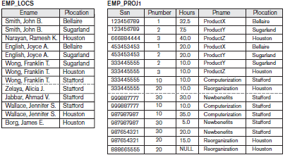

Slide 14
