Slide 1
Normalization
Module 4

Slide 2
Normalization
Normalization is defined as organizing data so as to reduce unnecessary data redundancy and to preserve information.
A Normal form is a measure of quality of design of a relation schema.

Slide 3
Normalization
The normal form of relation schema is the highest normal form satisfied by the schema.
Normal form
First Normal Form
Second Normal Form
Third Normal Form
Boyce-Codd Normal Form (BCNF)

Slide 4
First normal form (1NF)
A relation schema is said to be in first normal form if all its attributes are
atomic.

Slide 5

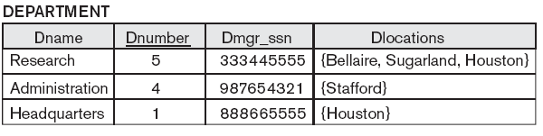
A relation schema NOT in 1NF
Dlocations is a
multi-valued
attribute.

Slide 6


Conversion into 1NF
The above relation schema is decomposed into two relation schemas.
Now DEPARTMENT & DEPT_LOCATIONS are in 1NF.

Slide 7

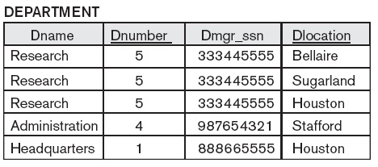
Conversion into 1NF
Alternative technique to decomposition also exists.
You may expand the primary key incorporating the multi-valued attribute into the primary key.
This solution has a
disadvantage of
introducing
redundancy in the
relation.

Slide 8
Conversion into 1NF
DEPARTMENT
Dname | Dnumber | Dmgr_ssn | Docation1 | Dlocation2 | Dlocation3
Research | 5 | 333445555 | Bellaire | Sugarland | Houston
Administration | 4 | 987654321 | Stafford
Headquaters | 1 | 888665555 | Houston

Slide 9

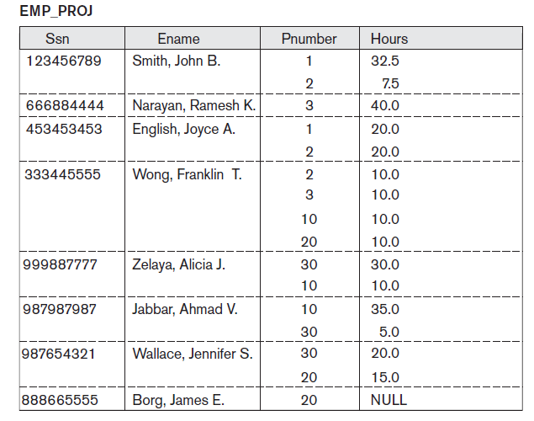
Conversion into 1NF
First normal form does not allow complex attribute too.

Slide 10


Conversion into 1NF
Replace
by two relations

Slide 11
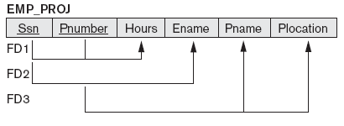
Partial dependency
FD1: {Ssn, Pnumber} → {Hours}
FD2: {Ssn} → {Ename}
FD3: {Pnumber} → {Pname, Plocation}

Slide 12
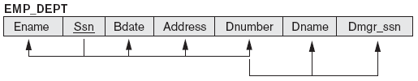
Transitive dependency
{Dnumber} → {Dname, Dmgr_ssn}

Slide 13
Second normal form (2NF)
A relation schema is said to be in second normal form if
(i) it is in first normal form and
(ii) there is no partial dependency on primary key of the schema.

Slide 14
Example
FD₁: {Ssn} → {Ename}
(It is a partial functional dependency.)
FD₂: {Pnumber} → {Pname, Plocation}
(It is a partial functional dependency.)
FD₃: {Ssn, Pnumber} → {Hours}
(It is a full functional dependency.)

Slide 15



Normalization

Slide 16
Decomposition rule
A partial dependency X → Y on R
Replace R by
R₁(X, Y) & R₂ = R – Y

Slide 17
Third normal form (3NF)
A relation schema is said to be in third normal form if
(i) it is in second normal form and
(ii) there is no transitive dependency in the schema.

Slide 18
Third Normal Form
A relation schema R is in third normal form (3NF) if it is in 2NF and no non-prime attribute A in R is transitively dependent on the primary key
R can be decomposed into 3NF relations via the process of 3NF normalization
NOTE:
In X -> Y and Y -> Z, with X as the primary key, we consider this a problem only if Y is not a candidate key.
When Y is a candidate key, there is no problem with the transitive dependency .
E.g., Consider EMP (SSN, Emp#, Salary ).
Here, SSN -> Emp# -> Salary and Emp# is a candidate key.

Slide 19
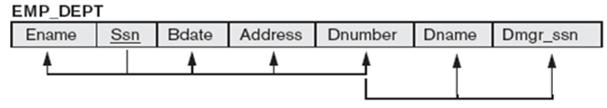
Example
{Dnumber} → {Dname, Dmgr_ssn}

Slide 20
Normalization
R₁(Dnumber, Dname, Dmgr_ssn)
R₂(Ename, Ssn, Address, Dnumber)

Slide 21
Boyce-Codd normal form (BCNF)
A relation schema is said to be in BCNF if
(i) it is in third normal form and
(ii) key attribute does not depend on non-key attribute.

Slide 22
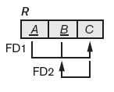
Normalization
FD₁: AB → C
FD₂: C → B
This relation schema is NOT in BCNF
because of the dependency C → B.
Decompose R into R₁(C, B) & R₂(A, C)

Slide 23
Example
TEACH(Reg_no, C_id, Instructor_id)
Instructor_id → C_id
R₁(Instructor_id, C_id)
R₂(Reg_no , Instructor_id)

Slide 24
Generalized definition of partial dependency
Dependency of non-key attribute on a part of any of the keys of a schema is called partial dependency.

Slide 25
Generalized definition of 2NF
A relation schema is said to be in second normal form if
(i) it is in first normal form and
(ii) there is no partial dependency on any of the keys of the schema.

Slide 26
Generalized definition of BCNF
A relation schema is said to be in BCNF if and only if for every non-trivial functional dependency that holds on the schema, the determinant of the
functional dependency is a super key of the schema.

Slide 27
Exercise problem 1
Consider the following relation schema:
CAR_SALE(Car_id, Date_sold, Salesperson_id, Commission_pct, Discount_amt).
Additional functional dependencies are
Date_sold → Discount_amt,
Salesperson_id → Commission_pct.

Slide 28
Exercise problem 1
Based on the given primary key, is this relation in 1NF, 2NF, or 3NF? Why
or why not? How would you successively normalize it completely?
Answer:
R₁(Salesperson_id, Commission_pct),
R₃(Date_sold, Discount_amt) and
R₄(Car_id, Date_sold, Salesperson_id).

Slide 29
Detail Solution
The attributes of the schema CAR_SALE are atomic in nature and hence the schema is in first normal form. But it is not in second normal form because of the partial dependency Salesperson_id → Commission_pct. So we replace the schema CAR_SALE by two schemas namely, R₁(Salesperson_id, Commission_pct) and R₂(Car_id, Date_sold, Salesperson_id, Discount_amt). The schema R₁ is in BCNF because the only non-trivial functional dependency that holds on the schema is Salesperson_id → Commission_pct and Salesperson_id is the only key of the schema. Though R₁ is in BCNF but R₂ is in second normal form because there is no partial dependency that holds on the schema but R₂ is not in third normal form because of the transitive dependency Date_sold → Discount_amt. So we replace R₂ by two schemas namely, R₃(Date_sold, Discount_amt) and R₄(Car_id, Date_sold, Salesperson_id). The schemas R₃ and R₄ are in BCNF. So the schema CAR_SALE is now replace by three schemas that are in BCNF namely,
R₁(Salesperson_id, Commission_pct), R₃(Date_sold, Discount_amt) and
R₄(Car_id, Date_sold, Salesperson_id).

Slide 30
CAR_SALE(Car_id, Date_sold, Salesperson_id, Commission_pct, Discount_amt)
Date_sold → Discount_amt,
Salesperson_id → Commission_pct.
R₁(Salesperson_id , Commission_pct.)
R₂ (Car_id, Date_sold, Salesperson_id, Discount_amt)
R₃(Date_sold, Discount_amt)
R₄ (Car_id, Date_sold, Salesperson_id)
D = {R₁, R₃, R₄}

Slide 31
Detail Solution
The attributes of the schema CAR_SALE are atomic in nature and hence the schema is in first normal form. But it is not in second normal form because of the partial dependency Salesperson_id → Commission_pct. So we replace the schema CAR_SALE by two schemas namely, R₁(Salesperson_id, Commission_pct) and R₂(Car_id, Date_sold, Salesperson_id, Discount_amt). The schema R₁ is in BCNF because the only non-trivial functional dependency that holds on the schema is Salesperson_id → Commission_pct and Salesperson_id is the only key of the schema. Though R₁ is in BCNF but R₂ is in second normal form because there is no partial dependency that holds on the schema but R₂ is not in third normal form because of the transitive dependency Date_sold → Discount_amt. So we replace R₂ by two schemas namely, R₃(Date_sold, Discount_amt) and R₄(Car_id, Date_sold, Salesperson_id). The schemas R₃ and R₄ are in BCNF. So the schema CAR_SALE is now replace by three schemas that are in BCNF namely,
R₁(Salesperson_id, Commission_pct), R₃(Date_sold, Discount_amt) and
R₄(Car_id, Date_sold, Salesperson_id).

Slide 32
Exercise problem 2
Consider the following relation for published books:
BOOK (Book_title, Author_name, Book_type, List_price, Author_affil, Publisher).
Author_affil refers to the affiliation of author.
Suppose that the following dependencies exist:
Book_title → Publisher, Book_type
Book_type → List_price
Author_name → Author_affil.

Slide 33
Exercise problem 2
What normal form is the relation in? Explain your answer.
Apply normalization until you cannot decompose the relations further.
State the reasons behind each decomposition.

Slide 34
BOOK (Book_title, Author_name, Book_type, List_price, Author_affil, Publisher)
Book_title → Publisher, Book_type
Book_type → List_price
Author_name → Author_affil.
R₁(Book_title, Publisher, Book_type)
R₂(Book_title, Author_name, List_price, Author_affil)
R₃(Author_name, Author_affil.)
R₄(Book_title, Author_name, List_price)
D = {R₁, R₃, R₄}
D = {R₁, R₃, R₄, R₅(Book_type, List_price) }

Slide 35
The attributes of the schema BOOK are atomic in nature and hence the schema is in first normal form. But it is not in second normal form because of the partial dependency Book_title → Publisher, Book_type and Author_name → Author_affil. So we decompose the schema BOOK with respect to these functional dependencies. Decomposing BOOK with respect to Book_title → Publisher, Book_type we get R₁(Book_title, Publisher, Book_type) and R₂(Book_title, Author_name, List_price, Author_affil.) The schema R1 is in BCNF but R2 is not in 2NF because of the transitive dependency Author_name → Author_affil. So we replace R2 by two schemas namely, R₃(Author_name, Author_affil.) and R₄(Book_title, Author_name, List_price). The schema R₃ and R₄ are in BCNF. So the schema BOOK is replace by three schemas namely, R₁(Book_title, Publisher, Book_type), R₃(Author_name, Author_affil.) and R₄(Book_title, Author_name, List_price).
It may be noted here this decomposition has resulted in loss of functional dependency Book_type → List_price. If we want to maintain dependency preserving decomposition then we should consider another schema R₅(Book_type, List_price). So the decomposition is given by
R₁(Book_title, Publisher, Book_type), R₃(Author_name, Author_affil.),
R₄(Book_title, Author_name, List_price) and R₅(Book_type, List_price).

Slide 36
A careful decomposition of BOOK schema can help one avoid loss of functional dependency and this is illustrated in the following alternative technique for decomposition through change of order of consideration of the functional dependencies (since the set of functional dependency is a set hence the functional dependencies may be considered in any order for evaluation).

Slide 37
Alternative decomposition
BOOK (Book_title, Author_name, Book_type, List_price, Author_affil, Publisher)
Book_title → Publisher, Book_type
Book_type → List_price
Author_name → Author_affil.
R₁(Book_type, List_price)
R₂(Book_title, Author_name, Book_type, Author_affil, Publisher)
R₃(Author_name, Author_affil.)
R₄(Book_title, Author_name, Book_type, Publisher)
D = {R₁, R₃, R₄}

Slide 38
The attributes of the schema BOOK are atomic in nature and hence the schema is in first normal form. But it is not in second normal form because of the partial dependency Book_title → Publisher, Book_type and Author_name → Author_affil. If we decompose BOOK with respect to Book_title → Publisher, Book_type, we lose the functional dependency Book_type → List_price, so we decompose BOOK with respect to Author_name → Author_affil. and get two schemas namely, R₁(Author_name, Author_affil.) and R₂(Book_title, Author_name, Book_type, List_price, Publisher). The schema R₁ is in BCNF. The schema R₂ is not in 2NF because of Book_title → Publisher, Book_type. So we replace R₂ by two schemas namely, R₃(Book_title, Publisher, Book_type) and R₄(Book_title, Author_name, List_price). So the normalized schemas are
R₁(Author_name, Author_affil.), R₃(Book_title, Publisher, Book_type) and R₄(Book_title, Author_name, List_price).

Slide 39
Exercise problem 3
Consider the universal relation
R = {A, B, C, D, E}
and the set of functional dependencies
F = {AB→C, A→DE}.
What is the key for R? Decompose R into 2NF and then 3NF relations.

Slide 40
Solution
(AB)⁺ = ABCDE = R
A⁺ = ADE ≠ R
B⁺= B
AB is a key of R
AB → C, A → DE
R₁(A, D, E)
R₂(A, B, C)
D = {R₁, R₂}

Slide 41
We find that (AB)⁺ = ABCD = R and A⁺ = ADE ≠ R and B⁺ = B ≠ R hence AB is key of R. The attributes of the schema are atomic and so the schema is in first normal form but it is not in 2NF because of the partial dependency A → DE. So we replace R by two schemas namely, R₁(A, D, E) and R₂(A, B, C). The only non-trivial functional dependency that holds on the schema R₁ is A → DE and hence R₁ is in BCNF and for similar reason R₂ too is in BCNF. So the normalized schemas are
R₁(A, D, E) and R₂(A, B, C).

