Slide 1
1 Introduction to Transaction Processing (1)
Single-User System:
At most one user at a time can use the system.
Multiuser System:
Many users can access the system concurrently.
Concurrency
Interleaved processing:
Concurrent execution of processes is interleaved in a single CPU
Parallel processing:
Processes are concurrently executed in multiple CPUs.

Slide 2
Introduction to Transaction Processing (2)
A Transaction:
Logical unit of database processing that includes one or more access operations (read -retrieval, write - insert or update, delete).
A transaction (set of operations) may be stand-alone specified in a high level language like SQL submitted interactively, or may be embedded within a program.
Transaction boundaries:
Begin and End transaction.
An application program may contain several transactions separated by the Begin and End transaction boundaries.

Slide 3
Introduction to Transaction Processing (3)
Basic operations are read and write
read_item(X): Reads a database item named X into a program variable. To simplify our notation, we assume that the program variable is also named X.
write_item(X): Writes the value of program variable X into the database item named X.

Slide 4
Introduction to Transaction Processing (4)
READ AND WRITE OPERATIONS:
Basic unit of data transfer from the disk to the computer main memory is one block. In general, a data item (what is read or written) will be the field of some record in the database, although it may be a larger unit such as a record or even a whole block.
read_item(X) command includes the following steps:
Find the address of the disk block that contains item X.
Copy that disk block into a buffer in main memory (if that disk block is not already in some main memory buffer).
Copy item X from the buffer to the program variable named X.

Slide 5
Introduction to Transaction Processing (5)
READ AND WRITE OPERATIONS (contd.):
write_item(X) command includes the following steps:
Find the address of the disk block that contains item X.
Copy that disk block into a buffer in main memory (if that disk block is not already in some main memory buffer).
Copy item X from the program variable named X into its correct location in the buffer.
Store the updated block from the buffer back to disk (either immediately or at some later point in time).

Slide 6
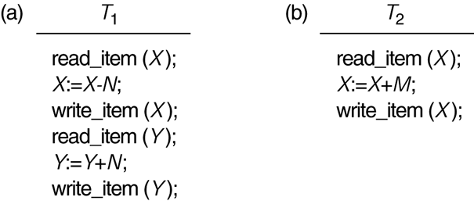
Two sample transactions
FIGURE 17.2 Two sample transactions:
(a) Transaction T1
(b) Transaction T2

Slide 7
Introduction to Transaction Processing (6)
Why Concurrency Control is needed:
The Lost Update Problem
This occurs when two transactions that access the same database items have their operations interleaved in a way that makes the value of some database item incorrect.
The Temporary Update (or Dirty Read) Problem
This occurs when one transaction updates a database item and then the transaction fails for some reason (see Section 17.1.4).
The updated item is accessed by another transaction before it is changed back to its original value.
The Incorrect Summary Problem
If one transaction is calculating an aggregate summary function on a number of records while other transactions are updating some of these records, the aggregate function may calculate some values before they are updated and others after they are updated.

Slide 8
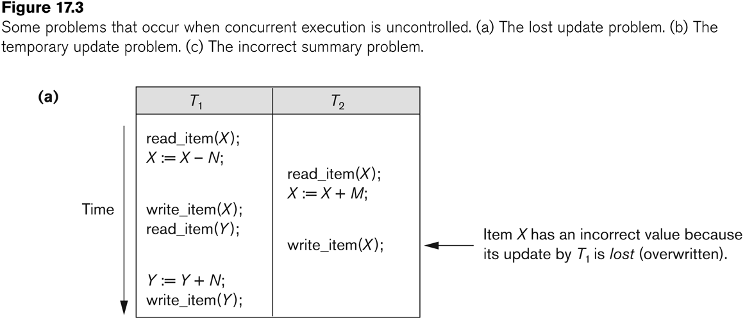
Concurrent execution is uncontrolled: (a) The lost update problem.

Slide 9
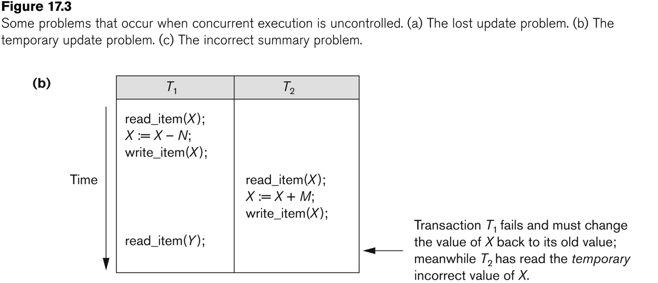
Concurrent execution is uncontrolled: (b) The temporary update problem.

Slide 10
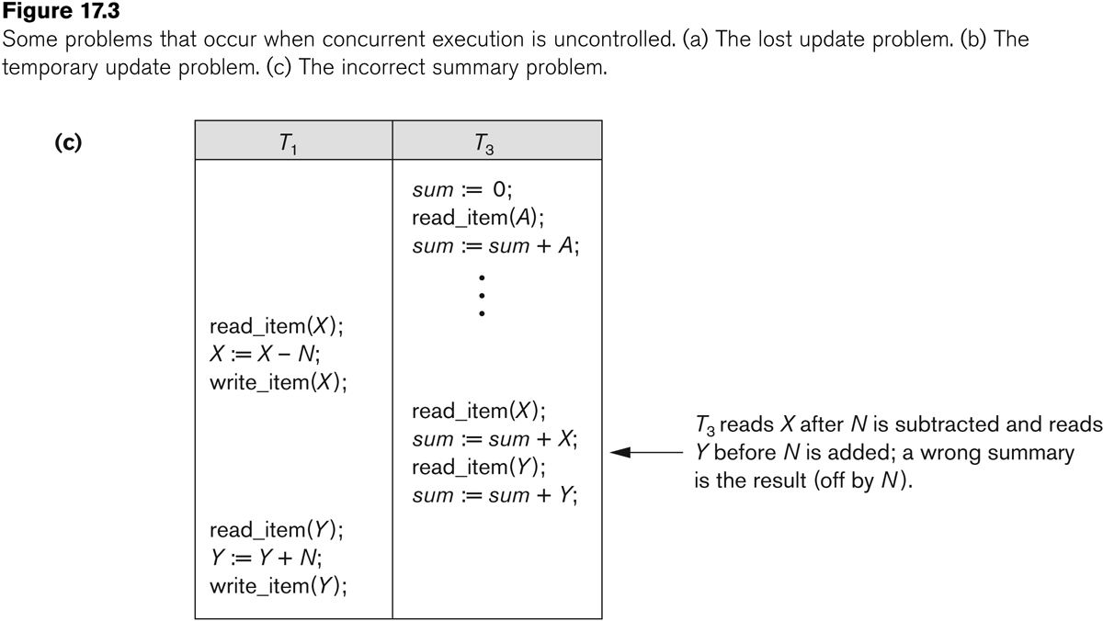
Concurrent execution is uncontrolled: (c) The incorrect summary problem.

Slide 11
Database Concurrency Control
1 Purpose of Concurrency Control
To enforce Isolation (through mutual exclusion) among conflicting transactions.
To preserve database consistency through consistency preserving execution of transactions.
To resolve read-write and write-write conflicts.
Example:
In concurrent execution environment if T1 conflicts with T2 over a data item A, then the existing concurrency control decides if T1 or T2 should get the A and if the other transaction is rolled-back or waits.

Slide 12
Desirable Properties of Transactions Atomicity and Consistency
Atomicity
Transactions are atomic – they don’t have parts (conceptually)
can’t be executed partially; it should not be detectable that they interleave with another transaction
Consistency
Transactions take the database from one consistent state into another
In the middle of a transaction the database might not be consistent

Slide 13
Desirable Properties of Transactions Isolation and Durability
Isolation
The effects of a transaction are not visible to other transactions until it has completed
From outside the transaction has either happened or not
To me this actually sounds like a consequence of atomicity…
Durability
Once a transaction has completed, its changes are made permanent
Even if the system crashes, the effects of a transaction must remain in place

Slide 14
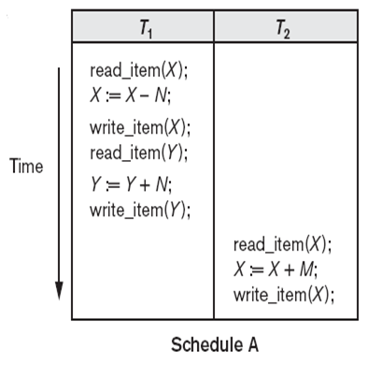
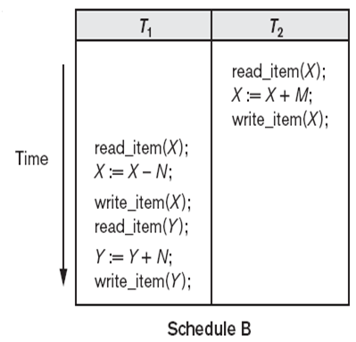
Serial schedule
S_{a}: r₁(X); w₁(X); r₁(Y); w₁(Y); r₂(X); w₂(X);
S_{b}: r₂(X); w₂(X); r₁(X); w₁(X); r₁(Y); w₁(Y);

Slide 15
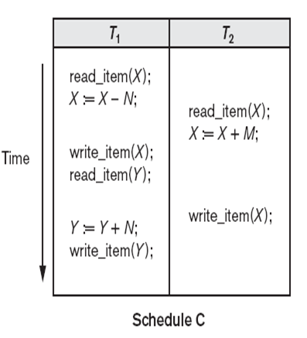
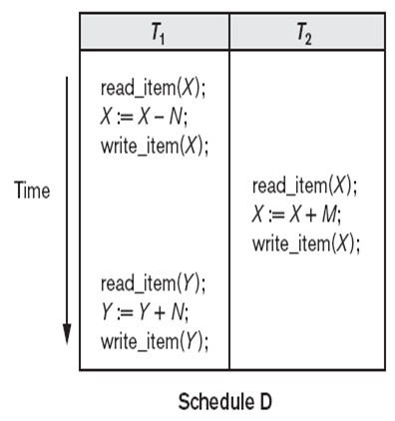
Non-serial schedule
S_{c}: r₁(X); r₂(X); w₁(X); r₁(Y); w₂(X); w₁(Y);
S_{d}: r₁(X); w₁(X); r₂(X); w₂(X); r₁(Y); w₁(Y)

Slide 16
Schedules
a schedule (or history) S of transactions (T1, T2 …TN) is ...
an interleaving of the set of actions contained in (T1, T2 .. TN) such that the actions of any single transaction are in order
interleaving of actions from transactions is allowed
Notes:
18

Slide 17
For Example
T1(a, b, c) T2(p, q, r, s)
These are schedules:
S1: (a, b, p, c, q, r, s)
S2: (p, a, q, b, c, r, s)
S3: (a, b, c, p, q, r, s)
This is not:
S4: (s, r, c, b, a, p, q)
Notes:
18

Slide 18
Acceptable Schedules
Serial Schedules
transactions run one at a time from start to finish; no interleaving.
Serializable Schedules
are equivalent to some serial schedule of the same transactions
final state is what some serial schedule would have produced.

Slide 19
Defining Correctness
We can assume that a serial schedule is correct assuming that:
transactions are independent; they do not depend on each other
each transaction is correct if executed on its own
So, why not just use serial schedules?

Slide 20
Because ...
Limits concurrency
wastes resources that could be utilized
for example, if a transaction is busy with I/O, the CPU could be used for another transaction.
Concurrency generally decreases the response time of shorter transactions because they don’t have to wait for longer transactions to complete.

Slide 21
Serializability
Some non-serial schedules produce correct results; others don’t
Serializability theory is used to ensure that only those schedules which produce correct results are used
a schedule S of n transactions is serializable if it is equivalent to some serial schedule of the same n transactions

Slide 22
Conflict Equivalence
2 operations in a schedule conflict if
they belong to different transactions
they access same item X
one of the operations is a write_item(X)
T1
T2
r(X)
w(X)
r(X)
w(X)
S1: r1(X), r2(X), w1(X), w2(X)
Conflicting Operations
Notes:
20

Slide 23
Conflict Serializability
Some schedules are serializable, some are not.
A handy algorithm allows us to determine if a schedule is conflict serializable
(although a DBMS would simply use protocols to guarantee that a schedule will be serializable)

Slide 24
Conflict Serializability Test
create a node for each transaction
for each case where T_{k} executes a read_item(X) after a write_item(X) executed by T_{i}, create an edge (T_{i} -> Tk)
for each case where T_{k} executes write_item(X) after T_{i} executes a read_item(X), create an edge (T_{i} -> T_{k})
for each case where T_{k} executes a write_item(X) after T_{i} executes a write item(X), create an edge (T_{i} -> T_{k})
if the graph has no cycles, it is serializable
NOTE - Edges are only created if one of the operations in T_{i} appears in the schedule before some conflicting operation in T_{k}.

Slide 25
Serializability Examples
T1
T2
read_item(X)
X:=X-10
write_item(X)
read_item(Y)
Y:=Y+10
write_item(Y)
read_item(X)
X:=X-20
write_item(X)
time
serializable?
Notes:
21

Slide 26
Serializability Test
T1
T2
T1 T2
Read (x)
Write(x)
Read(y)
Write(y)
Read(x)
Write(x)
2
Time
3

Slide 27
T1
T2
read_item(X)
X:=X-10
write_item(X)
read_item(Y)
Y:=Y+10
write_item(Y)
read_item(X)
X:=X-20
write_item(X)
time
serializable?
Notes:
22

Slide 28
T1
T2
T1
read_item(x)
write_item(x)
read_item(y)
write_item(y)
T2
read_item(x)
write_item(x)
time
1
2
3
Done!

Slide 29
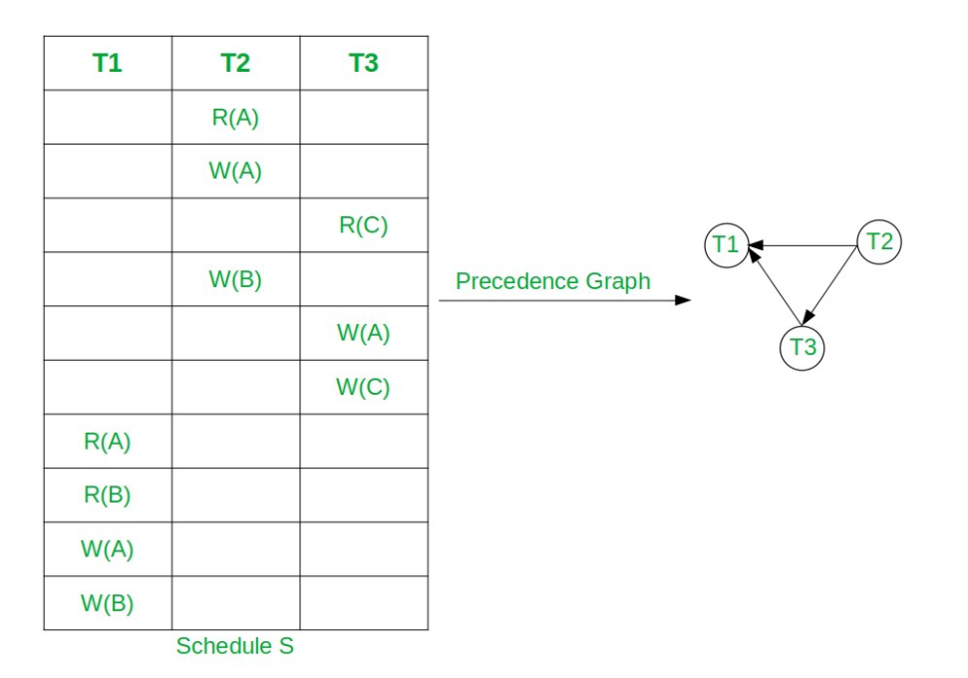
equivalent serial schedules.
Here node T2 has indegree 0.
So, select T2 and remove T2 and all edges connecting from it.
Now T3 has indegree 0. So, select T3 and remove the edge T3→T1.
At the end select T3. So the topological Sorting is T2, T3, T1.
Hence, the equivalent serial schedule of given conflict serializable schedule is T2→T3→T1, i.e., S2: R2(A) W2(A) W2(B) R3(C) W3(A) W3(C) R1(A) R2(B) W1(A) W1(B).
if the precedence graph has a cycle, it is easy to show that we cannot create any equivalent serial schedule, so not serializable

Slide 30
Check whether the below schedules are conflict serializable or not using precedence graph.
S1:R₁(A), R₂(A), W₂(A), R₂(B), W₁(A), R₁(B), W₁(B), W₂(B)
S2 : R₁(B), R₃(C), R₁(A), W₂(A), W₁(A), W₂(B), W₃(A), W₁(B), W₃(B), W₃(C)

Slide 31
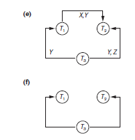
equivalent serial schedules

