Slide 1
William Stallings
Data and Computer Communications
7th Edition
Chapter 4
Transmission Media

Slide 2
Overview
Guided - wire
Unguided - wireless
Characteristics and quality determined by medium and signal
For guided, the medium is more important
For unguided, the bandwidth produced by the antenna is more important
Key concerns are data rate and distance

Slide 3
Guided Transmission Media
Twisted Pair
Coaxial cable
Optical fiber

Slide 4
Transmission Characteristics of Guided Media
Frequency Range
Typical Attenuation
Typical Delay
Repeater Spacing
Twisted pair (with loading)
0 to 3.5 kHz
0.2 dB/km @ 1 kHz
50 µs/km
2 km
Twisted pairs (multi-pair cables)
0 to 1 MHz
0.7 dB/km @ 1 kHz
5 µs/km
2 km
Coaxial cable
0 to 500 MHz
7 dB/km @ 10 MHz
4 µs/km
1 to 9 km
Optical fiber
186 to 370 THz
0.2 to 0.5 dB/km
5 µs/km
40 km

Slide 5
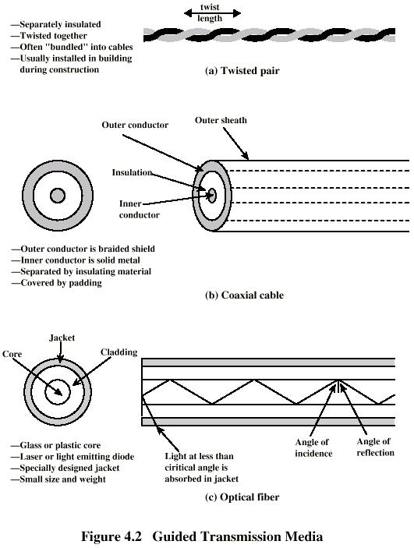
Twisted Pair

Slide 6
Twisted Pair - Applications
Most common medium
Telephone network
  Between house and local exchange (subscriber loop)
Within buildings
  To private branch exchange (PBX)
For local area networks (LAN)
  10Mbps or 100Mbps

Slide 7
Twisted Pair - Pros and Cons
Cheap
Easy to work with
Low data rate
Short range

Slide 8
Twisted Pair - Transmission Characteristics
Analog
  Amplifiers every 5km to 6km
Digital
  Use either analog or digital signals
  repeater every 2km or 3km
Limited distance
Limited bandwidth (1MHz)
Limited data rate (100MHz)
Susceptible to interference and noise

Slide 9
Unshielded and Shielded TP
Unshielded Twisted Pair (UTP)
  Ordinary telephone wire
  Cheapest
  Easiest to install
  Suffers from external EM interference
Shielded Twisted Pair (STP)
  Metal braid or sheathing that reduces interference
  More expensive
  Harder to handle (thick, heavy)

Slide 10
UTP Categories
Cat 3
  up to 16MHz
  Voice grade found in most offices
  Twist length of 7.5 cm to 10 cm
Cat 4
  up to 20 MHz
Cat 5
  up to 100MHz
  Commonly pre-installed in new office buildings
  Twist length 0.6 cm to 0.85 cm
Cat 5E (Enhanced) –see tables
Cat 6
Cat 7

Slide 11
Twisted Pair Categories and Classes
Category 3 Class C
Category 5 Class D
Category 5E
Category 6 Class E
Category 7 Class F
Bandwidth
16 MHz
100 MHz
100 MHz
200 MHz
600 MHz
Cable Type
UTP
UTP/FTP
UTP/FTP
UTP/FTP
SSTP
Link Cost (Cat 5 =1)
0.7
1
1.2
1.5
2.2

Slide 12
Coaxial Cable

Slide 13
Coaxial Cable Applications
Most versatile medium
Television distribution
  Ariel to TV
  Cable TV
Long distance telephone transmission
  Can carry 10,000 voice calls simultaneously
  Being replaced by fiber optic
Short distance computer systems links
Local area networks

Slide 14
Coaxial Cable - Transmission Characteristics
Analog
  Amplifiers every few km
  Closer if higher frequency
  Up to 500MHz
Digital
  Repeater every 1km
  Closer for higher data rates

Slide 15
Optical Fiber

Slide 16
Optical Fiber - Benefits
Greater capacity
  Data rates of hundreds of Gbps
Smaller size & weight
Lower attenuation
Electromagnetic isolation
Greater repeater spacing
  10s of km at least

Slide 17
Optical Fiber - Applications
Long-haul trunks
Metropolitan trunks
Rural exchange trunks
Subscriber loops
LANs

Slide 18
Optical Fiber - Transmission Characteristics
Act as wave guide for 10¹⁴ to 10¹⁵ Hz
  Portions of infrared and visible spectrum
Light Emitting Diode (LED)
  Cheaper
  Wider operating temp range
  Last longer
Injection Laser Diode (ILD)
  More efficient
  Greater data rate
Wavelength Division Multiplexing

Slide 19
Wireless Transmission Frequencies
2GHz to 40GHz
  Microwave
  Highly directional
  Point to point
  Satellite
30MHz to 1GHz
  Omnidirectional
  Broadcast radio
3 x 10¹¹ to 2 x 10¹⁴
  Infrared
  Local

