Slide 1
Transmission
Control Protocol
(TCP)

Slide 2
TCP
SERVICES

Slide 3
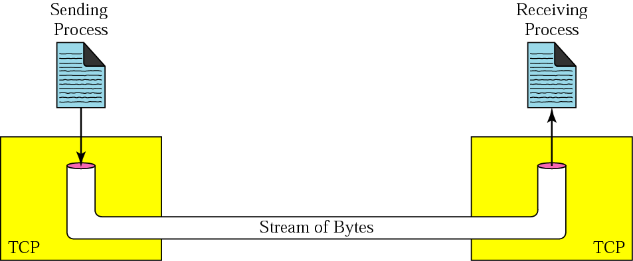
Process to Process Communication
Stream delivery

Slide 4
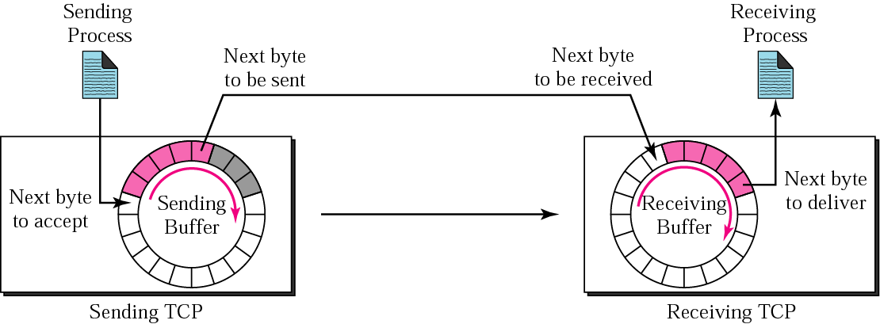
Sending and receiving buffers

Slide 5
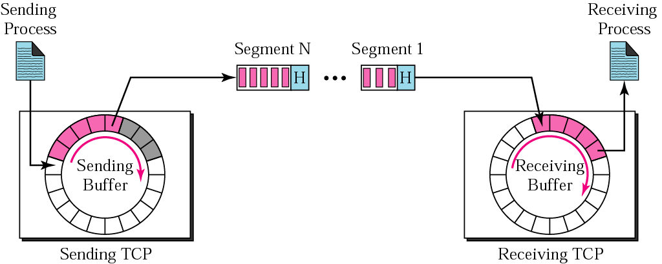
TCP segments

Slide 6
NUMBERING
BYTES

Slide 7

The bytes of data being transferred
in each connection are numbered by TCP.
The numbering starts with
a randomly generated number.

Slide 8
Example 1
Imagine a TCP connection is transferring
a file of 6000 bytes. The first byte is
numbered 10010. What are the sequence
numbers for each
segment if data is sent in five segments
with the first four segments carrying
1,000 bytes and the last
segment carrying 2,000 bytes?

Slide 9
Solution
The following shows the sequence number for each segment:
Segment 1 ➔ 10,010 (10,010 to 11,009)
Segment 2 ➔ 11,010 (11,010 to 12,009)
Segment 3 ➔12,010 (12,010 to 13,009)
Segment 4 ➔13,010 (13,010 to 14,009)
Segment 5 ➔ 14,010 (14,010 to 16,009)

Slide 10
The value of the sequence number field in
a segment defines the number
of the first data byte
contained in that segment.

Slide 11
The value of the acknowledgment field in a
segment defines the number of the
next byte a party expects to receives.
The acknowledgment number is cumulative.

Slide 12
SEGMENT

Slide 13
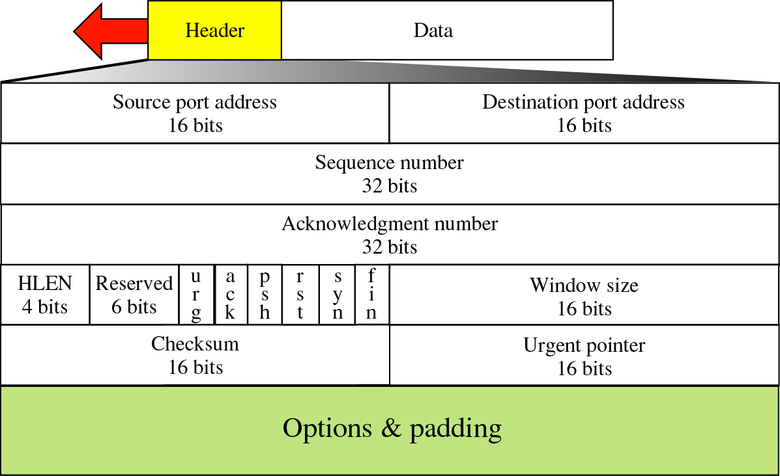
TCP segment format

Slide 14
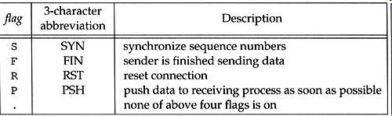

Slide 15
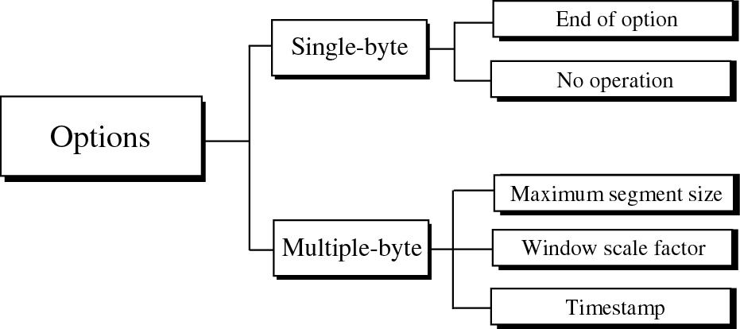
Options

Slide 16
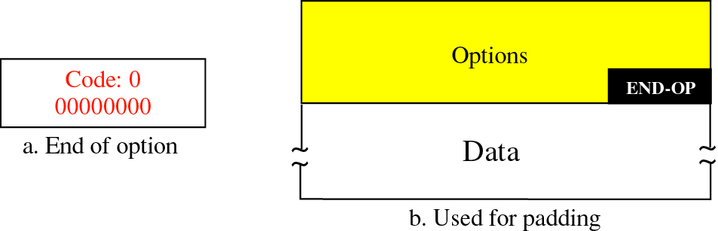
End of option option

Slide 17
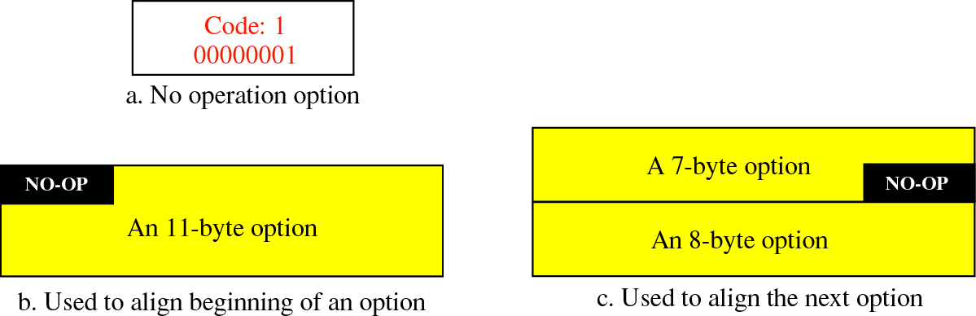
No operation option

Slide 18
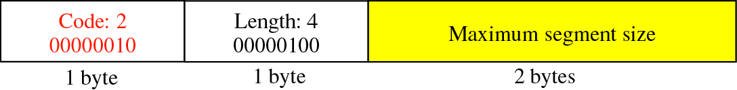
Maximum segment size option

Slide 19
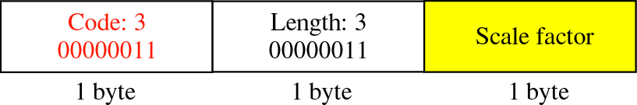
Window scale factor option

Slide 20
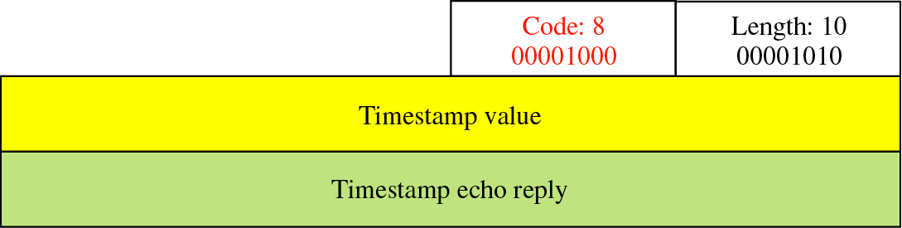
Timestamp option

Slide 21
CONNECTION

Slide 22
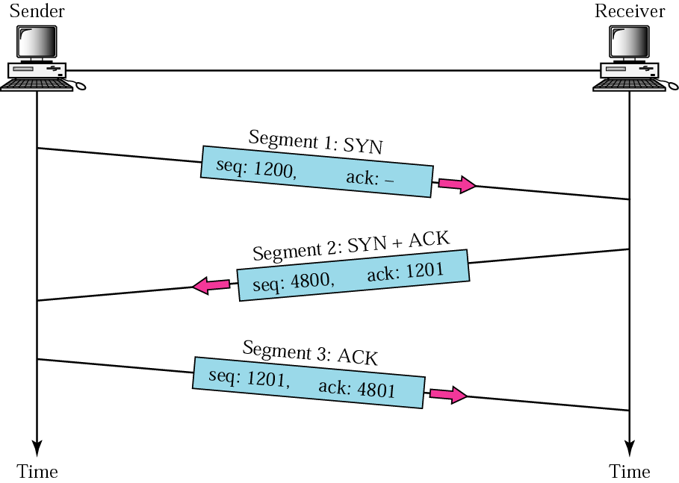
Figure 12-28
Three-way handshaking

Slide 23
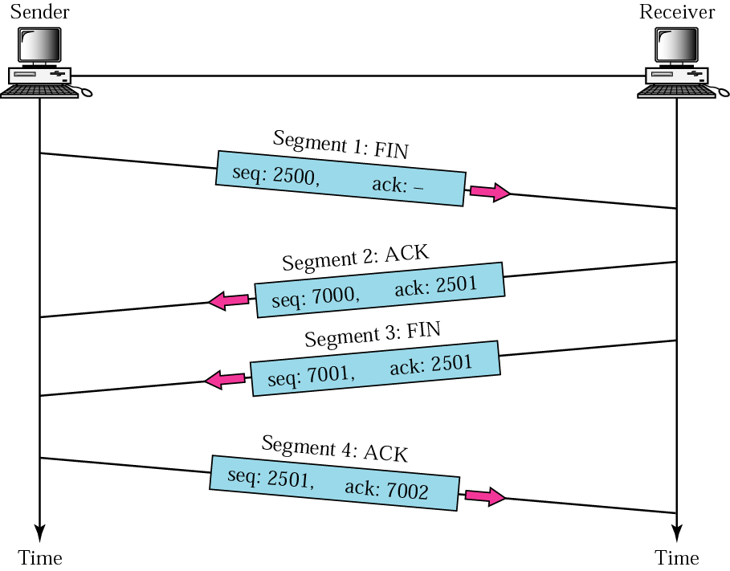
Figure 12-29
Four-way handshaking

Slide 24
FLOW
CONTROL

Slide 25
A sliding window is used to make
transmission more
efficient as well as to control the flow of
data so that the destination
does not become overwhelmed with data.
TCP’s sliding windows are byte oriented.

Slide 26
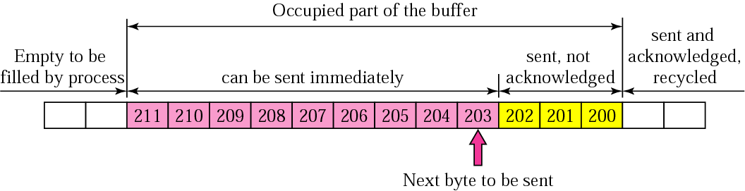
Figure 12-7
Sender buffer

Slide 27
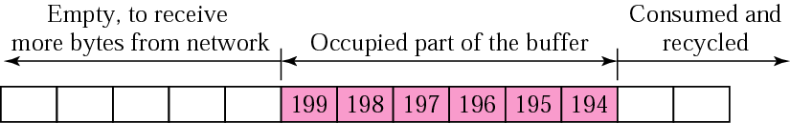
Figure 12-8
Receiver window

Slide 28
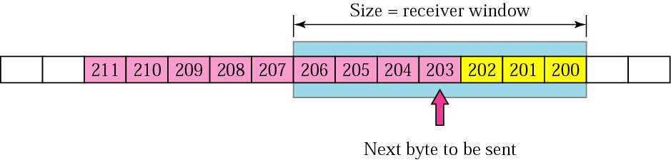
Figure 12-9
Sender buffer and sender window

Slide 29
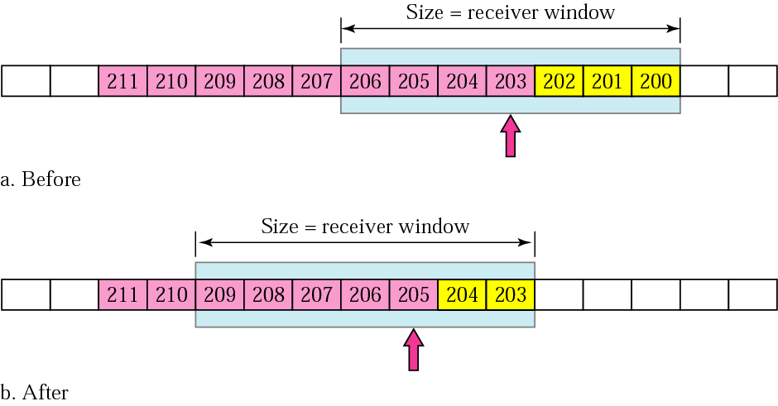
Figure 12-10
Sliding the sender window

Slide 30
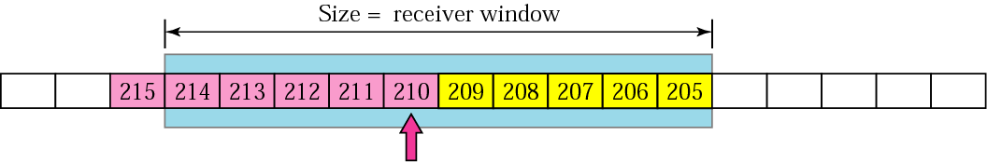
Figure 12-11
Expanding the sender window

Slide 31
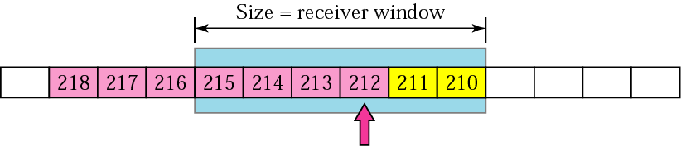
Figure 12-12
Shrinking the sender window

Slide 32
In TCP, the sender window
size is totally controlled
by the receiver window value. However, the actual window size
can be smaller if there is
congestion in the network.

Slide 33
Some Points about TCP’s Sliding Windows:
1. The source does not have to send a
full window’s worth of data.
2. The size of the window can be increased
or decreased by the destination.
3. The destination can send an
acknowledgment at any time.

Slide 34
ERROR
CONTROL

Slide 35
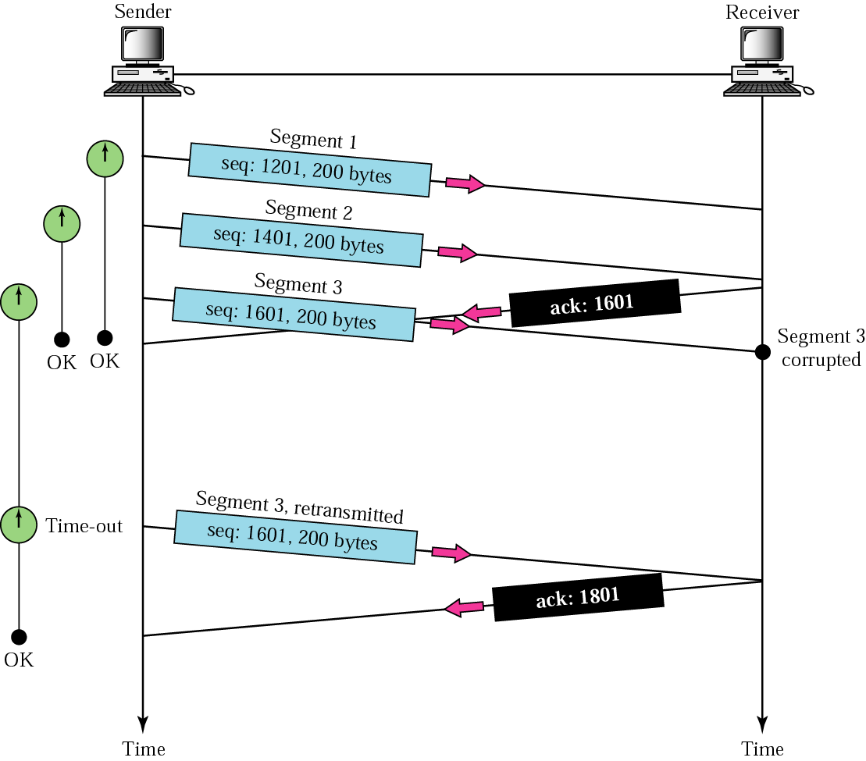
Figure 12-13
Corrupted segment

Slide 36
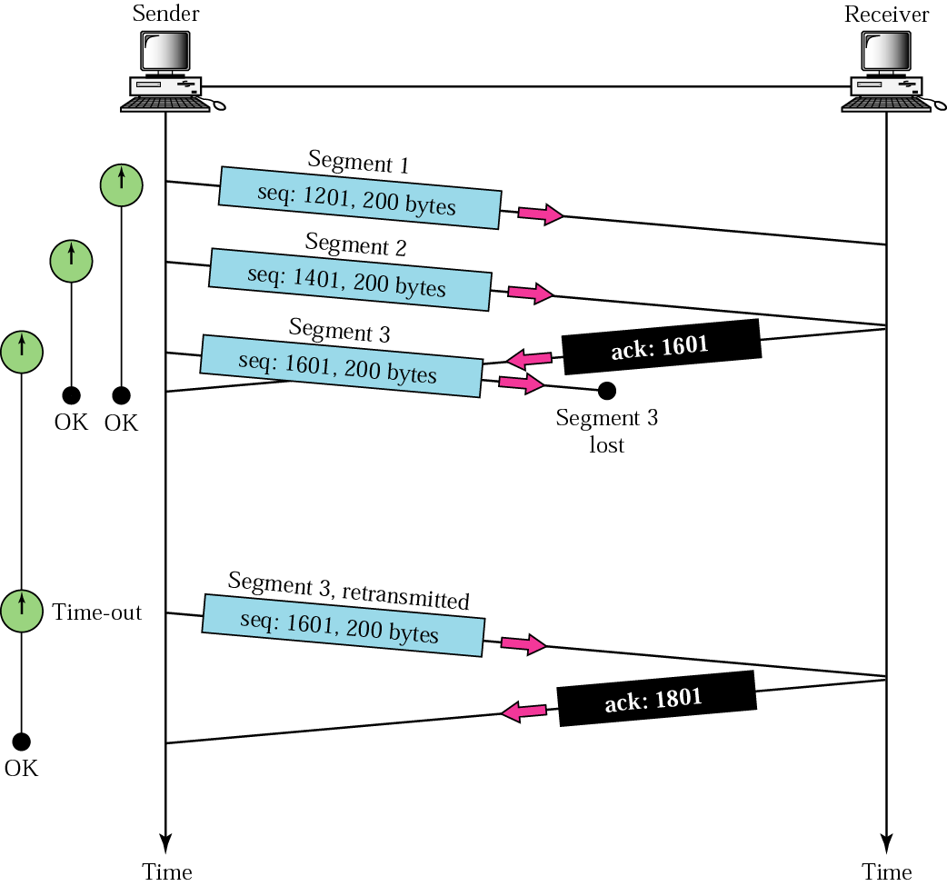
Figure 12-14
Lost segment

Slide 37
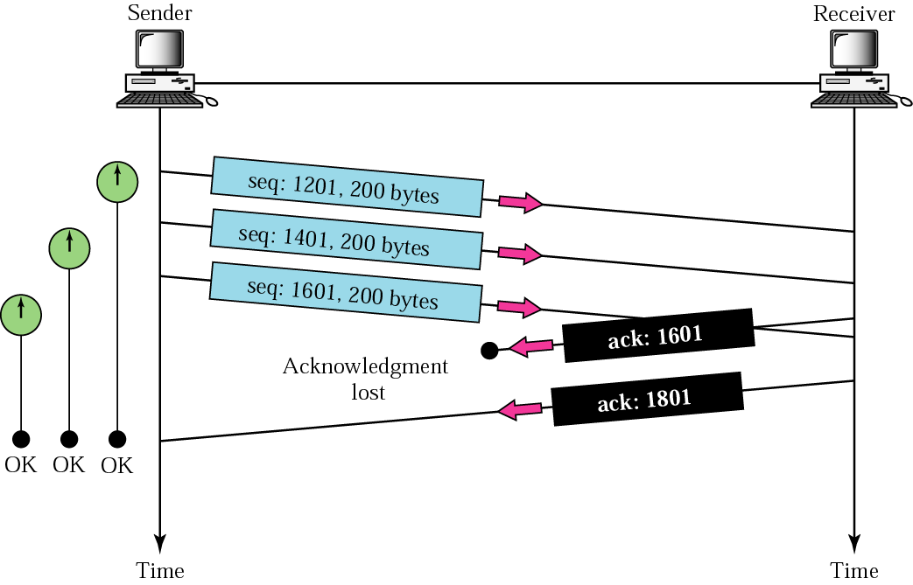
Figure 12-15
Lost acknowledgment

