Slide 1
OBCAS
Online BC ROY Appointment System

Slide 2
ABOUT THE PROJECT
Generally hospital is filled with all people working in kharagpur.If student had to go for some ailment he has to wait in long queues for hours and also if student has gone to hospital by rescheduling all the events for the day for some specialist doctor who comes on special days, very often the doctor will be absent or there will be huge rush of people.So this software intends to provide an online platform for booking doctor appointment at BC Roy Hospital. It basically specifies the availability dates and timings of the doctor to the patients and the patient list to the corresponding doctor respectively so if doctor is going to be absent on that particular day He or She will be informed in advance by mail and the student can also go at particular appointment slot he has booked which saves lot of time for him.

Slide 3
Contributions
Team Members :
1) P Amshumaan Varma (17CS30025) :
Doctor Page and Functionalities
Admin Page and Functionalities
2) Sashank Bonda (17CS30031) :
Patient Page and Functionalities
Team Contributions :
Database Tables and Connections
Template Styling
Server Connections

Slide 4
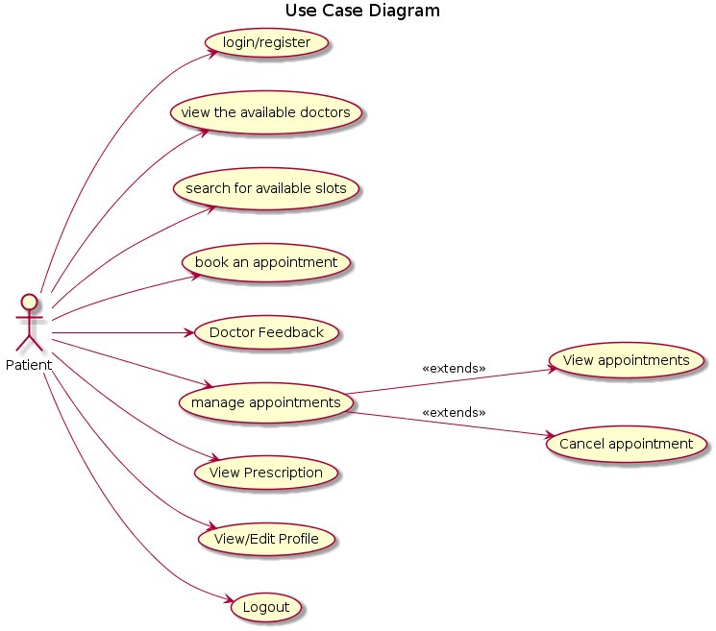
USE-CASE DIAGRAM --> PATIENT

Slide 5
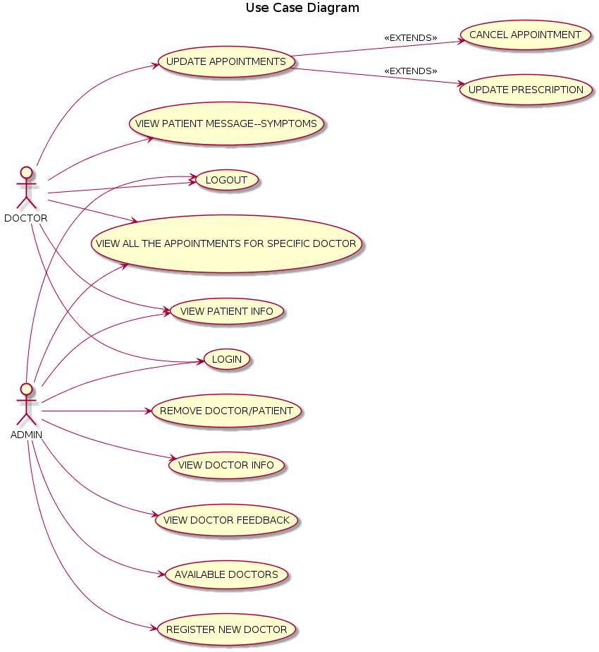
USE-CASE DIAGRAM --> DOCTOR AND ADMIN

Slide 6
ENVIRONMENT USED
FRONT END :
1) HTML, CSS
2) JQUERY (for widgets,slider animations)
BACK END :
1) JAVA SERVLETS
2) JAVA-SCRIPT (For AJAX Calls)
3) JSP
SERVER :
1) Apache Tomcat Server 8.5 (as it a servlet container)
* We did the project in Eclipse IDE

Slide 7
OVERALL WORK DONE
1)We have implemented almost all the use cases mentioned in the use case diagram diagram and some of the suggestions given.
2)Patient can regster, book appointment (can enter symptoms message) based on available slots and can view or cancel the bookings. He can view doctor prescription and later give him feedback. He can view and update his info.
3)Doctor can view his appointments, patient message (symptoms) given and update the appointments . He can enter the prescription. He can also view patient info
4)Admin can view appointments . He can register new doctor, remove existing doctor and patients and view all available doctors

Slide 8
CHALLENGES OVERCOME
1) Ubuntu 18 was giving proxy problems. So had to switch to eclipse.
2) At first we had no clue as to how a server would respond to request of HTML file which we had created , then we came across the concept of java servlets, then we got clarity on why we should use apache tomcat server since it is a servlet container.
3)Then while continuing our project we faced need for having dynamic pages(like eg selection of one drop menu affecting the other drop menu) so we needed to learn javascript to make ajax calls which refreshes only part of page rather than whole page.
4)Then finally for our front end we had to learn jquery,CSS to load widgets,tab menus,slider animations etc to make it look much better.

Slide 9
DEMO TIME !!!...

