Slide 1
Speckle Statistics
BME 844:
HW 5

Slide 2
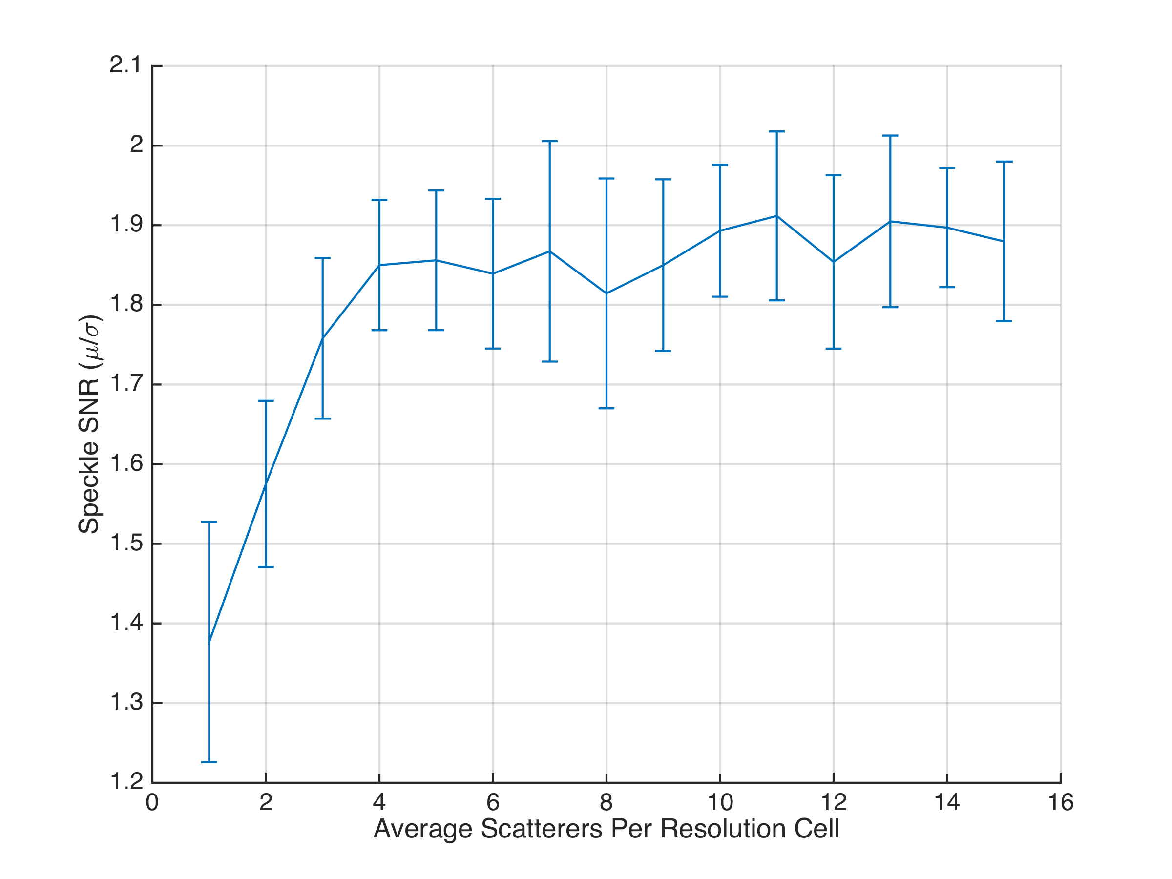
1st order: Speckle SNR

Slide 3
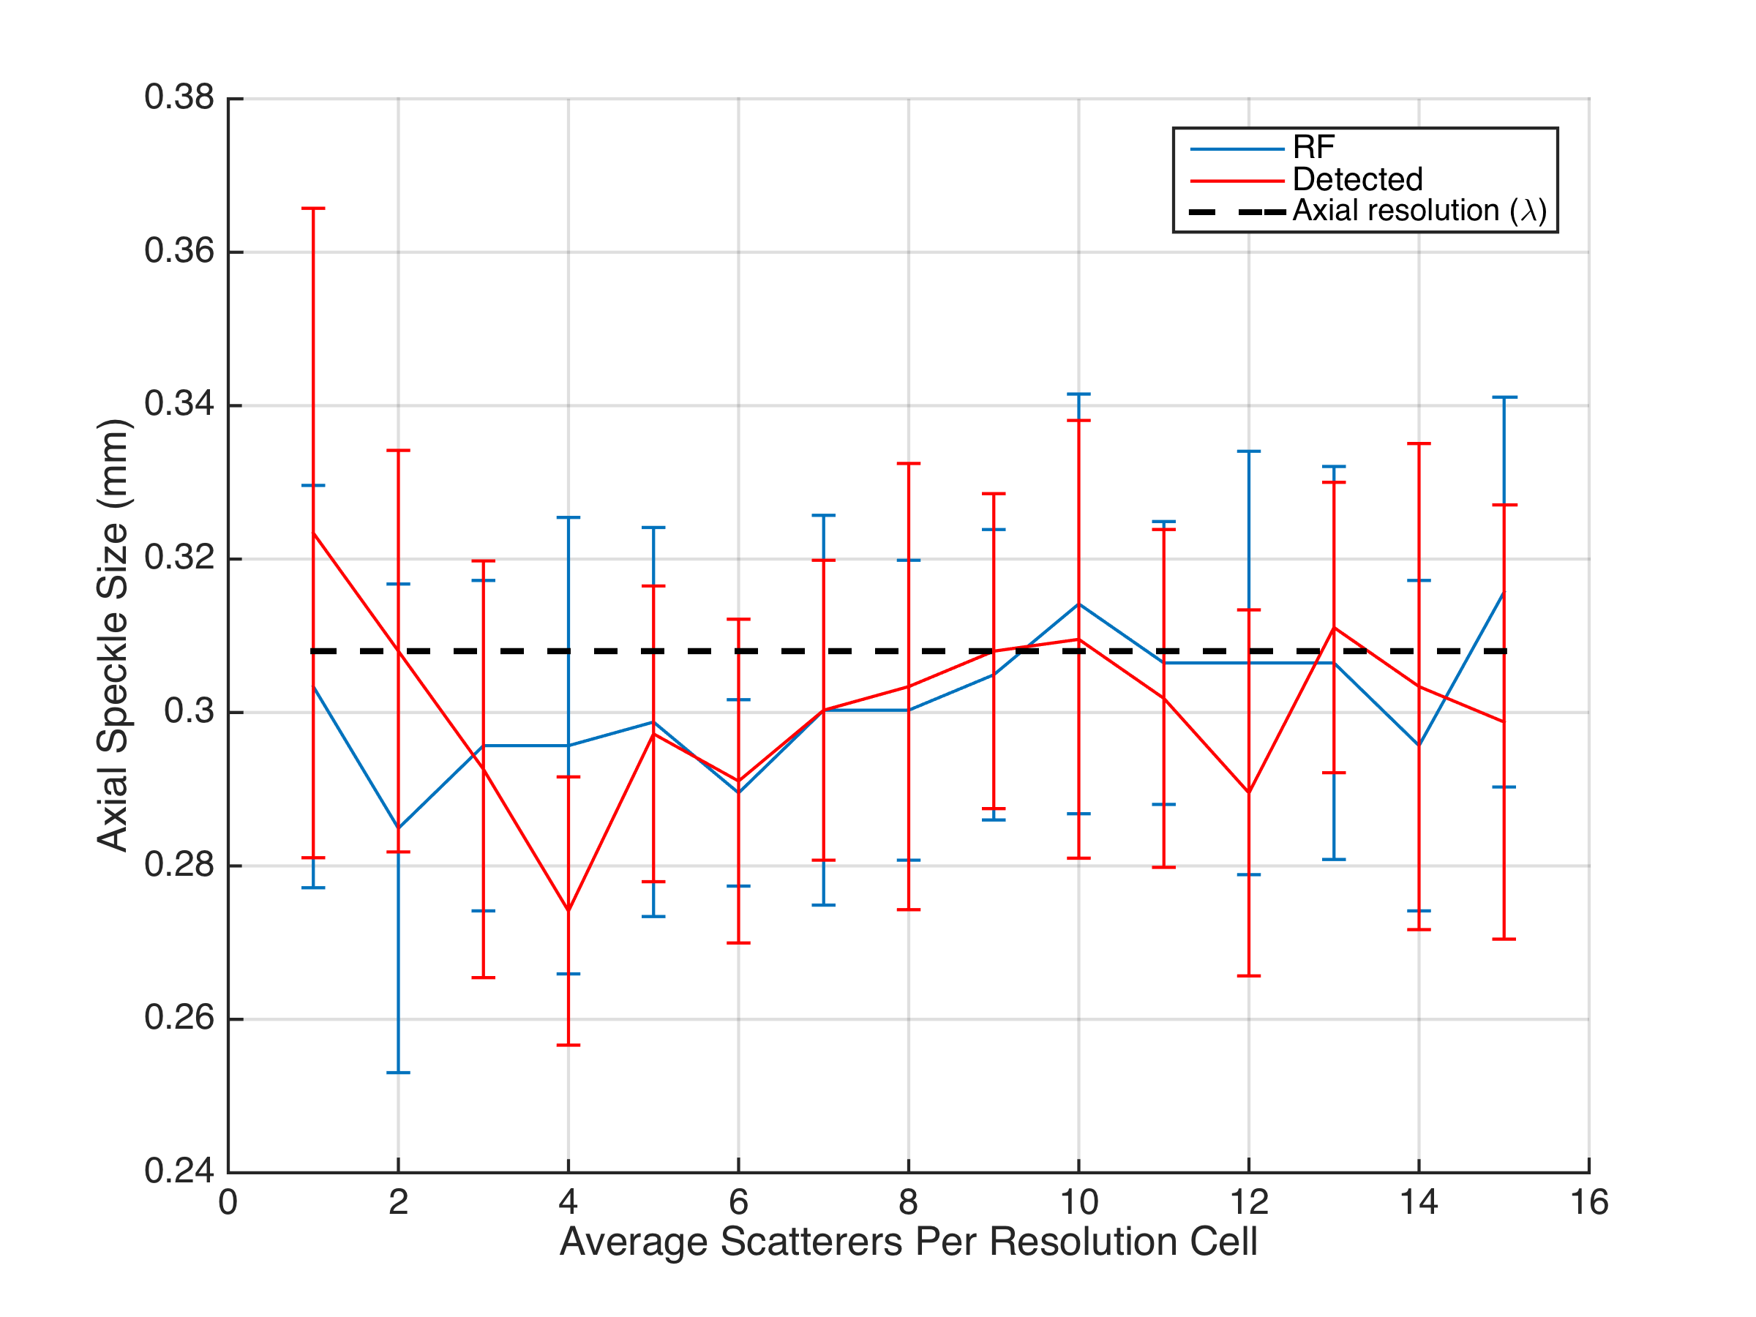
2nd order: Axial Speckle Size

Slide 4
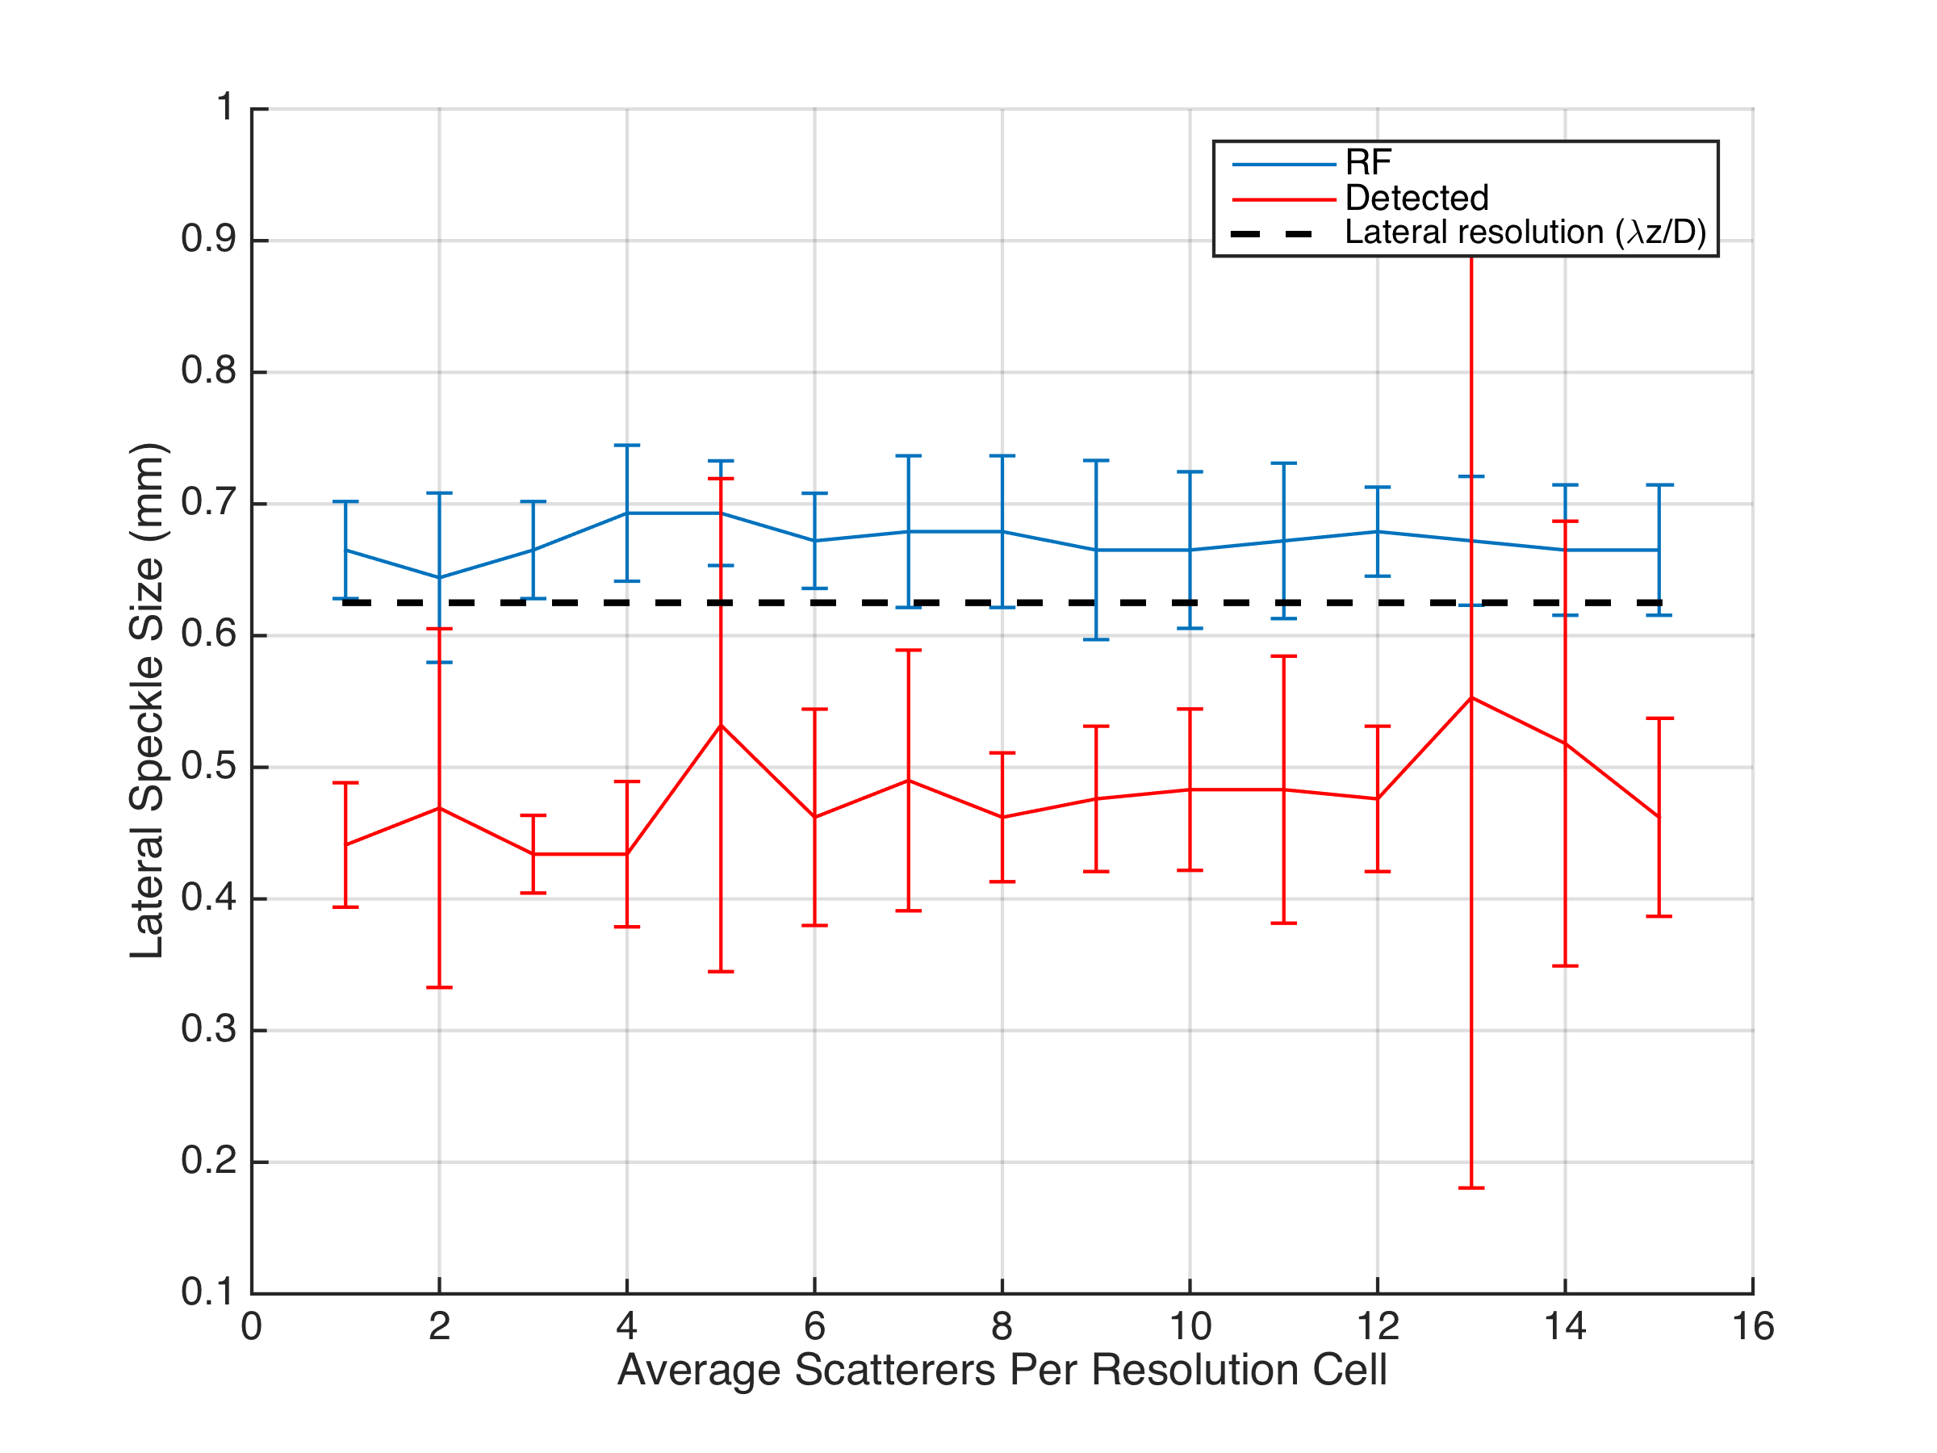
2nd order: Lateral Speckle Size

