Slide 1
Frequency Compounding
BME 844 - HW 6
Will Long

Slide 2
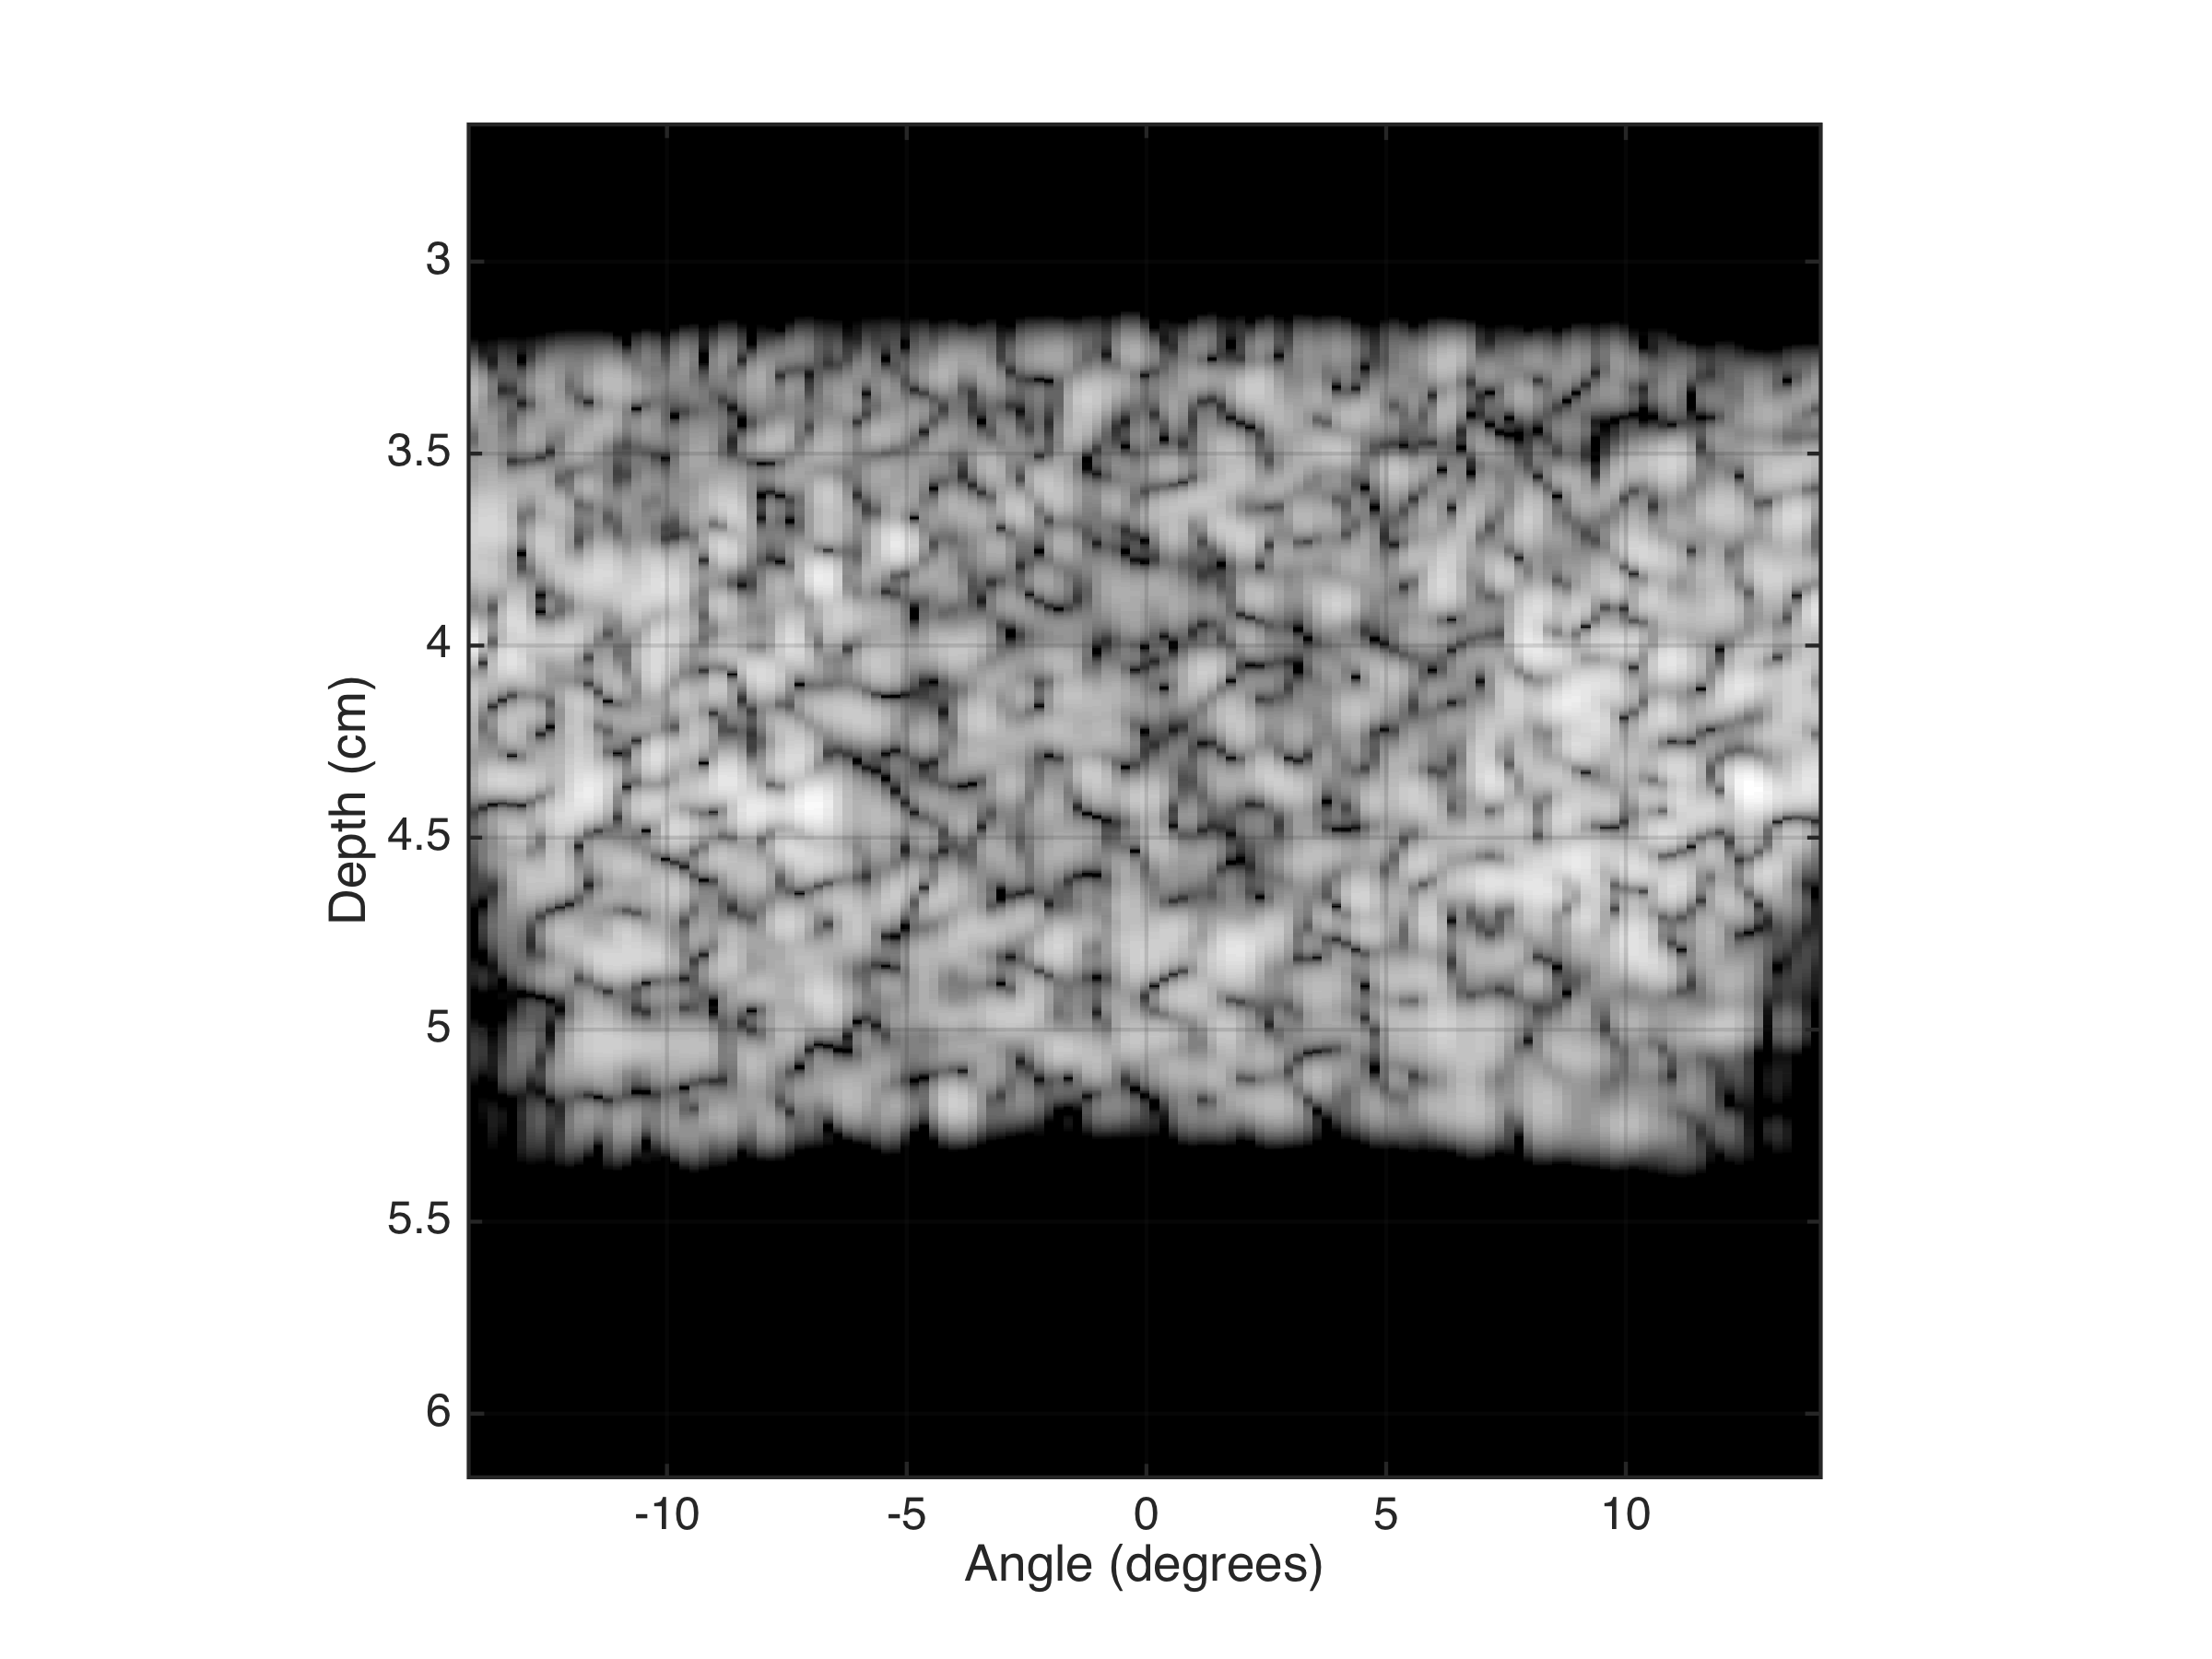
B-mode at 5 MHz (single band)

Slide 3
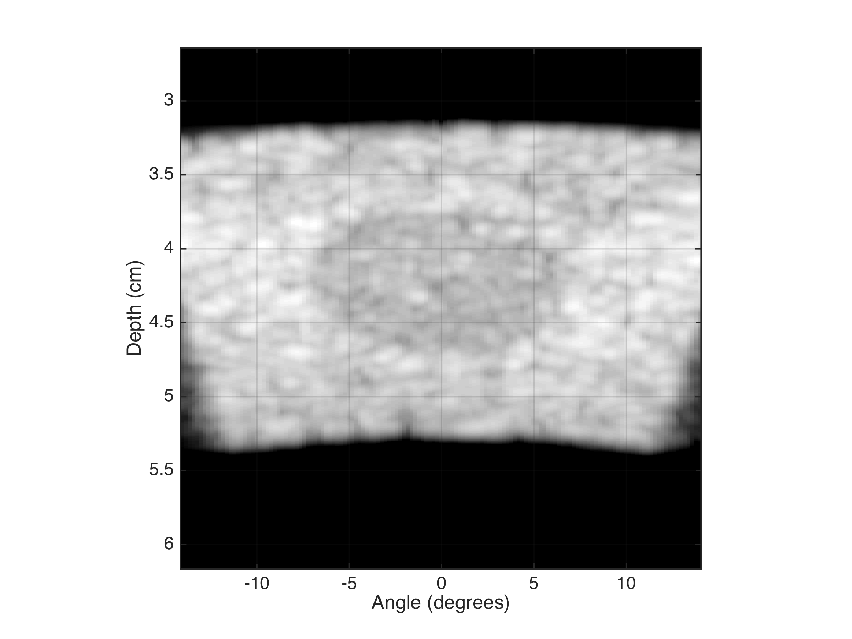
Frequency Compounded B-mode (Δf = 0.6 MHz)
Notes:
Depth = r

Slide 4
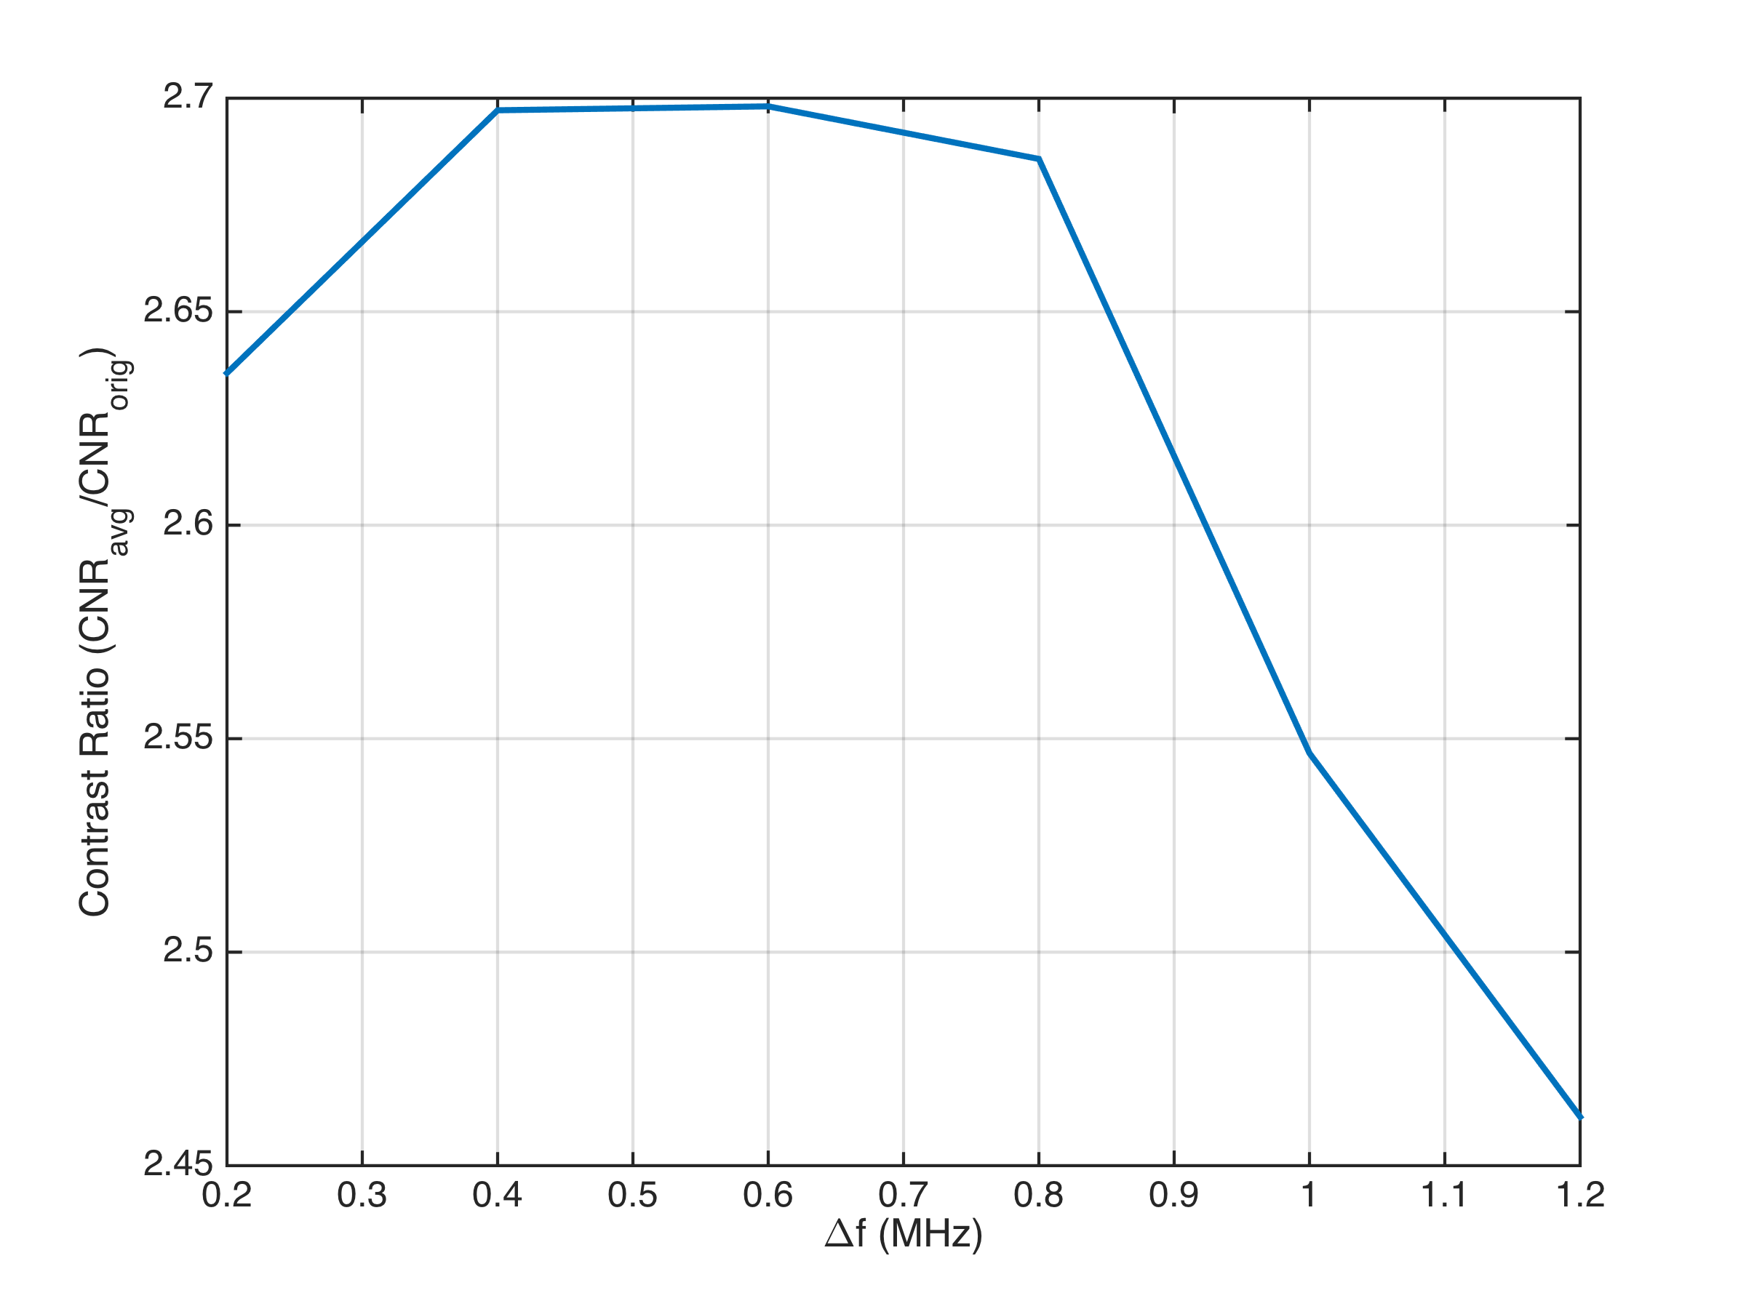
CNR with Frequency Compounding

