Slide 1
Image degradation (off-axis scattering)
BME 844 HW 8
Will Long

Slide 2
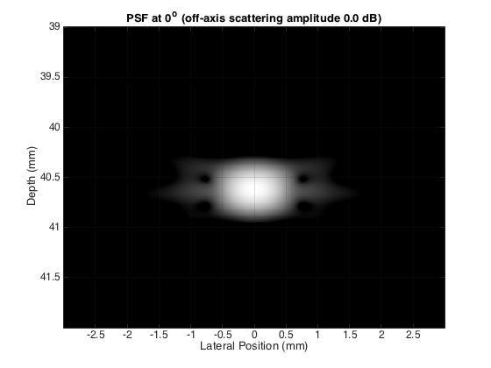
Masking of PSF

Slide 3
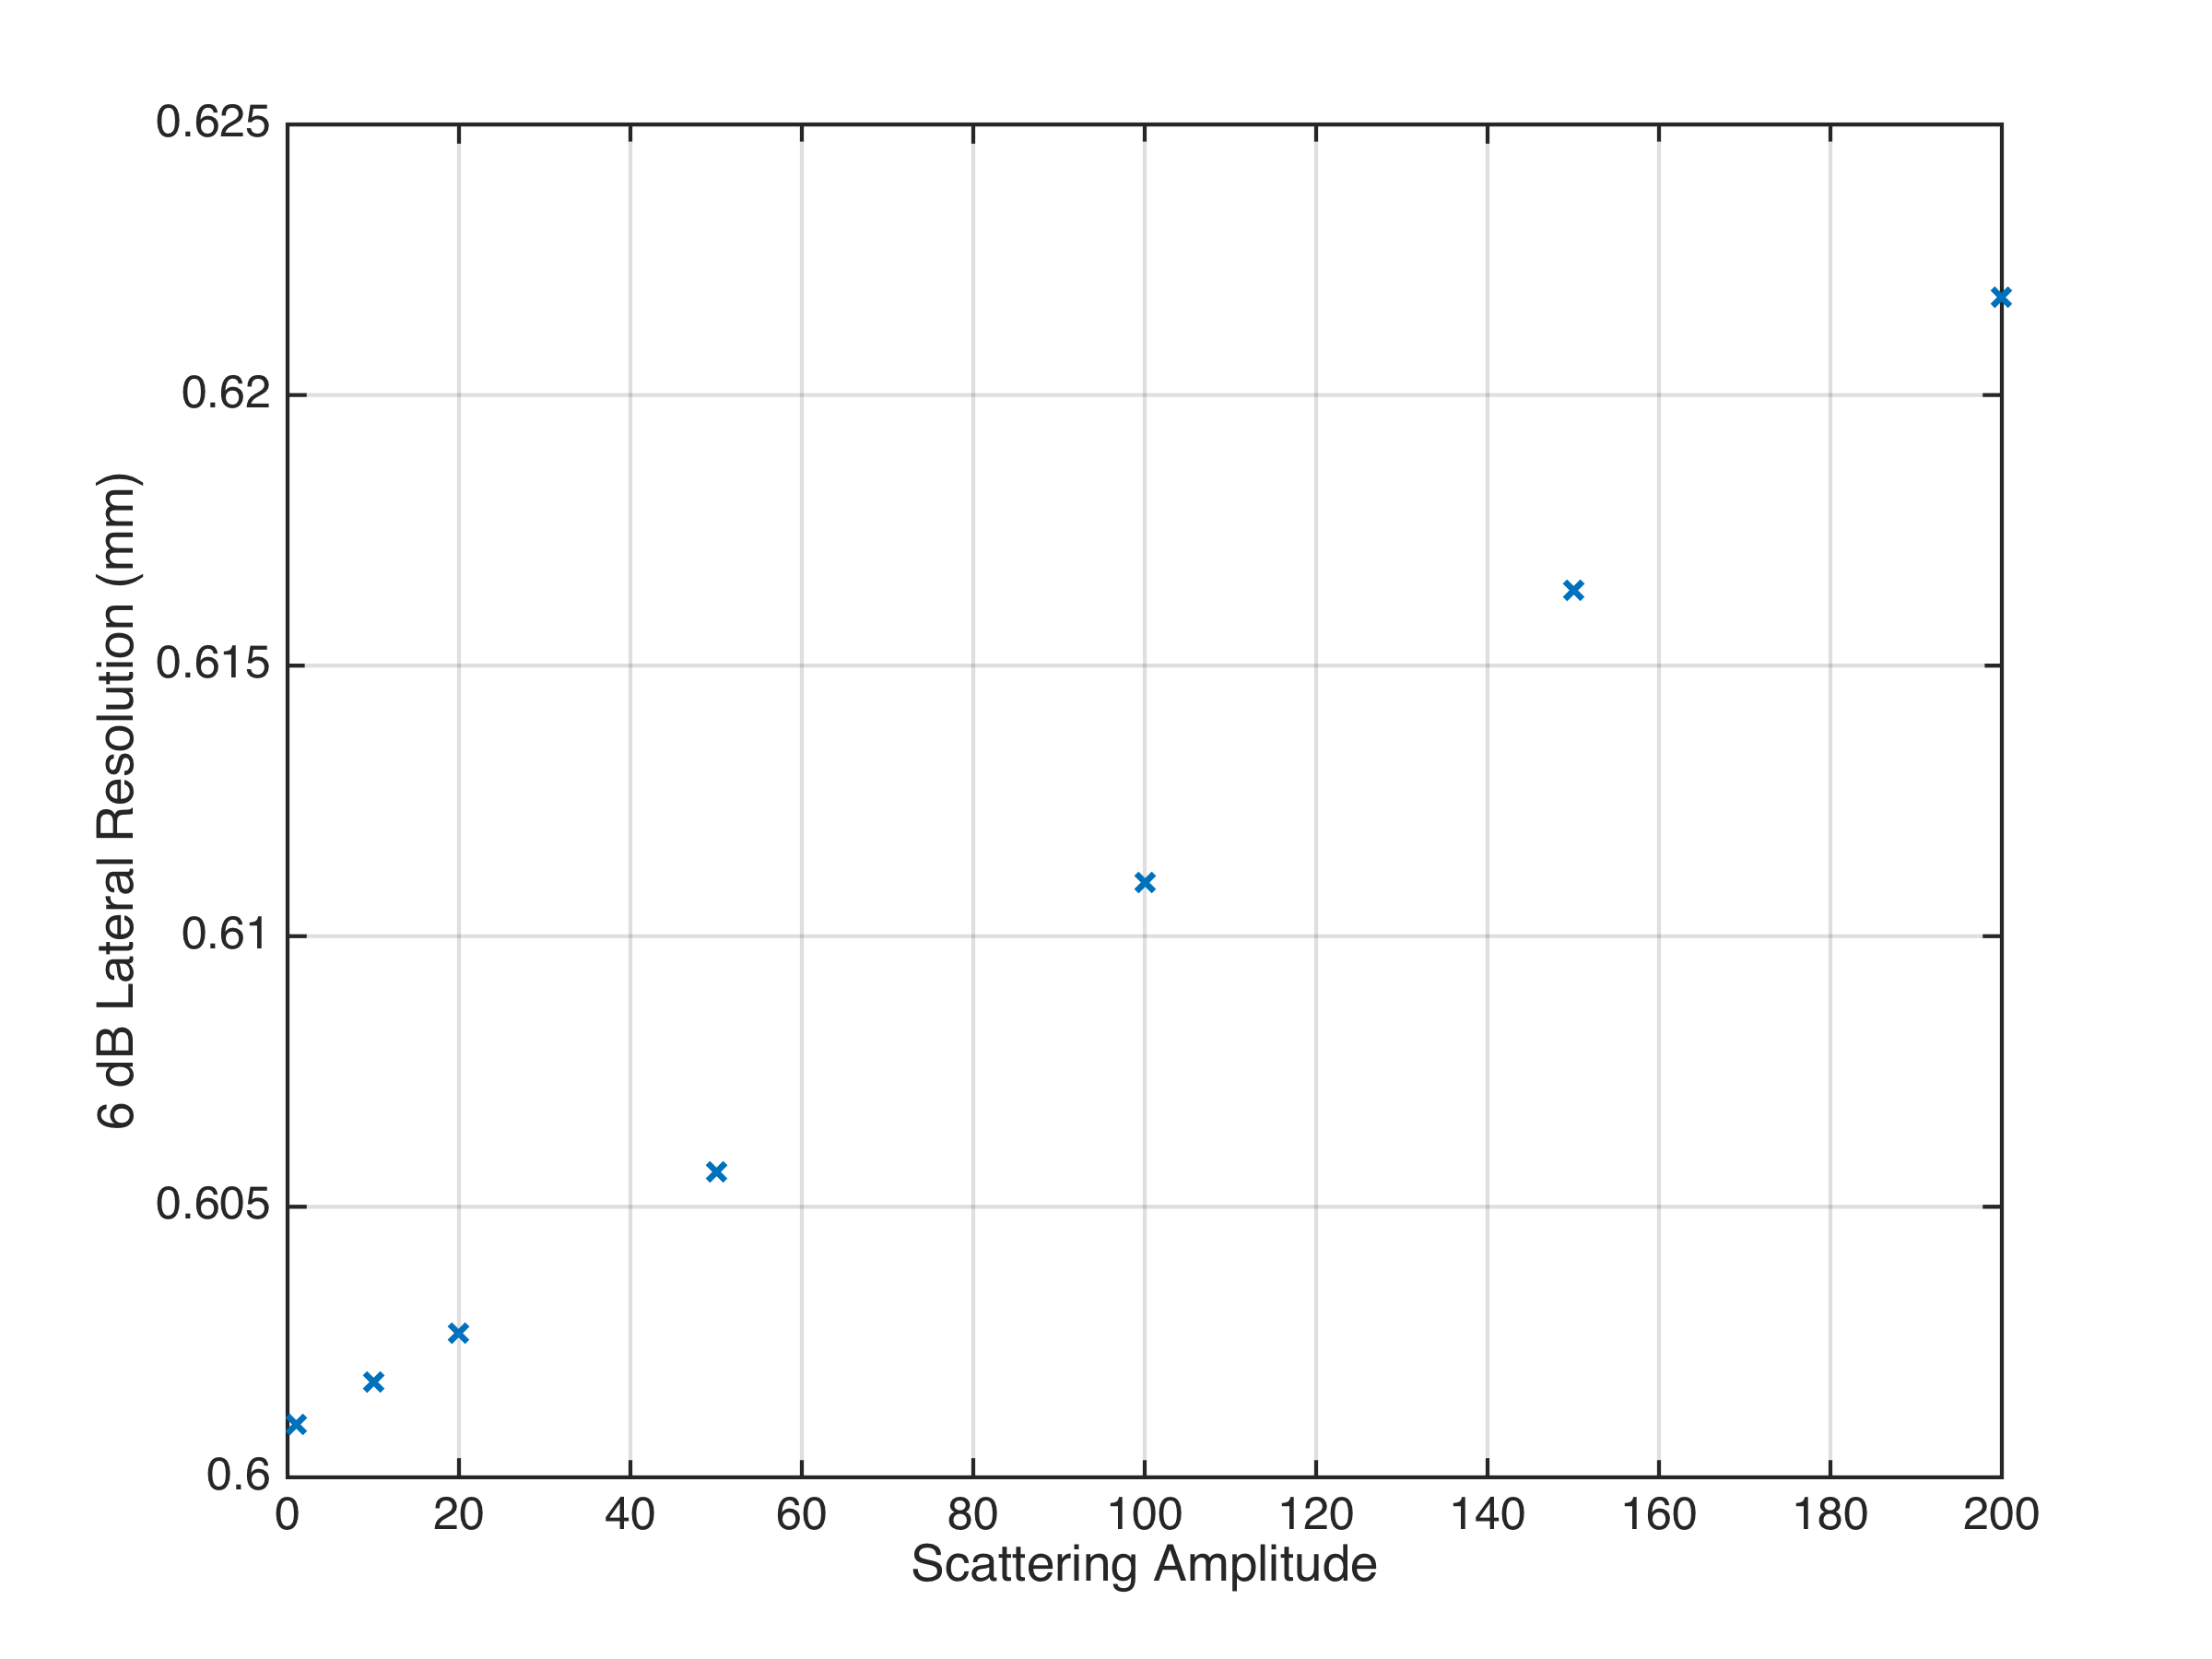
Increase in Lateral FWHM

Slide 4
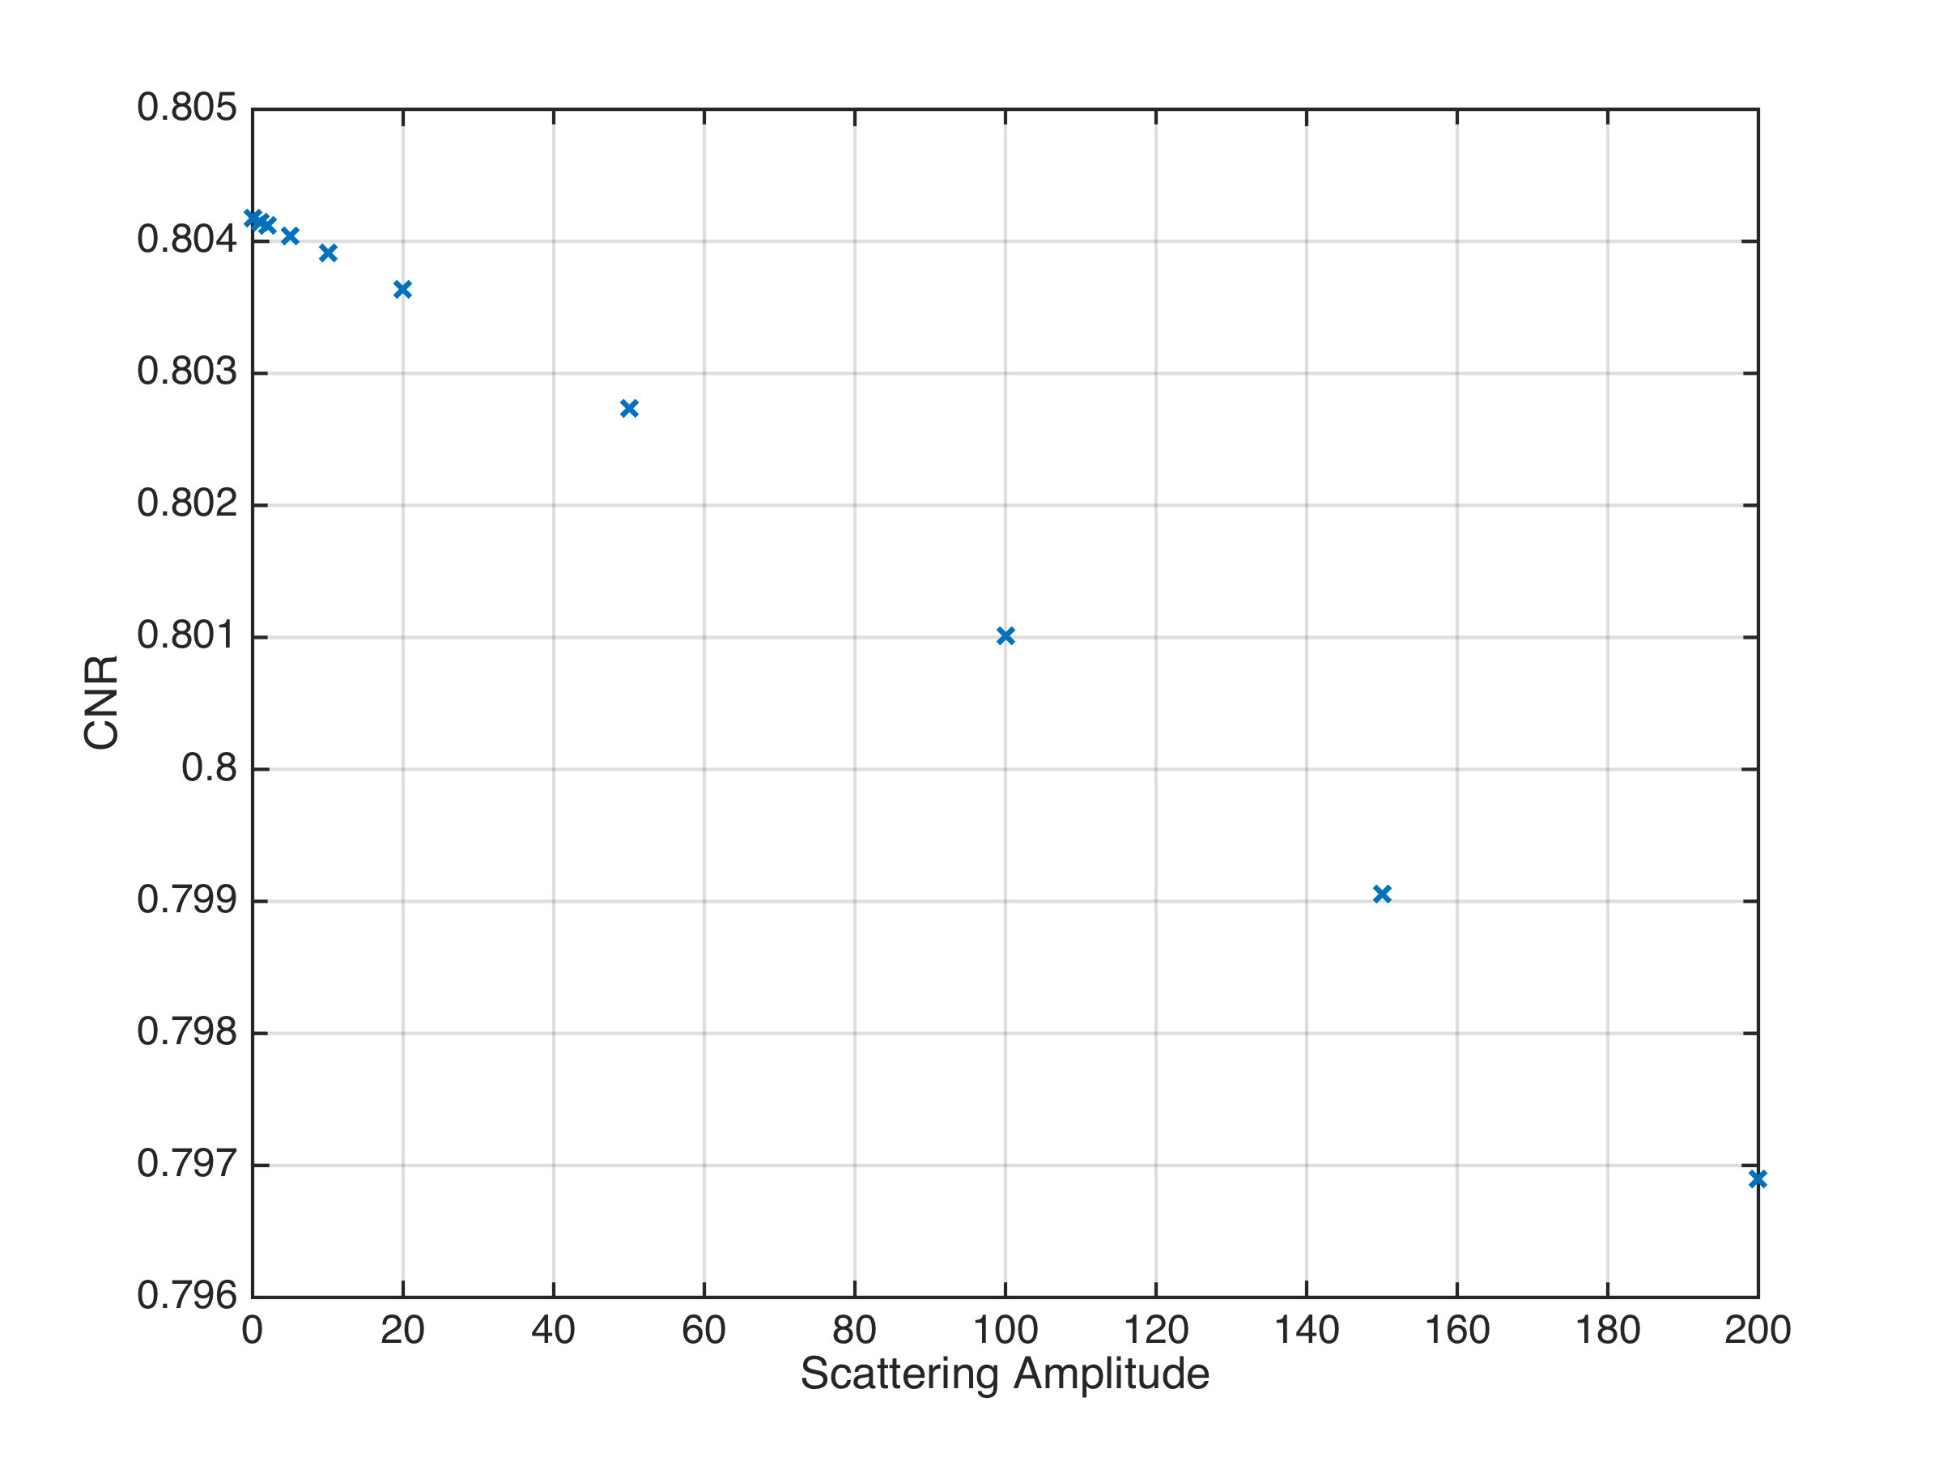
Decrease in Lesion CNR

