Slide 1

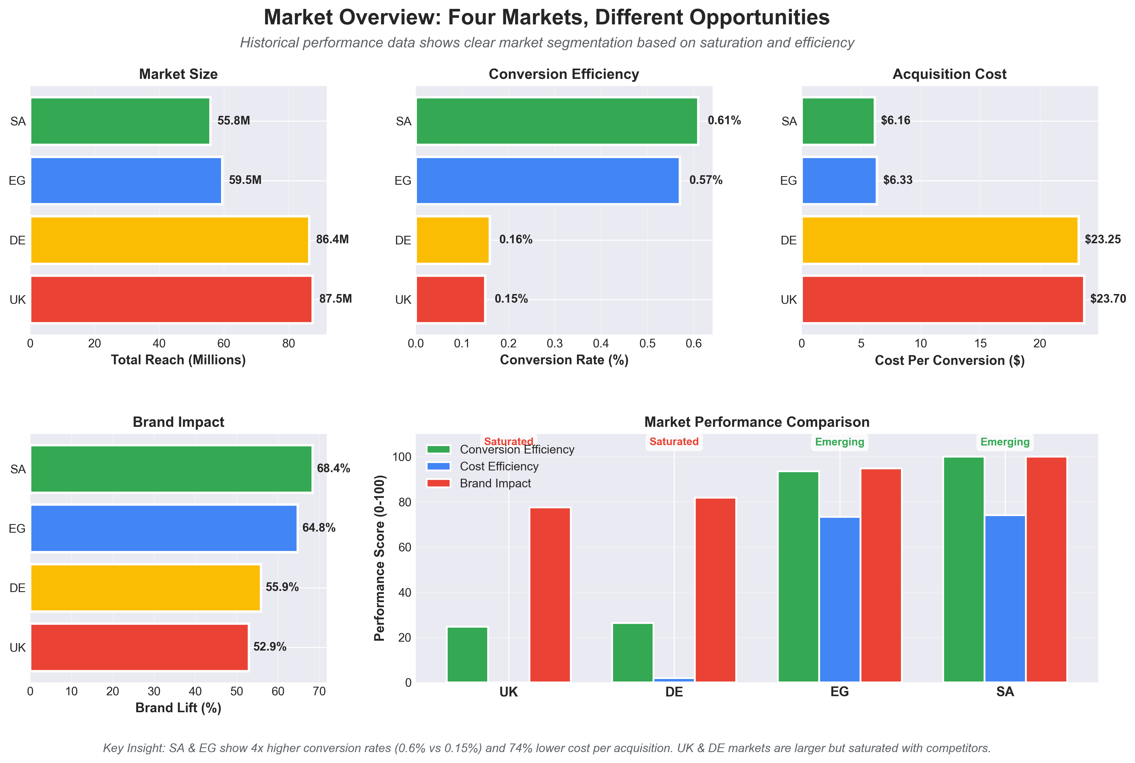
Market Intelligence: Strike Emerging Markets Before Competitors
Data reveals untapped efficiency in SA & EG—window closing fast
Two Market Playbook:
1. Emerging (SA/EG)
Capture uncontested demand with Search
4x higher conversion | $6 CPA | 70% of budget = 84% of results
2. Saturated (UK/DE)
Shift preference from ChatGPT with YouTube
Strong brand lift but 4x cost | 30% of budget = strategic presence
Action: Launch SA/EG immediately to reach unsaturated markets before competitors and focus on reach. Target saturated markets with conversion strategies.

Slide 2
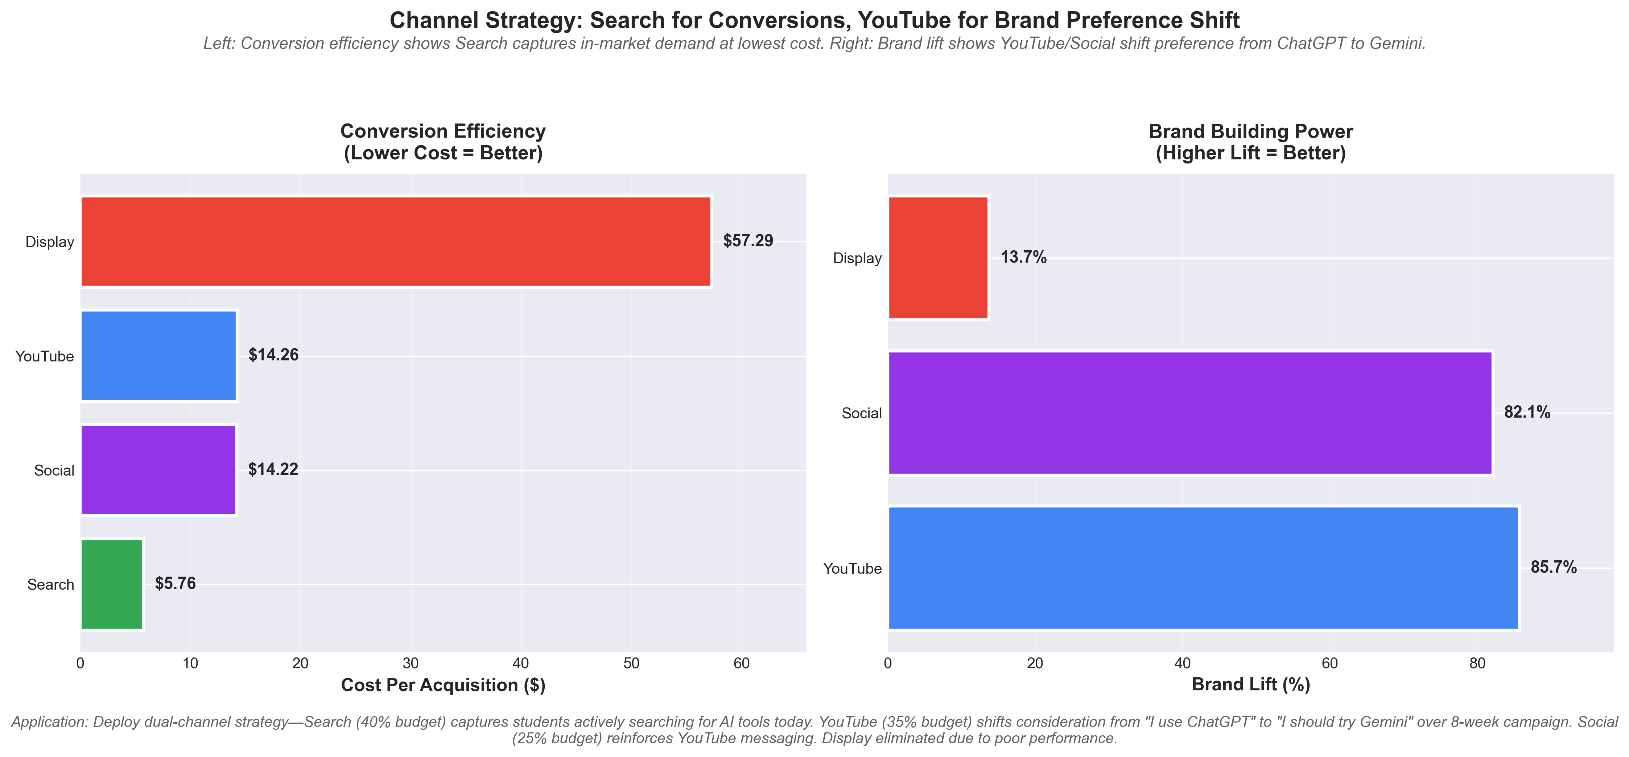
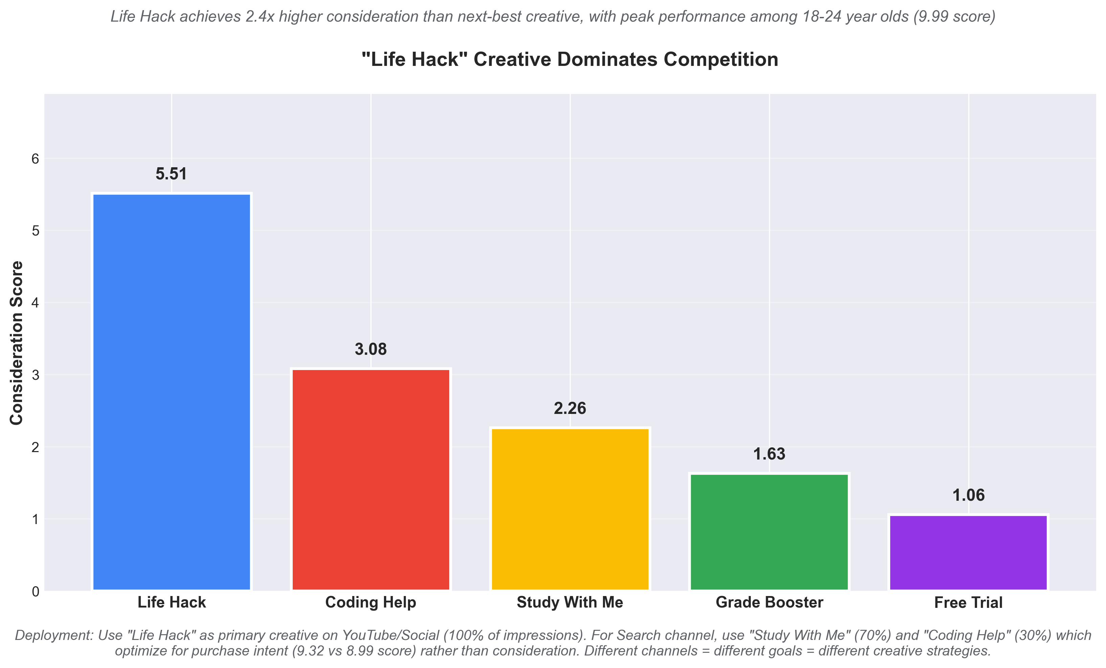
Dual-Channel Approach: Conversions Today, Brand Shift Tomorrow
Search captures demand. YouTube shifts preference from ChatGPT to Gemini.
Problem: Students know Gemini but choose competitors.
Solution: YouTube shifts preference (86% lift), Search captures intent ($5.76 CPA). 'Life Hack' creative drives 9.99 consideration score with target demo—2.4x better than next best.
Result: Dual-engine approach—build preference (YouTube) while harvesting demand (Search)

Slide 3
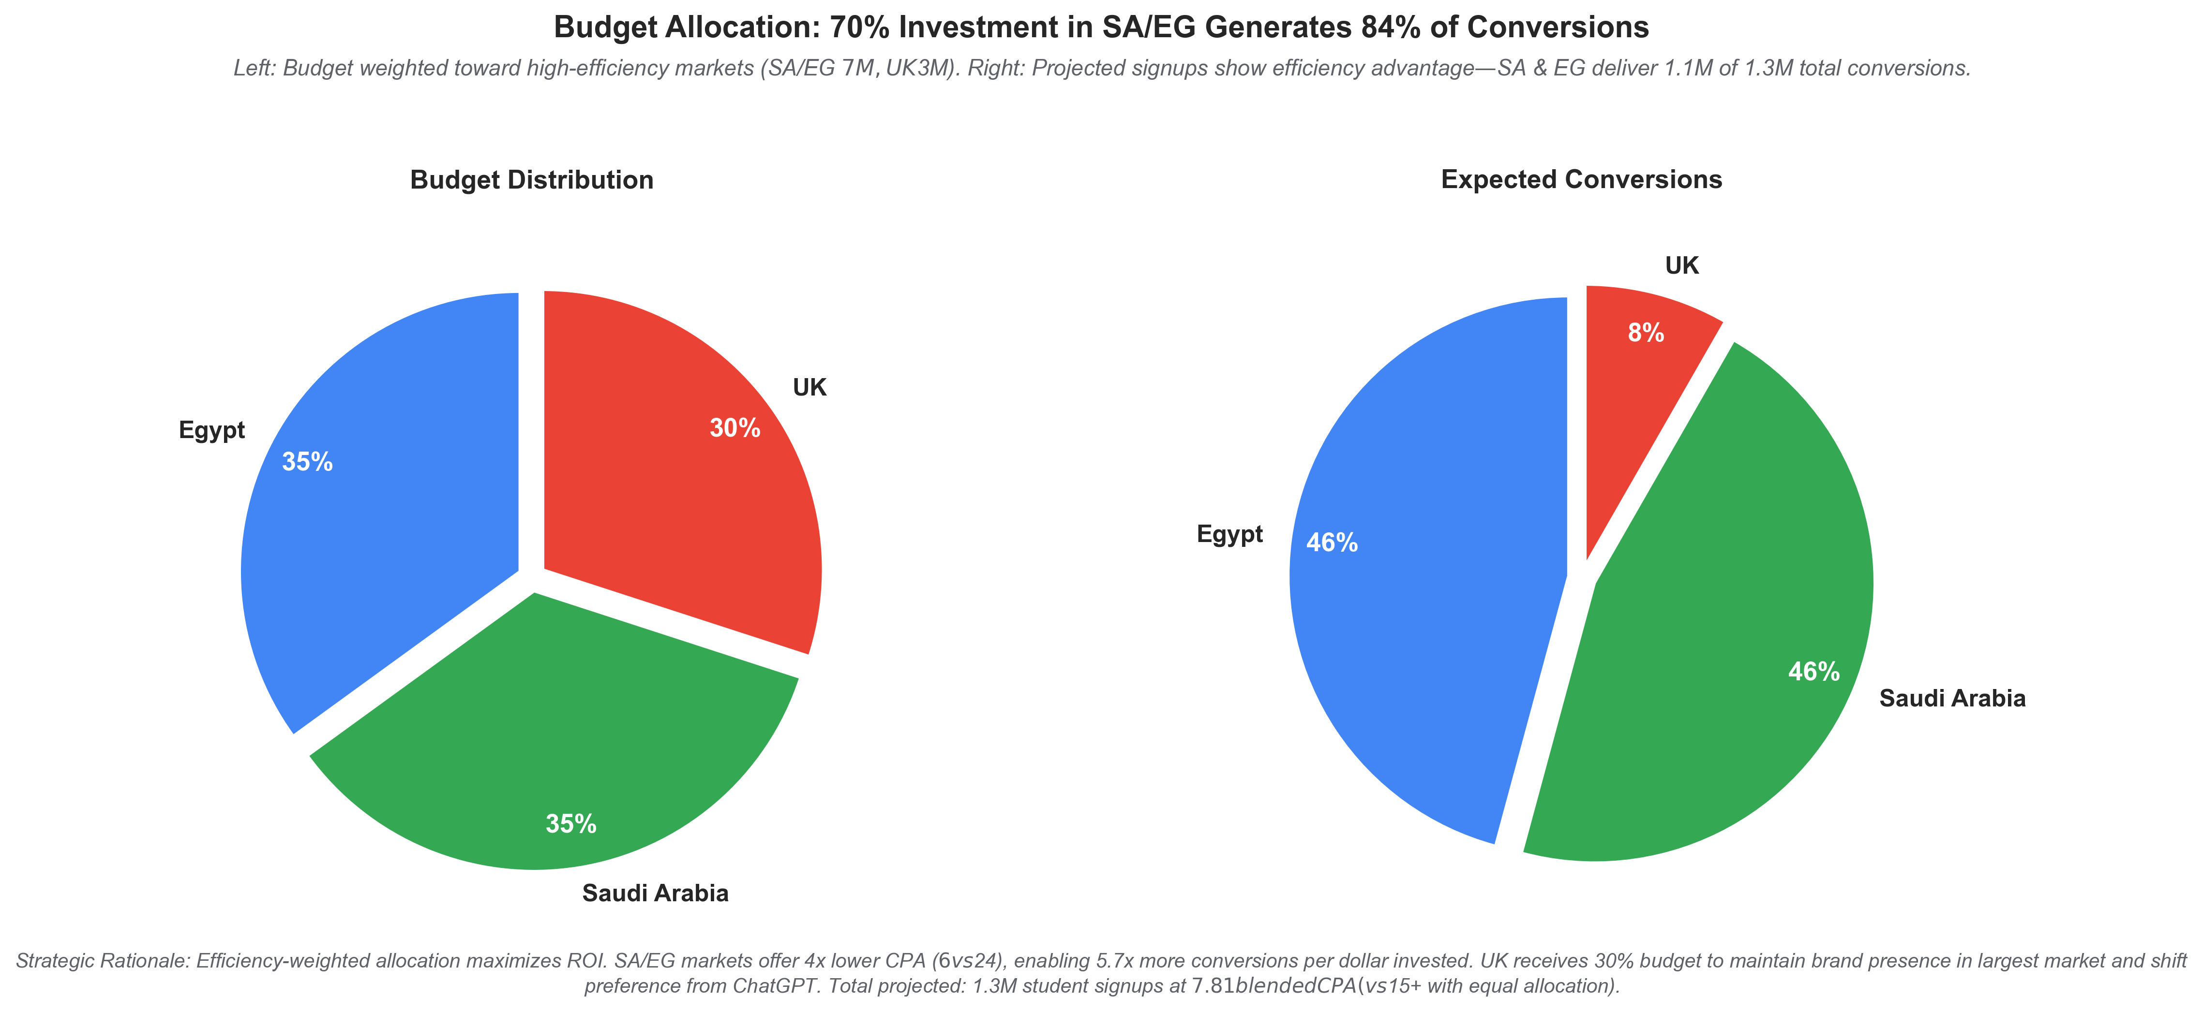
Budget Allocation: $10M Investment, 1.3M Expected Sign-ups
Efficiency-weighted strategy maximizes ROI in emerging markets
Budget Deployment:
SA/EG ($7M): Search-dominant strategy captures greenfield demand 50% Search | 30% YouTube | 20% Social = 1.1M conversions
UK ($3M): YouTube-dominant strategy shifts preference from competitors 45% YouTube | 30% Social | 25% Search = 127K conversions
Creative Strategy: 'Life Hack' (YouTube/Social) + 'Study With Me' (Search) Channel-optimized creative deployment maximizes performance
Timeline:
8-week campaign | Free upgrade deadline Sept 2026 Creates urgency aligned with student lifecycle (Finals period)
First-mover advantage: Execute before OpenAI/Anthropic saturate SA/EG market

