Slide 1
Git Basics
gaurav panwar

Slide 2
Introduction
The Linux kernel is an open source software project of fairly large scope.For most of the lifetime of the Linux kernel maintenance (19912002), changes to the software were passed around as patches and archived files. In 2002, the Linux kernel project began using a proprietary DVCS system called BitKeeper.
In 2005, the relationship between the community that developed the Linux kernel and the commercial company that developed BitKeeper broke down, and the tool’s free-of-charge status was revoked.
This prompted the Linux development community (and in particular Linus Torvalds, the creator of Linux) to develop their own tool based on some of the lessons they learned while using BitKeeper

Slide 3
As A VCS
The major difference between Git and any other VCS (Subversion and friends included) is the way Git thinks about its data. Conceptually, most other systems store information as a list of file-based changes. These systems (CVS, Subversion, Perforce, Bazaar, and so on) think of the information they keep as a set of files and the changes made to each file over time.
Git doesn’t think of or store its data this way. Instead, Git thinks of its data more like a set of snapshots of a mini filesystem.
Every time you commit, or save the state of your project in Git, it basically takes a picture of what all your files look like at that moment and stores a reference to that snapshot. To be efficient, if files have not changed, Git doesn’t store the file again

Slide 4
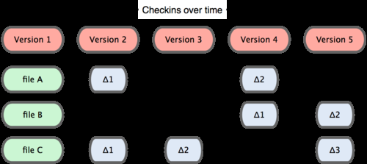
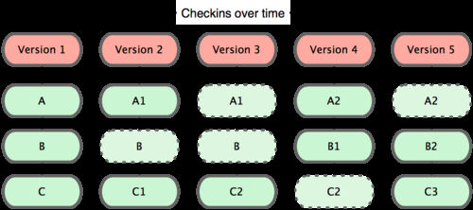
Comparision
Can be seen as-
Any vcs -
Git-

Slide 5
Most operations in Git only need local files and resources to operate generally no information is needed from another computer on your network. If you’re used to a CVCS where most operations have that network latency overhead
Everything in Git is check-summed before it is stored and is then referred to by that checksum. This means it’s impossible to change the contents of any file or directory without Git knowing about it

Slide 6
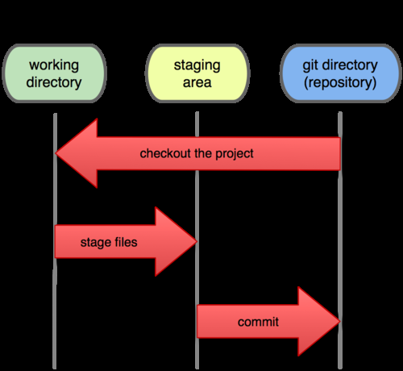
States
Git has three main states that your files can reside in: committed, modified, and staged. Committed means that the data is safely stored in your local database. Modified means that you have changed the file but have not committed it to your database yet. Staged means that you have marked a modified file in its current version to go into your next commit snapshot.

Slide 7
WORKING WITH GIT
The basic Git workflow goes something like this:
1. You modify files in your working directory.
2. You stage the files, adding snapshots of them to your staging area.
3. You do a commit, which takes the files as they are in the staging area and stores that snapshot permanently to your Git directory.
The first thing you should do when you install Git is to set your user name and e-mail address.
$ git config --global user.name "John Doe“
$ git config --global user.email johndoe@example.com
Now that your identity is set up, you can configure the default text editor that will be used when Git needs you to type in a message.
$ git config --global core.editor emacs

Slide 8
WORKING…
If you want to check your settings, you can use the git config --list command to list all the settings Git can find at that point:
$ git config –list
If you ever need help while using Git, there are three ways to get the manual page (manpage) help for any of the Git commands:
$ git help <verb> ex. $ git help config
Initializing a Repository in an Existing Directory
$ git init
Cloning an Existing Repository
$ git clone git://github.com/schacon/grit.git
That creates a directory named “grit”, initializes a .git directory inside it, pulls down all the data for that repository, and checks out a working copy of the latest version.

Slide 9
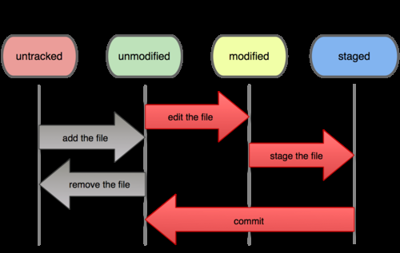
WORKING…
If you want to clone the repository into a directory named something other than grit
$ git clone git://github.com/schacon/grit.git mygrit
Checking the Status of Your Files.
$ git status

Slide 10
WORKING…
Tracking New Files
$ git add file_name
Staging Modified Files
$ git status
# On branch master
# Changes to be committed:
# (use "git reset HEAD <file>..." to unstage)
#
# new file: README
#
# Changed but not updated:
# (use "git add <file>..." to update what will be committed)
#
# modified: benchmarks.rb

Slide 11
WORKING…
To stage it, you run the git add command (it’s a multipurpose command)
$ git add benchmarks.rb
$ git status
# On branch master
# Changes to be committed:
# (use "git reset HEAD <file>..." to unstage)
#
# new file: README
# modified: benchmarks.rb
Ignoring Files
$ cat .gitignore
*.[oa]
The first line tells Git to ignore any files ending in .o or .a

Slide 12
WORKING…
The rules for the patterns you can put in the .gitignore file are as follows:
Blank lines or lines starting with # are ignored.
Standard glob patterns work.
You can end patterns with a forward slash (/) to specify a directory.
You can negate a pattern by starting it with an exclamation point (!).
Here is another example .gitignore file:
# a comment this is ignored
*.a # no .a files
!lib.a # but do track lib.a, even though you’re ignoring .a files above
/TODO # only ignore the root TODO file, not subdir/TODO
build/ # ignore all files in the build/ directory
doc/*.txt # ignore doc/notes.txt, but not doc/server/arch.txt

Slide 13
WORKING…
Viewing Your Staged and Unstaged Changes
$ git diff
diff --git a/benchmarks.rb b/benchmarks.rb
index 3cb747f..da65585 100644
--- a/benchmarks.rb
+++ b/benchmarks.rb
@@ -36,6 +36,10 @@ def main
@commit.parents[0].parents[0].parents[0]
end
+ run_code(x, ’commits 1’) do
+ git.commits.size
+ end
+
run_code(x, ’commits 2’) do
log = git.commits(’master’, 15)
log.size
If you want to see what you’ve staged that will go into your next commit, you can use
git diff -cached

Slide 14
WORKING…
Committing Your Changes
$ git commit
Removing Files
$ rm grit.gemspec
Then, if you run git rm, it stages the file’s removal:
$ git rm grit.gemspec
You can pass files, directories, and file-glob patterns to the git rm command. That
means you can do things such as
$ git rm log/\*.log
$ git rm \*˜
This command removes all files that end with .

Slide 15
Moving Files
$ git mv file_from file_to
Viewing the Commit History
$ git log
One of the more helpful options is -p, which shows the diff introduced in each commit
$ git log p -2
if you want to see some abbreviated stats for each commit, you can use the --stat option:
$ git log –stat
Limiting Log Output
$ git log --since=2.weeks
Changing Your Last Commit
$ git commit --amend

