Slide 1
QueueLess
Smart Queue Management System
Know the queue before you go.
Project Presentation
Academic V1 • Web Application
QueueLess • Smart Queue Management System
1

Slide 2
Problem Statement
QUEUELESS / 02
Queues are a daily challenge in many public and private services.
Long waiting time
No live visibility
Poor planning
Visitors spend valuable time standing in queues.
People cannot easily see crowd levels, active counters or current tokens.
Users may arrive at the busiest time or make unnecessary trips.
The opportunity
Create one simple platform that makes queue information visible before a person visits a location.
QueueLess • Smart Queue Management System
2

Slide 3
Proposed Solution
QUEUELESS / 03
QueueLess brings queue discovery and planning into one interface.
What QueueLess does
01
Search
02
Compare
Find a location
Check queue status
A web-based queue directory that lets users search service locations, compare queue loads, view live details and choose the required service.
03
Select
04
Join
Choose a service
Plan the visit
QueueLess • Smart Queue Management System
3

Slide 4
Key Features
QUEUELESS / 04
Live queue directory
Search & filters
Service selection
People waiting, current token, active counters and estimated wait.
Search by place, branch, doctor or service and filter by status.
Choose a specific desk, consultation or service before joining.
Role-based login
Queue load labels
Responsive design
Separate access for customers, staff and administrators.
Low, medium and high indicators make crowd levels easy to understand.
Clean cards, readable typography and simple navigation.
QueueLess • Smart Queue Management System
4

Slide 5
Technology Stack
QUEUELESS / 05
HTML
CSS
Provides the page structure: headings, forms, buttons, cards and semantic elements.
Designs layout, spacing, colors, typography, responsiveness and visual consistency.
JavaScript
React.js
Adds search, filtering, validation, events, queue updates and dynamic behavior.
Creates reusable components and updates the UI efficiently using state and props.
Result: a clean, interactive and component-based web application.
QueueLess • Smart Queue Management System
5

Slide 6
System Workflow
QUEUELESS / 06
1
Open homepage
The user sees the purpose of QueueLess and the main search bar.
2
Search a location
Matching hospitals, banks, labs and other services are displayed.
3
Review queue details
The user checks waiting time, current token, people waiting and counters.
4
Select a service
The user chooses the required desk or consultation.
5
Sign in / continue
The user enters the login flow and proceeds with the queue journey.
QueueLess • Smart Queue Management System
6

Slide 7
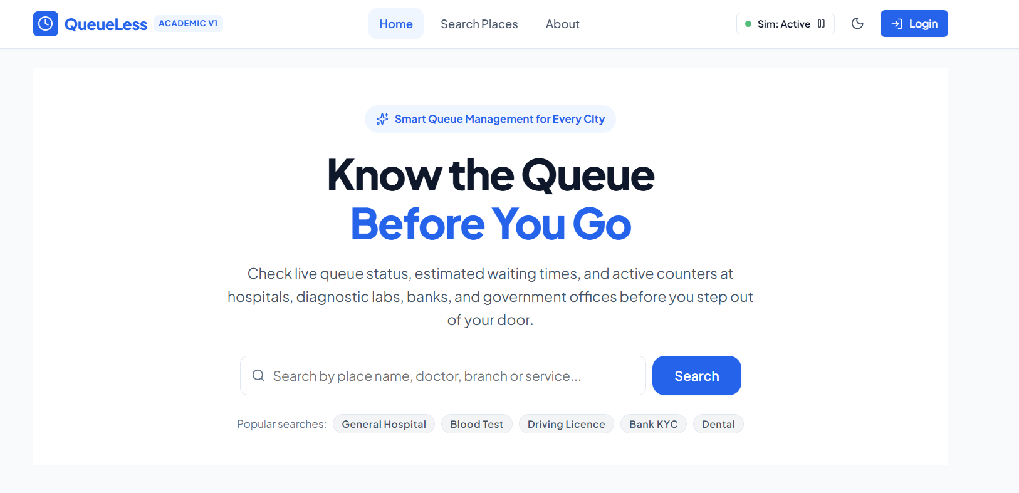
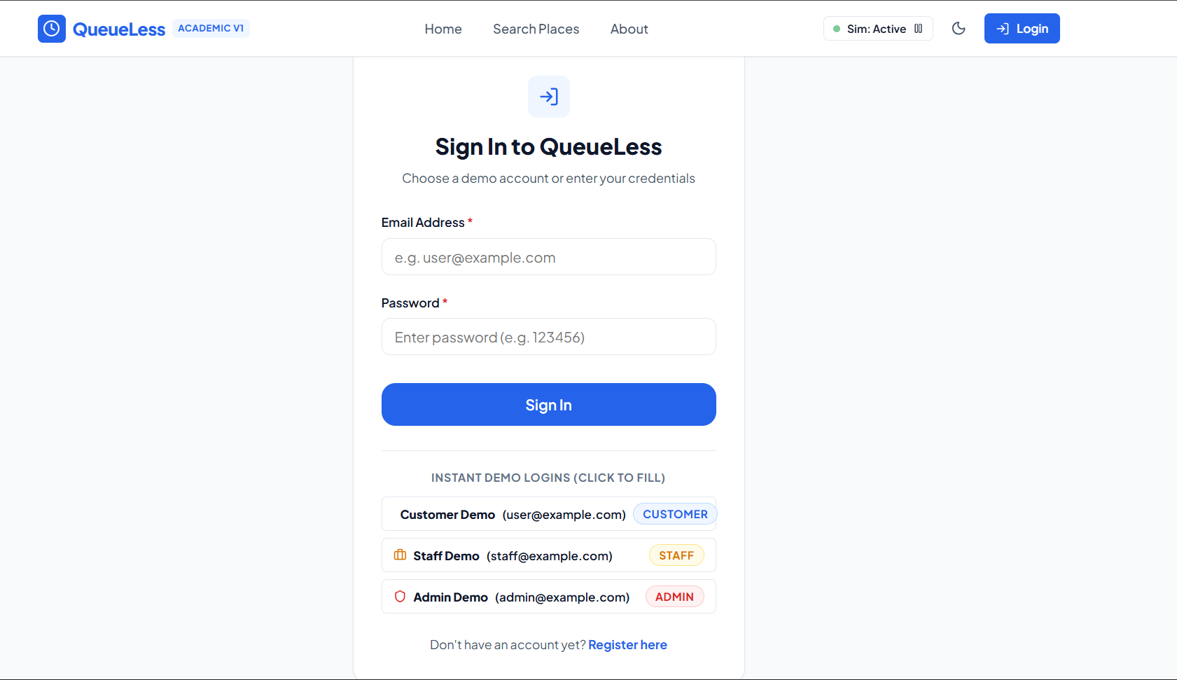
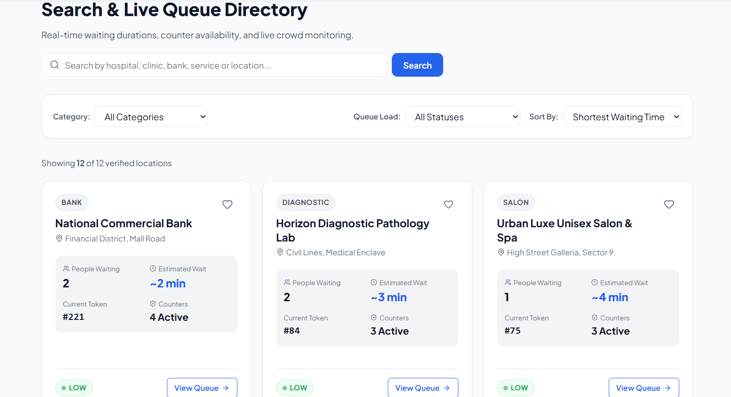
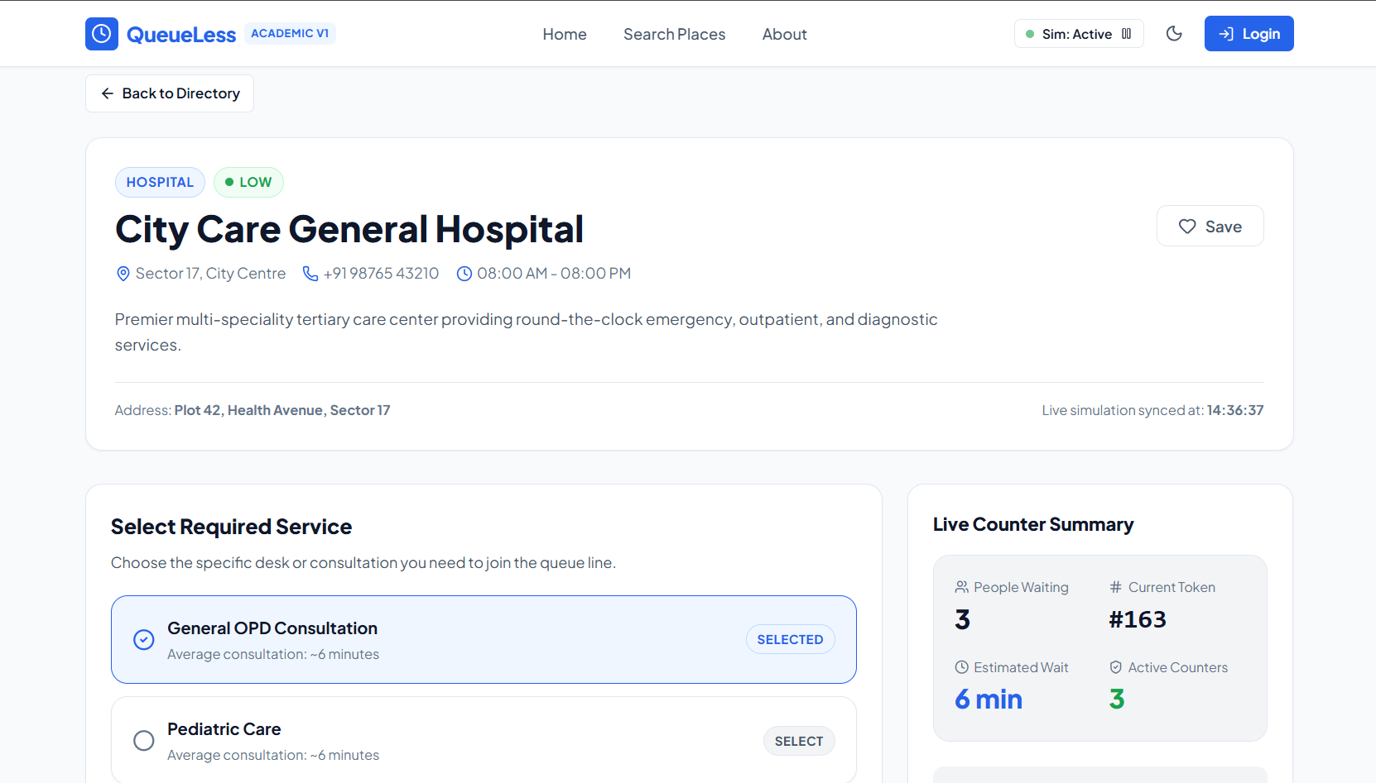
Application Screenshots — User Journey
QUEUELESS / 07
1 • Home page
2 • Login page
Landing page with search and popular searches
Customer, staff and admin demo sign-in
3 • Search & directory
4 • Location details
Filters, queue load and verified locations
Service selection and live counter summary
QueueLess • Smart Queue Management System
7

Slide 8
Benefits and Impact
QUEUELESS / 08
Saves time
Users can plan visits according to current queue conditions.
Improves transparency
Important queue information is visible and easy to compare.
Better experience
Simple navigation and clear status labels reduce confusion.
Supports staff
Organizations can monitor demand and service activity.
Scalable concept
The same model can support hospitals, banks, labs and public offices.
QueueLess • Smart Queue Management System
8

Slide 9
Future Scope & Conclusion
QUEUELESS / 09
Future enhancements
Conclusion
• Real-time backend and database integration
• SMS, email and push notifications
• Digital token booking and cancellation
• Live maps and nearby locations
• Staff analytics dashboard
• AI-based waiting-time prediction
QueueLess makes queue information accessible before a visit.
It combines search, queue indicators, service selection and role-based access in one user-friendly platform.
Goal: reduce uncertainty, save time and improve service experiences.
Thank you!
QueueLess • Smart Queue Management System
9

