Slide 1
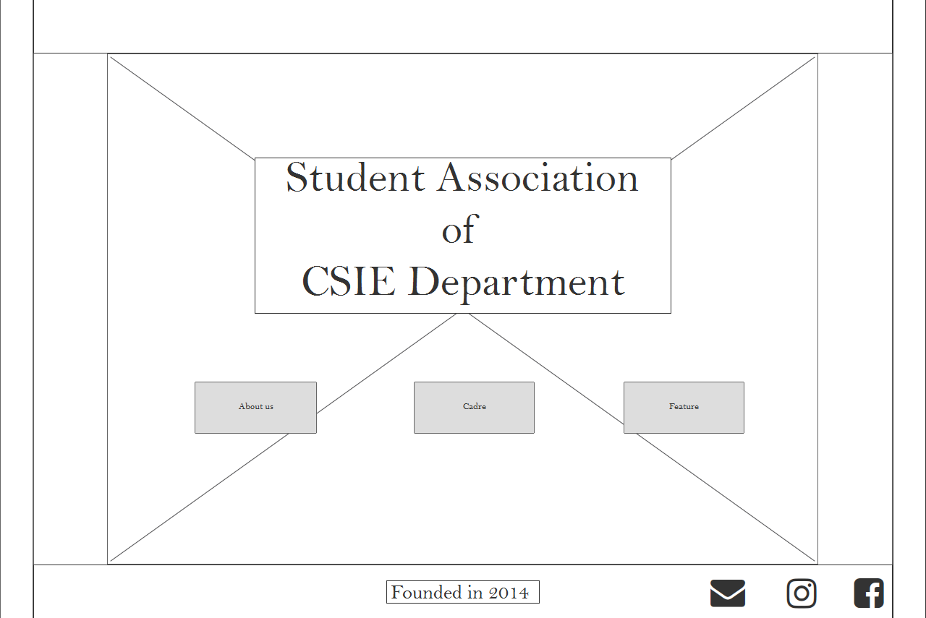





C S I E
Student Association
of
CSIE Department
About Us
Cadre
Feature
Founded in 2014

