Slide 1

EN 553.636
Data Analysis and Survival Prediction for the Cardiovascular Diseases
Group Members:
Yiyi Tao, Guanyu Song, Shuyao Tan, Zhan Si, Lingzhu Shen

Slide 2


Motivation
Cardiovascular diseases(CVDs):
A group of disorder of heart and blood vessels,
The world’s number 1 killer
Our Motivation:
i) Address risk factor for CVDs
ii) Predict the survival rate of patients with CVDs
Image from: https://world-heart-federation.org/resource/cardiovascular-disease-infographic/
Speaker: Yiyi Tao

Slide 3
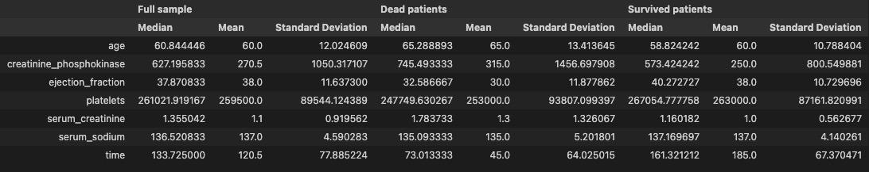
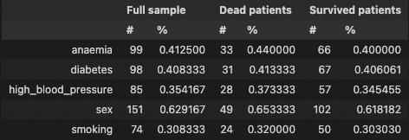
Description of data
We conduct data analyze on Heart Failure Prediction Dataset^{[1]}. There are 240 entries and 12 features on this dataset
[1] https://www.kaggle.com/andrewmvd/heart-failure-clinical-data
Speaker: Yiyi Tao

Slide 4
Methods
Statistical Features
Feature Selection
Decision Tree
Random Forest
Principal Component Analysis
Cox Model
Prediction of patients’ Survival Rate
Kaplan-Meier Estimator
Logistic Regression
Decision Tree / Random Forest
KNN
Support Vector Machines
Naive Bayes
Multi-layer Perceptron
Speaker: Guanyu Song

Slide 5
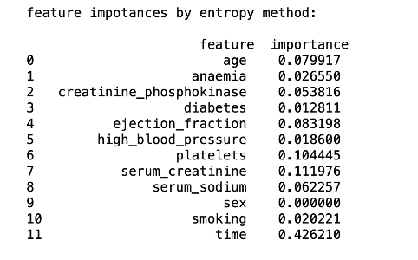
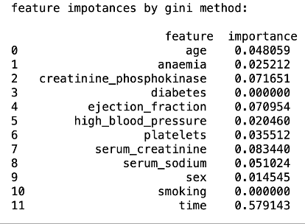
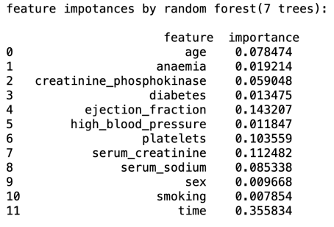
Random Forest
Feature importances predicted by decision tree method and random forest method:
Speaker: Guanyu Song

Slide 6
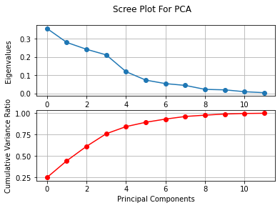
Principal Component Analysis (PCA)
Speaker: Shuyao Tan
Notes:
// Since there are 12 features and 144 correlations,
we propose to use PCA to extract the most important features.
By using scree plot, we found that first 6 principal components contribute to around 90% of cumulative variance ratio. So we decide to select these 6 for further processing.

Slide 7
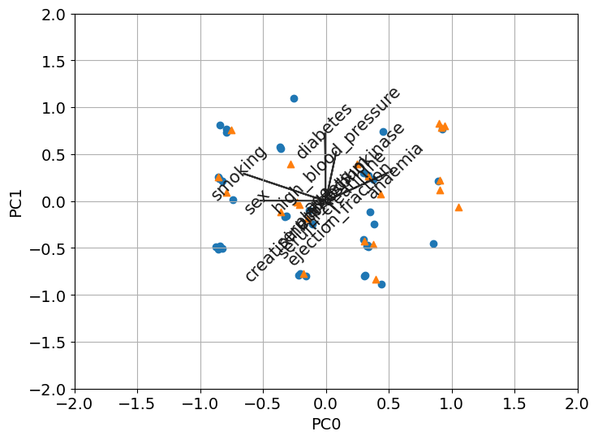
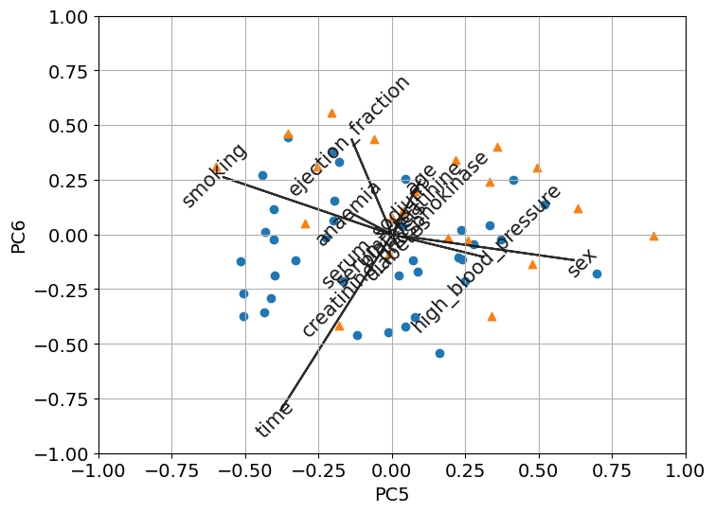
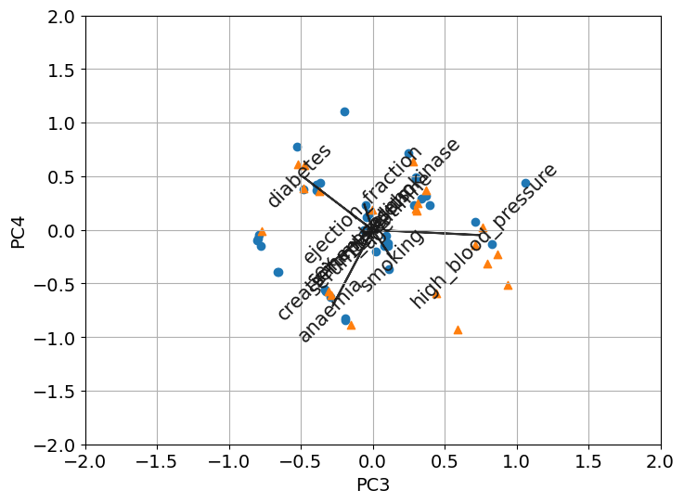
Principal Component Analysis (PCA)
Speaker: Shuyao Tan
Speaker: Yiyi Tao
Notes:
We used some biplots to visualize the scores of principal components and loadings. By using biplot, we can roughly see which features have more impact on each principal components.

Slide 8
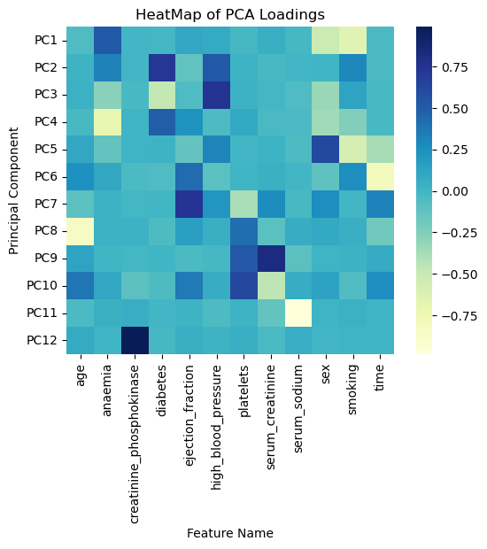
Principal Component Analysis (PCA)
The darker the square, the more important the feature
The most important features for the first 6 components are anaemia, diabetes, high blood pressure, sex, ejection fraction
Speaker: Shuyao Tan
Notes:
This is a heatmap plotted based on the magnitude of the loadings of each feature. We can find out the most important features by looking at the darkest square for each pc. By using heatmap and biplots, we can verify that the most important features for the first 6 components are anaemia, diabetes, high_blood_pressure, sex, ejection fraction.

Slide 9
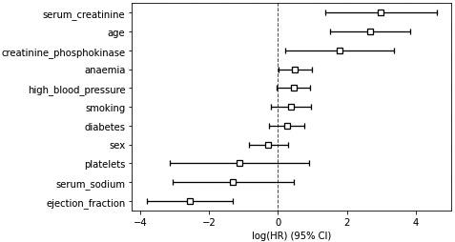

Results—Cox Model
Purpose:
Exploring the relationship between the survival of a patient and several explanatory variables
Hazard function:
Speaker: Yiyi Tao

Slide 10
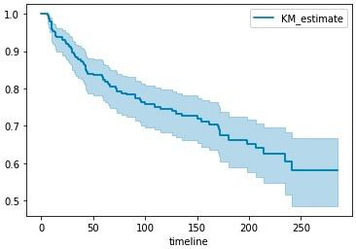
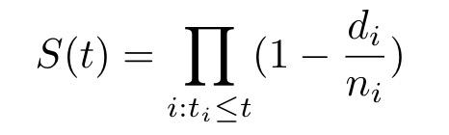
Results—Kaplan Meier Estimator
Purpose:
Estimate the survival function from lifetime data.
Survival function:
Speaker: Yiyi Tao

Slide 11
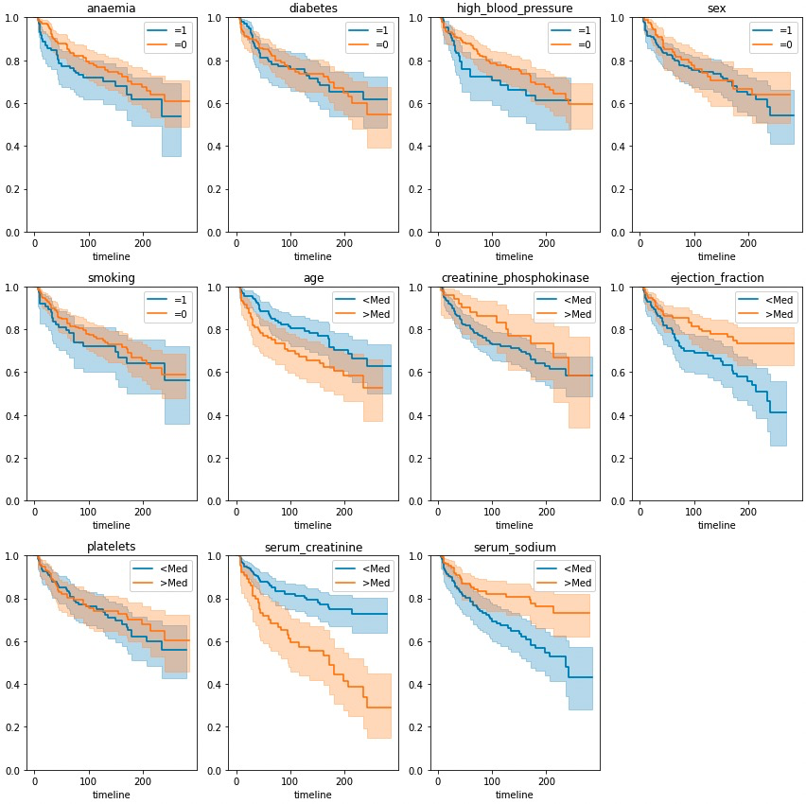
Results—Kaplan Meier Estimator
Purpose:
See the impact of different features
Feature with boolean value:
Classify the data into feature = 0 or 1
Feature with numerical value:
Classify the data into feature >Median or <Median
Speaker: Yiyi Tao

Slide 12
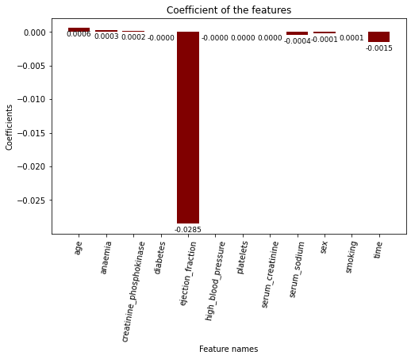
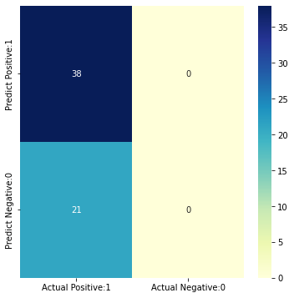
Logistic regression
A classic classification method
LogisticRegressionCV in sklearn
Cs = 10
cv = 5
penalty='l2'
ACC = 0.644
TPR = 0.0
Speaker: Lingzhu Shen
Notes:
If Cs is as an int, then a grid of Cs values are chosen in a logarithmic scale between 1e-4 and 1e4. Like in support vector machines, smaller values specify stronger regularization.

Slide 13
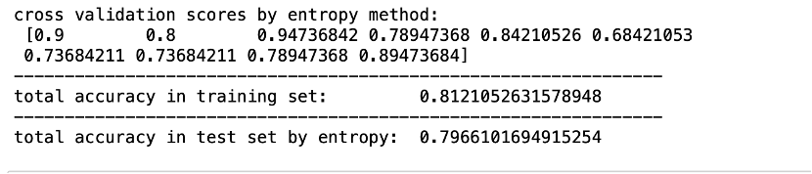
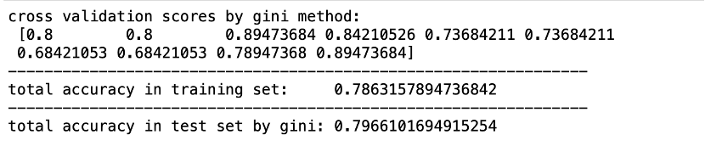
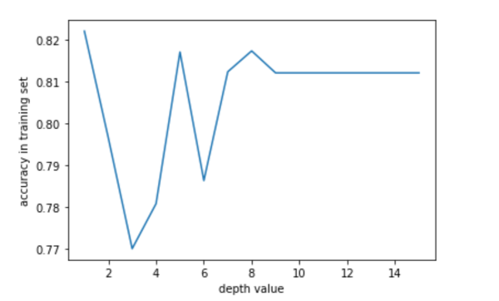
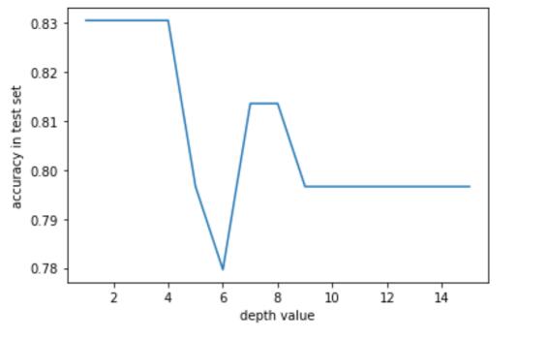
Decision Trees
In the decision tree part, we use entropy and gini independently to test the model’s performance. And we change the max depth from 1 to 15 to observe the effects.
Speaker: Guanyu Song

Slide 14
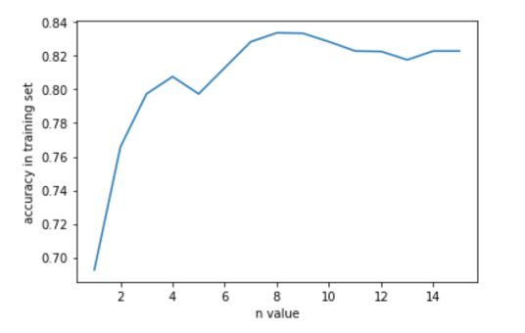
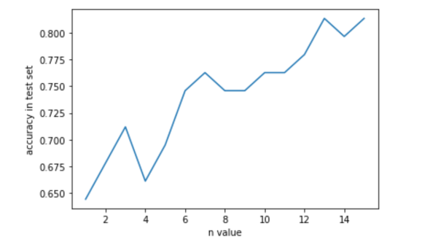
Random Forest
Also, we use random forest method for prediction. We use 1 to 15 trees to make a decision. Their performances are:
Speaker: Guanyu Song

Slide 15
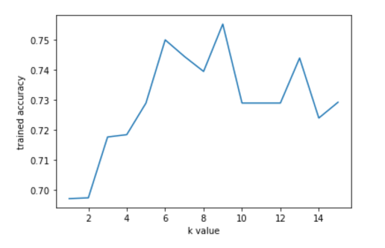
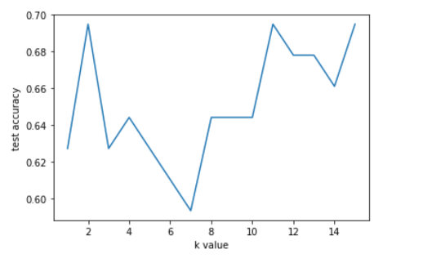
KNN
For the k-NN part, we vary the k value (the number of the neighbors make contribution to the decision) and observe the training and testing performances. We paint the accuracy curve to better visualize the results:
Speaker: Guanyu Song

Slide 16
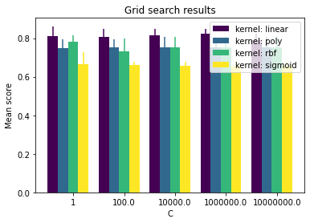
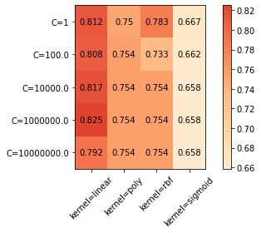
Support Vector Machine (SVM)
Speaker: Shuyao Tan
Notes:
We also used Support Vector Machine (SVM) to predict patient’s survival
To find the model with the best hyper-parameters, we used an exhaustive grid search approach to try different kernels and regularization parameter C.
As you can see from the diagrams, the accuracy score would be the best when kernel is linear and C is 10^6.

Slide 17
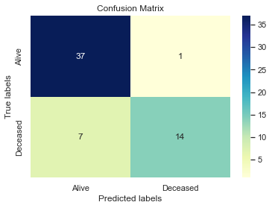
Support Vector Machine (SVM)
SVM Model Accuracy: 86%
37 True Positive and 14 True Negative among 59 testing data
Speaker: Shuyao Tan
Notes:
Then we fit the model with the hyper-parameters selected. Our model has an accuracy score of 86%.
To visualize this score, we used a confusion matrix. As you can see, there are 37 true positive and 14 true negative among the total of 59 data points in the test set.

Slide 18
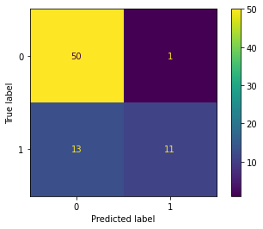
Naive Bayes
Parameter: Gaussian Likelihood & Sample-weighted Prior
Accuracy: 10-Fold CV mean score is 0.75
Insights: Bayes Model cannot effectively distinguish samples with true value of 1
Speaker: Zhan Si
Notes:
In this part, we implement Naive Bayes model to predict the death of patients.
Set the gaussian likelihood and sample-weighted prior. After applying the 10-fold cross validation, we reach the accuracy of 75%. From the confusion matrix, we can conclude the effect of this traditional model is relatively general, and it may not be a good choice for predicting samples with a true value of 1.

Slide 19
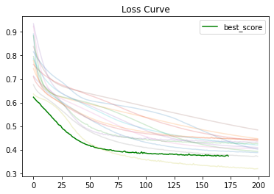
MLP (Multiple-Layer Perceptron)
A classic feedforward ANN (nonlinear activation function in hidden layers)
GridSearchCV:
activation: ('logistic', 'tanh', 'relu')
alpha: [0.0001, 0.001, 0.01, 0.1]
batch_size: [10, 20, 40, 80]
hidden_layer_sizes: [10, (10, 10)]
Reach the best score with
activation = 'tanh'
alpha = 0.001
batch_size = 20
hidden_layer_sizes = (10,10)
Speaker: Zhan Si
Notes:
The next one is MLP, which is a classic ANN model with nonlinear activation function in hidden layers.
We do the gridsearch at first in order to find the best parameter combination. After setting tanh activation and alpha=0.001, batch_size=20, two hidden layers with 10 neurons in each layer, the model reaches the best cross validation score

Slide 20
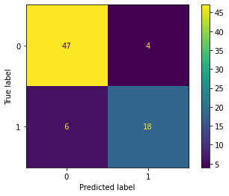
MLP (Multiple-Layer Perceptron)
Accuracy in test set is 0.87
Relatively small error rate in both FN and FP
Speaker: Zhan Si
Notes:
Based on the settings above, we get an accuracy of 87% in the test set. Also, we can find MLP has achieved a relatively small error rate in both False-negative and False-positive.

Slide 21
Conclusion
Feature Selection
Method
Cox Model
Decision Tree
Random Forest
Principal Component Analysis
Risk Factors
Ejection Fraction
Serum Creatinine
Platelets
Age
Time
Prediction of Patients’ Survival Rate
Naive Bayes
Logistic Regression
Decision Tree
Random Forest
KNN
Support Vector Machines
Multi-layer Perceptron
Kaplan-Meier Estimator
Speaker: Shuyao Tan
Notes:
In this project, we used Heart Failure Prediction Dataset to study the risk factors and mortality rate of cardiovascular diseases. We analyzed the basic statistical features of the dataset, found out the important risk factors of the disease, and did prediction of the patient’s survival rate using different methods.
In conclusion, we found that features such as ejection fraction, serum creatinine, platelets, age and time have more significant impact on patient’s survival, and using Multi-layer perceptron we can have better prediction on whether a patient survived or not. These information may provide us some insights on the future study of cardiovascular diseases
That’s all for our presentation, thank you for listening!
Cox Model: ejection fraction, serum creatinine, platelets, age, creatinine phosphokinase, serum sodium
Decision Tree: ejection fraction, serum creatinine, platelets, time, age
Random Forest: ejection fraction, serum creatinine, platelets, time, age
Principal Component Analysis: ejection fraction, anaemia, diabetes, high blood pressure, sex

Slide 22
Q&A
Thank you!
Questions/suggestions/ideas?

Slide 23
Contribution
Yiyi Tao:Statistic analysis, Cox Model, Kaplan Meier Estimator
Shuyao Tan: PCA, SVM
Guanyu Song: Decision Tree, Random Forest, KNN
Zhan Si: Naive Bayes, MLP
Lingzhu Shen: Logistic regression

