Slide 1

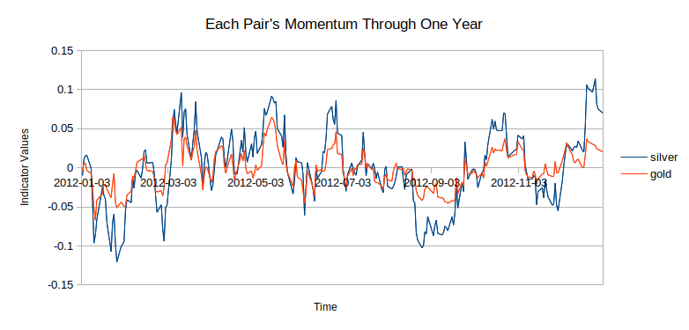
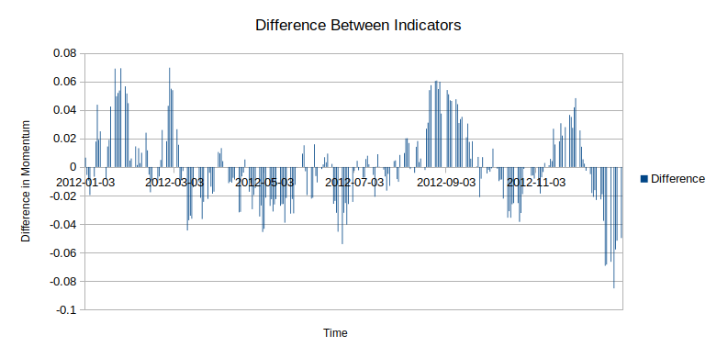
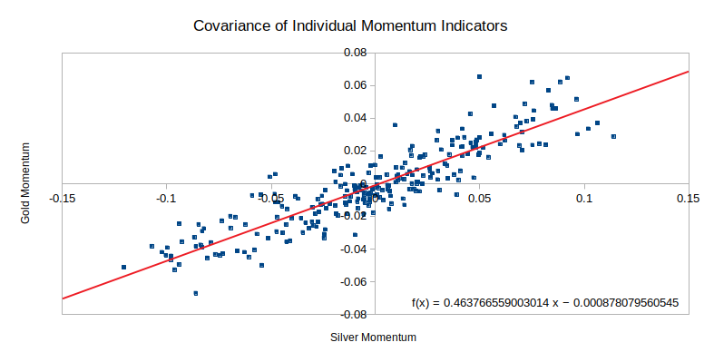
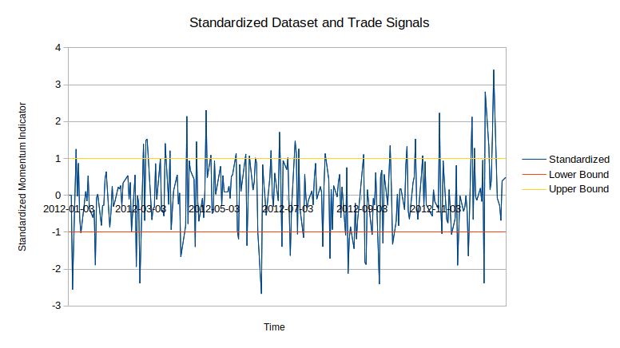
A Systematic Pair Trading Technique for Precious Metals
A Study By Wingate Jones; Mentored by Dr. Linxiong Li
University of New Orleans Department of Mathematics
Introduction
Systematic trading techniques have always been used on Wall Street, from moving average crossovers to the Heiken Ashi trading system. Systematic techniques provide the investor an algorithmic method of trading securities which prevents the trader from making emotional decisions in the face of extensive risk and tense situations that can arise when trading. Since the inception of computers, many talented individuals have been working tirelessly to create systematic trading techniques to forecast the market through computer programs. Some branches of these techniques include mean reversion, scalping, arbitrage, and swing trading strategies. These techniques are used by the human trader on a regular basis, but when working through a computer the investor is able to trade day or night, and make decisions in a matter of nanoseconds.
Abstract
The following strategy falls in the realm of statistical arbitrage trading. The idea behind these techniques is to provide a safer method of hedging one’s risk for every investment through placing an opposing investment in a correlated security. Exchange Traded Funds (E.T.F.’s) which follow the price of gold and silver are used as the securities traded. It is shown in figure 1 that these security’s price action move in a very similar fashion . This is the main motivator of the strategy, as if there is a large deviation in the price action, the algorithm assumes they will move back toward each other. For example, if gold moves 13% in one day, and silver moves 1%, then the algorithm will short gold prices, invest on the securities price falling, and long silver, invest on silver’s price rising.
Methods
Firstly, a strategy was developed on paper to try and determine how to capture the previously stated inefficiencies Once the strategy was developed, it was backtested in several different backtesting engines to determine how this strategy would have worked if employed on historical data. All coding was done in Python, with various libraries such as Pandas, Quantopian, and TA-Lib to aid in dealing with statistical modeling and get financial data. The following is the pseudo code for the strategy:
day=0
indicator_list = []
standardized_list = []
def initialize(context):
schedule_function(data_handling, date_rules.every_day(), time_rules.market_open())
def data_handling(context, data):
silver = symbol("SLV")
gold = symbol("GLD")
time_period = 60
gold_price = data.history(gold, 'price', time_period, '1d')
silver_price = data.history(silver, 'price', time_period, '1d')
cur_gold_price = data.current(gold,'price')
cur_silver_price = data.current(silver,'price')
my_gold_indicator= 1- (gold_price[-1]/gold_price[0])
my_gold_indicatorx100 = my_gold_indicator * 100
my_silver_indicator= 1- (silver_price[-1]/silver_price[0])
my_silver_indicatorx100 = my_silver_indicator * 100
difference_indicator = my_gold_indicator - my_silver_indicator
gold_price_shifted_left = gold_price.head(time_period-1)
silver_price_shifted_left = silver_price.head(time_period-1)
gold_price_shifted_right = gold_price.tail(time_period-1)
silver_price_shifted_right = silver_price.tail(time_period-1)
indicator_list= []
for i in range(0,time_period-1):
prev_gold = gold_price_shifted_right.get_value(i)
cur_gold = gold_price_shifted_left.get_value(i)
gold_indicator_val = (prev_gold/cur_gold)
prev_silver = silver_price_shifted_right.get_value(i)
cur_silver = silver_price_shifted_left.get_value(i)
silver_indicator_val = (prev_silver/cur_silver)
indicator_val = gold_indicator_val - silver_indicator_val
indicator_list.append(indicator_val)
The above strategy firstly defines the time period we will be operating in. The data_handling() method is called once per day, but the algorithm could be performed every minute or once a year. The following charts define a time period of 365 from January 1st, 2012 to December 31st, 2012. The current price and the previous price of each equity is defined, then their daily percent change is recorded. This allows us to define an indicator which describes the correlation between the two securities, without referring to their price. The data is standardized to provide straightforward metrics for buy and sell signals at ±1 standard deviations from the mean, as displayed in figure 4. This means we can safely reject the null hypothesis that gold and silver are currently correlated If we find a large positive value for our indicator, this implies gold has moved a large degree and silver has not followed. The algorithms buys silver and sells gold to try anticipate the two prices moving back to correlated prices where we cannot safely reject the null hypothesis, and the inverse follows when we have a large negative value.
Results
The dot-plot describing the co-variance of the indicator for the shows a correlation between the percent change of the two metal. After letting this model work on historical data we find the algorithm works best in a recession, likely because the price of precious metal’s rises when there is concern for the state of the economy. When the model began on 1/1/2007, we find a 5.84% increase in the account. Though when letting the algorithm run for 10 years, we find some statistics that does not incite confidence among the researchers. The highest draw-down was 43.33%. At its height, the account was up 20.71%, and in its lowest the account was worth -27.18% of its original value.
Research does show that there is a correlation between gold and silver price action. A correlation coefficient of roughly .46, see figure 3, showing there is a strong correlation between the two assets, as a correlation coefficient close to zero would generally be considered between +0.1 and -0.1. This provides a sound method for hedging risk of buying an asset. If one were just invested in gold throughout this time period they would see much higher returns, around 76%, but a much higher draw-down of roughly -46%. This highlights the algorithms ability to mitigate risk and bring it closer to a zero sum game. It also shows areas researchers can improve, such as the draw-down periods and ability to catch more of the market movements for smaller, more frequent gains.
Conclusion
The presented models have a lot of room for improvement. The portfolio performed the best under periods which gold and silver were both rising. Incorporating a larger sample of equities to choose from and then providing criterion for selecting equities, and their subsequent pairs. This would provide the opportunity to select stocks that are currently trending as opposed to working on a single class of correlated stocks. Work needs to be done to make downward drifting trends to capture capital as efficiently as when the trends are drifting toward higher prices.
Acknowledgments
I would like to take the time to thank Dr. Linxiong Li and the University of New Orleans Mathematics and Research departments for their continued support throughout this project. I would also like to thank the McNair Scholars Program for all of their help and encouragement. I am also grateful to have had the opportunity to find support from Dr. Luca Pezzo in the Department of Finance.
if(len(indicator_list)>time_period):
indicator_list.pop(time_period)
indicator_series = pd.Series(indicator_list)
if(len(indicator_series)>=time_period-1):
indicator_std = indicator_series.std()
indicator_mean = indicator_series.mean()
for e in indicator_list:
num = e - indicator_mean
std_score = e / indicator_std
standardized_list.insert(0,std_score)
if(len(standardized_list)>time_period):
standardized_list.pop(time_period)
standardized_series = pd.Series(standardized_list)
standardized_std = standardized_series.std()
open_orders = get_open_orders()
limit = standardized_std
upper_band = limit
lower_band = (-1.0*limit)
inner_upper_band = scalar* upper_band
inner_lower_band = scalar* lower_band
current_indicator_val = standardized_series.get_value(0)
if current_indicator_val >= upper_band:
if gold or silver not in open_orders:
order_target_percent(gold, .5)
order_target_percent(silver, -.5)
elif current_indicator_val <= lower_band:
if gold or silver not in open_orders:
order_target_percent(gold, 0.5)
order_target_percent(silver, -0.5)
Figure 1
Figure 2
Figure 3
Figure 4

