Slide 1


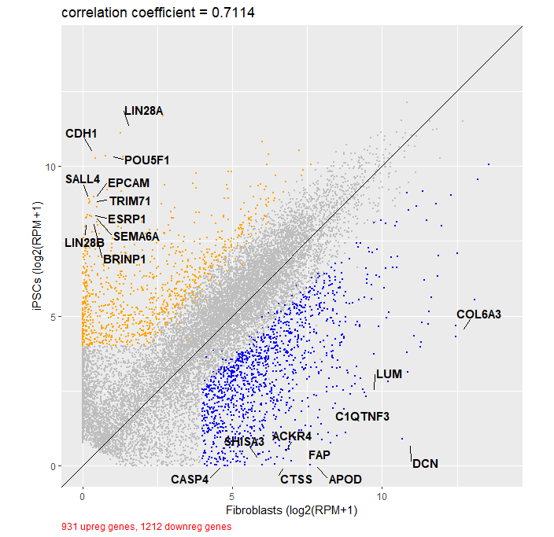
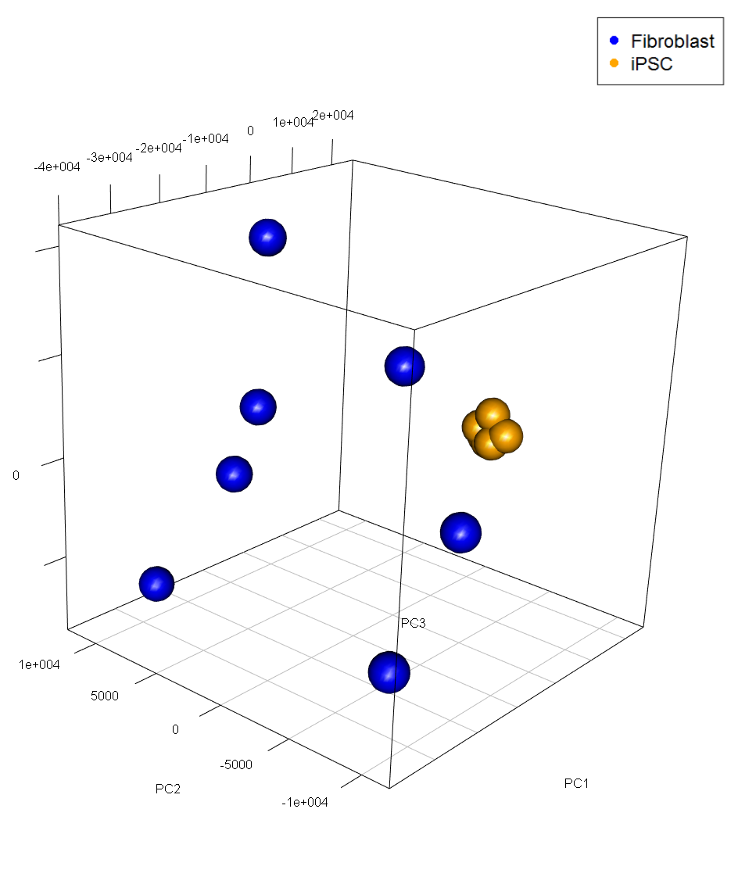
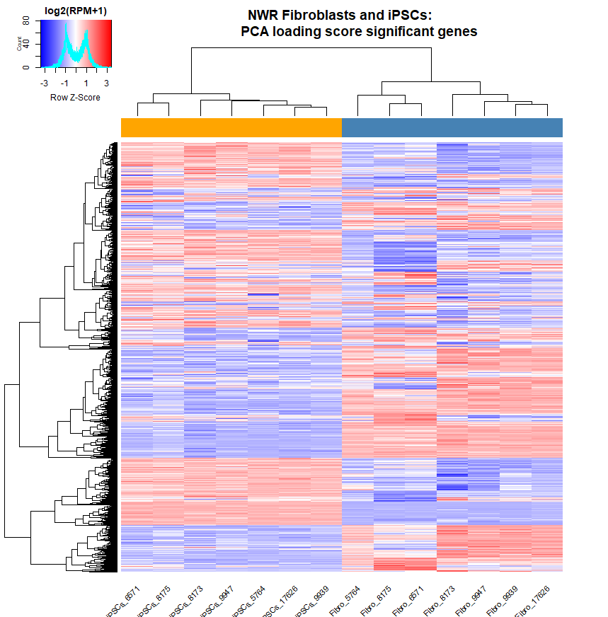
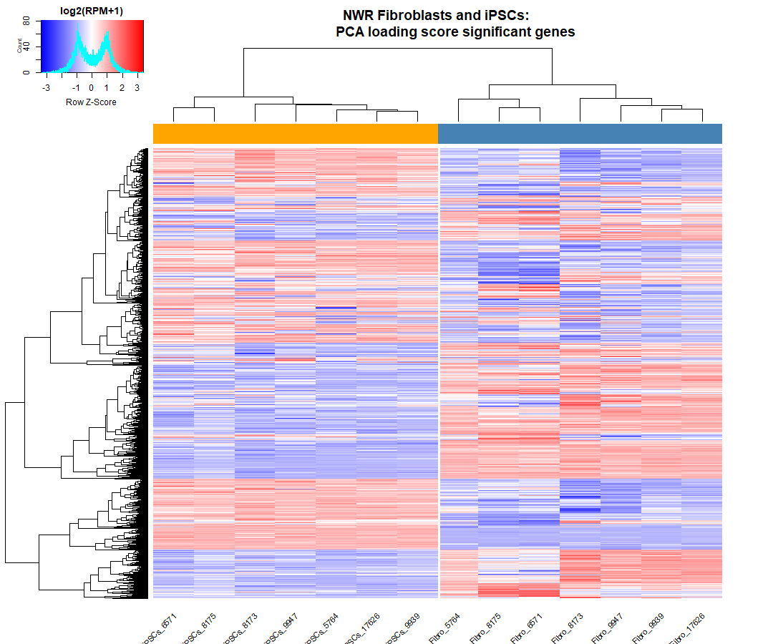
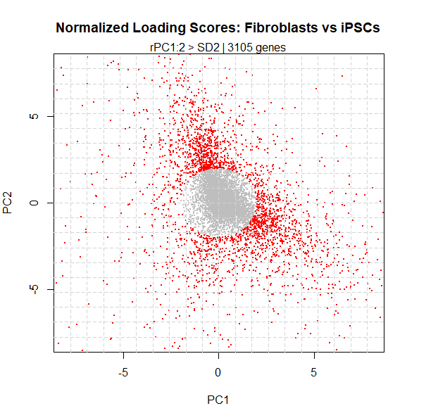
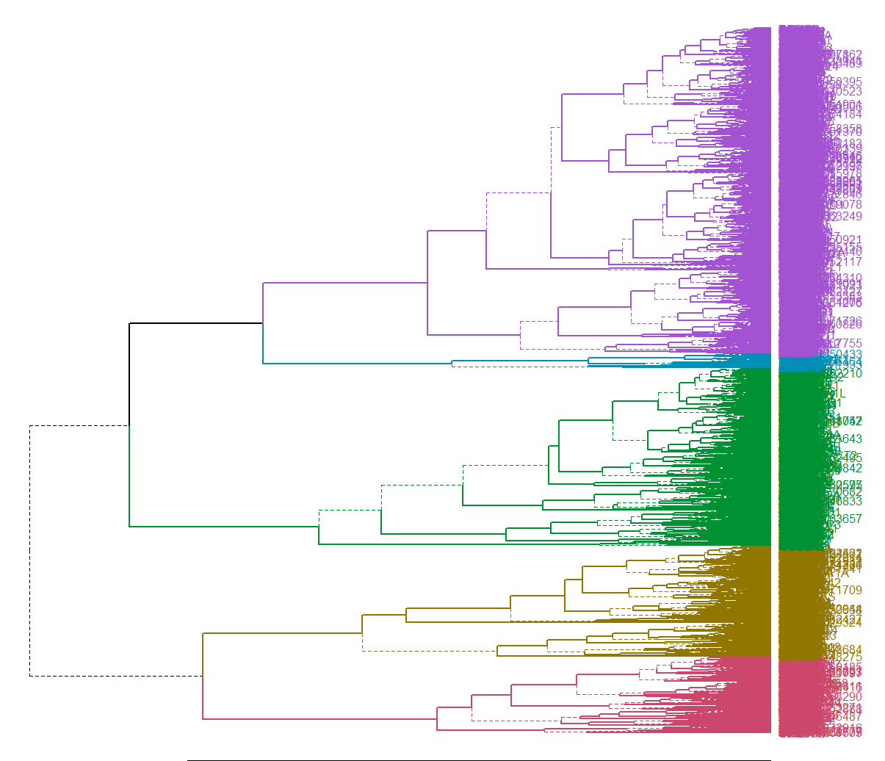
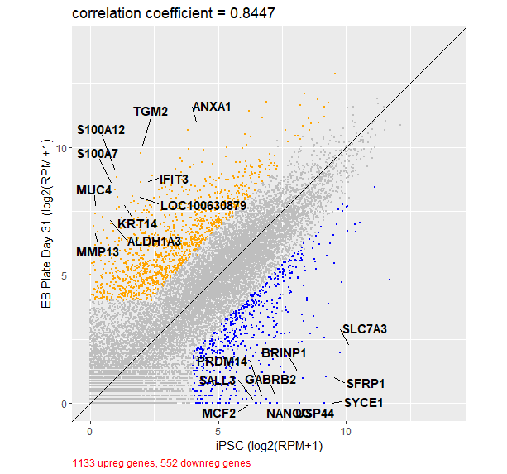
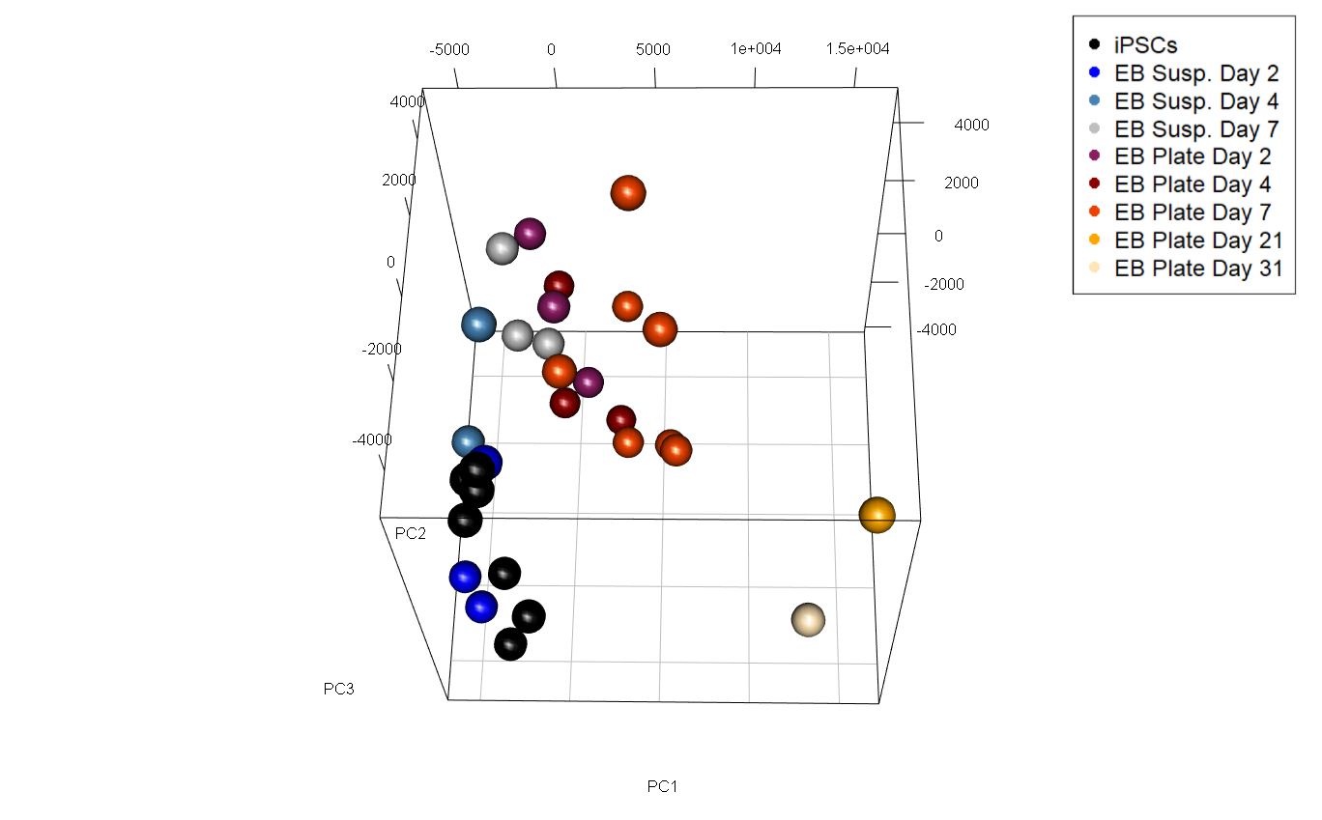
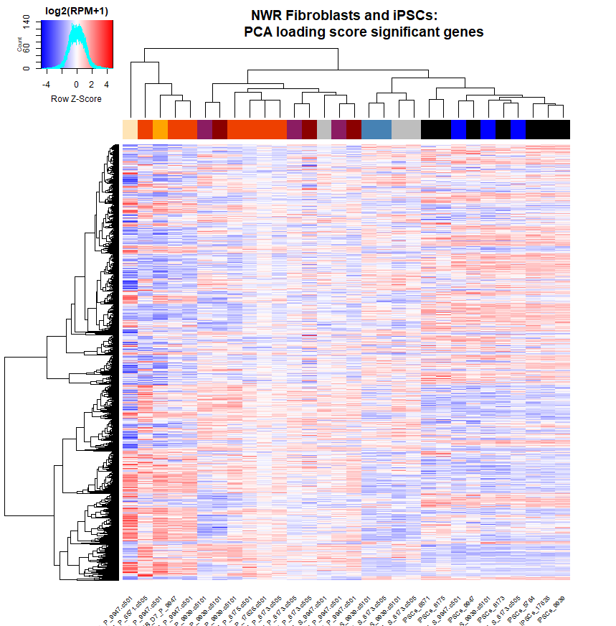
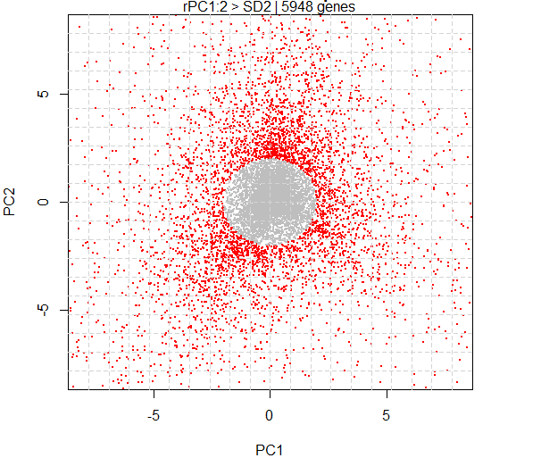
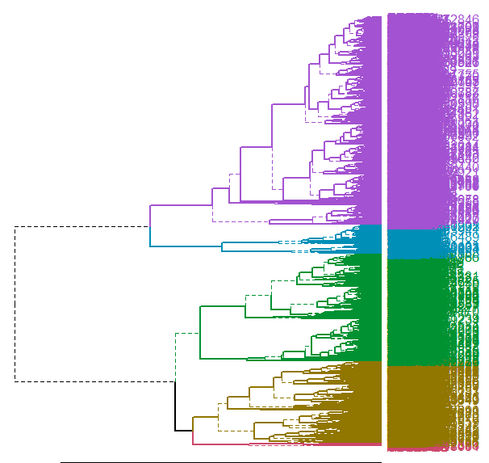

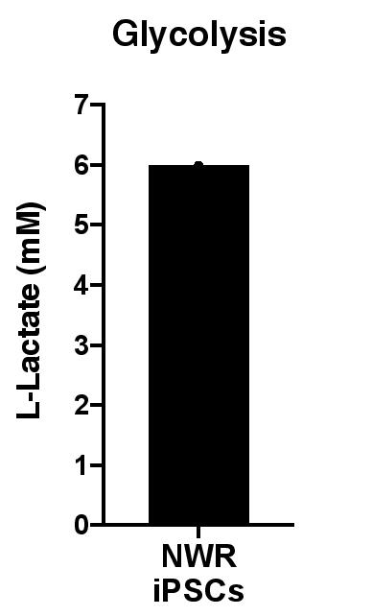

Delving into Northern White Rhino Stem Cells
Metabolic and Transcriptomic Analysis
Ginny Wu | University of California San Diego, 2020 | Biology: Bioinformatics | Patricia Beckman Summer Fellow | Conservation Genetics Department
RNAseq Analysis Pipeline^{[2]}
Northern White Rhino (NWR) Project
In the 1970s, there were around 500 Northern White Rhinos (NWR). Since then, poaching has reduced them to only 2 individuals: mother and daughter Najin and Fatu, thereby rendering them functionally extinct.^{[1]}
NWR Fibroblasts & iPSCs
Sudan
Nasima
Saut
Arthur
SWR
iPSCs
Fibroblasts
Cluster 1: Translational initiation, rRNA processing, translation
DDX21, NHP2, LARP1, RPL12, EIF1, FAU
Najin
Suni
Nasi
Hybrid NWR & SWR
Cluster 2: Cytoskeleton organization, mRNA
Nabire
CTNNB1, ACTG1, CALR, DYNC1H1, FLNA, HSP90B1, MYH9, NPM1, PDIA3, TMSB4X, TUBB
Cluster 3: Cell motion regulation, blood and bone development
The NWR Project hopes to revive the species using stem cell and reproductive technologies.
Fatu
ACVRL1, ADAM17, CDH13, EGFR, FURIN, HDAC6, IGF1R, LAMA2, PTEN, PDGFRA, VEGFA
Cluster 4: Mitosis, nuclear division
BCCIP, TP53, BRCA1, SPAG5, MCM2, LIG1, KIF15, INCENP, CCNB1, CDC6, POLA1
Introduction
Cluster 5: Negative regulation of transcription, blood vessel development
Pairwise Comparison of
Gene Expression
FOXO3, HMOX1, LIFSTAT2, PKIA, NFIB, BCL7A, WDTC1, ANKRD1
The NWR induced pluripotent stem cells (iPSCs) that we have generated will be utilized for gamete development and assisted reproduction with the aim of maintaining population viability and genetic diversity. To improve our understanding of NWR iPSCs and their differentiated derivatives, we studied their metabolic and transcriptomic features.
PCA Graph
Radial Plot of PCA
Loading Scores
Heatmap of significant PCA genes
Gene Cluster Ontology:
Biological Process ^{[3]}
Cluster 1: Mitosis, nuclear division, RNA splicing
DHCR24, CD2AP, DAXX, SKA2, KIF11, MDC1, TERF1, TP53, TUBB2A
Cluster 2: RNA Processing, chromatin and chromosome modification
DNMT3B, CDH1, SOX2, NASP, NPM1,
Metabolism: uncover some of NWR iPSCs energy processes
Cluster 3: Cell migration, neuron differentiation, epidermis, ectoderm, and epithelial cell differentiation
WNT1, TGFB1, NOG, JAK2, POU3F2, BMP4, KLF4, TFAP2A, TGFB1I1, IRF6, BNC1
Transcriptome: uncover up and down-regulated
genes using RNA transcripts
Gene loading scores with SD > 2 selected using radial plot
Cluster 4: Sensory organ development, embryonic organ development, ear development
SOX1, WNT1, WNT4, RAX, MITF, HAND1, HES3, BDNF
iPSC EB
Cluster 5: Ion transport, regulation of cell death, positive regulation of immune system process
Experimental Design
MCF2, DGKK, ADORA2B, LCK, ACTN3
NWR iPSCs & EBs
Focus cell lines:
• Fibroblasts (a common connective tissue)
• NWR induced pluripotent stem cells (iPSCs)
• NWR embryoid bodies (EBs) induced from iPSCs
Metabolism Analysis
Viable Mitochondria
Pluripotency Markers
Transcriptome: Drylab
Metabolism: Wetlab
Flow cytometry stained 98.79% of cells as opposed to 0% in unstained control NWR iPSCs. This indicates functional mitochondria in the majority of cells.
Flow cytometry showed that the majority of iPSCs expressed the Yamanaka factors SOX2 and OCT4, essential regulators for pluripotency in humans and mice.
CDH1 has been reported to have low expression in human iPSCs, which resembles our data for NWR iPSCs
Analyze RNAseq data for enriched biological processes:
Used R to create an analysis pipeline that extracts upregulated and downregulated genes for gene ontology analysis
Identify active metabolic pathways
Used assay kits to quantify glycolysis activity and ATP content
Compare cell type transcriptomes:
Used R to generate principal component analysis (PCA) graphs and conduct unsupervised hierarchical clustering
Flow Cytometry (FACs)
Used fluorescent antibodies to detect functional mitochondria and essential pluripotent gene expression
Glycolysis & ATP
Negative control (purple) and NWR iPSCs (black) are similar, which contrasts with the positive control (green). These results indicate little to no active oxidative phosphorylation in iPSCs.
According to our glycolysis and ATP experiments, the NWR iPSC energy production is mainly derived from the break down of glucose.
Citations
[1] International Rhino Foundation. 2002. Rhino Information – Northern White Rhino. 19 September 2006
[2] Yamashiro, et al. Generation of human oogonia from induced pluripotent stem cells in vitro. Science. 19 October 2019: 356-360
[3] Huang DW, Sherman BT, Lempicki RA. Systematic and integrative analysis of large gene lists using DAVID Bioinformatics Resources. Nature Protoc. 2009;4(1):44-57
Huang DW, Sherman BT, Lempicki RA. Bioinformatics enrichment tools: paths toward the comprehensive functional analysis of large gene lists. Nucleic Acids Res. 2009;37(1):1-13.
Acknowledgements
Many thanks to: Iñigo Valiente-Alandi, Ph.D | Marisa Korody , Ph.D | Oliver Ryder, Ph.D | Cythnia Steiner, Ph.D | Aryn Wilder, Ph.D | Sarah Ford, B.S. | Tom Nguyen | Claire Caputo
Notes:
International Rhino Foundation. 2002. Rhino Information – Northern White Rhino. 19 September 2006
CDH1 is required for the maintenance of cell-to-cell contacts in epithelial cells, Also a specific marker for undifferentiated mouse spermatogonial stem cells. CDH1 is used mostly in mouse iPSC to EB/sperm progenitor cell studies but not for human studies because it is less expressed. The NWR iPSCs seem more similar to human iPSCs in that they also have low (~4%) expression of CDH1
uman ESCs (Li et al., 2010
), it is likely that its knockdown will influence as well human somatic cell reprogramming. But human ESCs rely on TGF-β signaling to maintain their characteristics (James et al., 2005
) and it remains to be seen whether the epigenetic remodeling of human iPSCs generated with or without Alk5i are equivalent. Importantly, E-cadherin is not the only mechanism by which Klf4 induces reprogramming, as shown by the fact that substitution of this transcription factor by E-cadherin could not produce iPSC clones in MEFs
https://www.cell.com/cell-stem-cell/fulltext/S1934-5909(10)00169-4?_returnURL=https%3A%2F%2Flinkinghub.elsevier.com%2Fretrieve%2Fpii%2FS1934590910001694%3Fshowall%3Dtrue#fig7
CDH1 is a common pluripotency marker of mice studies, but not in human studies.

