Slide 1
Delving into Northern White Rhino Stem Cells
Conservation Genetics, Ginny Wu

Slide 2
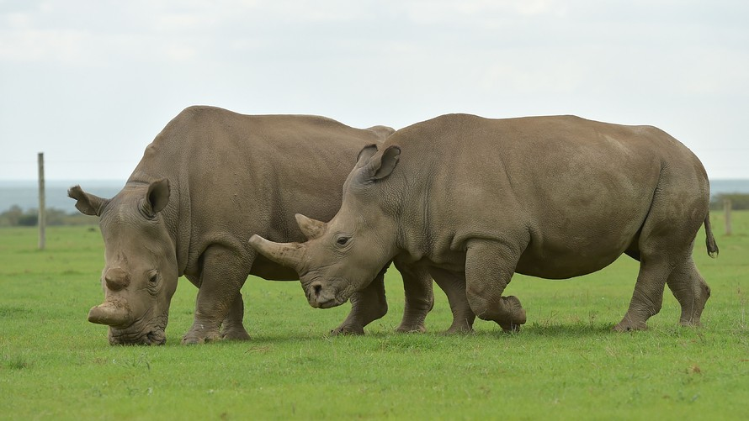
Northern White Rhino (NWR)
Population:
1970s: ~500 in East and Central Africa
2019: 2 mother and daughter, Najin and Fatu
Sudan
Saut
Arthur
SWR
Nasima
Najin
Suni
Nasi
Hybrid NWR & SWR
Nabire
Fatu
Getty Images
Najin (left) and Fatu grazing together at the Ol Pejeta Conservancy
Notes:
Poaching has reduced numbers
Functionally extinct
NWR Project hopes to revive this species using stem cells and reproductive technology like in vitro fertilizatio

Slide 3
NWR Project
NWR
Neurons
Fibroblasts
Reprogramming
factors
iPSCs
Cardiomyocytes
Most common connective tissue in animals, produces structural framework (extracellular matrix)
Like embryonic stem cells, these are capable of generating cells from all three germ layers
Southern White Rhino
Gametes
NWR
Notes:
Gametes:
The plan is to fertilize these induced sperm and egg cells in vitro so that we have an embryo to transfer into a surrogate SWR mother.

Slide 4

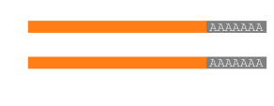
Where are we now?
Generated embryoid bodies (EBs) to test differential ability of NWR iPSCs
iPSCs
D2
Suspension
D4
Suspension
D2
Plated
D4
Plated
D7
Plated
Differentiation
Transcriptome Analysis using RNAseq
Fibroblasts
Sequencing
Analysis pipeline
RNA
iPSCs
Embryoid Bodies
Notes:
Conservation Genetics has reprogrammed iPSCs from 9 indivduals
Test differential potential by generating Ebs,
Aggregates begin to spontaneously differentiate
Dna -> rna TRANSCRIPT → protein
transcriptome = all rna transcripts present in a cell
Varies depending on cell type or environmental conditions
RNAseq takes snapshot of transcriptome in a cell
I was given the data to analysis = find characteristic genes, enriched biological pathways

Slide 5
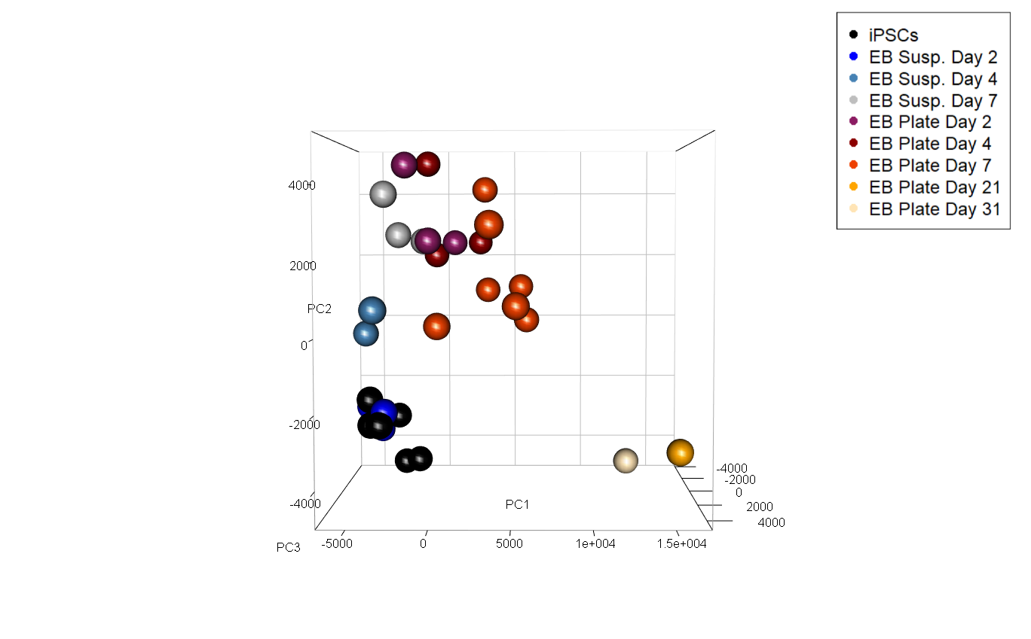
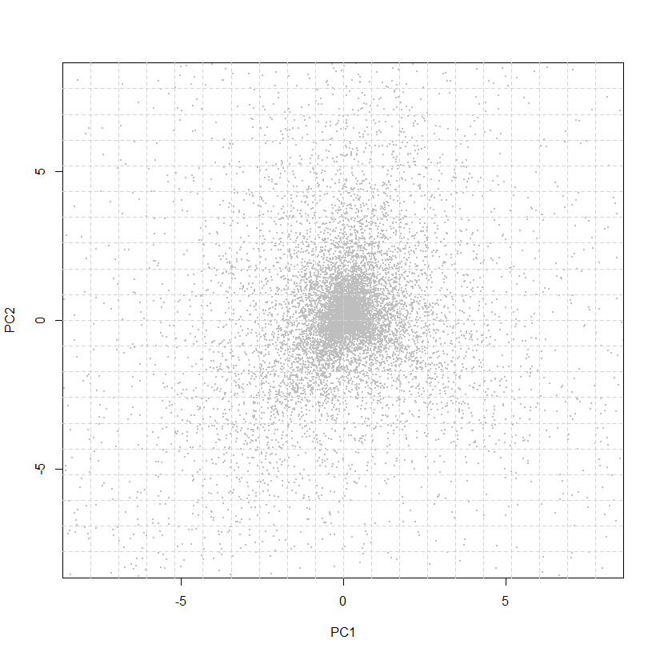
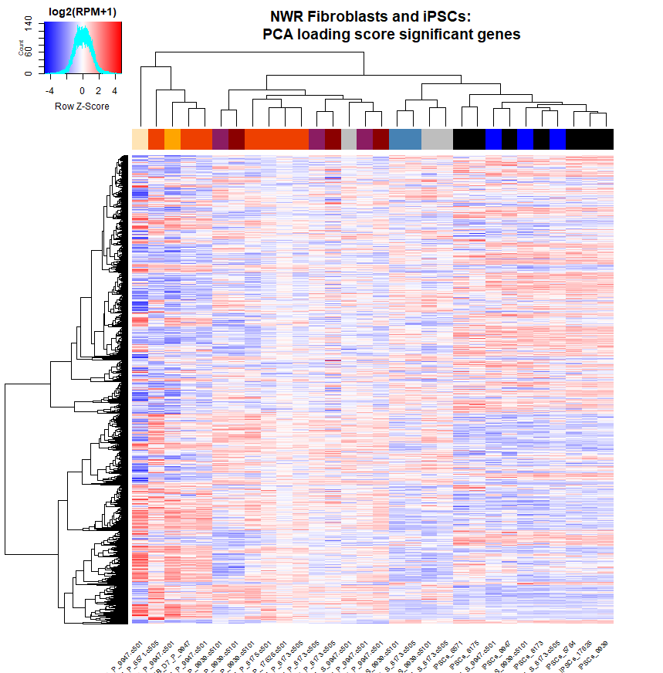
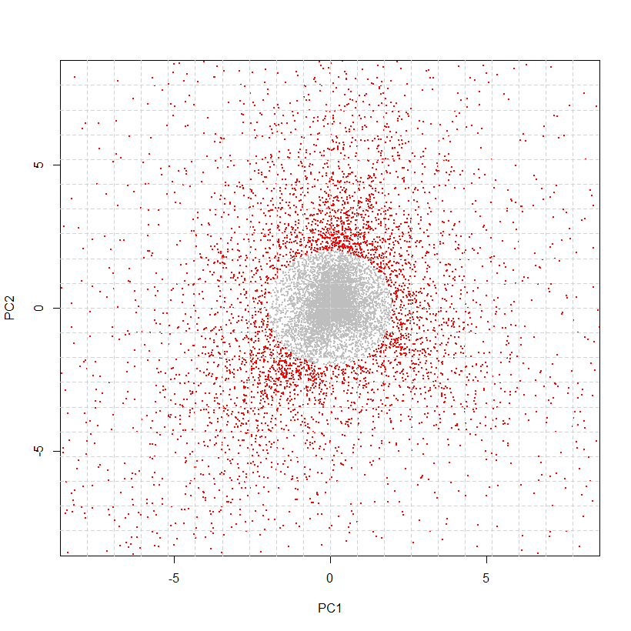
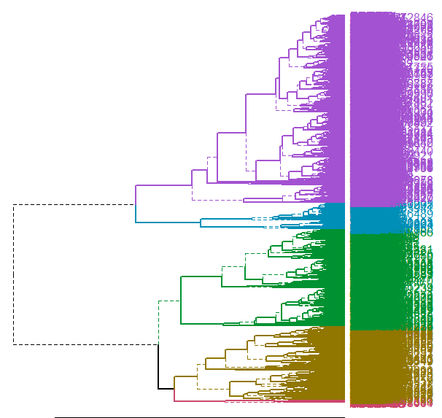
RNAseq Analysis: Differential Expression
RNAseq
raw counts
Principal Component Analysis (PCA)
Gene Loading Score Scatter Plot
Heatmap & Unsupervised
Hierarchical Clustering
Gene Cluster Ontology Analysis
iPSC EB
Data shown from iPSCs and EBs Timepoints experiment
Notes:
The data I show is from our iPSC to EB experiment
PCA:
Closer = similar, farther = dissimilar
The way each sample position is calculated is by giving each gene a score
Since we’re trying to find the most characterizing genes of a cell type, I plotted all gene scores on a scatterplot and selected for those that scored above 2 SD of the overall mean
~6000 genes selected (5948) that are 2 SD above mean for both PC1 and PC2
Expression heatmap of these 6000
Blue is lowly expressed, red is highly expressed
The heatmap clusters them by UHC
Cut dendrogram into 5 clusters for gene ontology analysis
Put in a list of genes → output biological processes associated with that gene, clustered by how relevant they are in your input

Slide 6
Gene Ontology: Biological Process
iPSC EB
iPSCs
Cluster 1:
Mitosis, nuclear division, RNA splicing
EBs
Cluster 2:
RNA Processing,
chromatin and chromosome modification
Cluster 3:
Neuron differentiation, epidermis, ectoderm, and epithelial cell differentiation
Cluster 4:
Sensory organ development, embryonic
organ development, ear development
Cluster 5:
Regulation of cell death,
positive regulation of immune system
Notes:
AN EXAMPLE OF GENE ONTOLOGY ANALYSIS RESULTS
Listed some of the biological processes

Slide 7


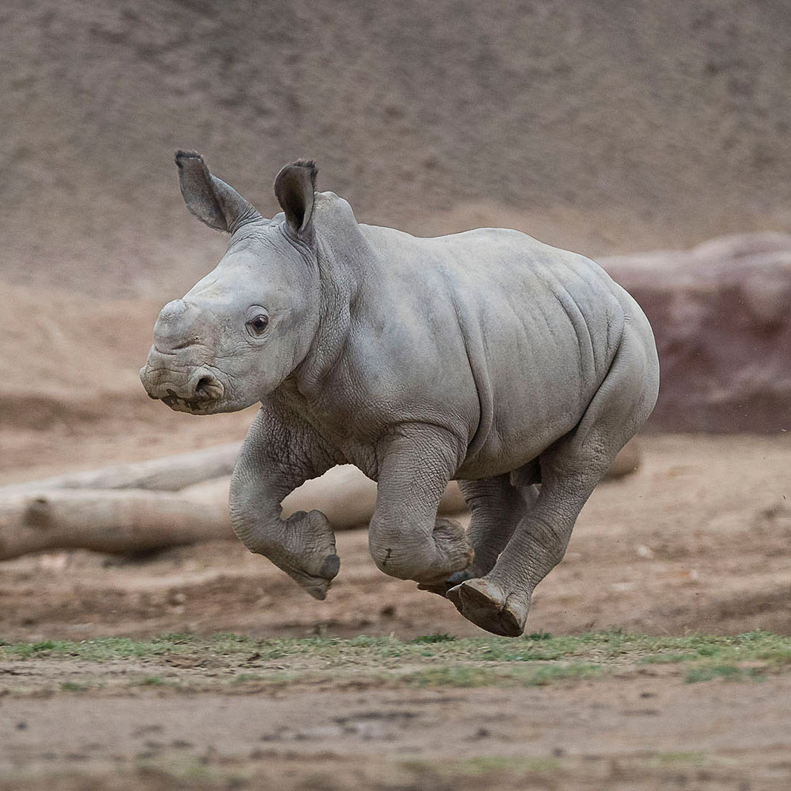
Acknowledgements
Many thanks to:
The Conservation Genetics team
Iñigo Valiente-Alandi Ph.D • Marisa Korody Ph.D • Oliver Ryder Ph.D •
Cythnia Steiner Ph.D • Aryn Wilder Ph.D • Sarah Ford B.S• Tom Nguyen • Claire Caputo
Arnold & Mabel Beckman Foundation
Notes:
WITH THAT I’D LIKE TO THANK
SETUP FOR GABE

