Slide 1
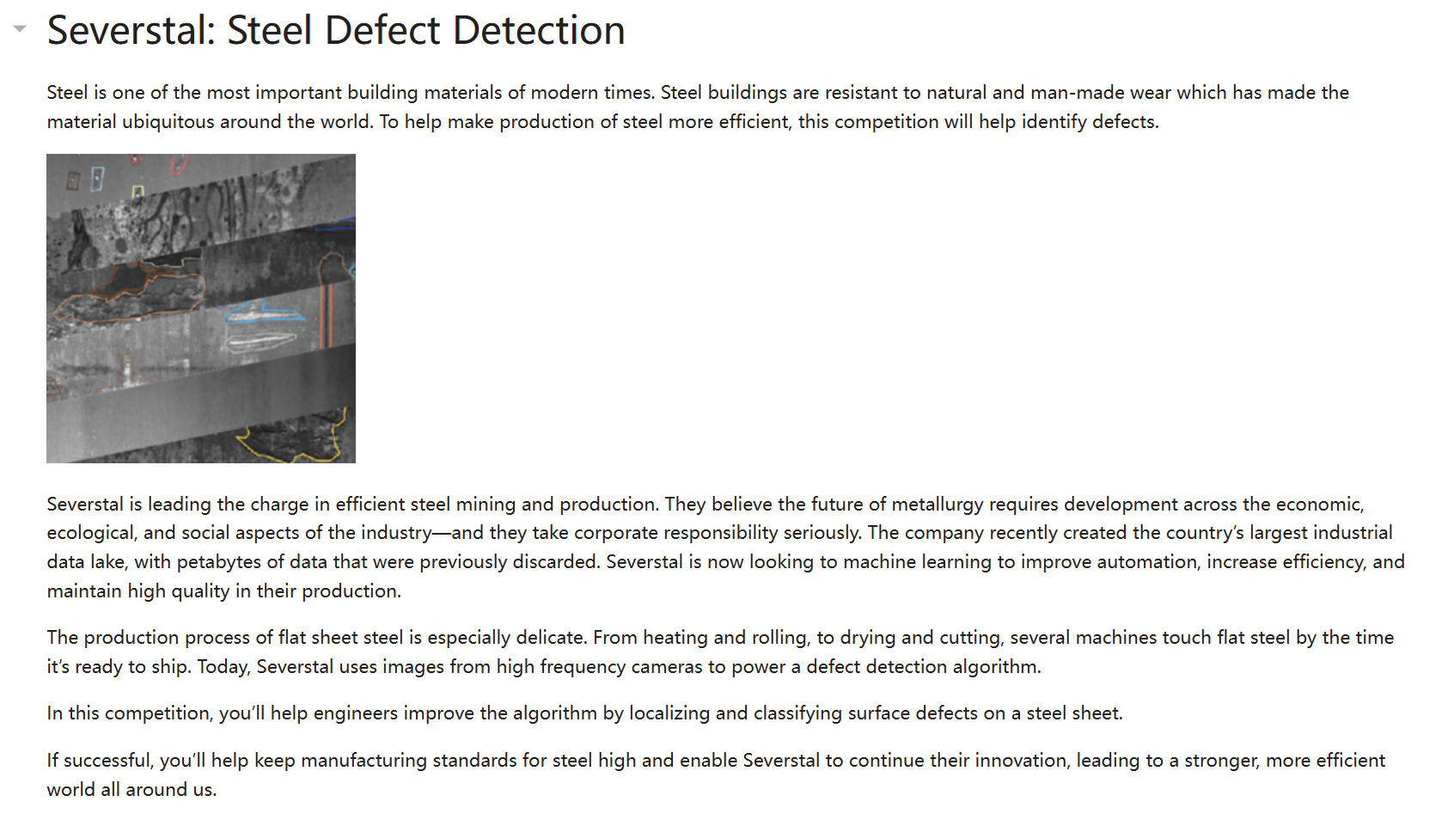

Slide 2
Data view and analysis

Slide 3
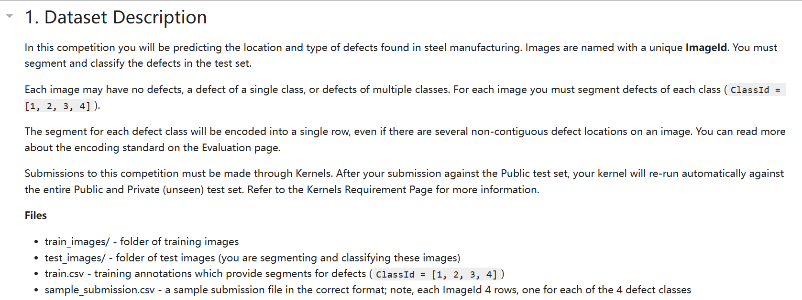

Slide 4
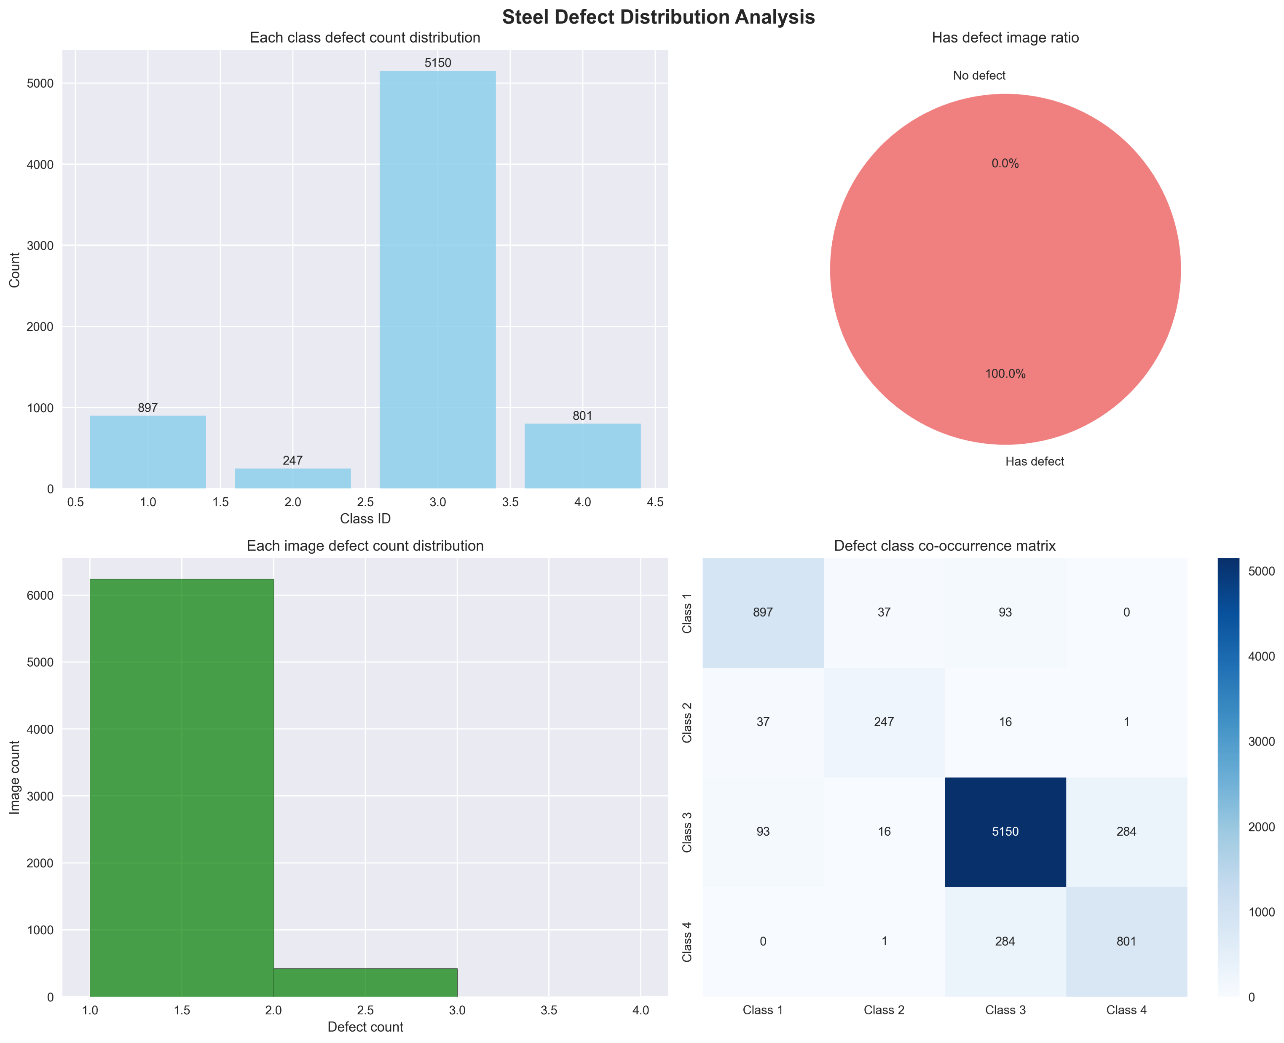
Data Analysis

Slide 5
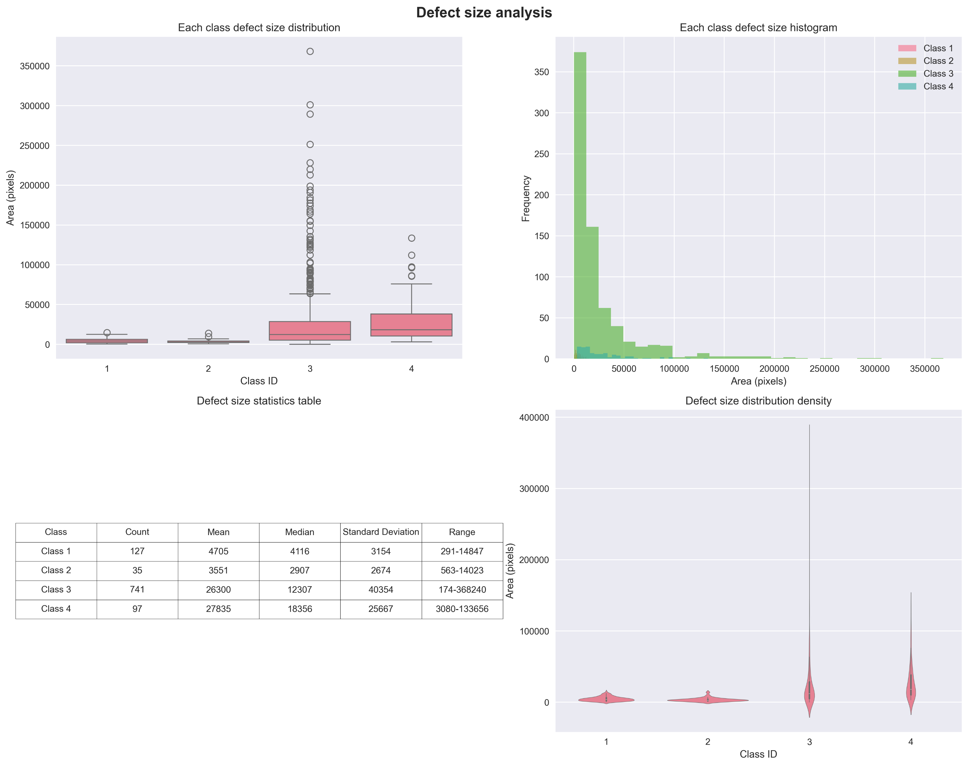

Slide 6
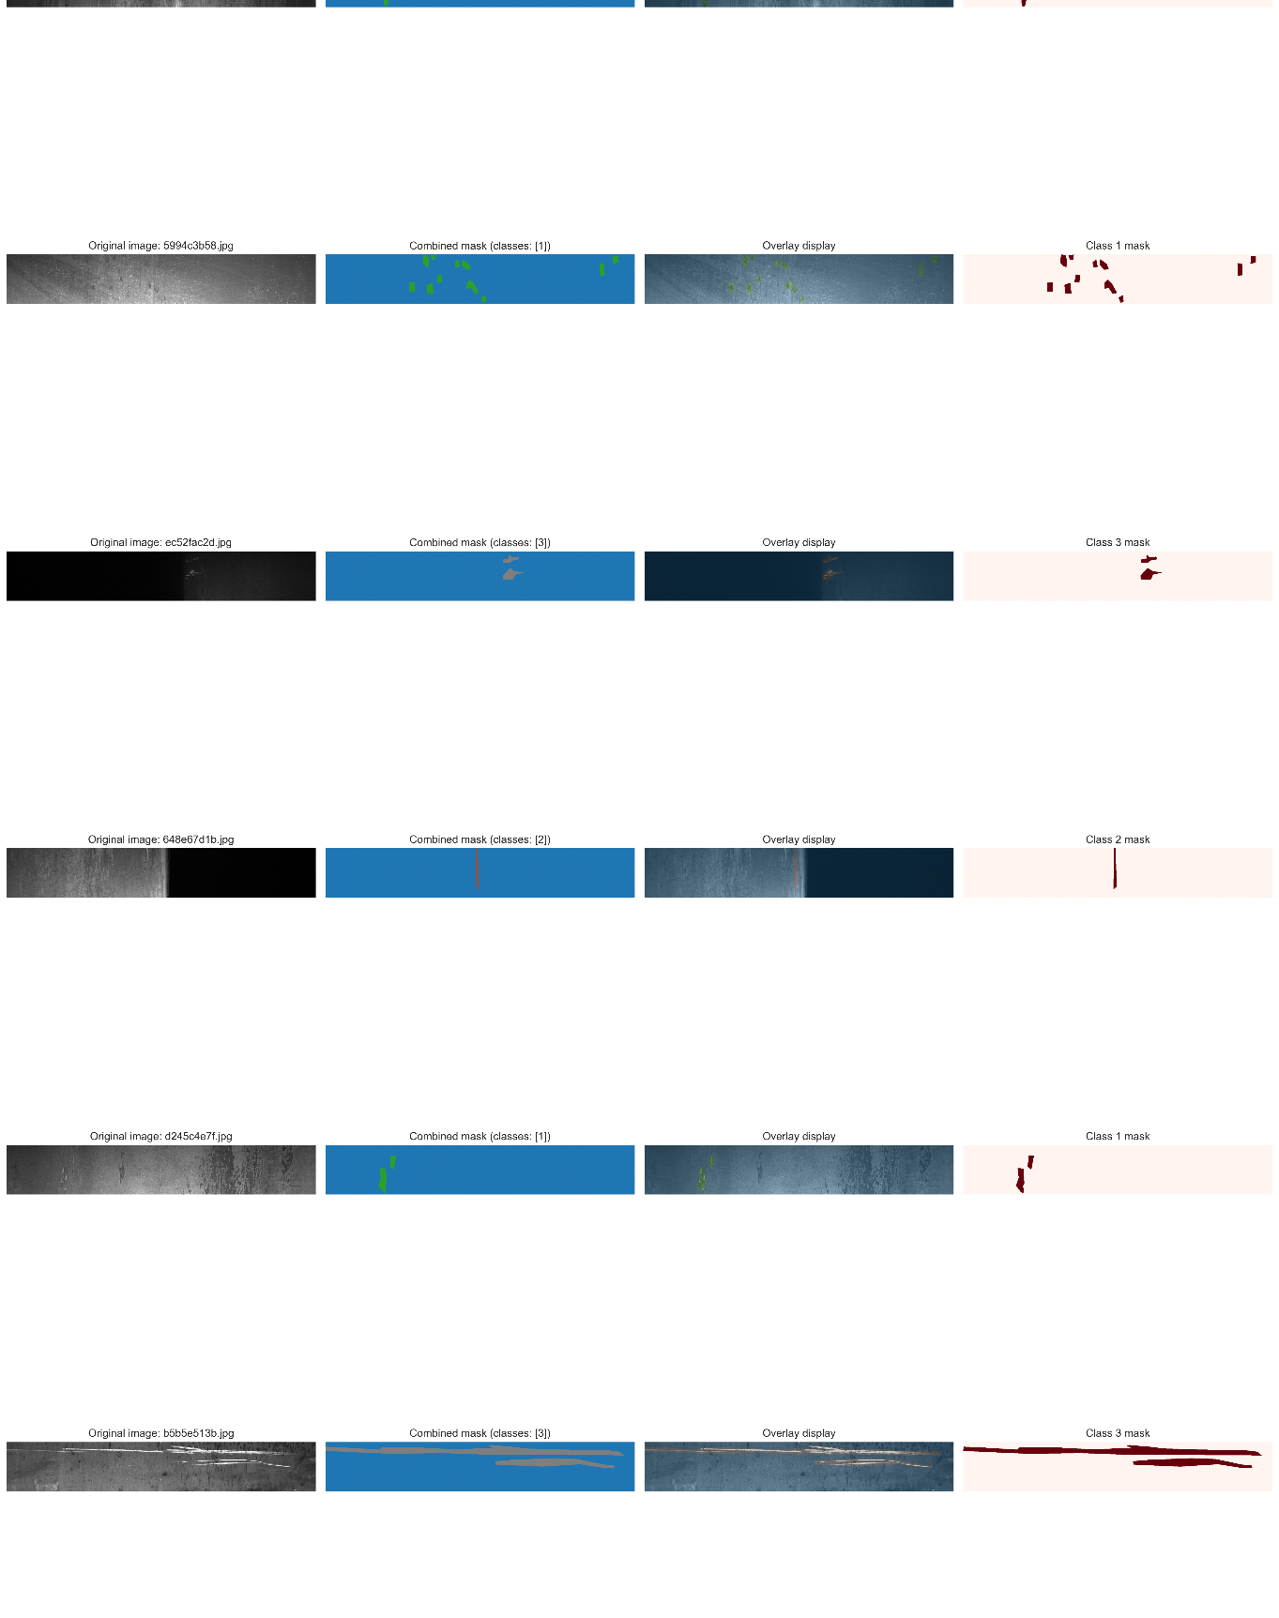
Train images with RLE mask

Slide 7
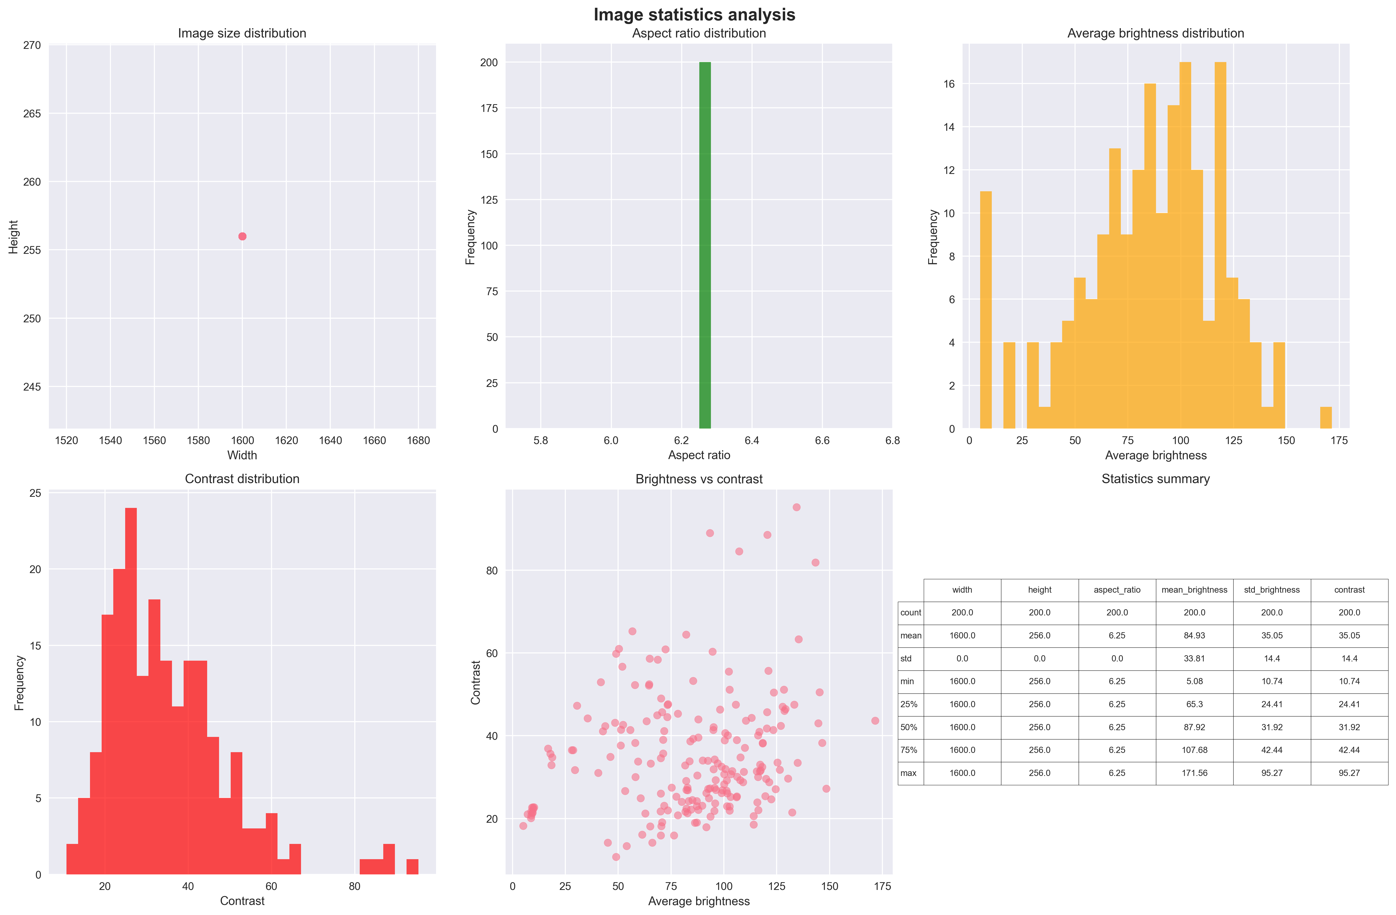

Slide 8
Data preprocessing

Slide 9
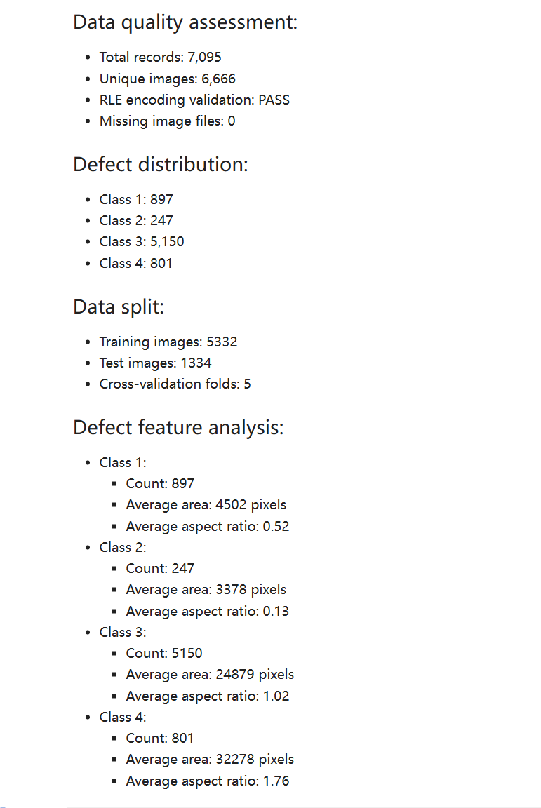
Through the analysis, I found that the distribution of metal scar types is very uneven, with type 3 accounting for the vast majority of the training samples, while type 1 and type 4 have the same basic number, and type 2 has very few samples. So here we use oversampling
to average it.

Slide 10
Model training

Slide 11
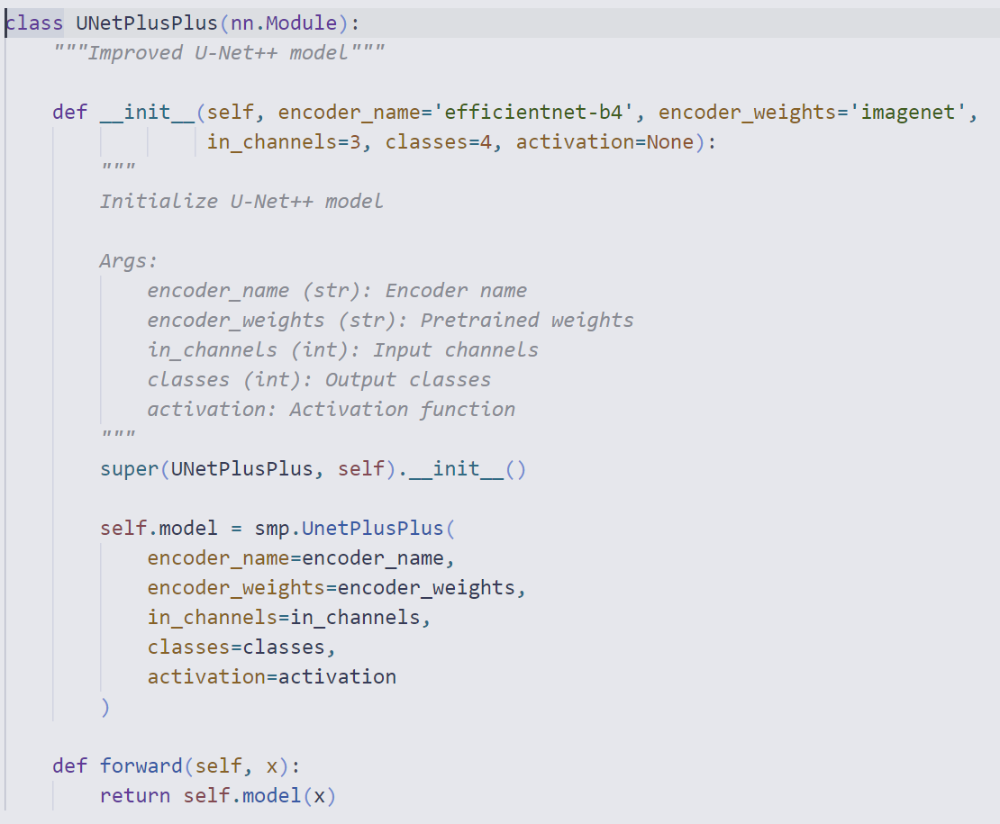
U-NET++
I used U-NET++ as the base model and used transfer learning on it to train.

Slide 12
Hypter Parameter
"encoder_name": "efficientnet-b4",
"encoder_weights": "imagenet",
"in_channels": 3,
"classes": 4,
"batch_size": 12,
"epochs": 100,
"encoder_lr": 1e-5,
"decoder_lr": 1e-3,
"val_split": 0.2,
"weight_decay": 1e-4,
"use_balanced_data": true,
"use_class_weights": true
…

Slide 13
Story
When training reaches 66 rounds, an error occurred in model saving, and the model saved has not appeared before. It may be video memory reasons or something else. It is an error reported by pytorch. But I thought the best prediction was in round 55, so I simply stopped training. Be prepared to adjust the hyperparameters and continue training.

Slide 14
Adjust
"encoder_lr": 2e-5,
"decoder_lr": 2e-3,
"use_class_weights": true
I want to skip the local optimal solution with a larger learning rate, because I found that the model did not improve at all in rounds 51-66, and then I wanted the model to focus more on samples with fewer types, so I used weight distribution. But the result is not very ideal.

Slide 15
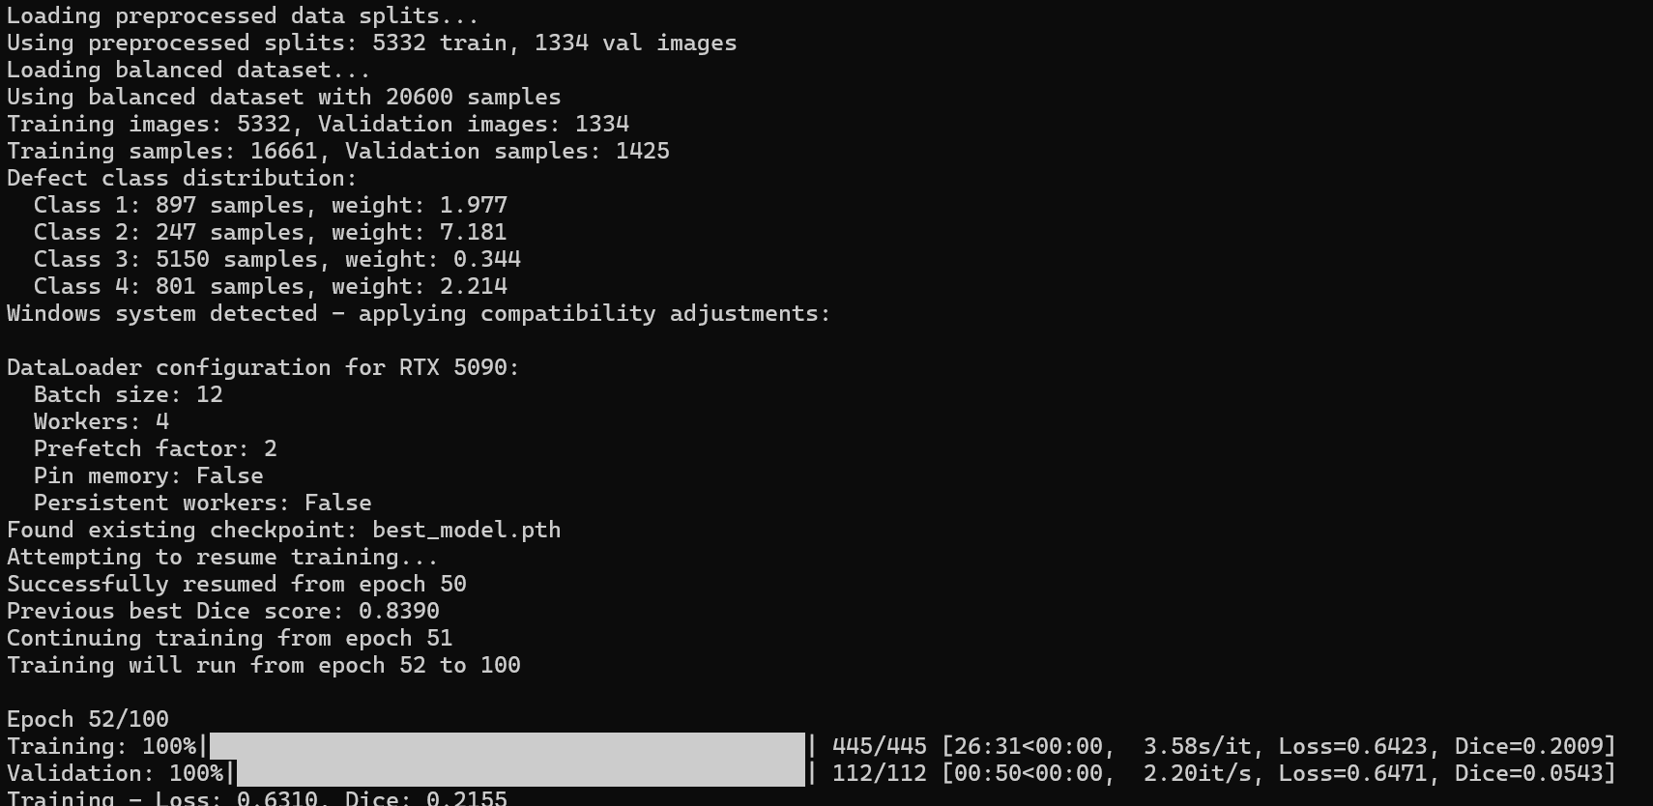
Story

Slide 16
Model predicting

Slide 17
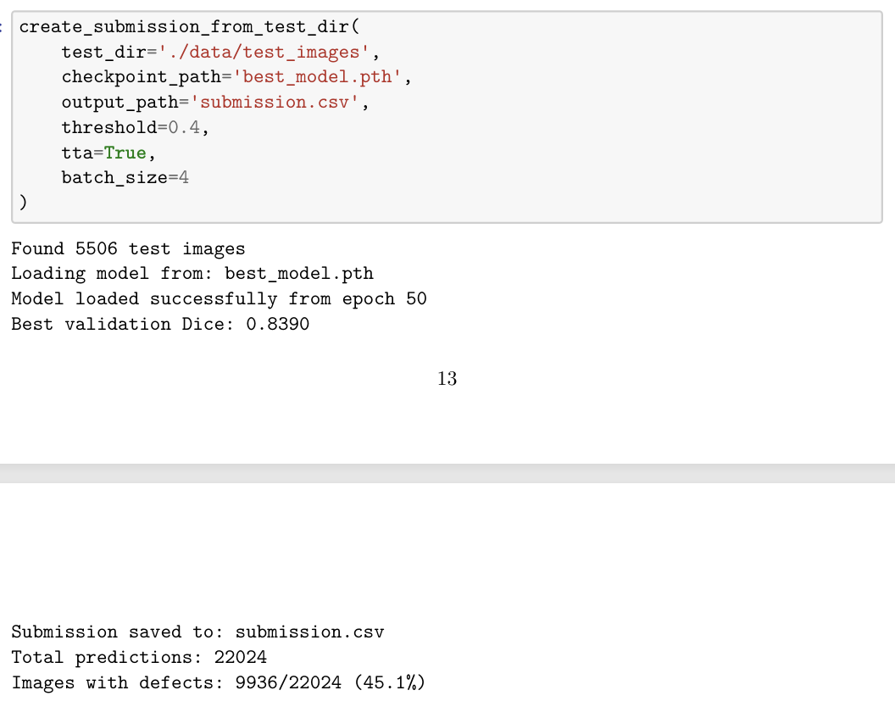

Slide 18
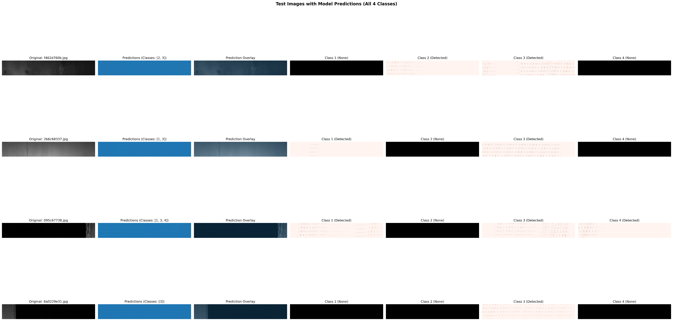

Slide 19
Thanks

