Slide 1

Posey insights

Slide 2
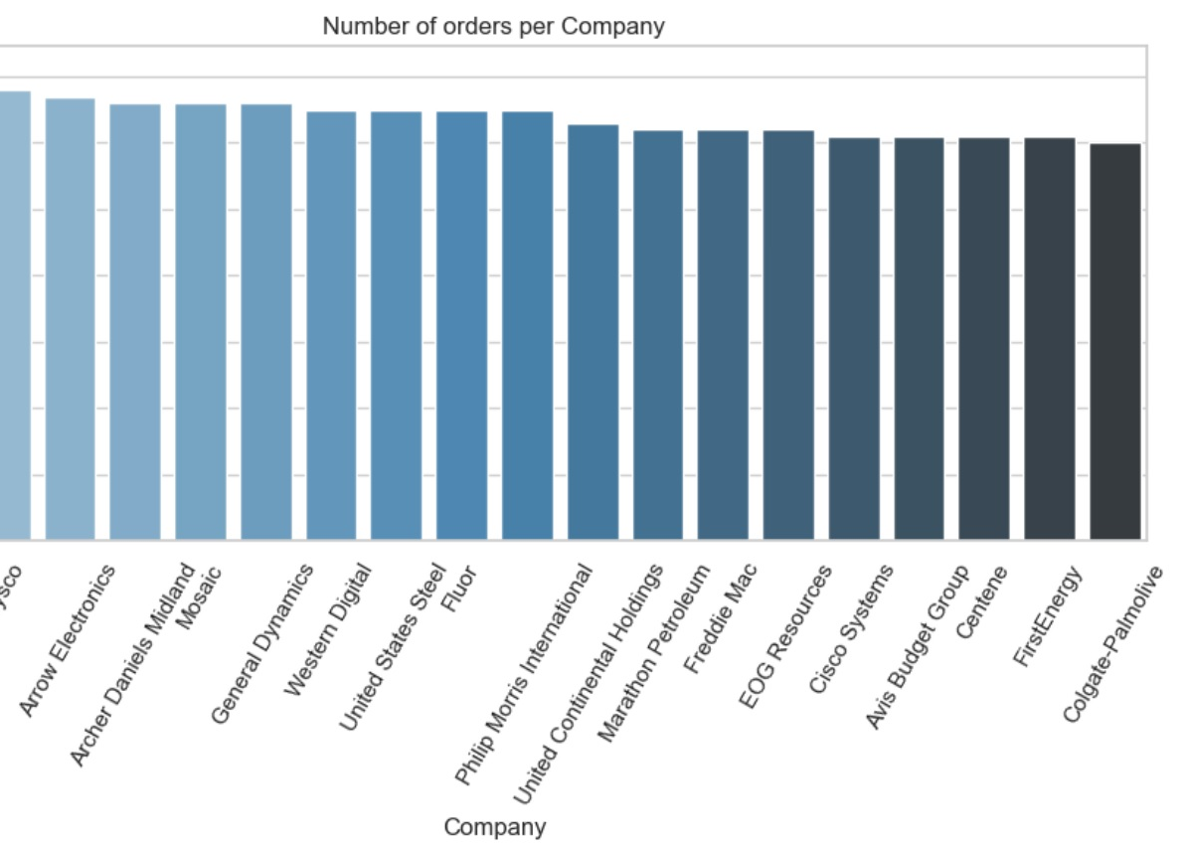
Top 20 companies in the number of orders

Slide 3
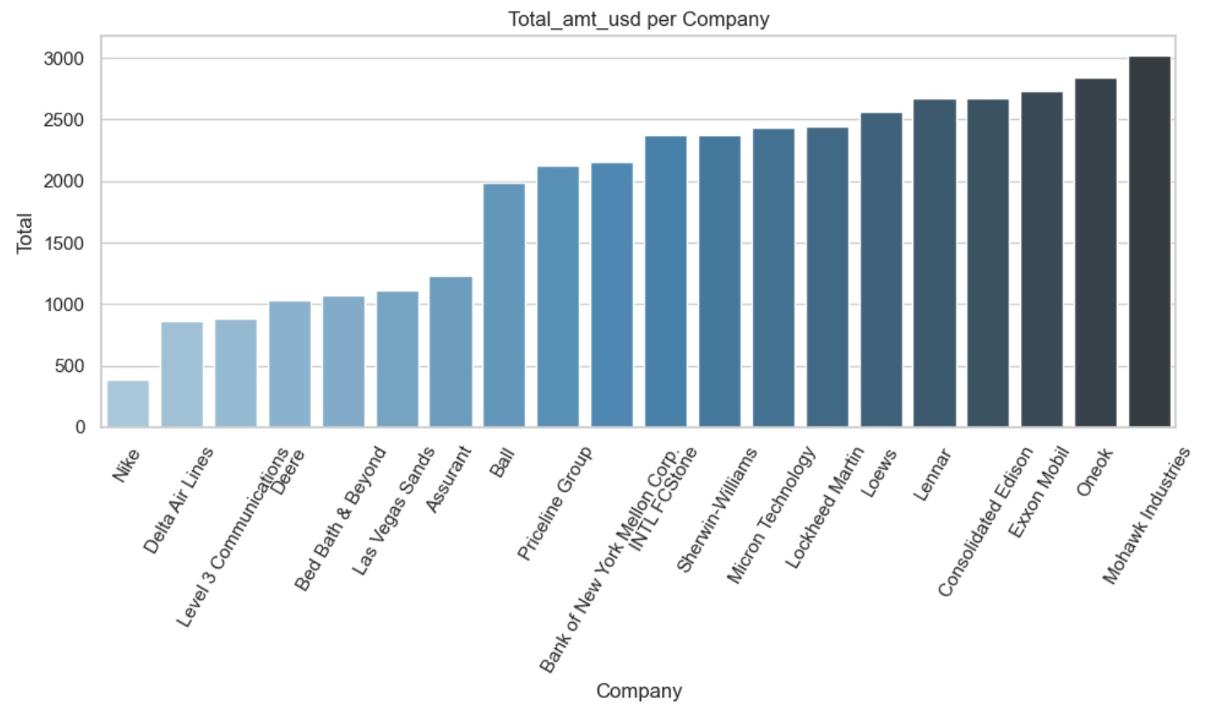
Top 20 companies in the total_amt_usd

Slide 4
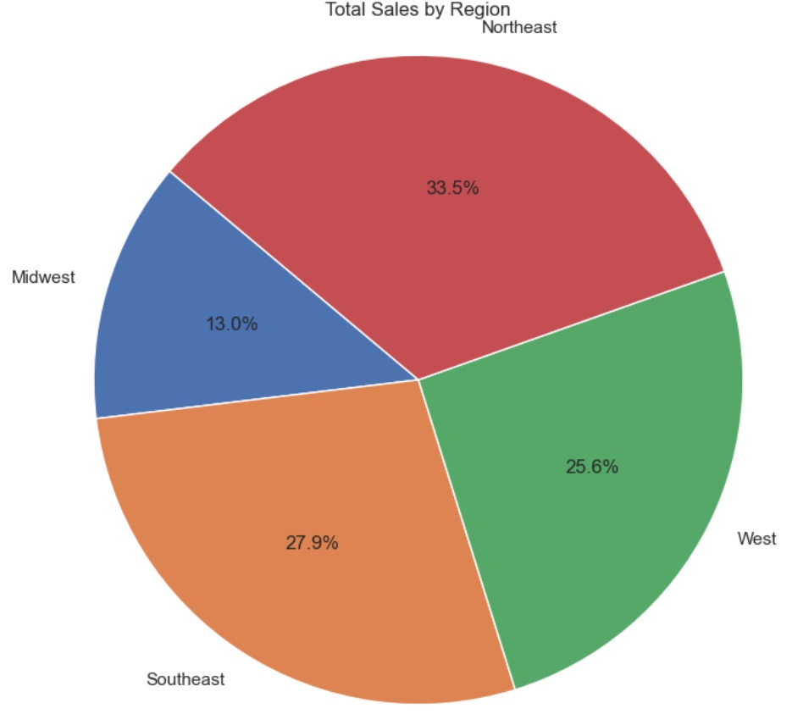
Total_amt_usd per Region
The Northeast has the largest portion of the total_amt_usd by 33.5%

Slide 5
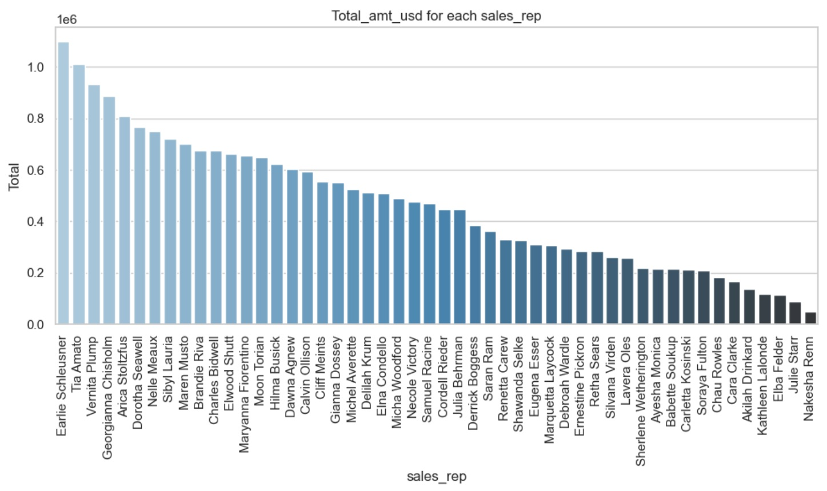
total_amt_usd per sales rep.

Slide 6
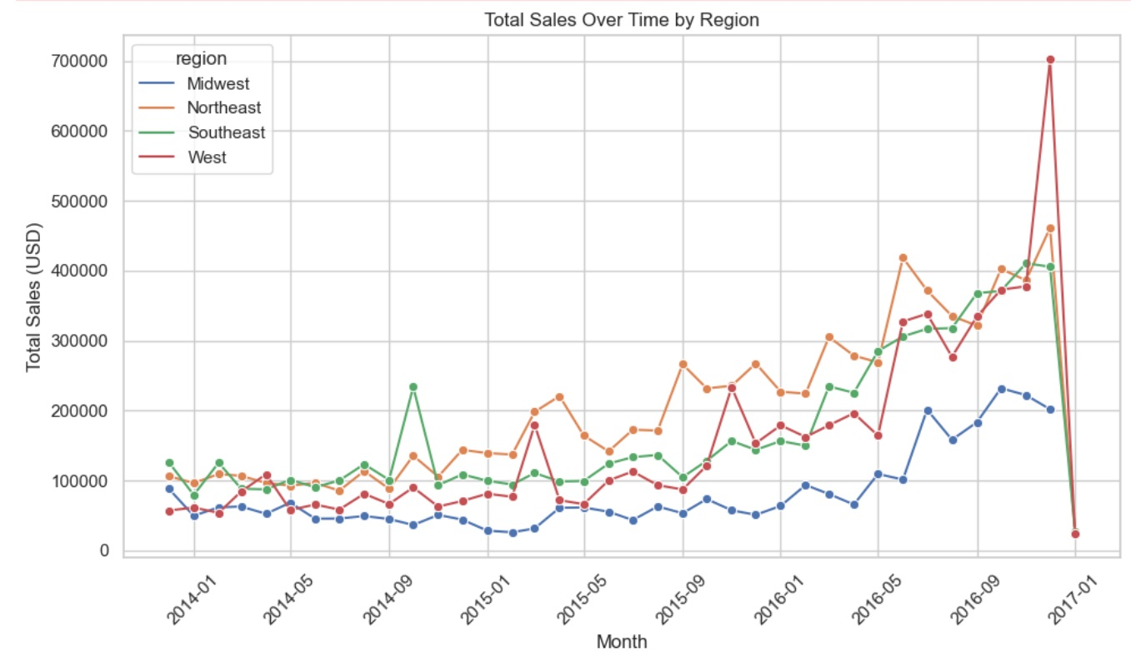
Total_amt_usd per time and region

