Slide 1


Slide 2
The requirements...
1. Defining a player
2. Defining "gym" locations
3. Create a pokedex
4. Create a data structure for players
5. Add captured pokemon for each player
6. What gyms have players visited?
7. Calculate player "power".
8. Load a pokedex file containing all the pokemon
9. Write a function to generate the full pokedex
10. Write a function to generate a "filtered" pokedex

Slide 3
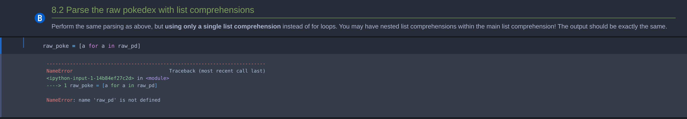
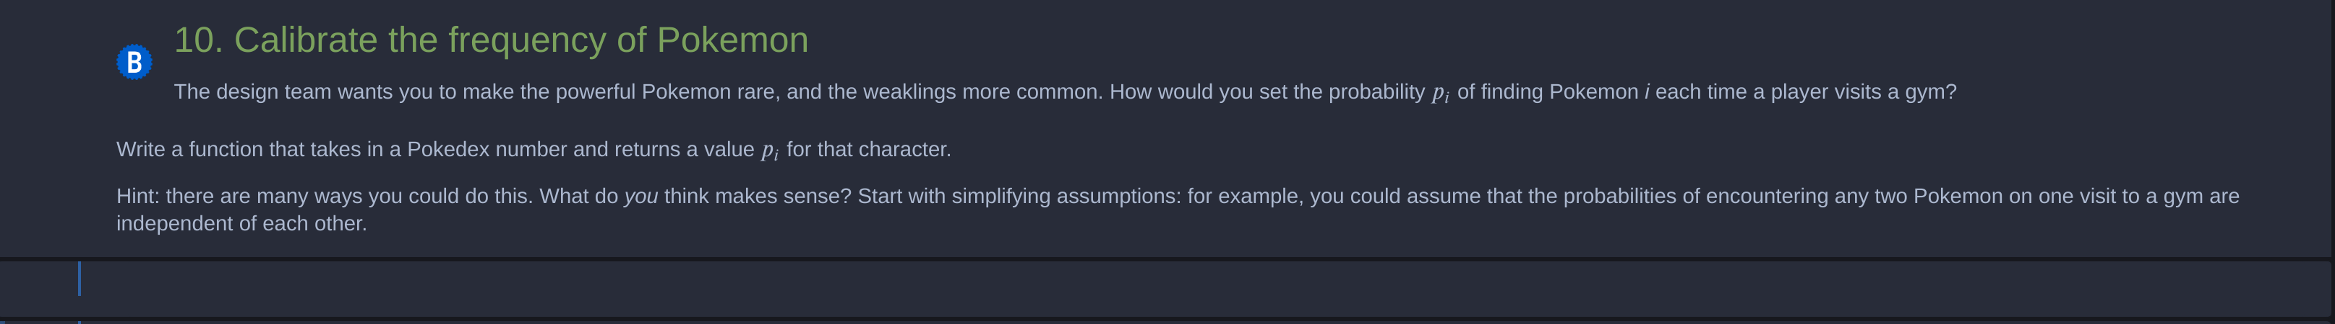
The challenges...

Slide 4
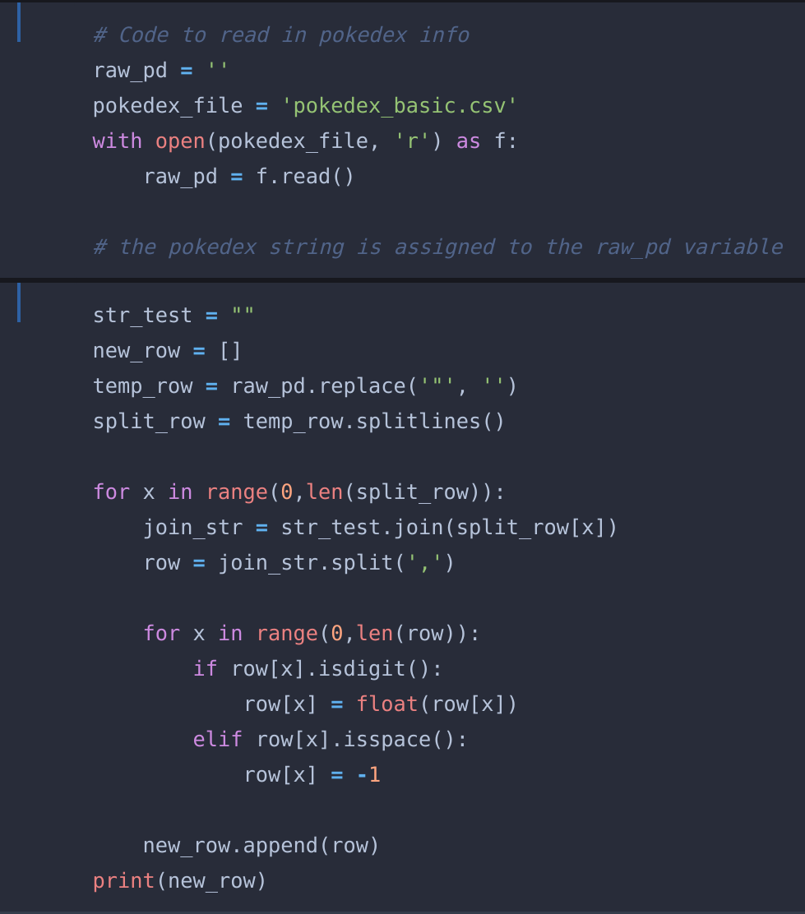
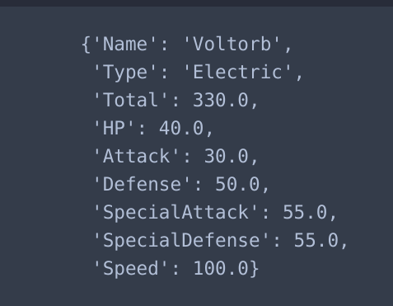
The fun part...

Slide 5


Glosary
Pokedex
Pokemon

Slide 6
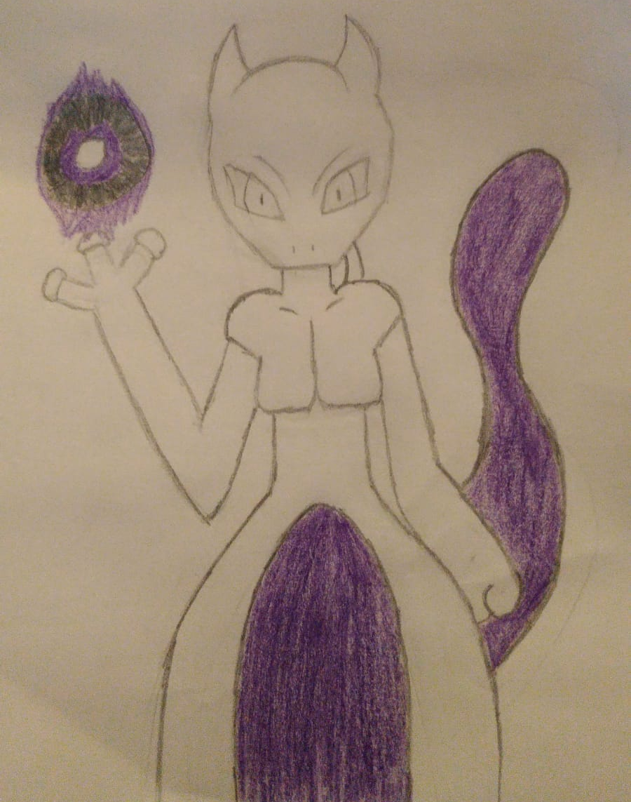
Thank you!

Slide 7
This work is licensed under a Creative Commons Attribution-ShareAlike 3.0 Unported License.
It makes use of the works of
Kelly Loves Whales and Nick Merritt.

