Slide 1

Web scraping
& salary prediction

Slide 2
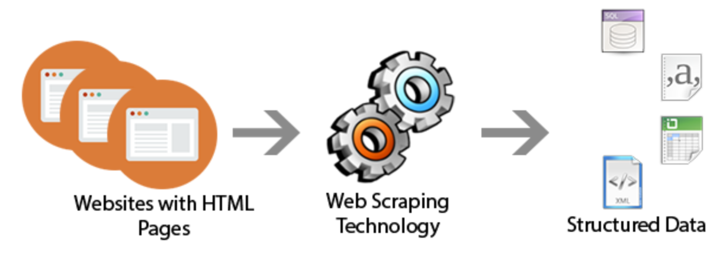
Tech Requirements
Scrape 1000+ jobs from indeed
Convert the data to CSV
Perform EDA
Create a M/L model
Predict the salary
Determine the factors that separate data scientist from other job postings

Slide 3

How to prevent getting blocked
Crawl slowly
Use VPN
Rotate User Agents
Automate multiple searches

Slide 4
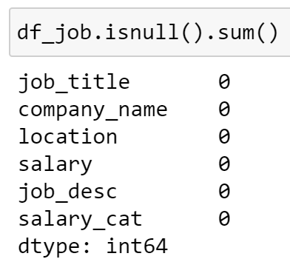
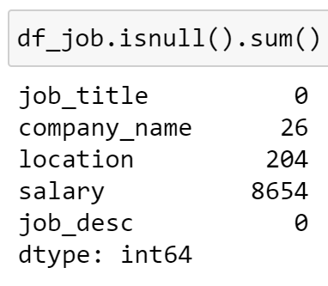
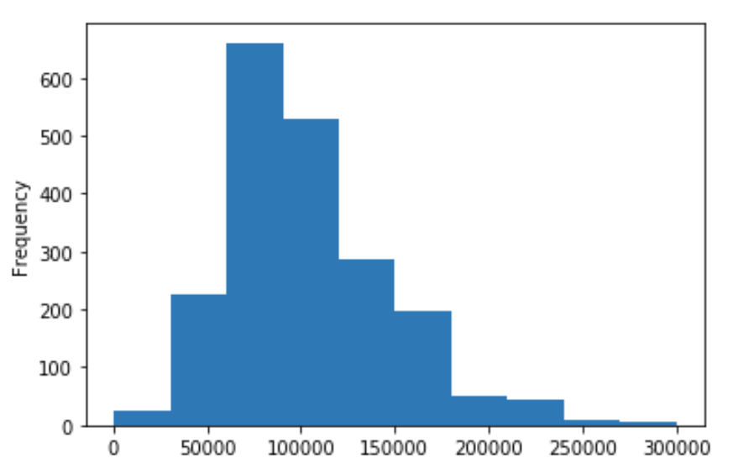
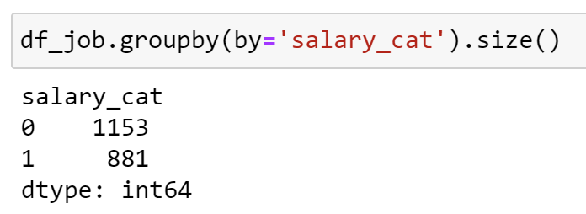
eda
Remove rows with zero salary values
Convert hourly, daily and weekly rates to annual rates
Used qcut to segregate ‘Low’ & ‘High’ value salaries.

Slide 5
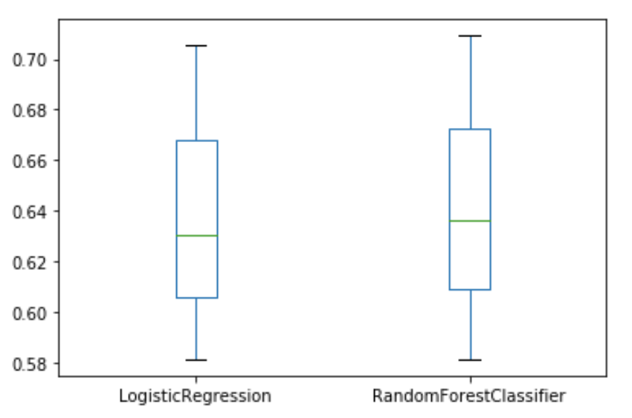
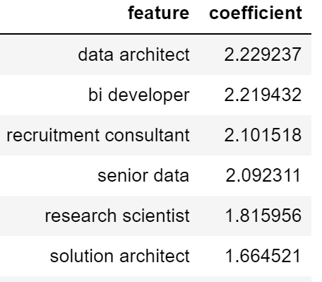
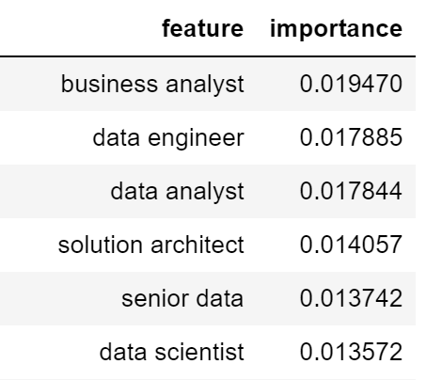
Predicting salary (feature title)

Slide 6
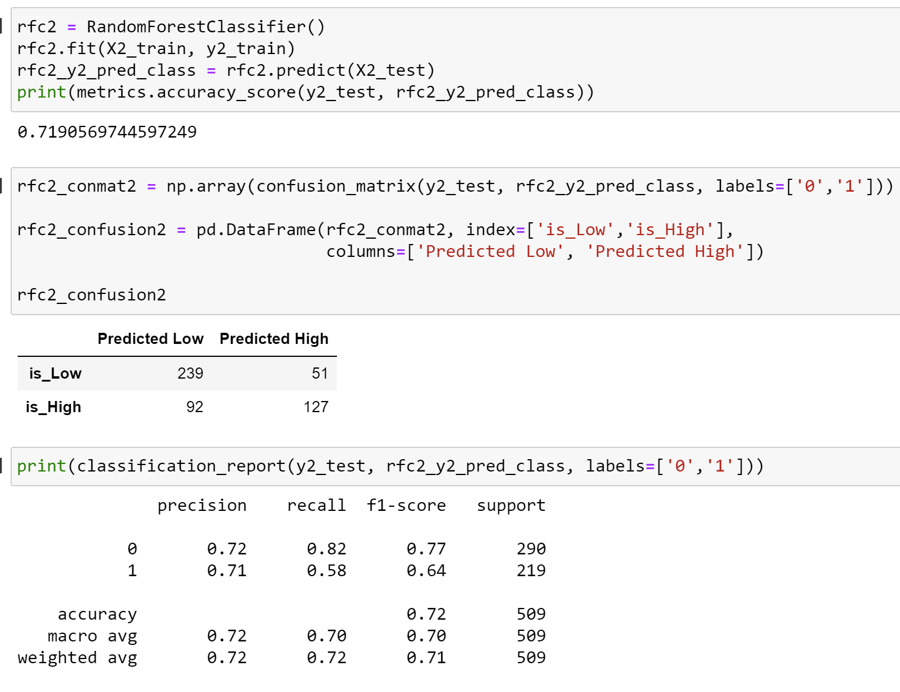
Highest accuracy rate

Slide 7

Thank You

