Slide 1

Computer Games Development – Team project Presentation
Team gSARdev: Stephen honnan, Richard Sneddon, Alex Gallacher

Slide 2
Page of Contents
Slide 1-2: Title + Content Page
Slide 3: Game Concept, Synopsis + Choice of Genre
Slide 4: Game Engine Justification
Slide 5: Moodboard
Slide 6: Game Mechanics + Gameplay
Slides 7 - 8: Level Design and Implementation
Slide 9: Immersive Quality
Slide 10: Version Control (More Specifically Unity Collab)
Slide 11: Game Prototype Demonstration
Slides 12 – 13: Individual Contribution and what we’ve learned.

Slide 3
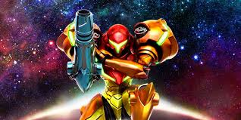
Game Concept – Synopsis + Genre choice
The name of the game: Ultra Aex.
A 2-D side scrolling shooter.
Set in a Sci-Fi themed world.
The main character, a bounty hunter named Aexalous H, must fight their way through a complex containing several different environments including a military bunker, sewer system and a modern building, collecting key cards hidden in specific places throughout the levels to progress further through them, reaching the end to defeat their main target and fulfil the mission.

Slide 4
Game Engine Justification
The team as a whole decided on Unity 2018.2.9f1 as the baseline for our game, there was no underlying decision based on the version itself, but it was agreed upon to all be working on the same version to avoid complications.
Another reason Unity was chosen was due to previous familiarity, as Richard has already worked on projects utilizing Unity in college.
The team believed It would’ve been easier in Unity and that Unity was more accessible to 2D games unlike engines such as Unreal.

Slide 5
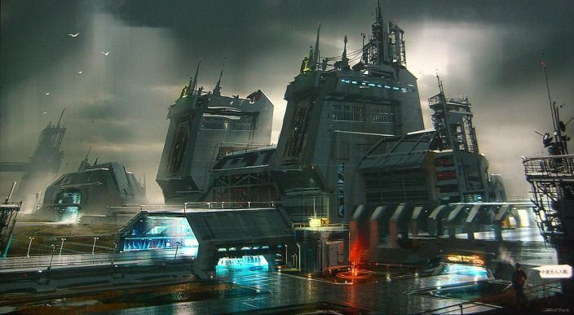
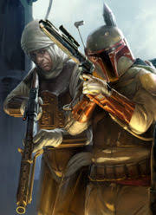
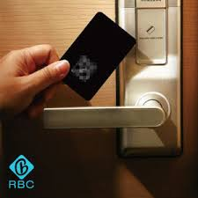
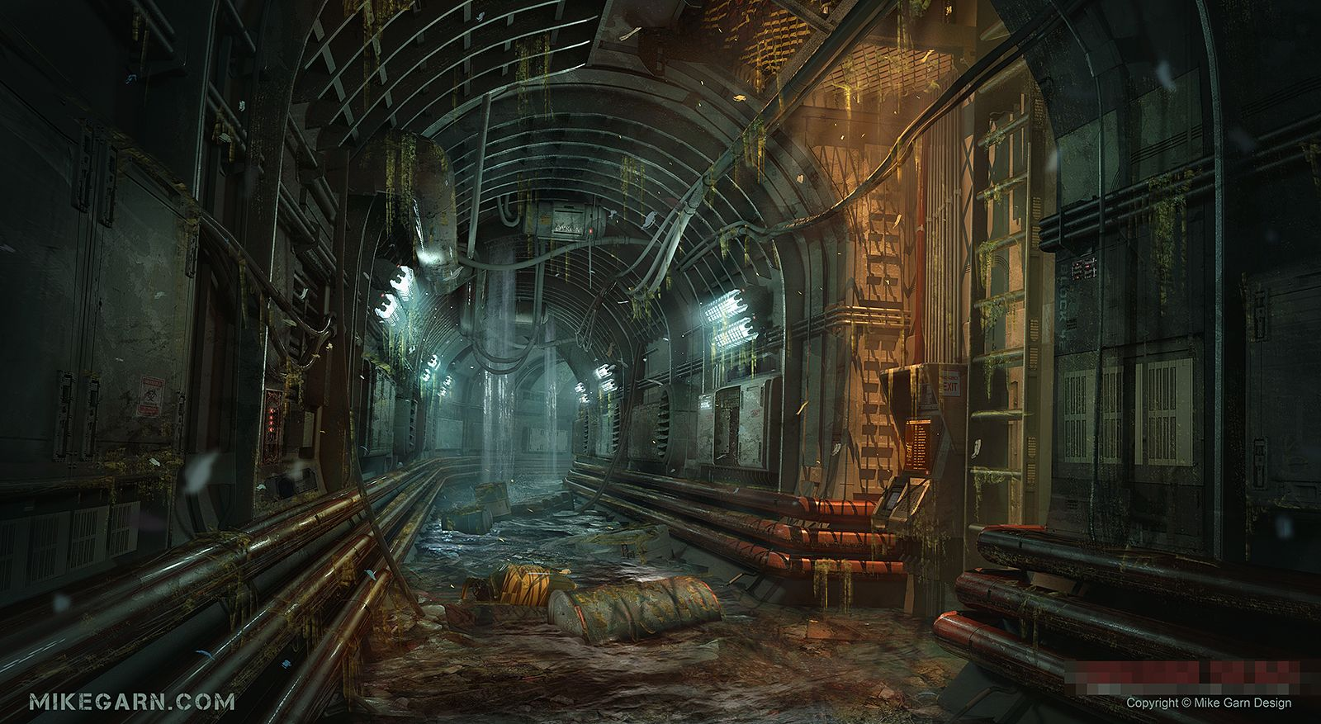
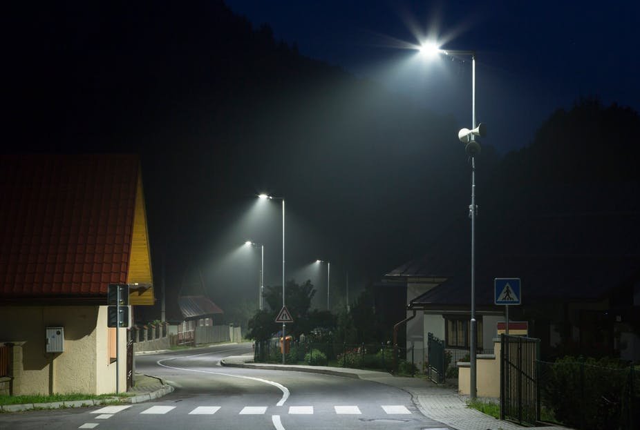
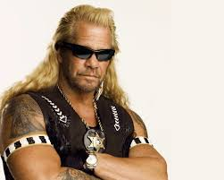
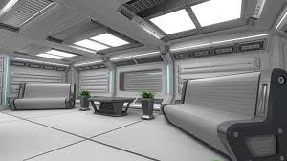
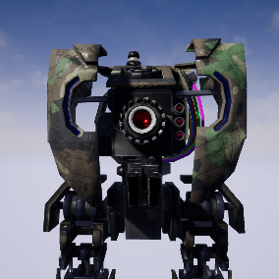
Moodboard
This slide shows a compilation of images that inspired us in the making of our project or pictures that convey the feel of the game.

Slide 6
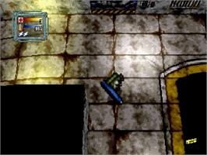
Game Mechanics and Gameplay
The main mechanic of the game involves shooting through enemies to reach the end of the level. Enemies will take 2-3 hits before a death animation plays, rendering them non existent so that the player is able to pass through with no issue.
The second mechanic proposed is finding the key card hidden somewhere within a level, usually the card will be hidden at the end of a path so the player will backtrack to the exit door once they have it in their inventory.
Loaded (Sega Saturn) (1995): The main inspiration for the key card mechanic. The bottom right sprite shows the character holding one.

Slide 7
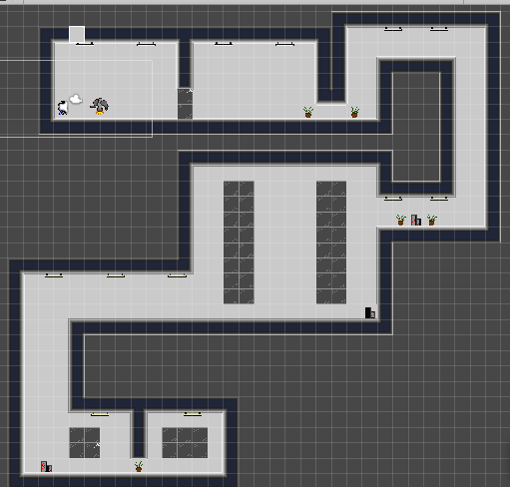
Level Design
The prototype includes three full levels.
Each level has it’s own style, due to the fact that each person on the team made their own specific tile sets and enemies with their own distinct environments.
Shows the difference in quality between each member of the team and their specific style.
Each level is sufficiently long enough to pass as its own area.
Each level comes complete with its own looing music track.
A W.I.P Build of
The 3rd level of the game.

Slide 8
Implementation of the game
Each team member worked on their own specific levels, their own backgrounds and decorations, along with their own enemy models and implemented them before publishing.
The team used the Unity tile set system in order to create our levels. Implementing each level by hand and drawing in the outlines ourselves through use of near seamless tile sets created by hand in Piskel and Asperite.
Once level design was complete, HUD assets were also implemented through use of external pixel art software.

Slide 9
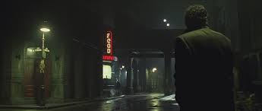
Immersion
The unique designs of each level we feel would stand out to the players, the main hook would be in both that and the audio.
The 2nd level for example stands out due to it’s use of flickering street lights at night-time, a common theme in sci-fi.
The game audio, produced by Stephen, uses real world sounds and appropriate musical
styles which recorded from scratch and composed for each level.
We believe the audio style used enhances user immersion.
Still image from “Dark City”, a Sci-Fi film
using the streetlight trope.

Slide 10
Version control - UNITY Collab feature
All team members worked on the same version of Unity, version 2018.2.9f1.
The team utilized the “collab” feature of the software, allowing users to all work on the same project simultaneously, each change that was made to the scenes had to be published, with a publish history available to each user with the option to return to a previous version in case there was a major error upon updating.
Proven risky on occasion, when publishing on an older version, will overwrite newer versions and their respective work. On one occasion Stephan has lost an entire morning’s work.
In the later stages of the project, merge conflicts began to appear, restoring to a previous version and back to the latest iteration solve these issues.

Slide 11

Game Prototype Demo
This video will demonstrate the three levels that the team has created, showing off the game from start to finish: https://www.youtube.com/watch?v=33AeNGohDHs

Slide 12
Individual Team Member Contribution
Stephen: Worked on – All scripts, 1st Level along will all respective enemies and tilesets along with the player model, provided links to high quality tutorials & general troubleshooting.
Richard: Worked on – Game Design Document (GDD), PowerPoint Presentation, 3rd Level with all respective enemies and tilesets. Created HUD assets.
Alex: Worked on – Research + Enemy Patrol AI, 2nd Level along with all respective enemies and tile sets. Thought up name of game and character. Creating the demonstration video for the PowerPoint.

Slide 13
What we’ve Learned
The Lessons learned in dealing with Unity during the making of this project:
Save very regularly. (Every 3-5 minutes)
Learned how to animate 2D sprites using Unity’s built in Animator. With research and tutorial help.
Coroutine functions used for waiting a specified time then executing or terminating game logic.
Make sure that, when publishing, you are on the latest version of the collab so there is no risk of overwriting (version control).
Experimentation with game mechanics that are unfamiliar to the team (key card specific doors).
Learned to use the Animator Timeline along with Animation Controllers.
Working as a team to achieve our goal within the deadline.
Not as easy as we’ve secretly hoped it to be.

Slide 14
Thank you for watching this presentation Any questions?
Team gSARdev: Stephen Honnan, Alex Gallacher, Richard Sneddon

