Slide 1
The Go Language: What Makes it Different?

Slide 2
Introduction

Slide 3
About me
Author, Head First Go
Treehouse instructor

Slide 4
Talk goals
We only have 45 minutes.
You are not going to learn Go today.
We’ll be moving fast.
But you’ll get an overview of the language.

Slide 5
Where to Learn Go
https://tour.golang.org

Slide 6
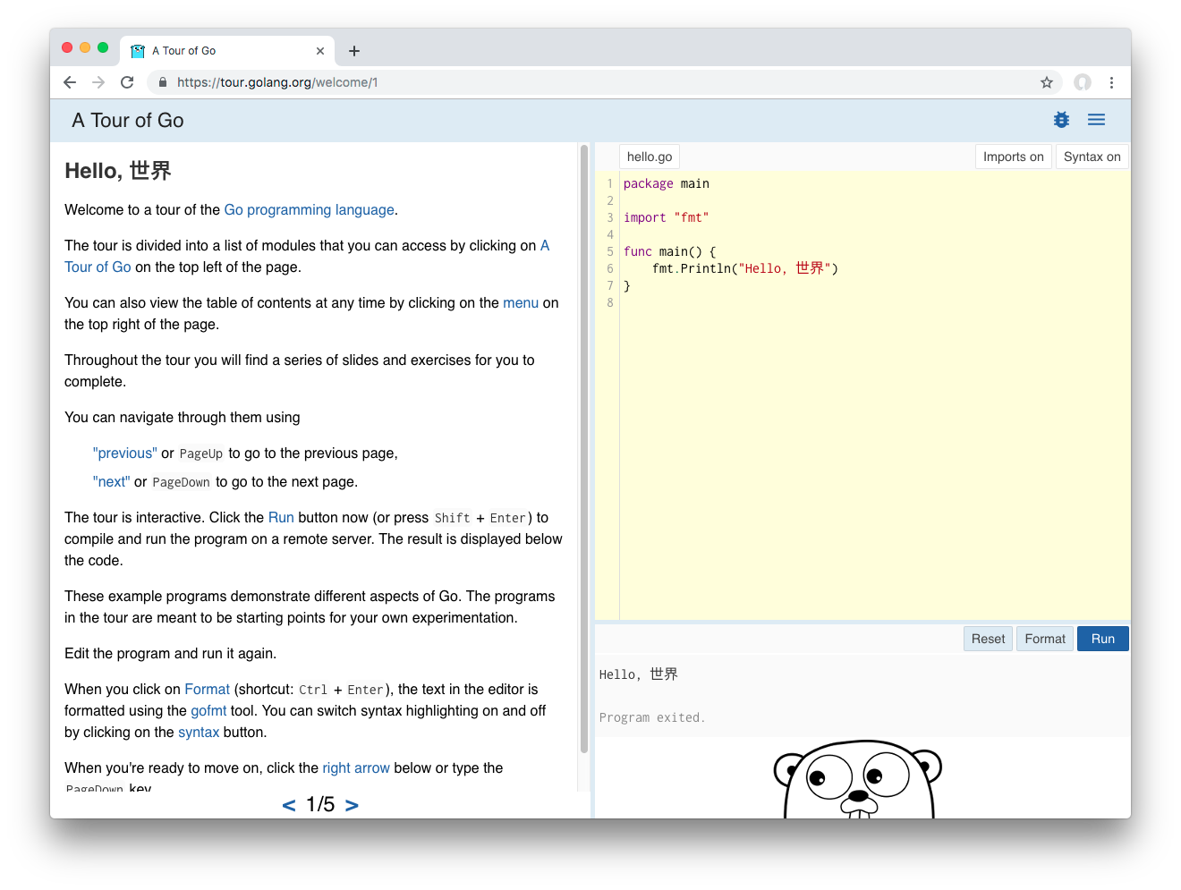

Slide 7
(We’ll repeat that link at the end.)

Slide 8
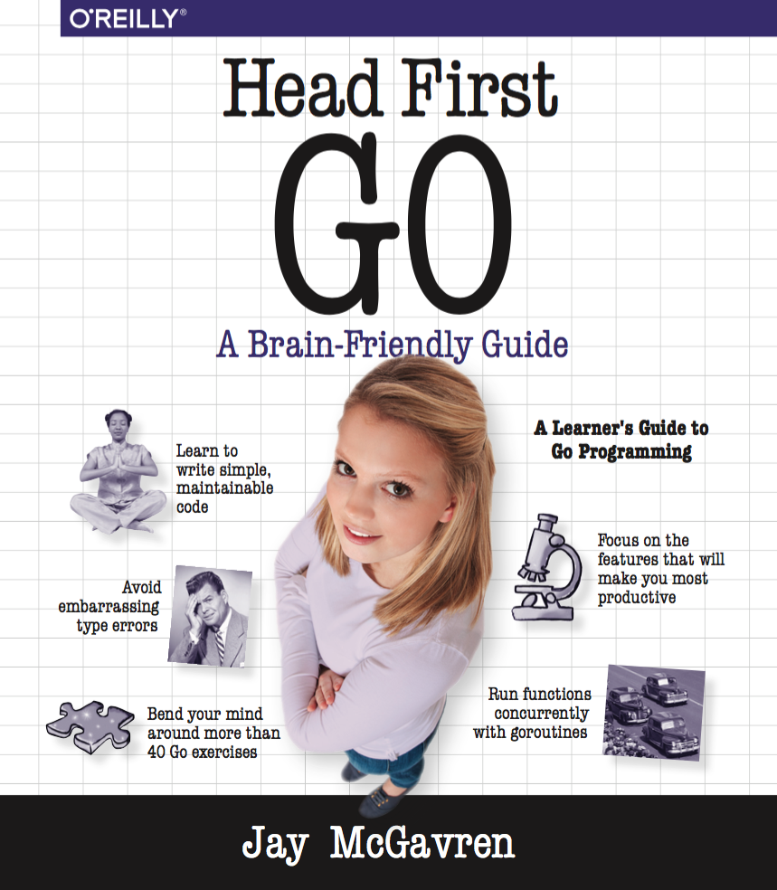
Another humble recommendation

Slide 9
Talk overview
TODO major sections TODO questions TODO slides are posted

Slide 10
A sneak peek

Slide 11
Hello, world
package main import "fmt" func main() { fmt.Println("Hello, Philadelphia!") }
TODO packages TODO goroutines, channels TODO “net/http”

Slide 12
Why Go?

Slide 13
Go at a glance
C-like syntax
Compiles to native code
Type-safe
Garbage collected
Concurrency built into language

Slide 14
Languages in order of creation
Year | Language
1972 | C
1983 | C++
1991 | Python
1995 | Java
1995 | JavaScript
1995 | PHP
1995 | Ruby
2000 | C#
2009 | Go
2011 | Kotlin
2014 | Swift

Slide 15
https://en.wikipedia.org/wiki/Timeline_of_programming_languages

Slide 16
Languages in (subjective) order of execution speed
https://benchmarksgame-team.pages.debian.net/benchmarksgame/performance/mandelbrot.html

Slide 17
Run Time | Language
1.5s | C++
1.65s | C
2.2s | Rust
3.22 | Swift
5.5s | Go
5.5s | C# (.NET Core)
6.84s | Java
18.13s | JavaScript (Node.js)
118.28s | PHP
265.56s | Python 3
>420s | Ruby

Slide 18
Languages in (subjective) order of execution speed
https://benchmarksgame-team.pages.debian.net/benchmarksgame/performance/binarytrees.html

Slide 19
Run Time | Language
3.1s | Rust
3.48s | C
3.77s | C++
5.05s | Swift
7.85s | C# (.NET Core)
8.32s | Java
26.94s | Go
45.89s | JavaScript (Node.js)
58.93s | PHP
64.07s | Ruby
81.74s | Python 3

Slide 20
Languages in (subjective) order of deployment ease
Native binary: C++, C, Go, Rust
Standalone or framework/VM dependent: C#, Kotlin
VM-dependent: JavaScript, Java
Interpreter-dependent: Python, PHP, Ruby

Slide 21
Languages in order of popularity
JavaScript (67.8%)
Python (41.7%)
Java (41.1%)
C# (31.0%)
PHP (26.4%)
C++ (23.5%)
C (20.6%)
Ruby (8.4%)
Go (8.2%)
Swift (6.6%)
Kotlin (6.4%)
Rust (3.2%)
Stack Overflow 2019 Developer Survey - percentage of developers saying they use a language
Notes:
Markup, shell, and database query languages omitted

Slide 22
Rationale
“we had become frustrated by the undue complexity required to use the languages we worked with to develop server software”
“multi[-core] processors were becoming universal but most languages offered little help to program them efficiently and safely”
“to make resource management tractable in a large concurrent program, garbage collection… was required”
—https://golang.org/doc/faq

Slide 23
Some overgeneralizations
Go always favors simplicity.
If a feature complicates code, or slows down compilation or execution, it’s left out.
Go values conceptual consistency.
Blocks work the same at all levels (func/for/if)
Same naming rules for everything (variables/functions/types)

Slide 24
Left out (on purpose)
Constructors
Method overloading
Class inheritance (mostly)
Exceptions

Slide 25
NO EXCEPTIONS?!
“We believe that coupling exceptions to a control structure, as in the try-catch-finally idiom, results in convoluted code. It also tends to encourage programmers to label too many ordinary errors, such as failing to open a file, as exceptional.”
“For plain error handling, Go’s multi-value returns make it easy to report an error without overloading the return value.”
—https://golang.org/doc/faq

Slide 26
Why Goroutines?
“multiplex independently executing functions—coroutines—onto a set of threads”
“The result, which we call goroutines, can be very cheap”
“It is practical to create hundreds of thousands of goroutines in the same address space”
—https://golang.org/doc/faq

Slide 27
Go and object-oriented programming
“Although Go has types and methods and allows an object-oriented style of programming, there is no type hierarchy.”
“There are… ways to embed types in other types to provide something analogous—but not identical—to subclassing.”
“methods in Go are more general than in C++ or Java: they can be defined for any sort of data, even built-in types”
—https://golang.org/doc/faq

Slide 28
Neat stuff
First-class functions
Built-in UTF8 support
Interfaces fully decoupled from types
go get package manager standard
go format command formats code for you
Unit testing in standard library

Slide 29
“go fmt”
Before
package main import "fmt" func main() { repeatLine("hello", 3 ) } func repeatLine( line string ,times int) { for i := 0; i < times; i++ { fmt.Println(line) } }

Slide 30
“go fmt”
$ go fmt repeat.go

Slide 31
“go fmt”
After
package main import "fmt" func main() { repeatLine("hello", 3) } func repeatLine(line string, times int) { for i := 0; i < times; i++ { fmt.Println(line) } }

Slide 32
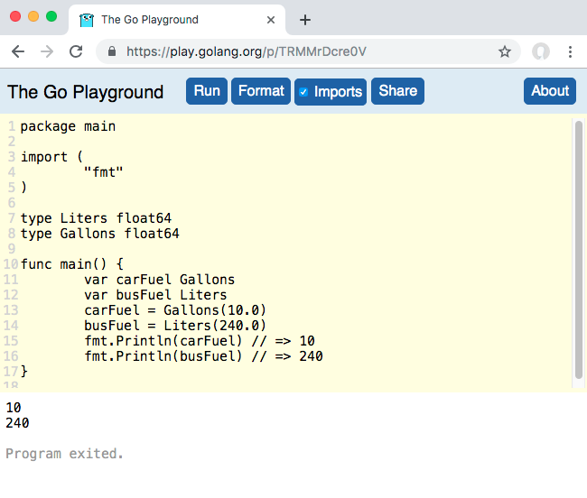
Playground
Notes:
Example saved session: https://play.golang.org/p/TRMMrDcre0V

Slide 33
Syntax

Slide 34
Go file layout
Package clause
Imports
Code
package main import "fmt" func main() { fmt.Println("Hello, Go!") }

Slide 35
Imports
package main import ( "fmt" "math" "strings" ) func main() { fmt.Println(math.Floor(2.75)) fmt.Println(strings.Title("head first go")) }

Slide 36
Other packages
package keyboard import ( "bufio" "os" "strconv" "strings" ) func GetFloat() (float64, error) { // GetFloat code here... }

Slide 37
Unused imports not allowed
package main import ( "fmt" "os" ) func main() { fmt.Println("Hello, Go!") }
Compile error:
temp.go:5:5: imported and not used: "os"

Slide 38
“goimports”
Automatically adds/removes imports
Wrapper for go fmt
Install:
$ go get golang.org/x/tools/cmd/goimports
Do a web search for “goimports” for directions on integrating with your editor.

Slide 39
“goimports”
Before saving
package main func main() { fmt.Println(math.Floor(2.75)) fmt.Println(strings.Title("head first go")) }

Slide 40
“goimports”
After saving
package main import ( "fmt" "math" "strings" ) func main() { fmt.Println(math.Floor(2.75)) fmt.Println(strings.Title("head first go")) }

Slide 41
Variables
var myInteger int myInteger = 1 var myFloat float64 myFloat = 3.1415 fmt.Println(myInteger) // => 1 fmt.Println(myFloat) // => 3.1415 fmt.Println(reflect.TypeOf(myInteger)) // => int fmt.Println(reflect.TypeOf(myFloat)) // => float64

Slide 42
Short Variable Declarations
myInteger := 1 myFloat := 3.1415 fmt.Println(myInteger) // => 1 fmt.Println(myFloat) // => 3.1415 fmt.Println(reflect.TypeOf(myInteger)) // => int fmt.Println(reflect.TypeOf(myFloat)) // => float64

Slide 43
Type Safety
myInteger := 1 myFloat := 3.1415 myInteger = "3"
Compile error:
prog.go:6:14: cannot use "3" (type string) as type int in assignment

Slide 44
Type Safety
myInteger := 1 myFloat := 3.1415 fmt.Println(myInteger + myFloat)
Compile error:
prog.go:8:24: invalid operation: myInteger + myFloat (mismatched types int and float64)

Slide 45
Casting
myInteger := 1 myFloat := 3.1415 fmt.Println(float64(myInteger) + myFloat) // => 4.141500000000001

Slide 46
Must use every variable you declare
subtotal := 24.70 tax := 1.89 fmt.Println(subtotal)
Compile error:
prog.go:9:2: tax declared and not used

Slide 47
Zero values
package main import ( "fmt" ) func main() { var myFloat float64 fmt.Printf("%#v\n", myFloat) // => 0 var myBool bool fmt.Printf("%#v\n", myBool) // => false var myString string fmt.Printf("%#v\n", myString) // => "" }

Slide 48
Zero values
var myFloat float64 fmt.Println(myFloat + 2.5) // => 2.5 var myBool bool fmt.Println(!myBool) // => false var myString string fmt.Println("(" + myString + ")") // => ()

Slide 49
“if” is unsurprising
if 1 < 2 { fmt.Println("Universe is OK") } else { fmt.Println("We have a problem") }

Slide 50
“for” is unsurprising
for i := 1; i <= 3; i++ { fmt.Println(i) }

Slide 51
“for” is unsurprising… mostly
mySlice := []string{"one", "two", "three"} for i, value := range mySlice { fmt.Println(i, value) }
Output:
0 one 1 two 2 three

Slide 52
What if we skip using the index?
mySlice := []string{"one", "two", "three"} for i, value := range mySlice { fmt.Println(value) }
Compile error:
prog.go:9:6: i declared and not used

Slide 53
Use the blank identifier to ignore values
(Provides clear visual indicator that a value’s being ignored!)
mySlice := []string{"one", "two", "three"} for _, value := range mySlice { fmt.Println(value) }
Output:
one two three

Slide 54
Functions
func quote(text string) { lines := strings.Split(text, "\n") for _, line := range lines { fmt.Println(">", line) } } func main() { originalMessage := `You still haven't finished your PhillyETE slides?? ...Fine. Just PLEASE have them ready Tuesday!` quote(originalMessage) fmt.Println("I will, I promise!") }

Slide 55
Return values
// Specify return value type after parameters func quote(text string) []string { lines := strings.Split(text, "\n") var quoted []string for _, line := range lines { quoted = append(quoted, "> "+line) } return quoted }

Slide 56
Return values
func main() { originalMessage := `You still haven't finished your PhillyETE slides?? ...Fine. Just PLEASE have them ready Tuesday!` quoted := quote(originalMessage) for _, line := range quoted { fmt.Println(line) } }

Slide 57
Multiple return values
func main() { flag := strconv.ParseBool("true") flag = strconv.ParseBool("foobar") fmt.Println(flag) }
Compile error:
prog.go:9:7: assignment mismatch: 1 variable but strconv.ParseBool returns 2 values prog.go:10:7: assignment mismatch: 1 variable but strconv.ParseBool returns 2 values

Slide 58
Multiple return values
func main() { flag, err := strconv.ParseBool("true") if err != nil { log.Fatal(err) } flag, err = strconv.ParseBool("foobar") if err != nil { log.Fatal(err) } fmt.Println(flag) }
Output:
2009/11/10 23:00:00 strconv.ParseBool: parsing "foobar": invalid syntax

Slide 59
Error handling
“In Go, error handling is important. The language’s design and conventions encourage you to explicitly check for errors where they occur (as distinct from the convention in other languages of throwing exceptions and sometimes catching them).” (Emphasis mine)
Andrew Gerrand, https://blog.golang.org/error-handling-and-go

Slide 60
Writing functions with multiple return values
func parseBools(values []string) ([]bool, error) { var bools []bool for i, value := range values { parsed, err := strconv.ParseBool(value) if err != nil { return nil, fmt.Errorf("invalid value %s at index %d", value, i) } bools = append(bools, parsed) } return bools, nil }

Slide 61
Writing functions with multiple return values
func main() { bools, err := parseBools([]string{"true", "false", "foobar"}) if err != nil { log.Fatal(err) } fmt.Println(bools) }
Output:
2009/11/10 23:00:00 invalid value foobar at index 2

Slide 62
First-class functions
func thrice(callback func()) { callback() callback() callback() } func refrain() { fmt.Print("give it away, ") } func main() { thrice(refrain) fmt.Println("now!") }
Output:
give it away, give it away, give it away, now!

Slide 63
First-class functions
package main import "net/http" // The * is a pointer type; we'll explain shortly! func helloHandler(writer http.ResponseWriter, request *http.Request) { // Note: error return value ignored! writer.Write([]byte("<h1>Hello, web!</h1>")) } func bonjourHandler(writer http.ResponseWriter, request *http.Request) { writer.Write([]byte("<h1>Bonjour, web!</h1>")) }

Slide 64
First-class functions
func main() { http.HandleFunc("/hello", helloHandler) http.HandleFunc("/bonjour", bonjourHandler) // Note: error return value ignored! http.ListenAndServe("localhost:8080", nil) }

Slide 65
More Types

Slide 66
Go is pass-by-value
We saw a pointer type earlier… let’s talk about those.
func helloHandler(writer http.ResponseWriter, request *http.Request) { writer.Write([]byte("<h1>Hello, web!</h1>")) } func bonjourHandler(writer http.ResponseWriter, request *http.Request) { writer.Write([]byte("<h1>Bonjour, web!</h1>")) }

Slide 67
Go is pass-by-value
func Increment(value int) { value += 1 } func main() { value := 9 Increment(value) fmt.Println(value) // => 9 }

Slide 68
Pointer types
// *mytype is a pointer type func Increment(myPointer *int) { // Read "*myPointer" aloud as "value at myPointer" *myPointer += 1 } func main() { value := 9 // Read "&value" aloud as "address of value" Increment(&value) fmt.Println(value) // => 10 }

Slide 69
Pointer types
There is no pointer arithmetic! (Whew!) 😌

Slide 70
Arrays
var primes [3]int primes[0] = 2 primes[1] = 3 fmt.Println(primes[0]) // => 2 fmt.Println(primes[1]) // => 3 fmt.Println(primes) // => [2 3 0] // primes[2] is at zero value
Can’t grow when needed
To me, they’re just a foundation for slices

Slide 71
Slices
var primes []int // Zero value is nil primes = make([]int, 3) // Create a slice primes[0] = 2 primes[1] = 3 fmt.Println(primes[0]) // => 2 fmt.Println(primes[1]) // => 3 fmt.Println(primes) // => [2 3 0]

Slide 72
Slices and “append”
var primes []int primes = append(primes, 2) primes = append(primes, 3) fmt.Println(primes[0]) // => 2 fmt.Println(primes[1]) // => 3 fmt.Println(primes) // => [2 3] primes = append(primes, 5) fmt.Println(primes) // => [2 3 5]

Slide 73
Maps
func main() { ranks := make(map[string]int) ranks["gold"] = 1 ranks["silver"] = 2 ranks["bronze"] = 3 fmt.Println(ranks["bronze"]) // => 3 fmt.Println(ranks["gold"]) // => 1 }

Slide 74
Structs
Anonymous struct types…
var bucket struct { number float64 word string toggle bool } bucket.number = 3.14 bucket.word = "pie" bucket.toggle = true fmt.Println(bucket.number) // => 3.14 fmt.Println(bucket.word) // => pie fmt.Println(bucket.toggle) // => true

Slide 75
Custom types
But referring to a struct type by its full definition gets unwieldy…
var bucket1 struct { number float64 word string toggle bool } var bucket2 struct { number float64 word string toggle bool } fmt.Println(reflect.TypeOf(bucket1)) fmt.Println(reflect.TypeOf(bucket2))
Output:
struct { number float64; word string; toggle bool } struct { number float64; word string; toggle bool }

Slide 76
Custom types
Instead, it’s better to declare it as a new type.
type myType struct { number float64 word string toggle bool } func main() { var bucket1 myType var bucket2 myType fmt.Println(reflect.TypeOf(bucket1)) fmt.Println(reflect.TypeOf(bucket2)) }
Output:
main.myType main.myType

Slide 77
Custom types
Then you can do all the same stuff using the defined type.
type myType struct { number float64 word string toggle bool } func main() { var bucket myType bucket.number = 3.14 bucket.word = "pie" bucket.toggle = true fmt.Println(bucket.number) // => 3.14 fmt.Println(bucket.word) // => pie fmt.Println(bucket.toggle) // => true }

Slide 78
Other underlying types
type Liters float64 type Gallons float64 func main() { var carFuel Gallons var busFuel Liters // Defining a type defines a conversion // from the underlying type to the new type carFuel = Gallons(10.0) busFuel = Liters(240.0) fmt.Println(carFuel) // => 10 fmt.Println(busFuel) // => 240 }

Slide 79
Can do math/comparisons with values of same type
type Liters float64 type Gallons float64 func main() { fmt.Println(Liters(1.2) + Liters(3.4)) // => 4.6 fmt.Println(Gallons(1.2) == Gallons(1.2)) // => true fmt.Println(Liters(3.4) < Liters(1.2)) // => false }

Slide 80
Can do math/comparisons with literal values
type Liters float64 type Gallons float64 func main() { fmt.Println(Liters(1.2) + 3.4) // => 4.6 fmt.Println(Gallons(1.2) == 1.2) // => true fmt.Println(Liters(3.4) < 1.2) // => false }

Slide 81
Cannot do math/comparisons with other types
type Liters float64 type Gallons float64 func main() { fmt.Println(Liters(1.2) + Gallons(3.4)) fmt.Println(Gallons(1.2) == Liters(1.2)) }
Compile errors:
prog.go:11:26: invalid operation: Liters(1.2) + Gallons(3.4) (mismatched types Liters and Gallons) prog.go:12:27: invalid operation: Gallons(1.2) == Liters(1.2) (mismatched types Gallons and Liters)

Slide 82
Need to convert first
type Liters float64 type Gallons float64 func main() { // Convert Liters to Gallons before adding to Gallons fmt.Println(Gallons(Liters(1.2)*0.264) + Gallons(3.4)) // => 3.7168 // Convert Gallons to Liters before comparing to Liters fmt.Println(Liters(Gallons(1.2)*3.785) == Liters(1.2)) // => false }

Slide 83
OOP-like Concepts

Slide 84
Methods
type MyType string func (m MyType) sayHi() { fmt.Println("Hi") } func main() { value := MyType("a MyType value") value.sayHi() // => Hi anotherValue := MyType("another value") anotherValue.sayHi() => Hi }
Notes:
Very similar to function definition
Add receiver parameter before function name
Receiver parameter type is type method will be defined on

Slide 85
Receiver parameter acts like just another parameter
type MyType string func (m MyType) sayHi() { fmt.Println("Hi from", m) } func main() { value := MyType("a MyType value") value.sayHi() // => Hi from a MyType value anotherValue := MyType("another value") anotherValue.sayHi() // => Hi from another value }

Slide 86
Underlying type is not a superclass
type MyType string func (m MyType) sayHi() { fmt.Println("Hi from", m) } type MyType2 MyType func main() { value2 := MyType2("a MyType2 value") fmt.Println(value2) }
Notes:
Underlying type specifies how type’s data is stored, so this is OK

Slide 87
Underlying type is not a superclass
type MyType string func (m MyType) sayHi() { fmt.Println("Hi from", m) } type MyType2 MyType func main() { value2 := MyType2("a MyType2 value") value2.sayHi() }
Compile error:
prog.go:15:8: value2.sayHi undefined (type MyType2 has no field or method sayHi)

Slide 88
Underlying type is not a superclass
There is no method inheritance!
But there’s another way to get the same benefits…

Slide 89
Embedding structs
type Coordinates struct { Latitude float64 Longitude float64 } type Landmark struct { Name string // An "anonymous field" // Has no name of its own, just a type Coordinates } func main() { var l Landmark l.Name = "The Googleplex" // Fields for "embedded struct" are "promoted" l.Latitude = 37.42 l.Longitude = -122.08 fmt.Println(l.Name, l.Latitude, l.Longitude) // => The Googleplex 37.42 -122.08 }

Slide 90
Promotion of embedded types’ methods
func (c Coordinates) Location() string { return fmt.Sprintf("(%0.2f, %0.2f)", c.Latitude, c.Longitude) } func main() { var l Landmark l.Name = "The Googleplex" l.Latitude = 37.42 l.Longitude = -122.08 // Methods from embedded type are // promoted to outer type fmt.Println(l.Location()) // => (37.42, -122.08) }

Slide 91
Interfaces
A type with Play and Stop methods…
type TapePlayer struct { Batteries string } func (t TapePlayer) Play(song string) { fmt.Println("Playing", song) } func (t TapePlayer) Stop() { fmt.Println("Stopped!") }

Slide 92
Interfaces
Another type with Play and Stop methods…
type TapeRecorder struct { Microphones int } func (t TapeRecorder) Play(song string) { fmt.Println("Playing", song) } func (t TapeRecorder) Record() { fmt.Println("Recording") } func (t TapeRecorder) Stop() { fmt.Println("Stopped!") }

Slide 93
Interfaces
A function that accepts a TapePlayer, but not a TapeRecorder…
func playList(device TapePlayer, songs []string) { for _, song := range songs { device.Play(song) } device.Stop() }

Slide 94
Interfaces
func main() { mixtape := []string{"Jessie's Girl", "Whip It", "9 to 5"} var player TapePlayer playList(player, mixtape) }
Output:
Playing Jessie's Girl Playing Whip It Playing 9 to 5 Stopped!

Slide 95
Interfaces
func main() { mixtape := []string{"Jessie's Girl", "Whip It", "9 to 5"} var recorder TapeRecorder playList(recorder, mixtape) }
Compile error:
prog.go:40:10: cannot use recorder (type TapeRecorder) as type TapePlayer in argument to playList

Slide 96
Interfaces
Define a Player interface with the methods you want:
type Player interface { // Must have a Play method with // a single string parameter Play(string) // Must have a Stop method with // no parameters Stop() }
Notice we don’t have to modify the TapePlayer or TapeRecorder type definitions!
Notes:
No return values specified, so neither method can have a return value

Slide 97
Interfaces
Modify the playList function to accept a value of the Player (interface) type:
func playList(device Player, songs []string) { for _, song := range songs { device.Play(song) } device.Stop() }

Slide 98
Interface
Now, you can pass in a TapePlayer or a TapeRecorder (or any other type with Play and Stop methods)!
func main() { mixtape := []string{"Jessie's Girl", "Whip It", "9 to 5"} var player TapePlayer playList(player, mixtape) var recorder TapeRecorder playList(recorder, mixtape) }

Slide 99
Interfaces
Output:
Playing Jessie's Girl Playing Whip It Playing 9 to 5 Stopped! Playing Jessie's Girl Playing Whip It Playing 9 to 5 Stopped!

Slide 100
Closing

Slide 101
The leftovers
“testing” package
Gorilla
Buffalo
Buffered channels

Slide 102
Other resources
https://tour.golang.org
https://headfirstgo.com

Slide 103
Questions?
Notes:
Repeat each question before answering!

