Slide 1
The Go Language: What Makes it Different?

Slide 2
Introduction

Slide 3
About me
Author, Head First Go
Treehouse instructor
Unlike the Rust and Zig speakers, not a language implementer! 😛
Notes:
(Carol Goulding and Andy Kelley)

Slide 4
Talk goals
Get an overview of the language.
We only have 45 minutes.
We’ll be moving fast.
You are not going to learn Go by the end of the session.

Slide 5
Where to Learn Go
https://tour.golang.org

Slide 6
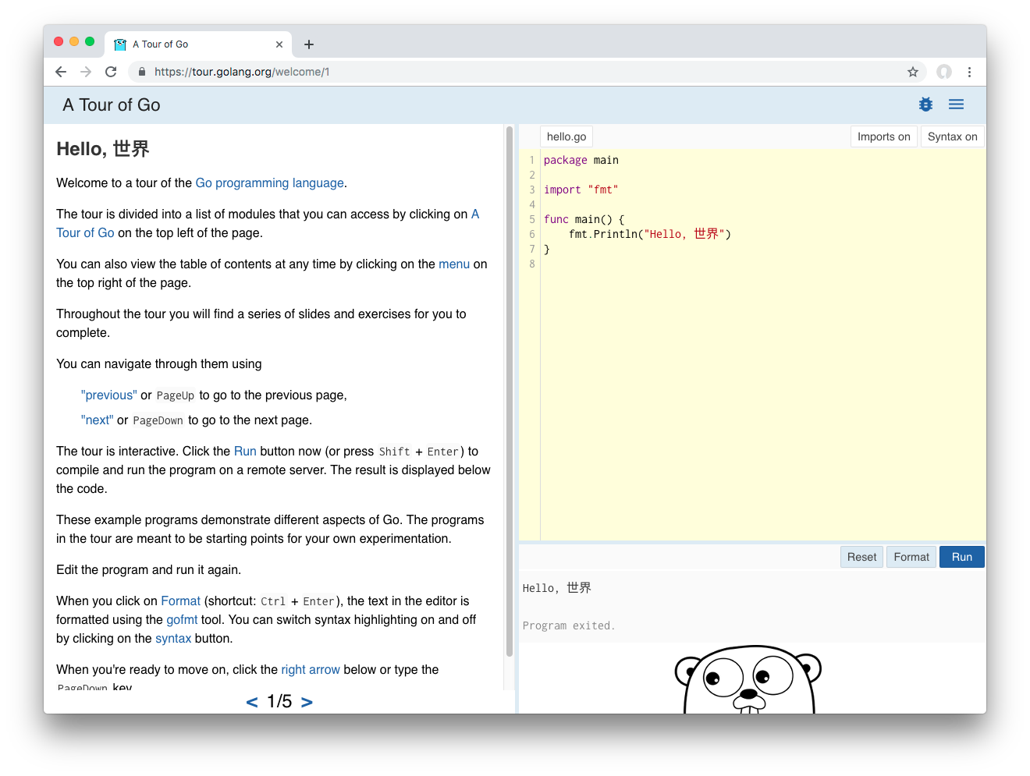

Slide 7
(We’ll repeat that link at the end.)

Slide 8
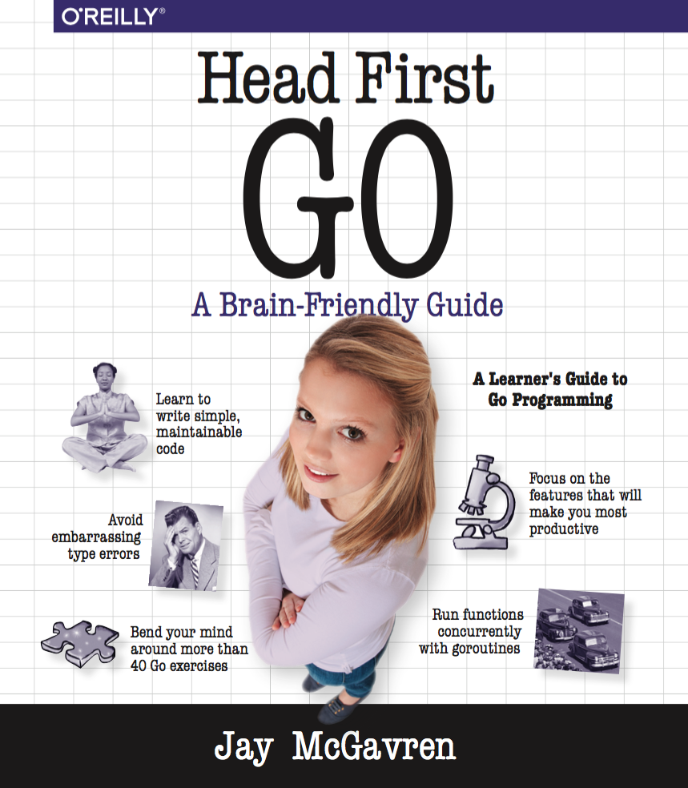
Another humble recommendation

Slide 9
Talk overview
A Sneak Peek
Why Go?
Syntax
OOP-like Concepts
Goroutines and Channels

Slide 10
Talk overview
Review these slides at:
https://github.com/jaymcgavren/presentations
We’ll show that URL again at the end.

Slide 11
You Are Here
A Sneak Peek
Why Go?
Syntax
OOP-like Concepts
Goroutines and Channels

Slide 12
A Sneak Peek

Slide 13
Sneak peek: Hello, world
package main import "fmt" func main() { fmt.Println("Hello, Philly!") }

Slide 14
Sneak peek: A tiny web app
package main import ( "log" "net/http" ) func helloHandler(writer http.ResponseWriter, request *http.Request) { writer.Write([]byte("<h1>Hello, web!</h1>")) } func main() { http.HandleFunc("/hello", helloHandler) err := http.ListenAndServe("localhost:8080", nil) log.Fatal(err) }

Slide 15
Sneak peek: goroutines and channels
package main import ( "fmt" "io/ioutil" "net/http" "time" ) func responseSize(url string, channel chan int) { fmt.Println("Getting", url) response, _ := http.Get(url) defer response.Body.Close() body, _ := ioutil.ReadAll(response.Body) channel <- len(body) }

Slide 16
Sneak peek: goroutines and channels
func main() { sizes := make(chan int) go responseSize("https://example.com/", sizes) go responseSize("https://golang.org/", sizes) go responseSize("https://golang.org/doc", sizes) fmt.Println(<-sizes) fmt.Println(<-sizes) fmt.Println(<-sizes) }

Slide 17
Sneak peek
We’ll take a more detailed look at each of these programs later.

Slide 18
You Are Here
A Sneak Peek
Why Go?
Syntax
OOP-like Concepts
Goroutines and Channels

Slide 19
Why Go?

Slide 20
Go at a glance
C-like syntax
Compiles to native code
Type-safe
Garbage collected
Concurrency built into language
Notes:
“Unpredictable stop the world latency glitches” -Andy Kelley 😏

Slide 21
OK, but what can you do with Go?

Slide 22

Docker

Slide 23
Docker
“‘go build’ will embed everything you need. (No more ‘install this in order to run my stuff’.)”
“Extensive standard library and data types.”
“Strong duck typing.”
—Jérôme Petazzoni, “Docker and Go: why did we decide to write Docker in Go?”
Notes:
https://www.slideshare.net/jpetazzo/docker-and-go-why-did-we-decide-to-write-docker-in-go

Slide 24

Kubernetes

Slide 25
Kubernetes
“Code in Go isn’t overly complex. People don’t create FactoryFactory objects.”
“Something with the feel of C with more advanced features like anonymous functions is a great combo.”
“Garbage Collection: We all know how to clean up after our selves but it is so nice to not have to worry about it.”
—Joe Beda, “Kubernetes + Go = Crazy Delicious”

Slide 26
Go values stability
“It is intended that programs written to the Go 1 specification will continue to compile and run correctly, unchanged, over the lifetime of that specification.”
—The Go “compatibility promise”
https://golang.org/doc/go1compat

Slide 27
My favorite summary
“It’s just a boring, really reliable, good language.”
—Ben DiFrancesco, overheard at PhillyETE

Slide 28
StackOverflow 2019 developer survey - popularity
JavaScript (67.8%)
Python (41.7%)
Java (41.1%)
C# (31.0%)
PHP (26.4%)
C++ (23.5%)
C (20.6%)
Ruby (8.4%)
Go (8.2%)
Swift (6.6%)
Kotlin (6.4%)
Rust (3.2%)
Notes:
Stack Overflow 2019 Developer Survey - percentage of developers saying they use a language
Markup, shell, and database query languages omitted

Slide 29
History
Designed by small team at Google in 2007
Made open source in 2009
Version 1.0 in 2012

Slide 30
Rationale
Simplicity: “we had become frustrated by the undue complexity required to use the languages we worked with to develop server software”
Concurrency: “multi[-core] processors were becoming universal but most languages offered little help to program them efficiently and safely”
Automatic memory management: “to make resource management tractable in a large concurrent program, garbage collection… was required”
—https://golang.org/doc/faq

Slide 31
Left out (on purpose)
Object constructors
Method overloading
Class inheritance (mostly)
Exceptions

Slide 32
NO EXCEPTIONS?!
Desire to avoid exception abuse: “We believe that coupling exceptions to a control structure, as in the try-catch-finally idiom, results in convoluted code. It also tends to encourage programmers to label too many ordinary errors, such as failing to open a file, as exceptional.”
Alternatives provided: “For plain error handling, Go’s multi-value returns make it easy to report an error without overloading the return value.”
—https://golang.org/doc/faq

Slide 33
Go and object-oriented programming
No inheritance: “Although Go has types and methods and allows an object-oriented style of programming, there is no type hierarchy.”
Alternatives provided: “There are… ways to embed types in other types to provide something analogous—but not identical—to subclassing.”
And even improvements: “methods in Go are more general than in C++ or Java: they can be defined for any sort of data, even built-in types”
—https://golang.org/doc/faq

Slide 34
Concurrency support
One thread, many goroutines: “multiplex independently executing functions—coroutines—onto a set of threads… The result, which we call goroutines, can be very cheap…”
Create all you want: “It is practical to create hundreds of thousands of goroutines in the same address space”
—https://golang.org/doc/faq
It’s like having multiple function calls running simultanously.
Multi-core processor? Goroutines will help you make use of it.

Slide 35
Neat stuff
First-class functions
Built-in UTF8 support, rune type
Interfaces fully decoupled from types (“compile time duck typing”)
Included tools:
go get: download and install packages
go fmt: formats code for you
go test: runs tests for you

Slide 36
“go fmt”
Automatically fixes code style
Acts as community’s style guide
No more arguing tabs vs. spaces!

Slide 37
“go fmt”
Before
package main import "fmt" func main() { repeatLine("hello", 3 ) } func repeatLine( line string ,times int) { for i := 0; i < times; i++ { fmt.Println(line) } }

Slide 38
“go fmt”
$ go fmt repeat.go

Slide 39
“go fmt”
After
package main import "fmt" func main() { repeatLine("hello", 3) } func repeatLine(line string, times int) { for i := 0; i < times; i++ { fmt.Println(line) } }

Slide 40
Playground
You don’t even have to install Go to try it!
Edit and run Go code in your browser
Link at end of talk

Slide 41
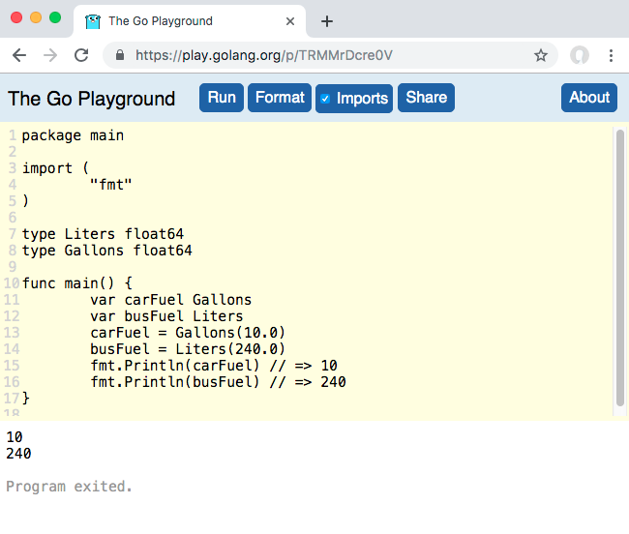

Slide 42
You Are Here
A Sneak Peek
Why Go?
Syntax
OOP-like Concepts
Goroutines and Channels

Slide 43
Syntax

Slide 44
Go file layout
Package clause
Imports
Code
package main import "fmt" func main() { fmt.Println("Hello, Go!") }

Slide 45
Imports
package main import ( "fmt" "math" "strings" ) func main() { fmt.Println(math.Floor(2.75)) fmt.Println(strings.Title("head first go")) }

Slide 46
Unused imports not allowed
package main import ( "fmt" "os" ) func main() { fmt.Println("Hello, Go!") }
Compile error:
temp.go:5:5: imported and not used: "os"

Slide 47
“goimports”
Wrapper for go fmt
Automatically adds/removes imports
Install:
$ go get golang.org/x/tools/cmd/goimports
Do a web search for “goimports” for directions on integrating with your editor.

Slide 48
“goimports”
Before saving
package main func main() { fmt.Println(math.Floor(2.75)) fmt.Println(strings.Title("head first go")) }

Slide 49
“goimports”
After saving
package main import ( "fmt" "math" "strings" ) func main() { fmt.Println(math.Floor(2.75)) fmt.Println(strings.Title("head first go")) }

Slide 50
Variables
var myInteger int myInteger = 1 var myFloat float64 myFloat = 3.1415 fmt.Println(myInteger) // => 1 fmt.Println(myFloat) // => 3.1415 fmt.Println(reflect.TypeOf(myInteger)) // => int fmt.Println(reflect.TypeOf(myFloat)) // => float64

Slide 51
Short Variable Declarations
myInteger := 1 myFloat := 3.1415 fmt.Println(myInteger) // => 1 fmt.Println(myFloat) // => 3.1415 fmt.Println(reflect.TypeOf(myInteger)) // => int fmt.Println(reflect.TypeOf(myFloat)) // => float64

Slide 52
Must use every variable you declare
subtotal := 24.70 tax := 1.89 fmt.Println(subtotal)
Compile error:
prog.go:9:2: tax declared and not used

Slide 53
Zero values
package main import ( "fmt" ) func main() { var myFloat float64 fmt.Printf("%#v\n", myFloat) // => 0 var myBool bool fmt.Printf("%#v\n", myBool) // => false var myString string fmt.Printf("%#v\n", myString) // => "" }

Slide 54
Zero values
var myFloat float64 fmt.Println(myFloat + 2.5) // => 2.5 var myBool bool fmt.Println(!myBool) // => true var myString string fmt.Println("(" + myString + ")") // => ()

Slide 55
“for”
for i := 1; i <= 3; i++ { fmt.Println(i) }
Output:
1 2 3

Slide 56
“for” … “range”
mySlice := []string{"one", "two", "three"} for i, value := range mySlice { fmt.Println(i, value) }
Output:
0 one 1 two 2 three

Slide 57
What if we skip using the index?
mySlice := []string{"one", "two", "three"} for i, value := range mySlice { fmt.Println(value) }
Compile error:
prog.go:9:6: i declared and not used

Slide 58
Use the blank identifier to ignore values
Discards the value.
Provides clear visual indicator that a value’s being ignored!
mySlice := []string{"one", "two", "three"} for _, value := range mySlice { fmt.Println(value) }
Output:
one two three

Slide 59
Multiple return values
func main() { flag := strconv.ParseBool("true") flag = strconv.ParseBool("foobar") fmt.Println(flag) }
Compile error:
prog.go:9:7: assignment mismatch: 1 variable but strconv.ParseBool returns 2 values prog.go:10:7: assignment mismatch: 1 variable but strconv.ParseBool returns 2 values

Slide 60
Multiple return values
func main() { flag, err := strconv.ParseBool("true") if err != nil { log.Fatal(err) } fmt.Println(flag) flag, err = strconv.ParseBool("foobar") if err != nil { log.Fatal(err) } fmt.Println(flag) }
Output:
true 2009/11/10 23:00:00 strconv.ParseBool: parsing "foobar": invalid syntax

Slide 61
Error handling
“In Go, error handling is important. The language’s design and conventions encourage you to explicitly check for errors where they occur (as distinct from the convention in other languages of throwing exceptions and sometimes catching them).” (Emphasis mine)
-Andrew Gerrand, https://blog.golang.org/error-handling-and-go

Slide 62
Writing functions with multiple return values
func parseBools(values []string) ([]bool, error) { var bools []bool for i, value := range values { parsed, err := strconv.ParseBool(value) if err != nil { return nil, fmt.Errorf( "invalid value %s at index %d", value, i) } bools = append(bools, parsed) } return bools, nil }

Slide 63
Writing functions with multiple return values
func main() { bools, err := parseBools( []string{"true", "false", "foobar"}) if err != nil { log.Fatal(err) } fmt.Println(bools) }
Output:
2009/11/10 23:00:00 invalid value foobar at index 2

Slide 64
First-class functions
func thrice(callback func()) { callback() callback() callback() } func refrain() { fmt.Print("give it away, ") } func main() { thrice(refrain) fmt.Println("now!") }
Output:
give it away, give it away, give it away, now!

Slide 65
Anonymous functions
func thrice(callback func()) { callback() callback() callback() } func main() { thrice(func() { fmt.Print("give it away, ") }) fmt.Println("now!") }

Slide 66
First-class functions: a simple web app
package main import "net/http" func helloHandler(writer http.ResponseWriter, request *http.Request) { // Note: error return value ignored! writer.Write([]byte("<h1>Hello, web!</h1>")) } func bonjourHandler(writer http.ResponseWriter, request *http.Request) { writer.Write([]byte("<h1>Bonjour, web!</h1>")) }

Slide 67
First-class functions: a simple web app
func main() { http.HandleFunc("/hello", helloHandler) http.HandleFunc("/bonjour", bonjourHandler) // Note: error return value ignored! http.ListenAndServe("localhost:8080", nil) }
Notes:
samples/web_app.go

Slide 68
You Are Here
A Sneak Peek
Why Go?
Syntax
OOP-like Concepts
Goroutines and Channels

Slide 69
OOP-like Concepts

Slide 70
Structs
Anonymous struct types…
var bucket struct { number float64 word string toggle bool } bucket.number = 3.14 bucket.word = "pie" bucket.toggle = true fmt.Println(bucket.number) // => 3.14 fmt.Println(bucket.word) // => pie fmt.Println(bucket.toggle) // => true

Slide 71
Custom types
type myType followed by an underlying type declares a new type.
type myType struct { number float64 word string toggle bool }

Slide 72
Custom types
func main() { var bucket myType bucket.number = 3.14 bucket.word = "pie" bucket.toggle = true fmt.Println(bucket.number) // => 3.14 fmt.Println(bucket.word) // => pie fmt.Println(bucket.toggle) // => true }

Slide 73
Other underlying types
A custom type can have an underlying basic type
type Liters float64 type Gallons float64 func main() { var carFuel Gallons var busFuel Liters // Defining a type defines a conversion // from the underlying type to the new type carFuel = Gallons(10.0) busFuel = Liters(240.0) fmt.Println(carFuel) // => 10 fmt.Println(busFuel) // => 240 }

Slide 74
Methods
type MyType string // Specify a "receiver parameter" within a function // definition to make it a method. The receiver // parameter's type will be the type the method // gets defined on. func (m MyType) sayHi() { fmt.Println("Hi") }

Slide 75
Methods
type MyType string func (m MyType) sayHi() { fmt.Println("Hi") } func main() { value := MyType("a MyType value") value.sayHi() // => Hi anotherValue := MyType("another value") anotherValue.sayHi() // => Hi }

Slide 76
Receiver parameter acts like just another parameter
type MyType string func (m MyType) sayHi() { fmt.Println("Hi from", m) } func main() { value := MyType("a MyType value") value.sayHi() // => Hi from a MyType value anotherValue := MyType("another value") anotherValue.sayHi() // => Hi from another value }

Slide 77
Underlying type is not a superclass
The underlying type specifies how a type’s data will be stored, so this is OK…
type MyType string func (m MyType) sayHi() { fmt.Println("Hi from", m) } type MyType2 MyType func main() { value2 := MyType2("a MyType2 value") fmt.Println(value2) }

Slide 78
Underlying type is not a superclass
But a type does not inherit methods from its underlying type.
type MyType string func (m MyType) sayHi() { fmt.Println("Hi from", m) } type MyType2 MyType func main() { value2 := MyType2("a MyType2 value") value2.sayHi() }
Compile error:
prog.go:15:8: value2.sayHi undefined (type MyType2 has no field or method sayHi)

Slide 79
Underlying type is not a superclass
“Although Go has types and methods and allows an object-oriented style of programming, there is no type hierarchy.”
—https://golang.org/doc/faq
There is no method inheritance!
But there’s another way to get the same benefits…

Slide 80
Embedding structs is like inheriting fields
type Coordinates struct { Latitude float64 Longitude float64 } type Landmark struct { Name string // An "anonymous field" // Has no name of its own, just a type Coordinates }
func main() { var l Landmark l.Name = "The Googleplex" // Fields for "embedded struct" are "promoted" l.Latitude = 37.42 l.Longitude = -122.08 fmt.Println(l.Name, l.Latitude, l.Longitude) // => The Googleplex 37.42 -122.08 }

Slide 81
Promotion of embedded types’ methods
func (c Coordinates) Location() string { return fmt.Sprintf("(%0.2f, %0.2f)", c.Latitude, c.Longitude) } func main() { var l Landmark l.Name = "The Googleplex" l.Latitude = 37.42 l.Longitude = -122.08 // Methods from embedded type are // promoted to outer type fmt.Println(l.Location()) // => (37.42, -122.08) }

Slide 82
Promotion of embedded types’ methods
Embed additional types to gain additional methods.
You’ve heard “favor composition over inheritance”…
Go implements that principle at the language level.
type Coordinates struct { Latitude float64 Longitude float64 } func (c Coordinates) Location() string { return fmt.Sprintf("(%0.2f, %0.2f)", c.Latitude, c.Longitude) } type Landmark struct { Name string Coordinates }

Slide 83
Interfaces
(This part is my favorite!)

Slide 84
Interfaces
A type with Play and Stop methods…
type TapePlayer struct { Batteries string } func (t TapePlayer) Play(song string) { fmt.Println("Playing", song) } func (t TapePlayer) Stop() { fmt.Println("Stopped!") }

Slide 85
Interfaces
Another type with Play and Stop methods…
type TapeRecorder struct { Microphones int } func (t TapeRecorder) Play(song string) { fmt.Println("Playing", song) } func (t TapeRecorder) Record() { fmt.Println("Recording") } func (t TapeRecorder) Stop() { fmt.Println("Stopped!") }

Slide 86
Interfaces
A function that accepts a TapePlayer…
func playList(device TapePlayer, songs []string) { for _, song := range songs { device.Play(song) } device.Stop() }

Slide 87
Interfaces
func main() { mixtape := []string{"Jessie's Girl", "Whip It", "9 to 5"} var player TapePlayer playList(player, mixtape) }
Output:
Playing Jessie's Girl Playing Whip It Playing 9 to 5 Stopped!

Slide 88
Interfaces
But don’t try to pass a TapeRecorder to playList!
func main() { mixtape := []string{"Jessie's Girl", "Whip It", "9 to 5"} var recorder TapeRecorder playList(recorder, mixtape) }
Compile error:
prog.go:40:10: cannot use recorder (type TapeRecorder) as type TapePlayer in argument to playList

Slide 89
Interfaces
Define a Player interface with the methods you want:
type Player interface { // Must have a Play method with // a single string parameter Play(string) // Must have a Stop method with // no parameters Stop() }
Notice we don’t have to modify the TapePlayer or TapeRecorder type definitions!
Any type with Play(string) and Stop() methods automatically satisfies this interface.

Slide 90
Interfaces
Modify the playList function to accept a value of the Player (interface) type:
func playList(device Player, songs []string) { for _, song := range songs { device.Play(song) } device.Stop() }

Slide 91
Interface
Now, you can pass in a TapePlayer or a TapeRecorder (or any other type with Play and Stop methods)!
func main() { mixtape := []string{"Jessie's Girl", "Whip It", "9 to 5"} var player TapePlayer playList(player, mixtape) var recorder TapeRecorder playList(recorder, mixtape) }

Slide 92
Interfaces
Output:
Playing Jessie's Girl Playing Whip It Playing 9 to 5 Stopped! Playing Jessie's Girl Playing Whip It Playing 9 to 5 Stopped!

Slide 93
Interfaces
“Structural typing is like compile time duck typing. It makes Go feel like a dynamic language, such as Ruby or Python.”
-Jared Carroll, “Structural Typing: Compile Time Duck Typing”

Slide 94
You Are Here
A Sneak Peek
Why Go?
Syntax
OOP-like Concepts
Goroutines and Channels

Slide 95
Goroutines and Channels

Slide 96
A non-concurrent program
// responseSize retrieves "url" and prints // the response length in bytes. func responseSize(url string) { fmt.Println("Getting", url) // Note: errors ignored with _! response, _ := http.Get(url) defer response.Body.Close() body, _ := ioutil.ReadAll(response.Body) fmt.Println(len(body)) }

Slide 97
A non-concurrent program
func main() { // Note the time we started. start := time.Now() responseSize("https://example.com/") responseSize("https://golang.org/") responseSize("https://golang.org/doc") // Print how long everything took. fmt.Println(time.Since(start).Seconds(), "seconds") }

Slide 98
A non-concurrent program
Output:
Getting https://example.com/ 1270 Getting https://golang.org/ 8158 Getting https://golang.org/doc 12558 1.5341211000000001 seconds
If only we could make additional calls to responseSize while we were waiting for HTTP responses…

Slide 99
Goroutines
responseSize function unchanged.
Just add go keyword before each call to it.
func main() { start := time.Now() go responseSize("https://example.com/") go responseSize("https://golang.org/") go responseSize("https://golang.org/doc") fmt.Println(time.Since(start).Seconds()) }

Slide 100
Goroutines
Output:
3.1e-06
Run time so brief the duration is printed in scientific notation.
None of the responseSize goroutines get to even request their URL.
Problem is, main goroutine exits, ending the program, without waiting for responseSize goroutines.

Slide 101
Channels
Modify responseSize to accept a “channel” as a parameter.
// A channel type is written as "chan" followed by data type. func responseSize(url string, channel chan int) { fmt.Println("Getting", url) // Unchanged response, _ := http.Get(url) // Unchanged defer response.Body.Close() // Unchanged body, _ := ioutil.ReadAll(response.Body) // Unchanged // Send body length value via channel. channel <- len(body) }

Slide 102
Channels
func main() { start := time.Now() // Unchanged // Make a channel to carry ints. sizes := make(chan int) // Pass channel to each call to responseSize. go responseSize("https://example.com/", sizes) go responseSize("https://golang.org/", sizes) go responseSize("https://golang.org/doc", sizes) // Read and print values from channel. fmt.Println(<-sizes) fmt.Println(<-sizes) fmt.Println(<-sizes) fmt.Println(time.Since(start).Seconds()) // Unchanged }

Slide 103
Channels
Getting https://golang.org/doc Getting https://golang.org/ Getting https://example.com/ 1270 8158 12558 0.695384291
Finishes in half the time of the original! (YMMV.)
The channel accomplishes two things:
Channel reads cause main goroutine to block until responseSize goroutines send, so they have time to finish before program ends.
The channel transmits data from the responseSize goroutines back to the main goroutine.

Slide 104
Closing

Slide 105
Stuff we didn’t have time for
defer, panic, and recover
Packages and modules
“testing” package
Buffered channels
Runes and UTF8 support

Slide 106
Go Gopher
By Renee French, used under a CC-Attribution-3.0 license.

Slide 107
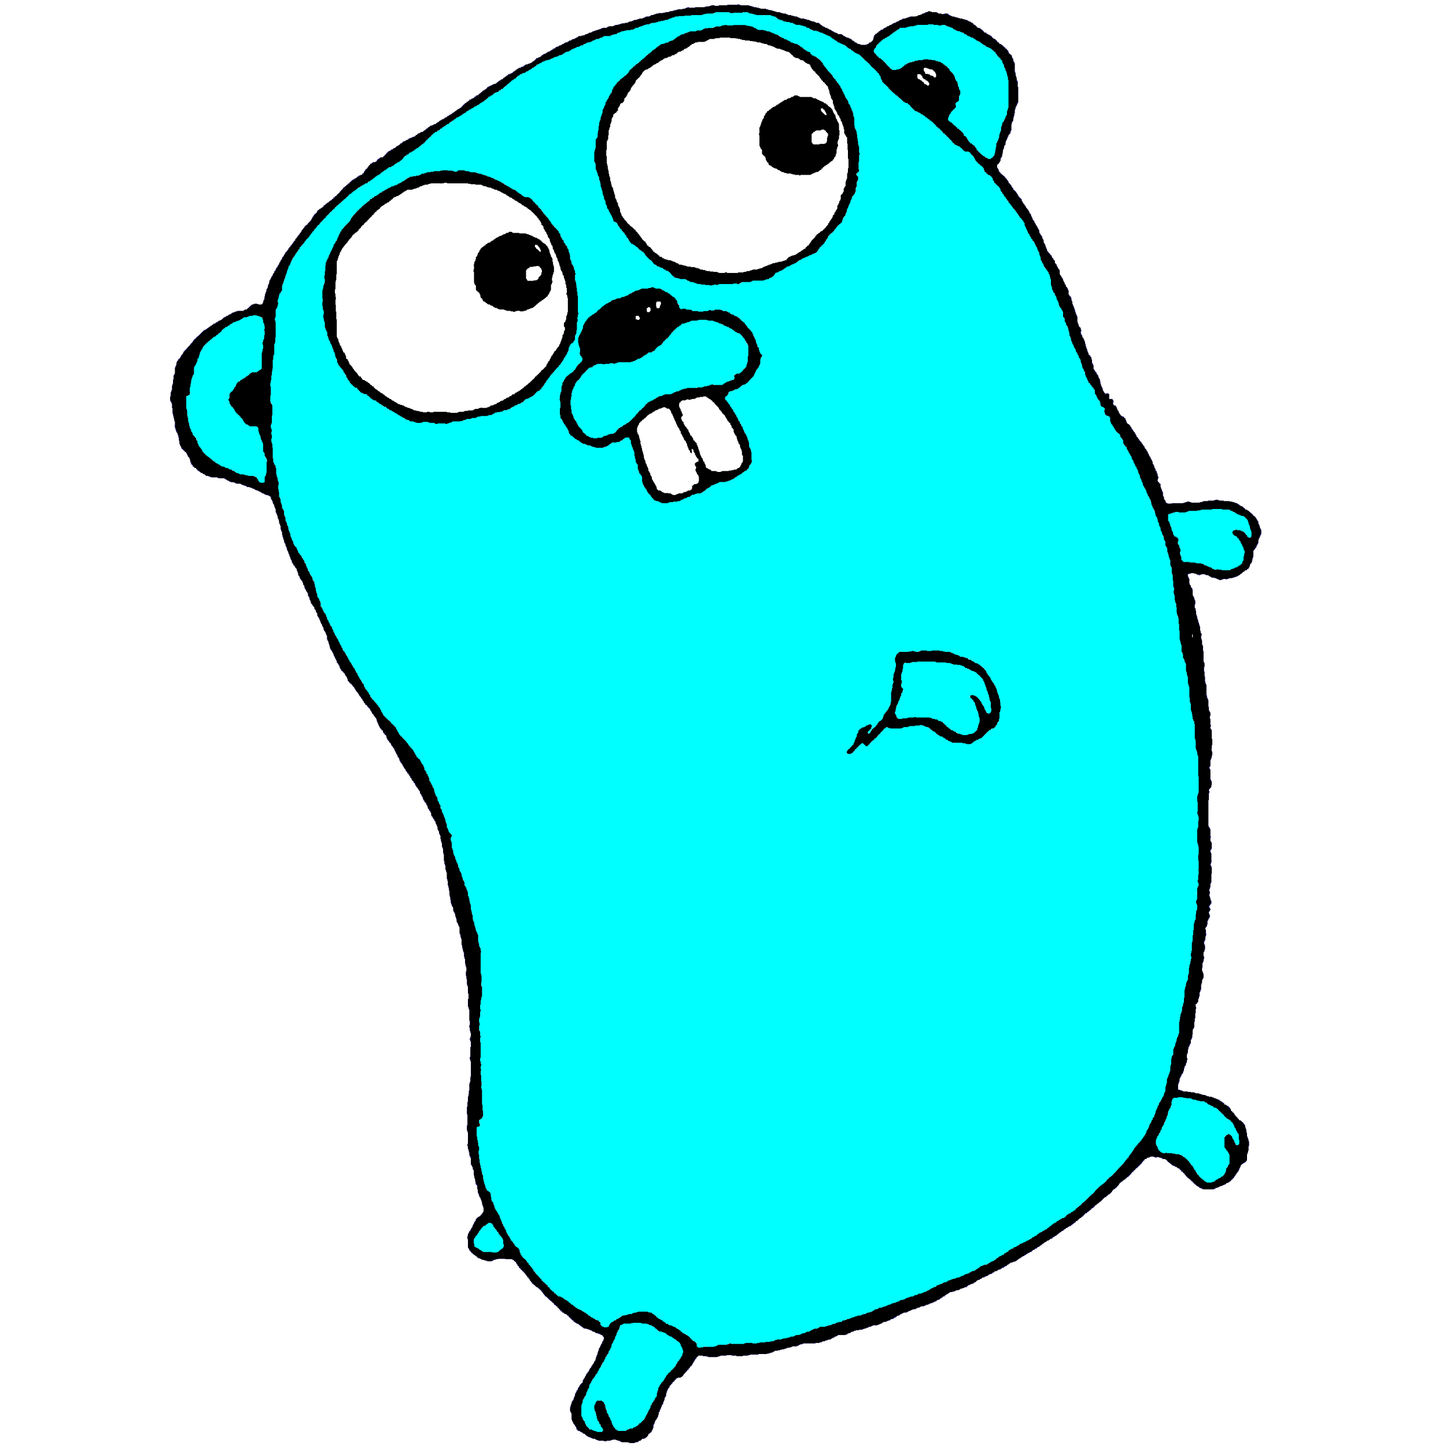

Slide 108
Other resources
These slides: https://github.com/jaymcgavren/presentations
Go Tour: https://tour.golang.org
Go Playground: https://play.golang.org
Head First Go: https://headfirstgo.com
Questions?
https://2019.phillyemergingtech.com/qa/

Slide 109
Notes:
Repeat each question before answering!

